Slide 1
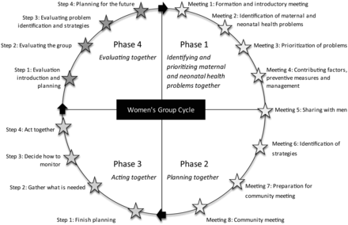
Figure 2. MaiKhanda Women's Group Action Cycle followed by the women's groups.
Notes:
Figure 2. MaiKhanda Women's Group Action Cycle followed by the women's groups.
Unless provided in the caption above, the following copyright applies to the content of this slide: © Royal Society of Tropical Medicine and Hygiene 2013. All rights reserved.This is an Open Access article distributed under the terms of the Creative Commons Attribution License (http://creativecommons.org/licenses/by/3.0/), which permits unrestricted reuse, distribution, and reproduction in any medium, provided the original work is properly cited.

Slide 2
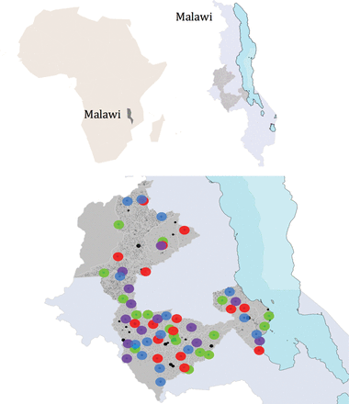
Figure 1. Map showing the central region of Malawi with the three districts where the randomized controlled trial took ...
Notes:
Figure 1. Map showing the central region of Malawi with the three districts where the randomized controlled trial took place shown in darker grey: Kasungu (top), Lilongwe (bottom) and Salima (right, by Lake Malawi). Key to randomized intervention areas: green: control clusters; red: quality improvement at health centres (MaiKhanda facilities intervention); blue: community women's groups (MaiKhanda community intervention); purple: facility and community interventions together.
Unless provided in the caption above, the following copyright applies to the content of this slide: © Royal Society of Tropical Medicine and Hygiene 2013. All rights reserved.This is an Open Access article distributed under the terms of the Creative Commons Attribution License (http://creativecommons.org/licenses/by/3.0/), which permits unrestricted reuse, distribution, and reproduction in any medium, provided the original work is properly cited.

Slide 3
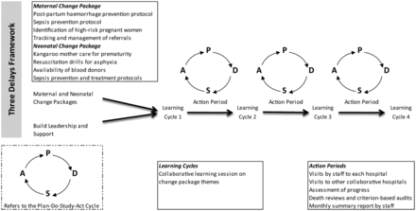
Figure 3. Overview of the facilities quality improvement intervention.
Notes:
Figure 3. Overview of the facilities quality improvement intervention.
Unless provided in the caption above, the following copyright applies to the content of this slide: © Royal Society of Tropical Medicine and Hygiene 2013. All rights reserved.This is an Open Access article distributed under the terms of the Creative Commons Attribution License (http://creativecommons.org/licenses/by/3.0/), which permits unrestricted reuse, distribution, and reproduction in any medium, provided the original work is properly cited.

Slide 4
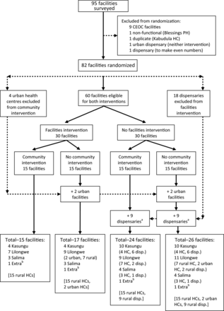
Figure 4. Randomization design flowchart. CEOC: comprehensive emergency obstetric care; disp.: dispensary; HC: health ...
Notes:
Figure 4. Randomization design flowchart. CEOC: comprehensive emergency obstetric care; disp.: dispensary; HC: health centre; PH: private hospital. aSome of the rural clusters with dispensaries (HCs that do not do deliveries) that, according to the original trial design, were supposed to have women's groups mistakenly never had women's groups formed in them so there are actually 31 control clusters out of the 82 originally randomized to receive quality improvement and establishment of womens' groups. bThe ‘extra’ facilities are three from Lilongwe and one from Kasungu that were left over after randomly allocating the others to each of the four intervention groups. To ensure the balance across interventions was maintained, they were allocated to each of the four intervention groups.
Unless provided in the caption above, the following copyright applies to the content of this slide: © Royal Society of Tropical Medicine and Hygiene 2013. All rights reserved.This is an Open Access article distributed under the terms of the Creative Commons Attribution License (http://creativecommons.org/licenses/by/3.0/), which permits unrestricted reuse, distribution, and reproduction in any medium, provided the original work is properly cited.

Slide 5
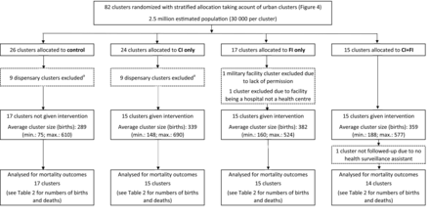
Figure 5. Trial profile flowchart (further details are provided in the technical report⁹). CI: community ...
Notes:
Figure 5. Trial profile flowchart (further details are provided in the technical report9). CI: community intervention; FI: facilities intervention. aDispensaries do not perform deliveries and were excluded as women's groups were not set up in their catchment areas.
Unless provided in the caption above, the following copyright applies to the content of this slide: © Royal Society of Tropical Medicine and Hygiene 2013. All rights reserved.This is an Open Access article distributed under the terms of the Creative Commons Attribution License (http://creativecommons.org/licenses/by/3.0/), which permits unrestricted reuse, distribution, and reproduction in any medium, provided the original work is properly cited.

Slide 6
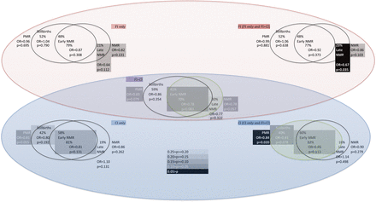
Figure 6. Internal consistency of randomized controlled trial (RCT) results. Percentages of observed PMR and NMR ...
Notes:
Figure 6. Internal consistency of randomized controlled trial (RCT) results. Percentages of observed PMR and NMR reductions due to reductions in stillbirth rate, early NMR, and late NMR by RCT comparison groups. CI: community intervention; FIL: facilities intervention; NMR: neonatal mortality rate; PMR: perinatal mortality rate.
Unless provided in the caption above, the following copyright applies to the content of this slide: © Royal Society of Tropical Medicine and Hygiene 2013. All rights reserved.This is an Open Access article distributed under the terms of the Creative Commons Attribution License (http://creativecommons.org/licenses/by/3.0/), which permits unrestricted reuse, distribution, and reproduction in any medium, provided the original work is properly cited.

