Slide 1
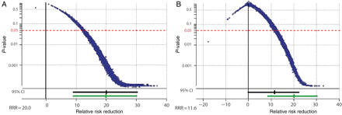
Figure 1 (A) Simulation of 5000 trials with a sample size of 3100 patients, power of 0.92, and α 0.05, non-compliance ...
Notes:
Figure 1 (A) Simulation of 5000 trials with a sample size of 3100 patients, power of 0.92, and α 0.05, non-compliance zero, an absolute 5% reduction in mortality from 25 to 20% (relative risk 0.8). (B) Simulation of 5000 trials with a sample size of 3100 patients, proportion lost to follow-up 1% in both groups, proportion of patients not receiving the allocated treatment 3.3% in single internal mammary artery group and 16.4% in bilateral mammary artery group. Proportion of patients receiving the other treatment in the single internal mammary artery group was 2.4% and in the bilateral mammary artery group 13.9%.
Unless provided in the caption above, the following copyright applies to the content of this slide: Published on behalf of the European Society of Cardiology. All rights reserved. © The Author 2010. For permissions please email: journals.permissions@oxfordjournals.org

