Slide 1
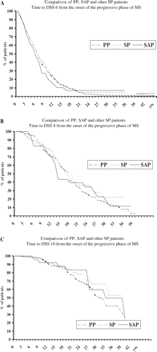
Fig. 2 Comparison of SAP, SP and PP patients; time to DSS6 (A), DSS8 (B) and DSS10 (C) from onset of progressive ...
Notes:
Fig. 2 Comparison of SAP, SP and PP patients; time to DSS6 (A), DSS8 (B) and DSS10 (C) from onset of progressive disease.
Unless provided in the caption above, the following copyright applies to the content of this slide: © The Author (2006). Published by Oxford University Press on behalf of the Guarantors of Brain. All rights reserved. For Permissions, please email: journals.permissions@oxfordjournals.org

Slide 2
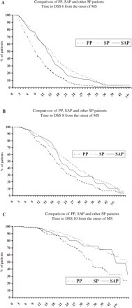
Fig. 1 Comparison of SAP, SP and PP patients; time to DSS6 (A), DSS8 (B) and DSS10 (C) from onset of disease.
Notes:
Fig. 1 Comparison of SAP, SP and PP patients; time to DSS6 (A), DSS8 (B) and DSS10 (C) from onset of disease.
Unless provided in the caption above, the following copyright applies to the content of this slide: © The Author (2006). Published by Oxford University Press on behalf of the Guarantors of Brain. All rights reserved. For Permissions, please email: journals.permissions@oxfordjournals.org

