Slide 1
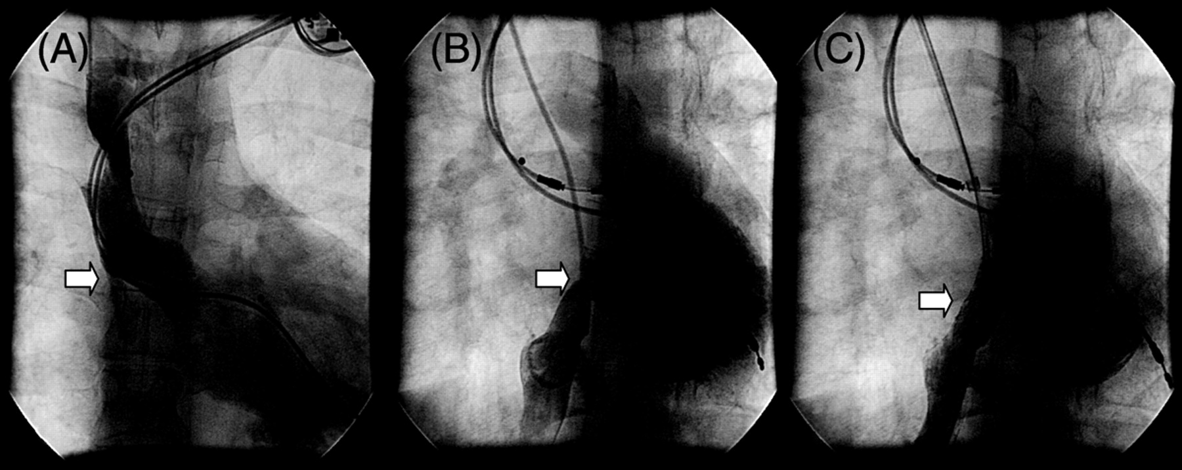
Figure 1 Panel A displays the leak in the superior limb of the atrial baffle. The existing dual chamber pacemaker ...
Notes:
Figure 1 Panel A displays the leak in the superior limb of the atrial baffle. The existing dual chamber pacemaker leads are also noted. Panel B shows the stenotic inferior baffle limb. Panel C displays the post-stent result.
Unless provided in the caption above, the following copyright applies to the content of this slide: © The European Society of Cardiology 2007. All rights reserved. For permissions, please e-mail: journals.permissions@oxfordjournals.org

Slide 2
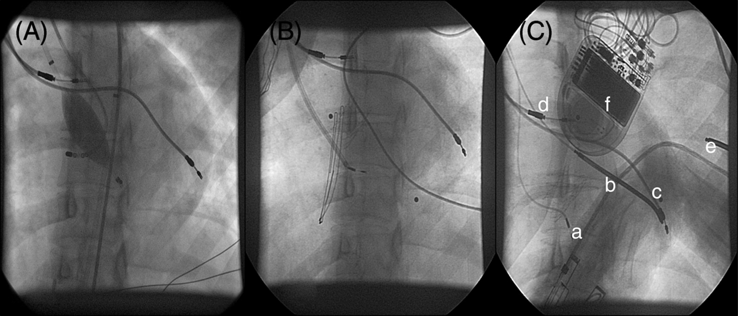
Figure 2 Panel A shows the MEA catheter deployed within the sRV with a roving ablation catheter used for geometry and ...
Notes:
Figure 2 Panel A shows the MEA catheter deployed within the sRV with a roving ablation catheter used for geometry and pacing. The pre-existing atrial and pLV pacing leads are also visible. Panel B depicts the sheathed delivery of the 4F pacing lead through the atrial baffle defect into the sRV. Panel C shows the final lead positions: (a) sRV pacing lead, (b) defibrillator lead in the pLV, (c) pre-existing pLV pacing lead, (d) pre-existing atrial pacing lead, (e) subcutaneous array posteriorly located around the left chest wall, and (f) left sub-pectoral ICD position.
Unless provided in the caption above, the following copyright applies to the content of this slide: © The European Society of Cardiology 2007. All rights reserved. For permissions, please e-mail: journals.permissions@oxfordjournals.org

Slide 3
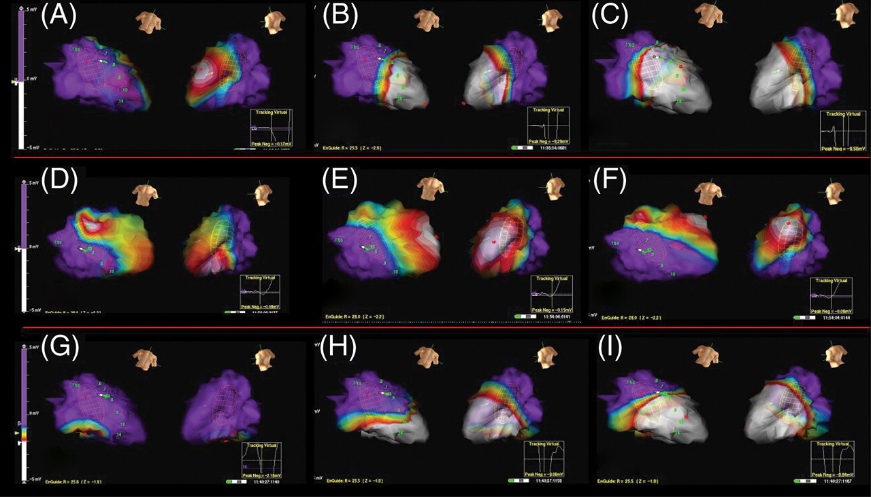
Figure 3 Sequence of voltage maps of the sRV depicting the motion of endocardial depolarization (white = maximum ...
Notes:
Figure 3 Sequence of voltage maps of the sRV depicting the motion of endocardial depolarization (white = maximum voltage, purple = minimum voltage) during various pacing configurations. The sRV is shown in right and left oblique views in each frame. Top row of images during RA pacing shows activation of the entire sRV starting at the interventricular septum ( A ), then apex ( B ), progressing toward the basal segments ( C ). The middle row during pLV endocardial stimulation shows an incomplete ventricular activation pattern: the peak depolarization wave front remains over the septal and apical regions ( D – F ) and fails to involve the sRV free wall and all basal regions before dissipating. Pacing endocardially on the sRV free wall (bottom row) shows activation originating in the inferior region of the sRV ( G ), spreading toward the apex ( H ) to involve the entire endocardial surface in the direction of the basal segments ( I ).
Unless provided in the caption above, the following copyright applies to the content of this slide: © The European Society of Cardiology 2007. All rights reserved. For permissions, please e-mail: journals.permissions@oxfordjournals.org

