Slide 1
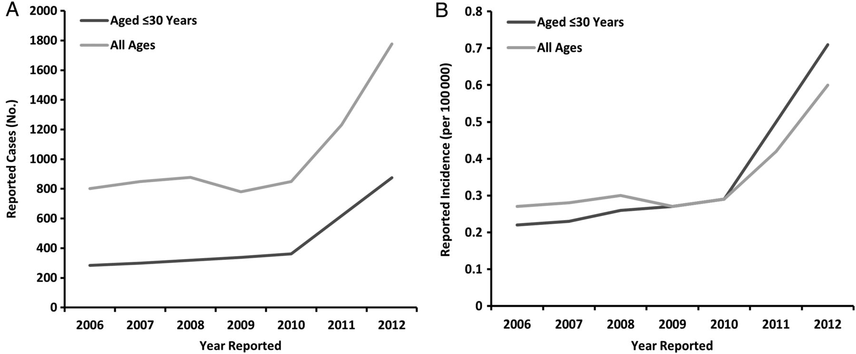
Figure 1. Number of cases (A) and incidence (B) of acute hepatitis C reported to CDC by year among young persons and ...
Notes:
Figure 1. Number of cases (A) and incidence (B) of acute hepatitis C reported to CDC by year among young persons and all persons, United States, 2006–2012. Abbreviation: CDC, Centers for Disease Control and Prevention.
Unless provided in the caption above, the following copyright applies to the content of this slide: Published by Oxford University Press on behalf of the Infectious Diseases Society of America 2014. This work is written by (a) US Government employee(s) and is in the public domain in the US.

Slide 2
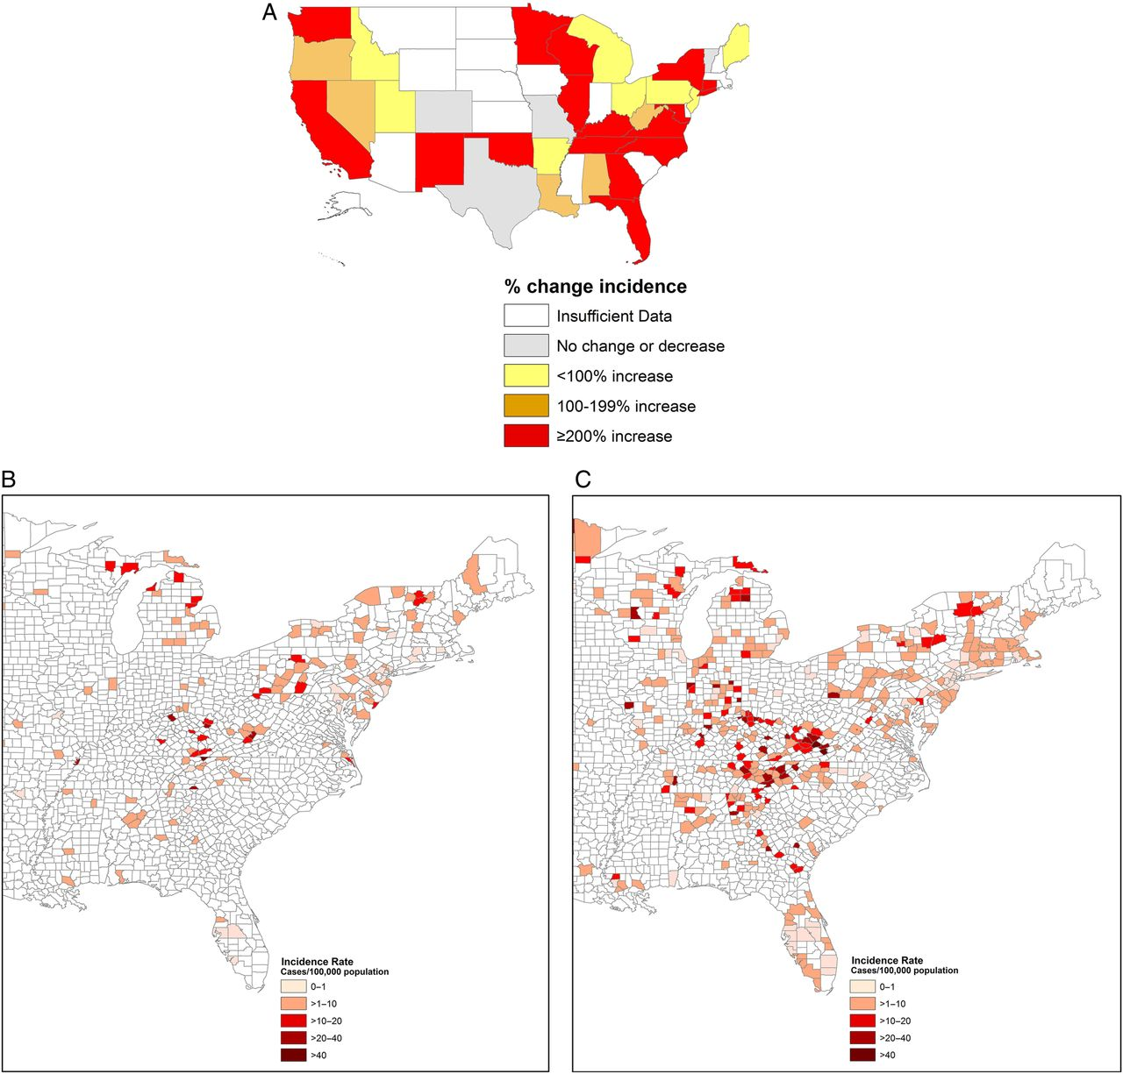
Figure 2. Maps of incidence of acute hepatitis C among young persons reported to CDC, indicating changes by state, ...
Notes:
Figure 2. Maps of incidence of acute hepatitis C among young persons reported to CDC, indicating changes by state, United States, 2006 vs 2012 (A), and by county, Eastern United States, 2006 (B) vs 2012 (C). Abbreviation: CDC, Centers for Disease Control and Prevention.
Unless provided in the caption above, the following copyright applies to the content of this slide: Published by Oxford University Press on behalf of the Infectious Diseases Society of America 2014. This work is written by (a) US Government employee(s) and is in the public domain in the US.

Slide 3
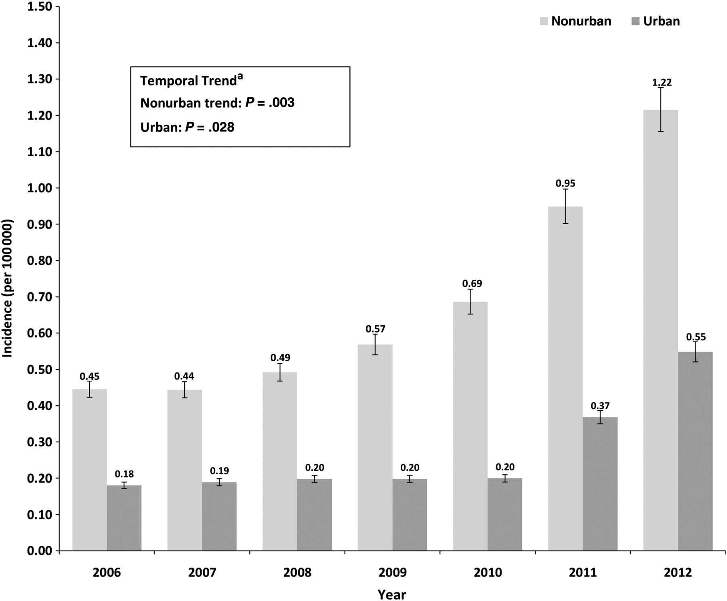
Figure 3. Trends in incidence of acute hepatitis C among young persons reported to CDC, by Urbanicity, 2006–2012. ...
Notes:
Figure 3. Trends in incidence of acute hepatitis C among young persons reported to CDC, by Urbanicity, 2006–2012. aTemporal trends in incidence from 2006 to 2012 were assessed separately among cases of urban and nonurban county of residence using R-squared test and linear trend analysis. Trend was considered statistically significant at P < .05. Abbreviation: CDC, Centers for Disease Control and Prevention.
Unless provided in the caption above, the following copyright applies to the content of this slide: Published by Oxford University Press on behalf of the Infectious Diseases Society of America 2014. This work is written by (a) US Government employee(s) and is in the public domain in the US.

