Slide 1
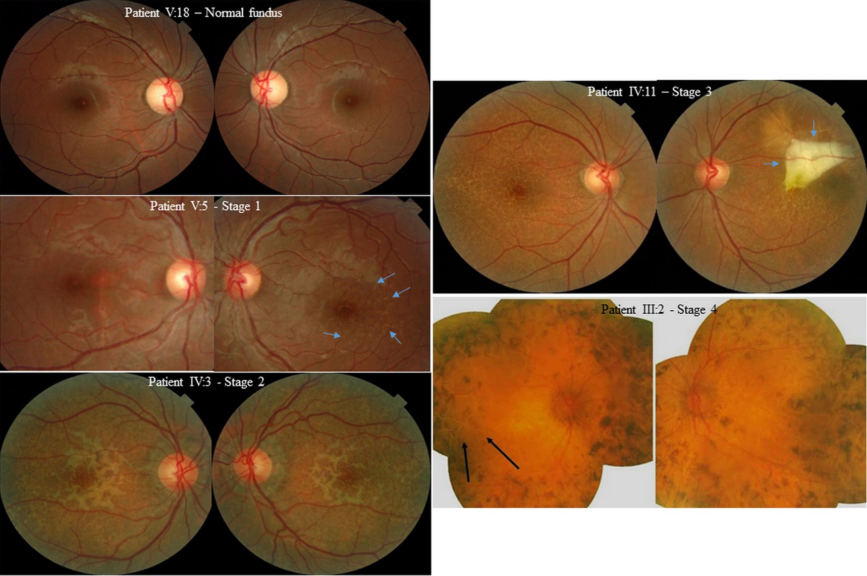
Figure 1. Phenotypic characteristics of a unique retinal dystrophy, the MCRPE. Fundus pictures and disease progression ...
Notes:
Figure 1. Phenotypic characteristics of a unique retinal dystrophy, the MCRPE. Fundus pictures and disease progression with age, from pre-clinical stage with a normal fundus to retinitis pigmentosa. After a pre-clinical stage with a normal fundus, a dry desert land pattern appears. It first involves the posterior pole in the temporal part of the fovea in the case presented (stage 1, blue arrows) and slowly progresses with age to the peripheral retina with a bilateral involvement (stage 2). Stage 3 is defined by a macular and peripheral dry desert land pattern combined with a retinal complication. In the left eye of this patient aged 50 years, there is a large fibrous macular scar (blue arrows). Stage 4, fundus photography of an 86-year-old woman. She has a retinitis pigmentosa with peripheral bone spicules and a dry desert land pattern in the temporal part in the right eye (black arrows).
Unless provided in the caption above, the following copyright applies to the content of this slide: © The Author 2016. Published by Oxford University Press. All rights reserved. For Permissions, please email: journals.permissions@oup.com

Slide 2
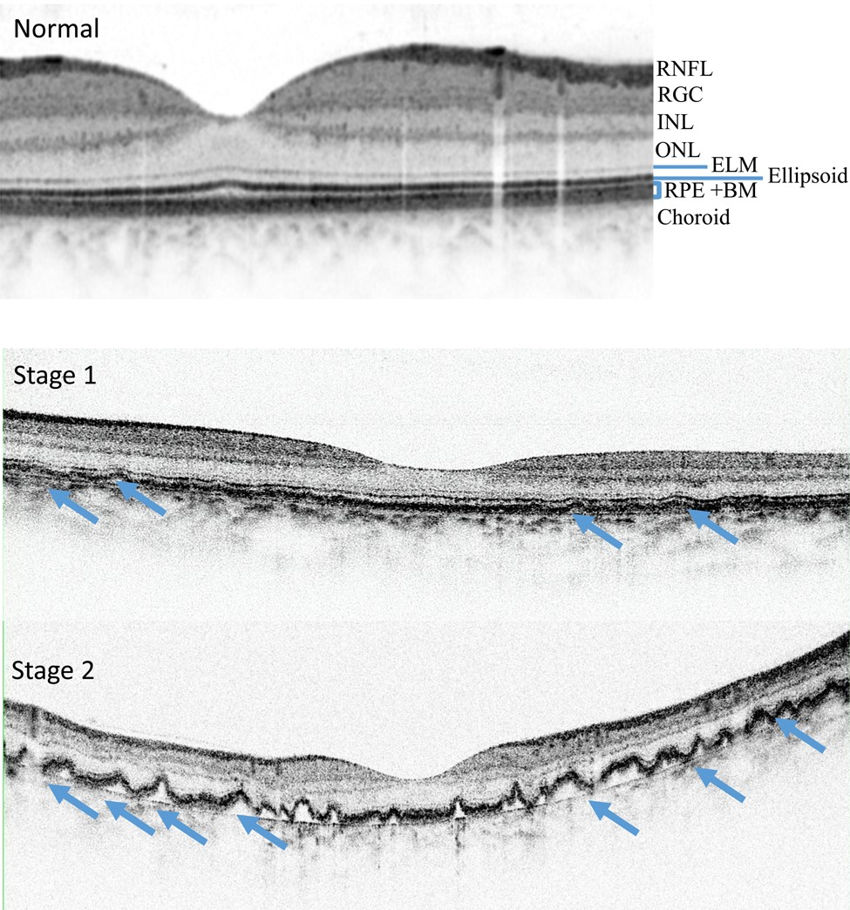
Figure 2. Spectral domain coherent tomography in stages 1 and 2 of MCRPE. Normal segmentation from the inner to the ...
Notes:
Figure 2. Spectral domain coherent tomography in stages 1 and 2 of MCRPE. Normal segmentation from the inner to the outer layers, the retinal nerve fiber (RNFL), the retinal ganglion cell (RGC), the inner (INL) and outer nuclear (ONL) layers, the external limiting membrane (ELM), the ellipsoid zone (inside inner segment of photoreceptor cell), the RPE and Bruch's membrane complex (RPE + MB) and the choroid. In comparison to normal image, the dry desert land pattern corresponds to irregular, thickened and scalloped elevation of the RPE (blue arrows).
Unless provided in the caption above, the following copyright applies to the content of this slide: © The Author 2016. Published by Oxford University Press. All rights reserved. For Permissions, please email: journals.permissions@oup.com

Slide 3
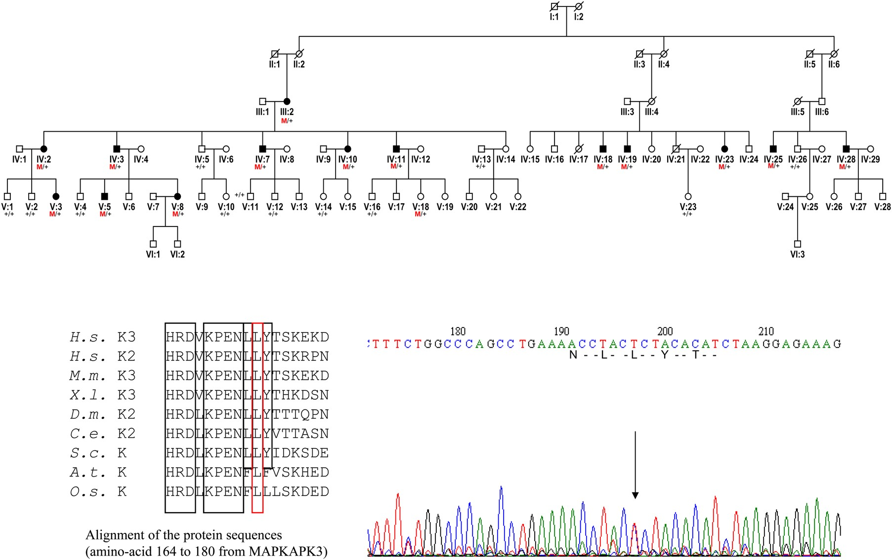
Figure 3. Pedigree of family originating from Martinique, one of the French West Indies islands. The dystrophy is ...
Notes:
Figure 3. Pedigree of family originating from Martinique, one of the French West Indies islands. The dystrophy is inherited as an autosomal dominant trait. Forty-two individuals from three generations have been examined. Fourteen patients older than 30 have a typical dry desert land pattern. All affected individuals (black symbols) have the c.518T>C (p.Leu173Pro) mutation (M/+) in MAPKAPK3. The 12 patients older than 30 with a normal fundus (open symbols) do not have the mutation (+/+). Electropherogram showing the affected sequence surrounding the c.518T>C mutation in exon 8 of MAPKAPK3. Alignment of eukaryote protein sequences (amino acids 164–180 from MAPKAPK3) including the mutated amino acid Leu173Pro (H.s., Homo sapiensMAPKAPK3 and K2; M.m., Mus musculus ; X.l., Xenopus laevis; D.m., Drosophila melanogaster; C.e., Caenorhabditis elegans; S.c ., Saccharomyces cerevisiae ; A.t., Arabidopsis thaliana and O.s., Oriza sativa) showing conserved amino acids across species. Protein kinase subdomain VIb (HRDxKPEN) containing the aspartate (D) necessary for catalysis is indicated (boxed).
Unless provided in the caption above, the following copyright applies to the content of this slide: © The Author 2016. Published by Oxford University Press. All rights reserved. For Permissions, please email: journals.permissions@oup.com

Slide 4
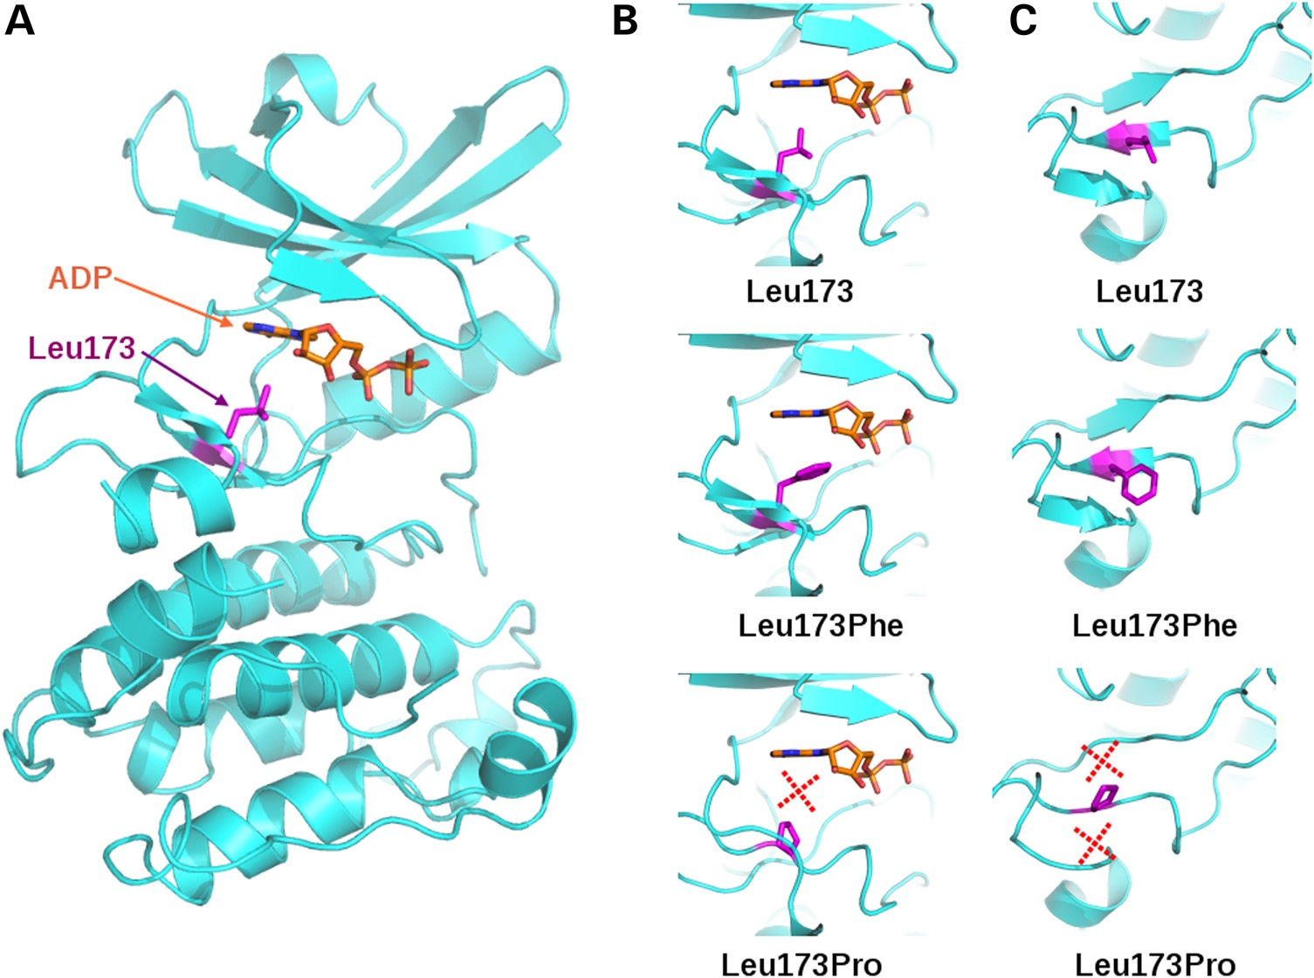
Figure 4. Model of ADP-bound MAPKAPK3 and mutation impacts. (A) The overall structure of MAPKAPK3 is shown in cyan ...
Notes:
Figure 4. Model of ADP-bound MAPKAPK3 and mutation impacts. (A) The overall structure of MAPKAPK3 is shown in cyan ribbon with the bound ADP in orange stick and the leucine Leu173 in violet stick. (B) Side view of the ADP binding with the wild-type or mutant side chain drawn as in (A). (C) Top view of the β-sheet containing a central β-strand harboring the mutated residue. The red crosses in (B) and (C) indicate bad or lost contacts. The 3D models were built using as template the crystal structure of MAPKAPK2 bound to an ADP molecule. The corresponding models can be found at http://atome1.cbs.cnrs.fr/AT2B/MAPKAPK3_MUTANTS/. The figure was drawn using Pymol.
Unless provided in the caption above, the following copyright applies to the content of this slide: © The Author 2016. Published by Oxford University Press. All rights reserved. For Permissions, please email: journals.permissions@oup.com

Slide 5
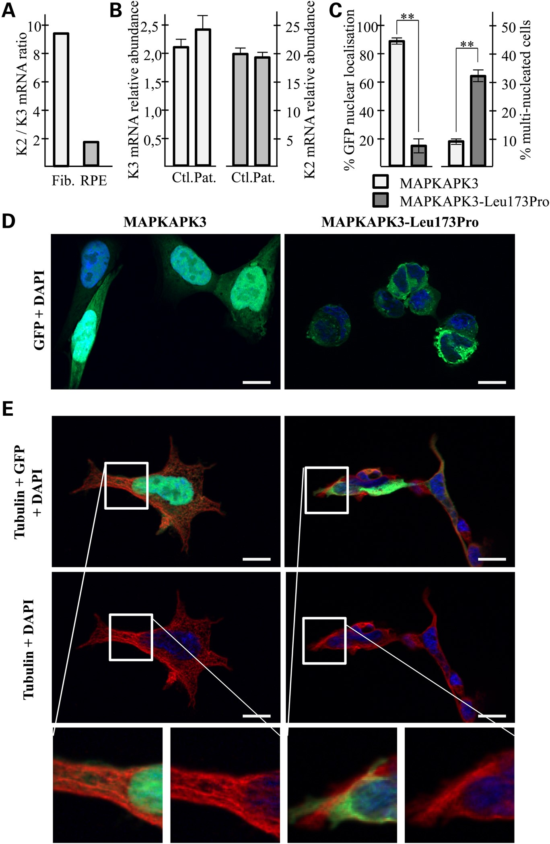
Figure 5. Wild-type and mutated MAPKAPK3 expression, localization and effects on cells. (A) Ratio of MAPKAPK2/MAPKAPK3 ...
Notes:
Figure 5. Wild-type and mutated MAPKAPK3 expression, localization and effects on cells. (A) Ratio of MAPKAPK2/MAPKAPK3 mRNA abundance in fibroblasts (Fib.) and retinal pigmentary epithelium (RPE). (B) MAPKAPK3 (left) and MAPKAPK2 (right) mRNA relative abundance in control (Ctl.; n = 3) and patient (Pat.; n = 2) fibroblasts, determined by RT–q-PCR. Results are given as mean ± SEM. (C) Intracellular localization and effect on nuclear segregation of wild-type and mutated MAPKAPK3-GFP fusion protein expression in HEK cells. Assessment of the nuclear localization of the GFP fluorescence (left) and of the percentage of multi-nucleated transfected cells (right). Results are given as mean ± SEM. (**P < 0.01). (D) Fluorescent pictures of the GFP and DAPI staining in HEK cells transfected with the wild-type (left) and Leu173Pro (right) MAPKAPK3-GFP fusion proteins (bar: 10 µm). (E) Fluorescent pictures of the tubulin-associated, GFP and DAPI staining in HEK cells transfected with the wild-type (left) and Leu173Pro (right) MAPKAPK3-GFP fusion proteins. Top: merge of the three fluorescent signals; middle: merge of the tubulin and DAPI staining; bottom: enlargement of the former pictures showing the nuclear localization of the wild-type GFP fusion protein and normal cytoskeleton (left) and the cytoplasmic localization of the mutated Leu173Pro GFP fusion protein with disorganized cytoskeleton (right) (bar: 10 µm).
Unless provided in the caption above, the following copyright applies to the content of this slide: © The Author 2016. Published by Oxford University Press. All rights reserved. For Permissions, please email: journals.permissions@oup.com

Slide 6
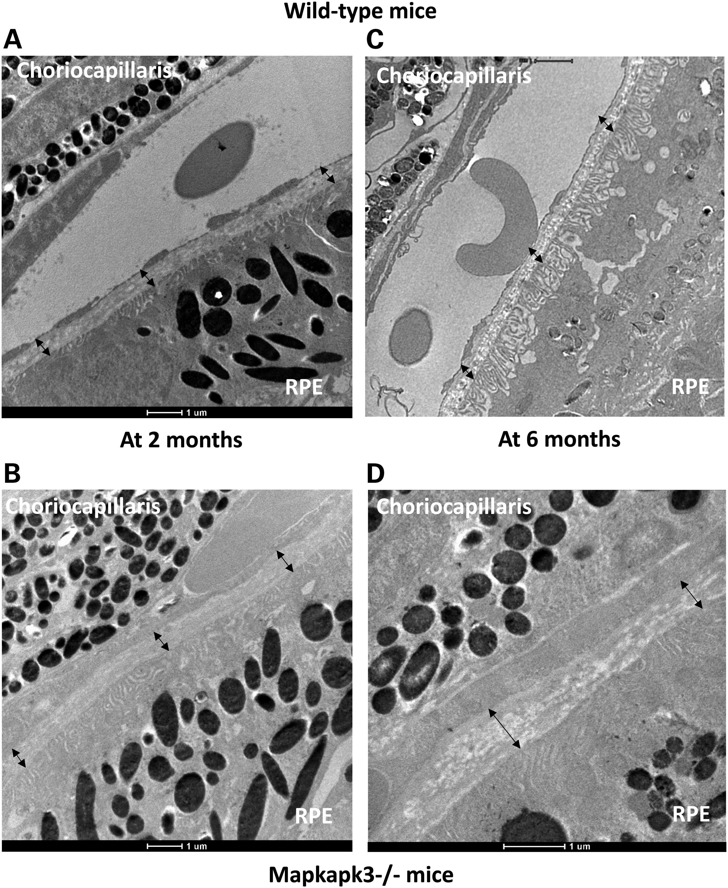
Figure 6. Bruch's membrane electron microscopy of wild-type and Mapkapk3−/− mice. Bruch's membrane is a pentalaminated ...
Notes:
Figure 6. Bruch's membrane electron microscopy of wild-type and Mapkapk3−/− mice. Bruch's membrane is a pentalaminated extracellular matrix interposed between RPE with characteristic basal infoldings and choroidal endothelial cells (choriocapillaris) (bar: 1 µm). (A) Bruch's membrane has a regular and normal thickness below 600 nm in 2-month-old wild-type mouse (mean value: 451 ± 73.88 nm, black arrows). (B) Two-month-old Mapkapk3−/− mouse presents a mean Bruch's membrane (black arrows) thickness of 516 ± 204.9 nm. (C) Bruch's membrane thickness (black arrows) is regular in the 6-month-old wild-type mouse (mean 514 ± 98.29 nm). (D) Six-month-old Mapkapk3−/− mouse has a Bruch's membrane thickness of 857 ± 663 nm. The Bruch's membrane architecture is severely disorganized in several parts with abnormal thickening (large black arrow) and thinning (narrow black arrow) portions. These morphological changes are in line with the coherent tomography data of affected subjects in whom RPE and Bruch's membrane are thickened and irregular on SD-OCT.
Unless provided in the caption above, the following copyright applies to the content of this slide: © The Author 2016. Published by Oxford University Press. All rights reserved. For Permissions, please email: journals.permissions@oup.com

