Slide 1
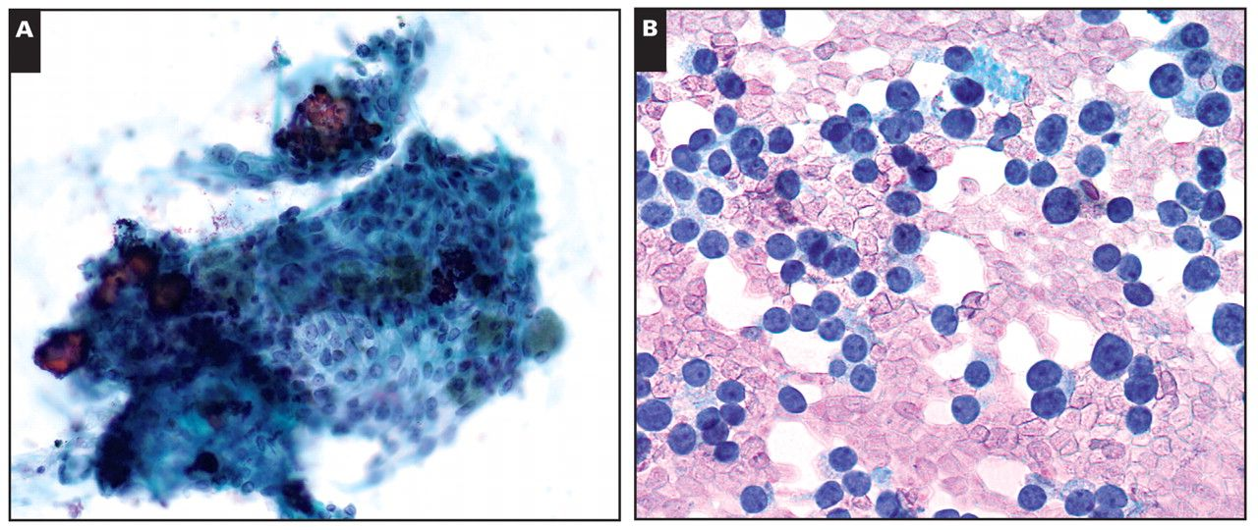
Image 1 Malignant findings, thyroid bed fine-needle aspiration, direct smears. A, Recurrent/residual papillary ...
Notes:
Image 1 Malignant findings, thyroid bed fine-needle aspiration, direct smears. A, Recurrent/residual papillary thyroid carcinoma. Tissue fragment with cells displaying oval nuclei, fine powdery chromatin, and numerous psammoma bodies (Papanicolaou, ×200). B, Recurrent medullary thyroid carcinoma. Dispersed, single and monotonous, round to oval, naked nuclei with neuroendocrine-type chromatin pattern (rapid Romanowsky, ×400).
Unless provided in the caption above, the following copyright applies to the content of this slide: © American Society for Clinical Pathology

Slide 2
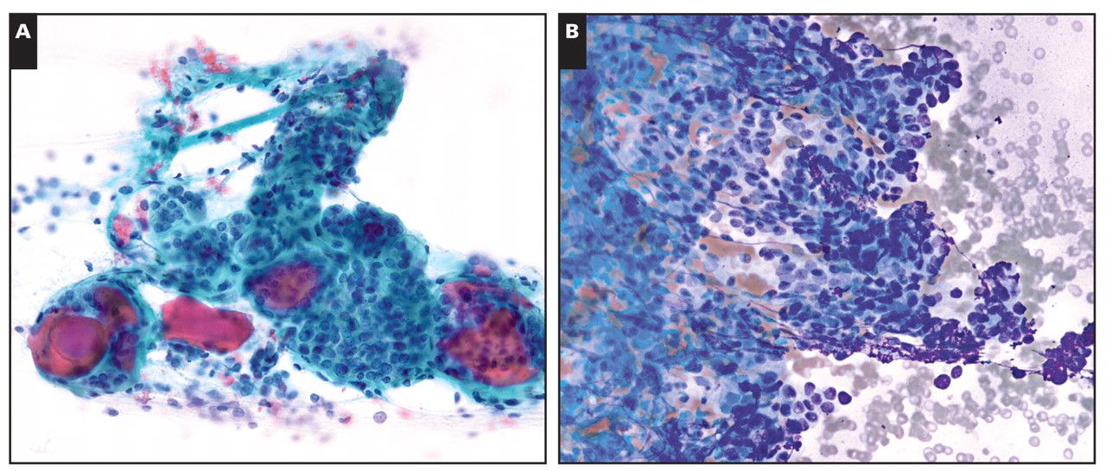
Image 2 Benign findings, thyroid bed fine-needle aspiration, direct smears. A, Residual hyperplastic thyroid tissue ...
Notes:
Image 2 Benign findings, thyroid bed fine-needle aspiration, direct smears. A, Residual hyperplastic thyroid tissue in a patient with a history of papillary thyroid carcinoma. Macrofollicles containing colloid (Papanicolaou, ×200). B, Incidental hyperplastic parathyroid tissue. A tight tissue fragment with relatively small and uniform, round to oval nuclei. Some follicle-like formations are also observed. No colloid is present (rapid Romanowsky, ×200).
Unless provided in the caption above, the following copyright applies to the content of this slide: © American Society for Clinical Pathology

