Slide 1
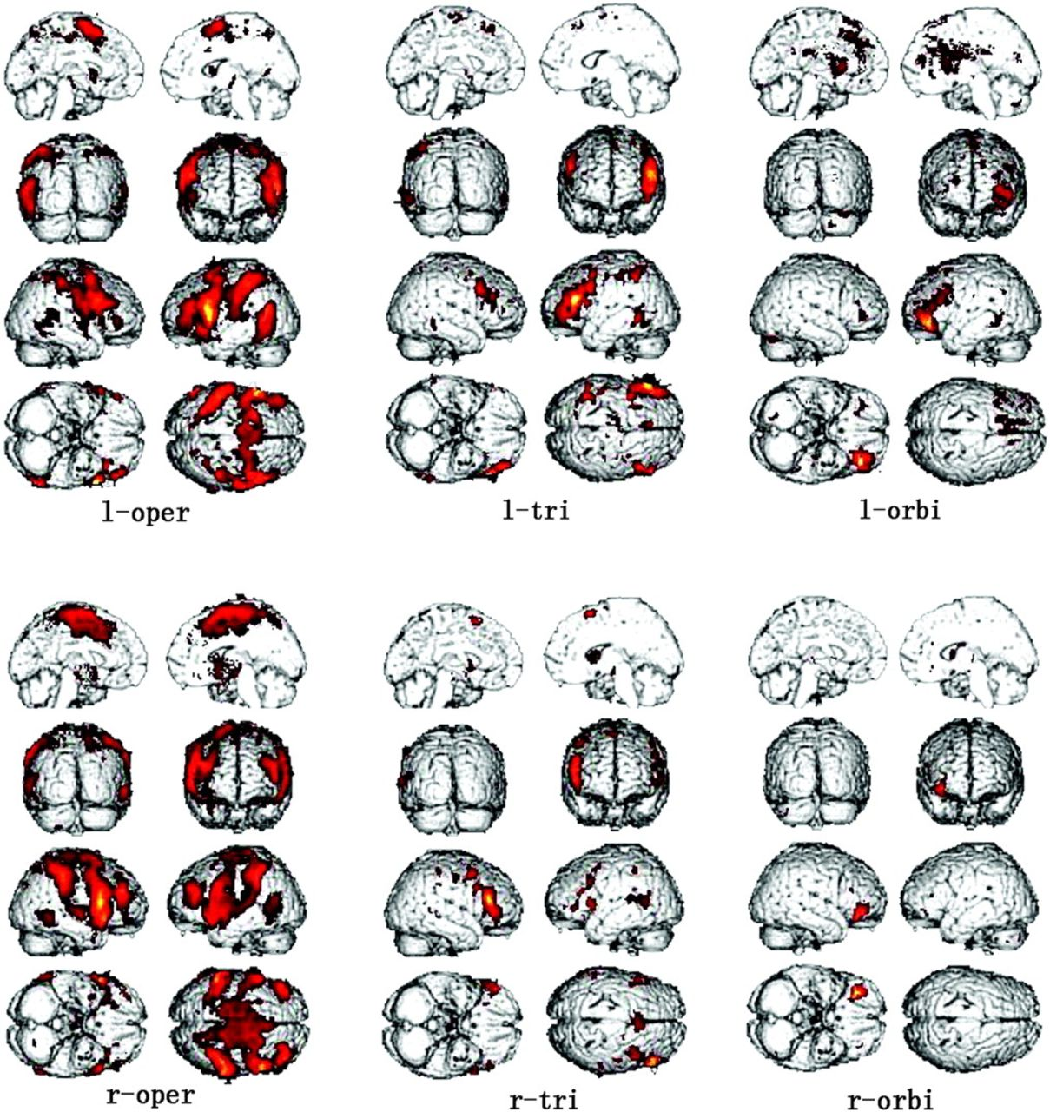
Figure 1. Resting-state connectivity pattern of 6 frontal seed regions across the whole group of subjects (P ≤ 0.05 FDR ...
Notes:
Figure 1. Resting-state connectivity pattern of 6 frontal seed regions across the whole group of subjects (P ≤ 0.05 FDR corrected), overlaid on SPM5 standard brain in MNI space. L-oper, l-tri, l-orbi, r-oper, r-tri, and r-orbi represent the connectivity pattern to l-oper, l-tri, l-orbi, r-oper, r-tri, and r-orbi, respectively.
Unless provided in the caption above, the following copyright applies to the content of this slide: © The Author 2009. Published by Oxford University Press. All rights reserved. For permissions, please e-mail: journals.permissions@oxfordjournals.org

Slide 2
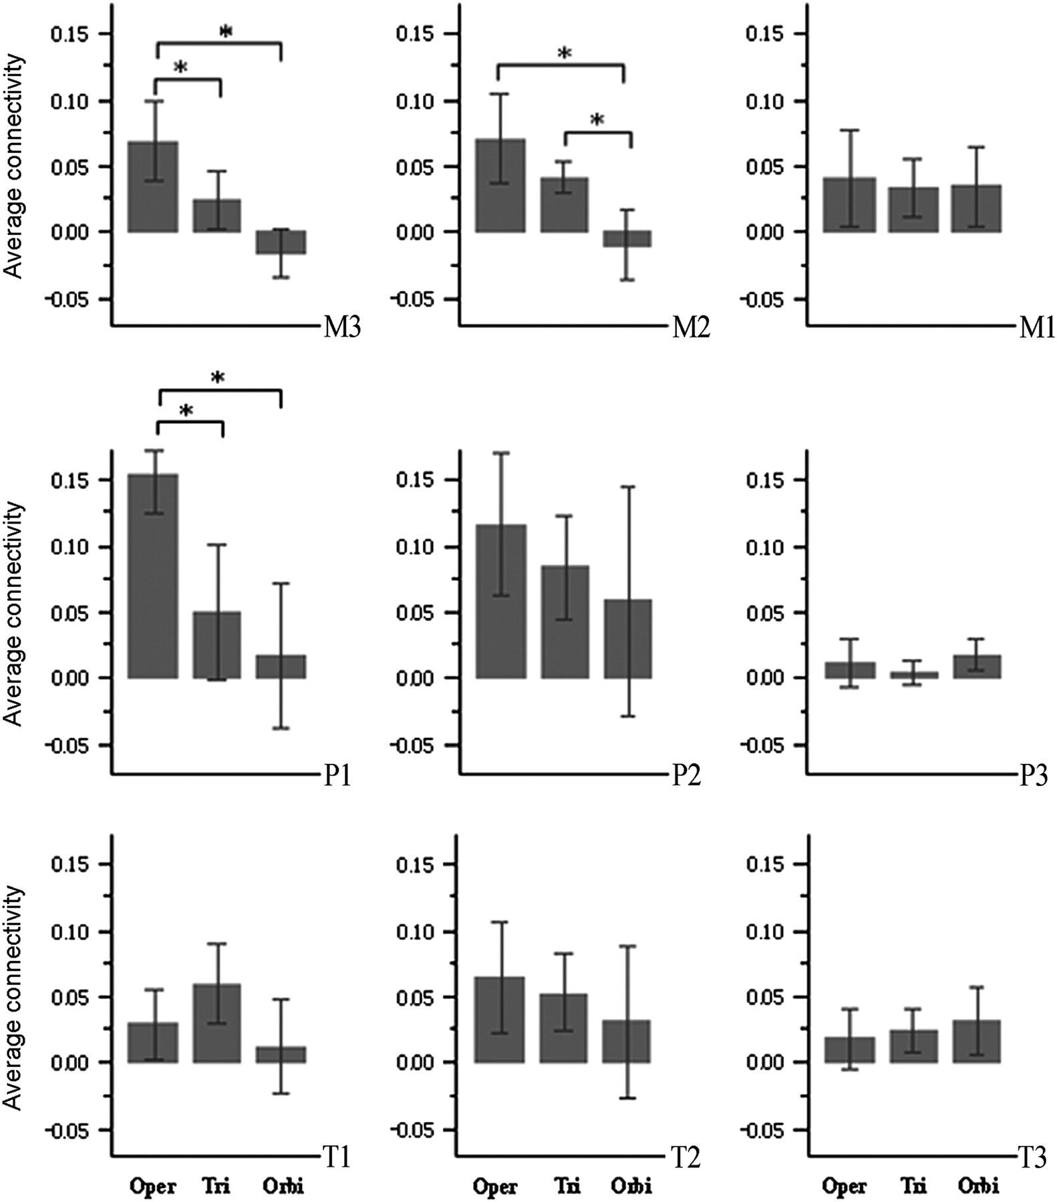
Figure 4. The average connectivity (with standard errors) of each of the 3 right seeds to each of the 3 right ...
Notes:
Figure 4. The average connectivity (with standard errors) of each of the 3 right seeds to each of the 3 right homologous regions in the right middle frontal, parietal, and temporal lobes. M1, the anterior inferior part of MFG; M3, the posterior superior part of MFG; M2, the MFG area between M1 and M3; P1, superior and anterior part of the superior and inferior parietal lobules; P3, area adjacent to and overlapping with AG; P2, the area between P1 and P3 in the superior and inferior parietal lobules; T1, pSTG and superior pMTG; T2, inferior pMTG; T3, pITG. Oper, Tri, or Orbi represent each of the 3 right seeds. “*” Indicates significant difference of the connectivity strength between 2 seeds in that brain region.
Unless provided in the caption above, the following copyright applies to the content of this slide: © The Author 2009. Published by Oxford University Press. All rights reserved. For permissions, please e-mail: journals.permissions@oxfordjournals.org

Slide 3
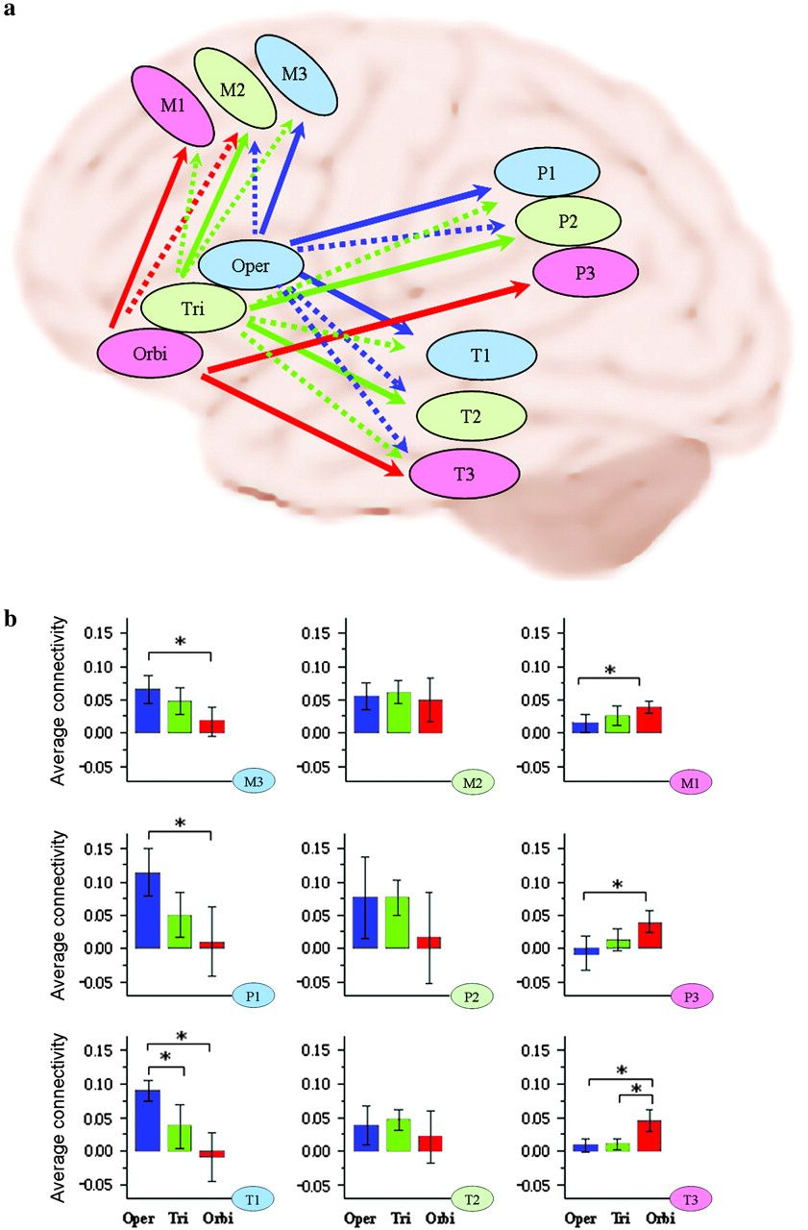
Figure 3. a) The topographical connectivity pattern in the perisylvian language networks. Connections to l-oper (oper), ...
Notes:
Figure 3. a) The topographical connectivity pattern in the perisylvian language networks. Connections to l-oper (oper), l-tri (tri), and l-orbi (orbi) are shown with blue, green, and red arrows, respectively. The solid arrows represent the highest connectivity, and the dashed arrows represent the overlapping connections. Brain areas assumed to be mainly involved in phonological, syntactic, and semantic processing are shown in light blue, light green, and light red circles, respectively (for details on the function and interaction of these brain areas, refer to the Discussion). (b) The average connectivity (with standard errors) of each of the 3 left seeds to each of the 3 regions that constituted the observed topographical connectivity pattern in the left middle frontal, parietal, and temporal lobes. M1, the anterior inferior part of MFG; M3, the posterior superior part of MFG; M2, the MFG area between M1 and M3; P1, superior and anterior part of the superior and inferior parietal lobules; P3, area adjacent to and overlapping with AG; P2, the area between P1 and P3 in the superior and inferior parietal lobules; T1, pSTG and superior pMTG; T2, inferior pMTG; T3, pITG. Oper, Tri, or Orbi represent each of the 3 left seeds. “*” Indicates significant difference (P < 0.05 Bonferroni corrected) in the connectivity strength between 2 seeds in that brain region.
Unless provided in the caption above, the following copyright applies to the content of this slide: © The Author 2009. Published by Oxford University Press. All rights reserved. For permissions, please e-mail: journals.permissions@oxfordjournals.org

Slide 4
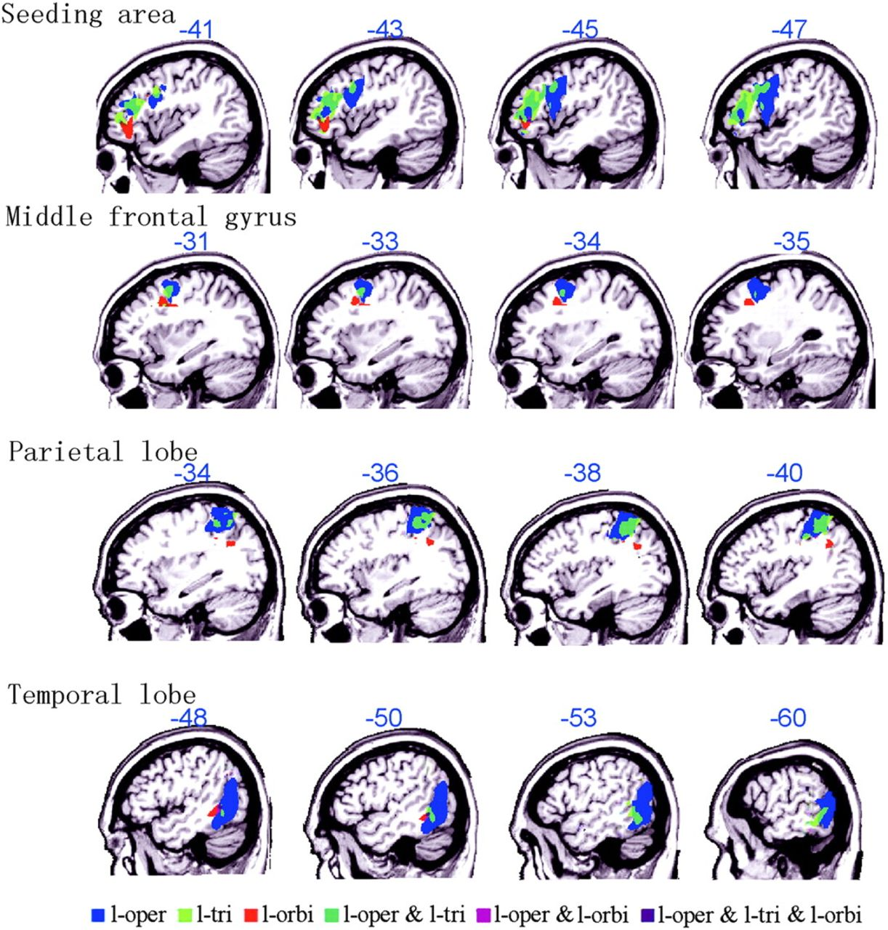
Figure 2. The topographical connectivity pattern in frontal, temporal, and parietal lobes of the 3 left seeds. L-oper, ...
Notes:
Figure 2. The topographical connectivity pattern in frontal, temporal, and parietal lobes of the 3 left seeds. L-oper, l-tri, and l-orbi represent the connectivity pattern to l-oper, l-tri, and l-orbi, respectively. “&” Indicates the overlapping connectivity pattern to the 2 or 3 seeds. Above each image, the MNI coordinate index is shown in blue. For the sake of a better presentation, the threshold for the connectivity map of seeding area is set to P < 0.02 FDR corrected, which is a little bit more conservative than the threshold used for the connectivity map of left MFG, temporal lobe, and parietal lobe (P < 0.05 FDR corrected).
Unless provided in the caption above, the following copyright applies to the content of this slide: © The Author 2009. Published by Oxford University Press. All rights reserved. For permissions, please e-mail: journals.permissions@oxfordjournals.org

