Slide 1
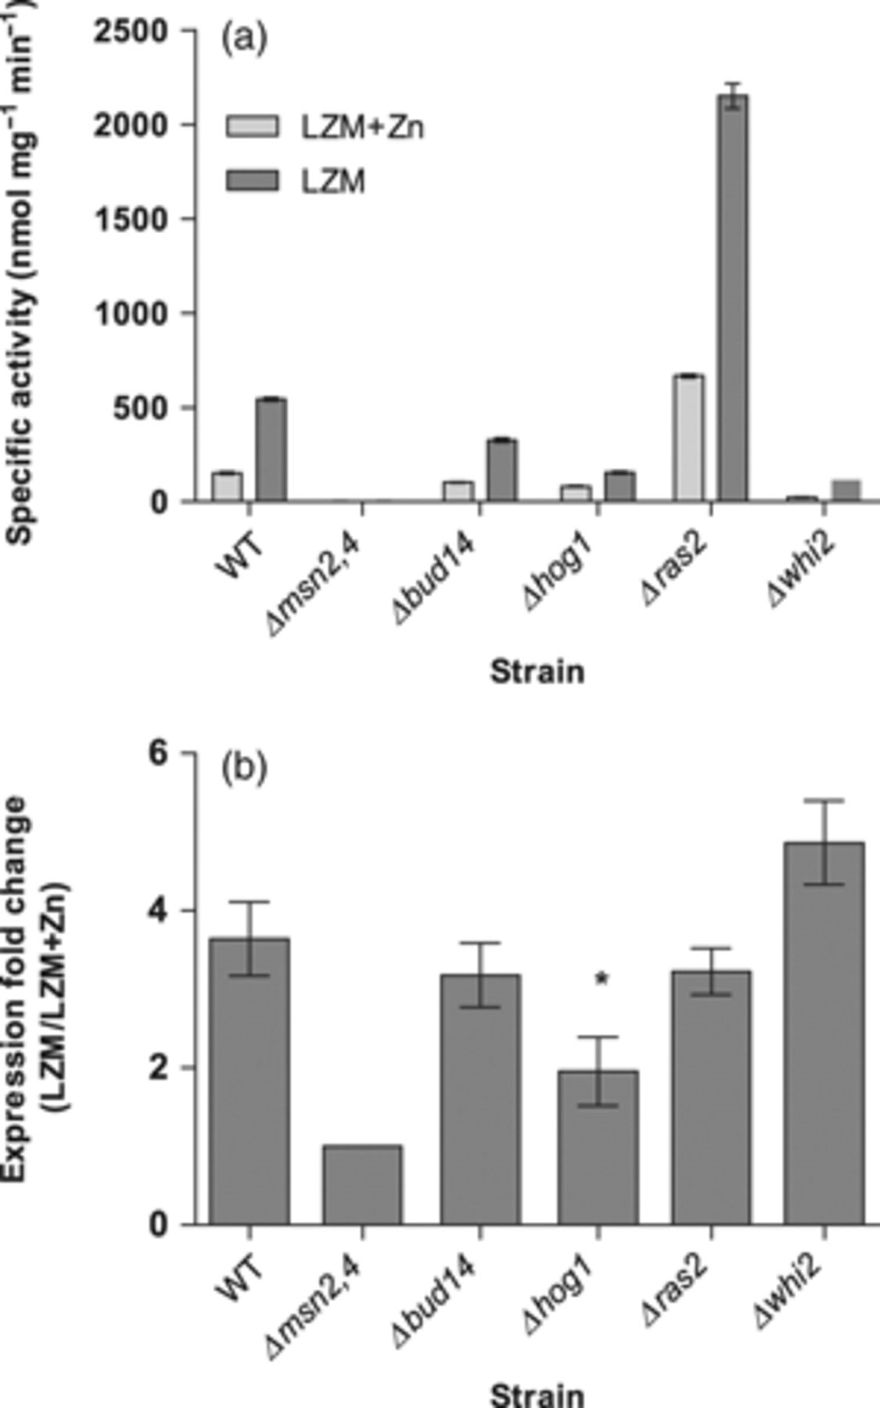
1 Zinc responsiveness of the STRE driven-lacZ reporter construct. (a) Yeast strains, W303 WT, Δmsn2,4, Δbud14, ...
Notes:
1 Zinc responsiveness of the STRE driven-lacZ reporter construct. (a) Yeast strains, W303 WT, Δmsn2,4, Δbud14, Δhog1, Δras2 and Δwhi2 were grown and shifted to conditions with normal zinc (LZM+Zn) and limited zinc (LZM) until samples in the logarithmic phase (≈OD 0.5) were collected and β-gal activity was measured. (b) The fold induction for each strain represents the ratio of induction in zinc limitation to normal zinc. The asterisk above Δhog1 denotes Tukey's significance. Error bars in both figures represent SD from mean.
Unless provided in the caption above, the following copyright applies to the content of this slide: © 2009 Federation of European Microbiological Societies. Published by Blackwell Publishing Ltd. All rights reserved

