Slide 1
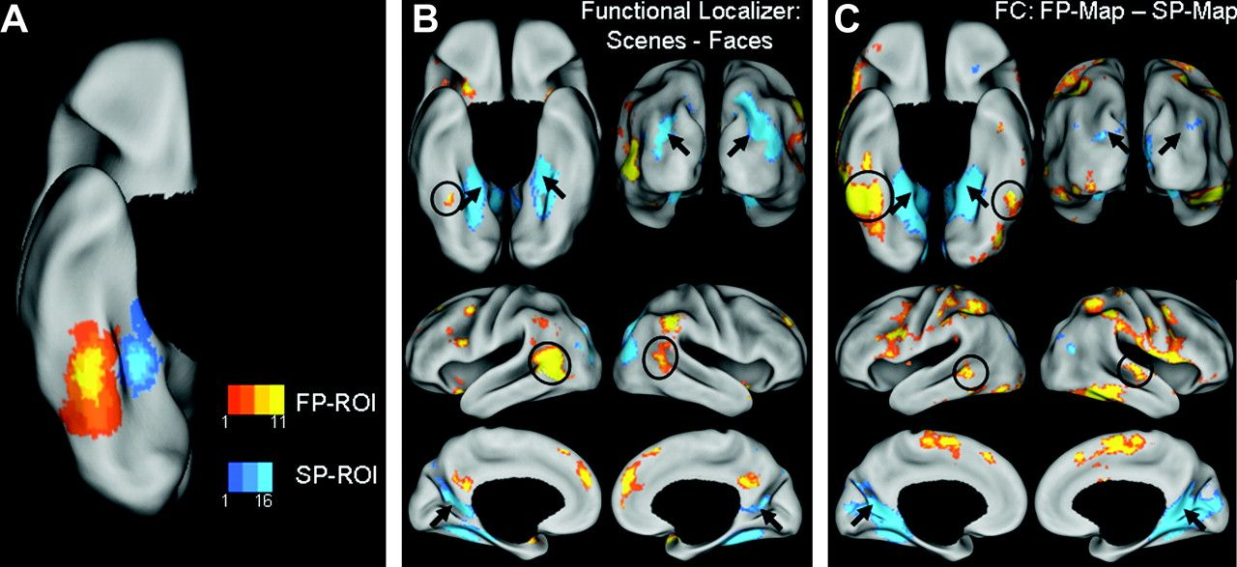
Figure 1. Comparison of task-based functional localizer activity and FC maps. (A) Overlap of the FP- and SP-ROIs for ...
Notes:
Figure 1. Comparison of task-based functional localizer activity and FC maps. (A) Overlap of the FP- and SP-ROIs for all participants (n = 30) overlaid on the inflated right ventral cortical surface. (B) Group difference-maps for FP (yellow/orange scale) and SP (blue scale) regions defined by the contrast faces – scenes in the task-based functional localizer, overlaid on the inflated bilateral ventral (top left), posterior (top right), lateral (middle), and medial (bottom) cortical surfaces. (C) Group difference-maps for LF-BOLD correlations collapsed across all rest runs, specific to the FP-ROI (yellow/orange scale) and SP-ROI (blue scale) defined by the contrast FP-map – SP-map, overlaid on inflated cortical surfaces as in panel B. The functional localizer maps and FC difference-maps show similarities between the pattern of activation and correlated activity, respectively. Arrows indicate regions associated with scene processing: bilateral PHC, transverse occipital sulcus, and retrosplenial cortex, on the ventral, posterior, and medial surfaces, respectively. Circles indicate regions associated with face processing: FG and lateral temporal cortex, on the ventral and lateral surfaces, respectively.
Unless provided in the caption above, the following copyright applies to the content of this slide: © The Author 2009. Published by Oxford University Press. All rights reserved. For permissions, please e-mail: journals.permissions@oxfordjournals.org

Slide 2
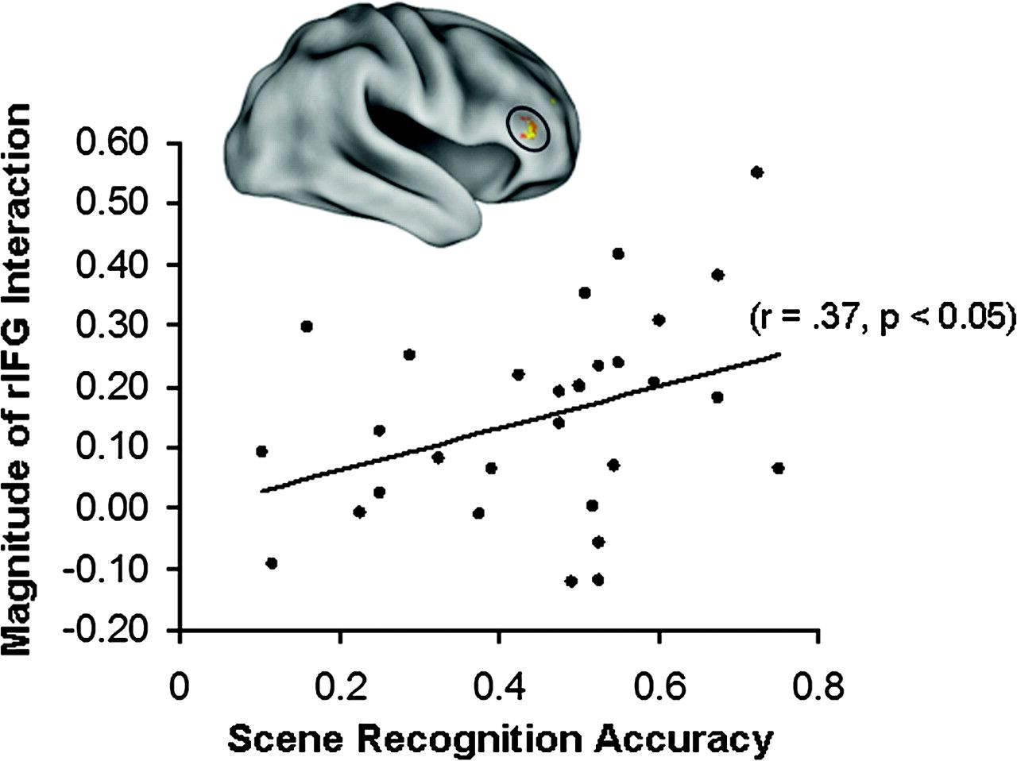
Figure 4. Coupling of LF-BOLD fluctuations in the rIFG with category-preferential visual regions during rest predicts ...
Notes:
Figure 4. Coupling of LF-BOLD fluctuations in the rIFG with category-preferential visual regions during rest predicts subsequent memory. Across all participants (n = 30), the magnitude of the interaction in rIFG was significantly correlated with subsequent recognition accuracy for scenes (r = 0.37, P < 0.05, 2-tailed).
Unless provided in the caption above, the following copyright applies to the content of this slide: © The Author 2009. Published by Oxford University Press. All rights reserved. For permissions, please e-mail: journals.permissions@oxfordjournals.org

Slide 3
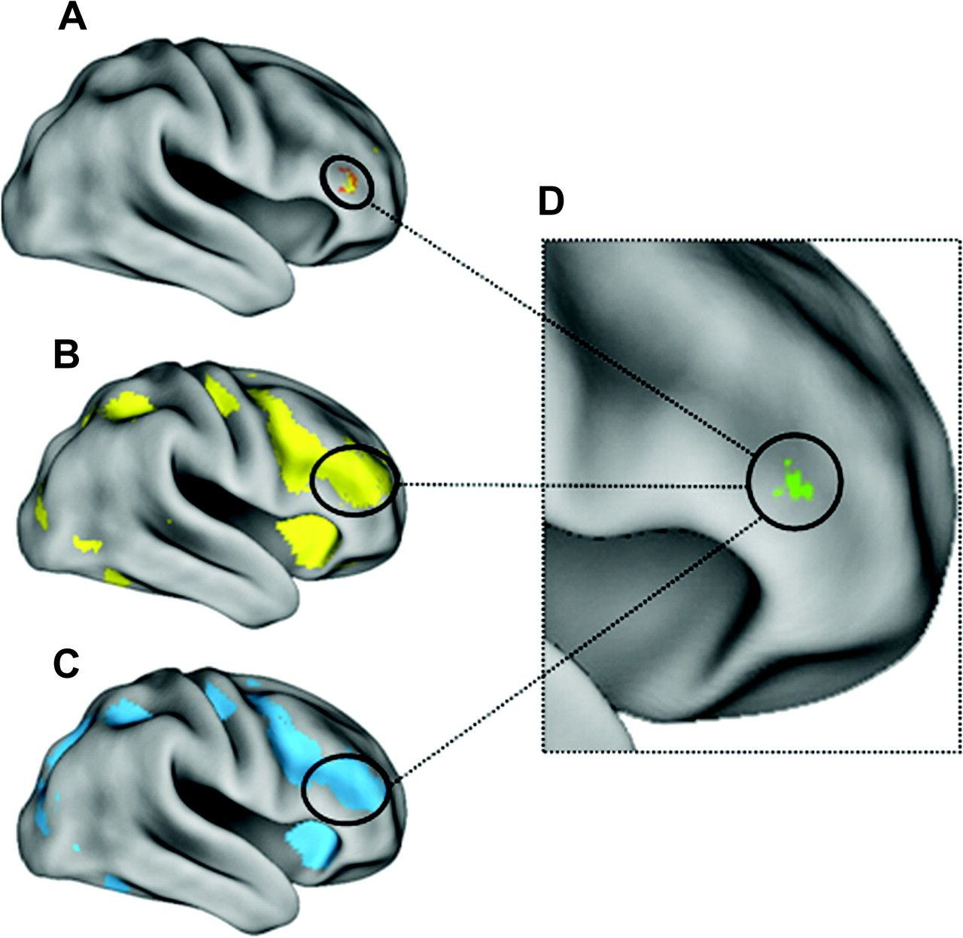
Figure 3. Both face and scene processing engage the rIFG during both task performance and subsequent rest. Region ...
Notes:
Figure 3. Both face and scene processing engage the rIFG during both task performance and subsequent rest. Region showing the task by ROI interaction in rIFG (A) overlapped peak activation for the task-based localizer contrast for faces (B: faces > fixation) and for scenes (C: scenes > fixation). (D) Conjunction of activation for all 3 contrasts, each contrast thresholded at: t > 2.76, P 2.76, P < 0.005.
Unless provided in the caption above, the following copyright applies to the content of this slide: © The Author 2009. Published by Oxford University Press. All rights reserved. For permissions, please e-mail: journals.permissions@oxfordjournals.org

Slide 4
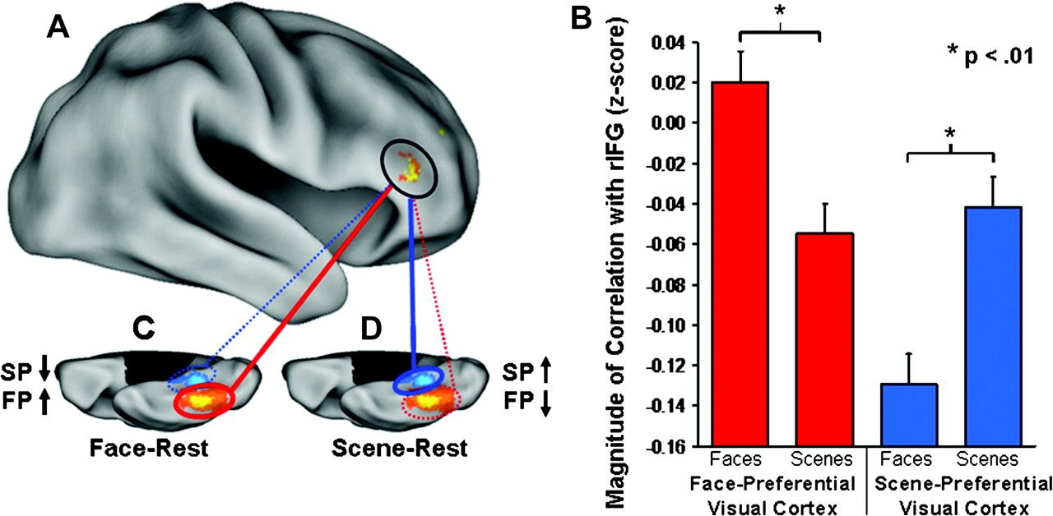
Figure 2. LF-BOLD correlations during rest were modulated by previous task. (A) Region in the rIFG (circled) showing a ...
Notes:
Figure 2. LF-BOLD correlations during rest were modulated by previous task. (A) Region in the rIFG (circled) showing a task by ROI interaction for correlations with the FP- and SP-ROIs (t > 3.4, P 2.76, P < 0.005). (B) Paired samples comparisons revealed a significant simple effect of task on correlations between rIFG and both the FP- and SP-ROIs (FP-ROI t = 3.0, P < 0.01, 2-tailed; SP-ROI t = −3.3, P < 0.01, 2-tailed). (C) Correlations with the FP-ROI increased during face–rest relative to scene–rest; (D) Correlations with the SP-ROI increased during scene-rest relative to face-rest. (C, D) The orange/yellow scale and blue-scale ROIs overlaid on the right ventral cortical surface images show the degree of overlap of all FP- and SP-ROIs, respectively, for all participants (n = 30); red and blue lines indicate correlation with FP-ROI and SP-ROI, respectively; solid lines and dotted lines indicate increased correlations and decreased correlations, respectively. Error bars represent standard error of the mean calculated for within-subjects design.
Unless provided in the caption above, the following copyright applies to the content of this slide: © The Author 2009. Published by Oxford University Press. All rights reserved. For permissions, please e-mail: journals.permissions@oxfordjournals.org

