Slide 1
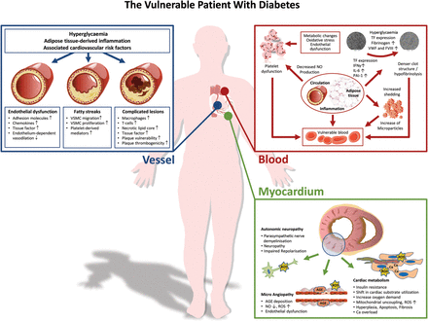
Figure 1 The vulnerable patient with diabetes. Vulnerable vessel, vulnerable blood, and vulnerable myocardium ...
Notes:
Figure 1 The vulnerable patient with diabetes. Vulnerable vessel, vulnerable blood, and vulnerable myocardium characterize the vulnerable patient—a patient with a high risk for the development of cardiovascular complications.
Unless provided in the caption above, the following copyright applies to the content of this slide: Published on behalf of the European Society of Cardiology. All rights reserved. © The Author 2012. For permissions please email: journals.permissions@oup.com

Slide 2
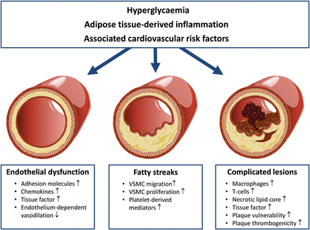
Figure 2 Vulnerable vessel. Hyperglycaemia, adipose tissue-derived inflammation, as well as various cardiovascular ...
Notes:
Figure 2 Vulnerable vessel. Hyperglycaemia, adipose tissue-derived inflammation, as well as various cardiovascular risk factors influence all phases of atherogenesis in patients with diabetes, thus contributing to the development of complicated lesions that are prone to rupture and cause an acute coronary event. VSMC, vascular smooth muscle cells.
Unless provided in the caption above, the following copyright applies to the content of this slide: Published on behalf of the European Society of Cardiology. All rights reserved. © The Author 2012. For permissions please email: journals.permissions@oup.com

Slide 3
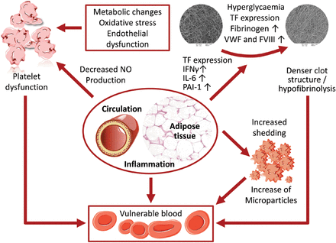
Figure 3 Vulnerable blood. Components of the prothrombotic risk cluster in diabetes mellitus—including platelet ...
Notes:
Figure 3 Vulnerable blood. Components of the prothrombotic risk cluster in diabetes mellitus—including platelet dysfunction, denser fibrin clot structure and hypofibrinolysis, increase in microparticles, and inflammation—are leading to alterations summarized as vulnerable blood. Platelet dysfunction in diabetes is induced by metabolic changes, oxidative stress, and endothelial dysfunction. The development of a compact and dense fibrin clot structure that is more difficult to lyse and is associated with an increased cardiovascular risk is induced by hyperglycaemia and elevation of components of the coagulation cascade. In addition, microparticles are also increased. Furthermore, the underlying inflammation milieu in diabetes does increase all processes enhancing the prothrombotic risk cluster. FVIII, factor VIII; IFN-γ, interferon gamma; IL-6, interleukin 6; PAI-1, plasminogen activator inhibitor 1; TF, tissue factor; vWF, von Willebrand factor.
Unless provided in the caption above, the following copyright applies to the content of this slide: Published on behalf of the European Society of Cardiology. All rights reserved. © The Author 2012. For permissions please email: journals.permissions@oup.com

Slide 4
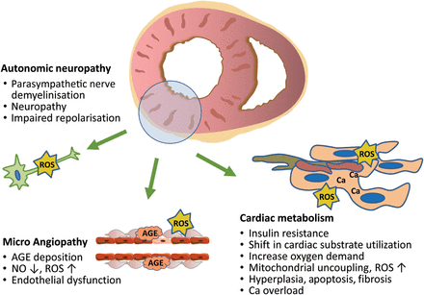
Figure 4 Vulnerable myocardium. Alterations in cardiac metabolism with cellular insulin resistance and a shift in ...
Notes:
Figure 4 Vulnerable myocardium. Alterations in cardiac metabolism with cellular insulin resistance and a shift in substrate utilization form glucose to fatty acid oxidation leading to increased oxygen demand and reactive oxygen production as a cause for cardiomyocyte apoptosis and fibrosis. This is paralleled by AGE deposition, endothelial dysfunction, and microangiopathy, which, in conjunction with neuropathy and repolarization disorders, cause a state of vulnerability to external stressors, including ischaemia and electrolyte imbalance. AGE, advanced glycation end-products; Ca, calcium; NO, nitric oxide; ROS, reactive oxygen species.
Unless provided in the caption above, the following copyright applies to the content of this slide: Published on behalf of the European Society of Cardiology. All rights reserved. © The Author 2012. For permissions please email: journals.permissions@oup.com

