Slide 1
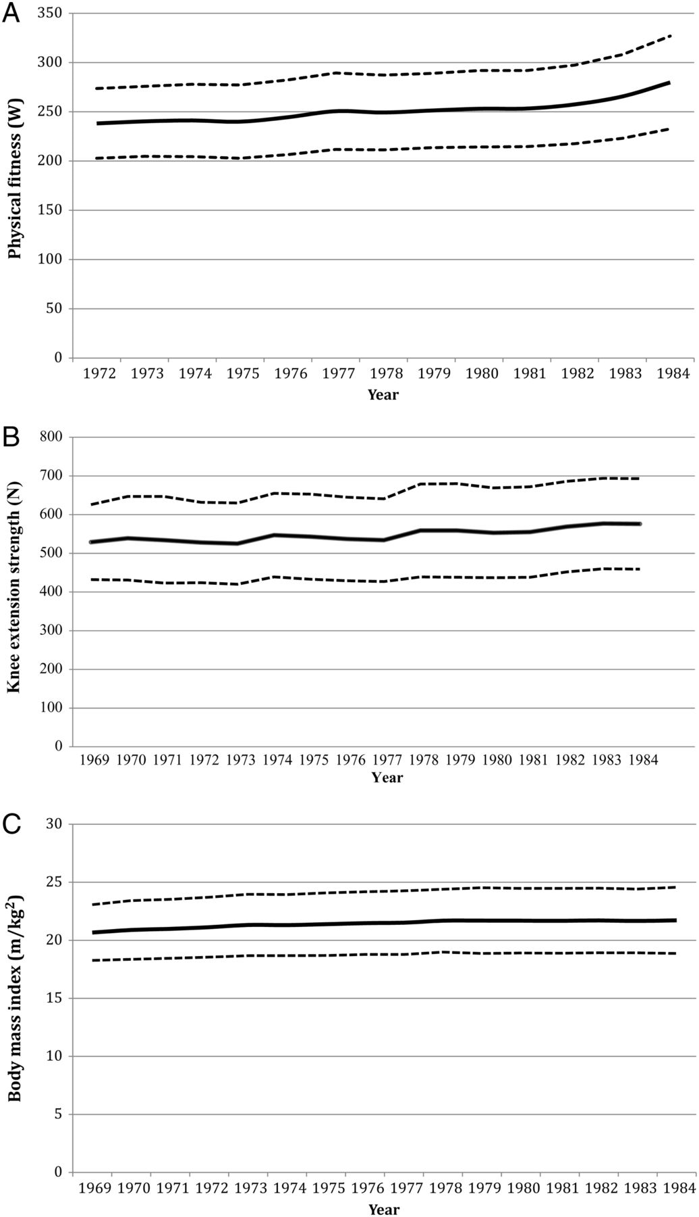
Figure 1 Means and standard deviations of aerobic fitness (W_{max}; A), knee extension strength (B), and BMI ...
Notes:
Figure 1 Means and standard deviations of aerobic fitness (Wmax; A), knee extension strength (B), and BMI (C) during the years of conscription.
Unless provided in the caption above, the following copyright applies to the content of this slide: Published on behalf of the European Society of Cardiology. All rights reserved. © The Author 2013. For permissions please email: journals.permissions@oup.com

Slide 2
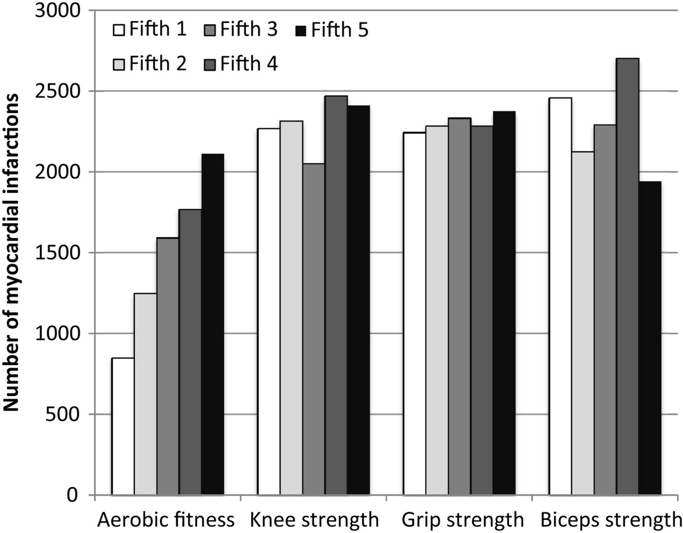
Figure 2 Number of myocardial infarctions for fifth of aerobic fitness (W_{max}, measured in Watt, W) and ...
Notes:
Figure 2 Number of myocardial infarctions for fifth of aerobic fitness (Wmax, measured in Watt, W) and estimates of muscle strength (measured in Newton, N). The 1st fifth represents men with the highest physical performance test results.
Unless provided in the caption above, the following copyright applies to the content of this slide: Published on behalf of the European Society of Cardiology. All rights reserved. © The Author 2013. For permissions please email: journals.permissions@oup.com

Slide 3
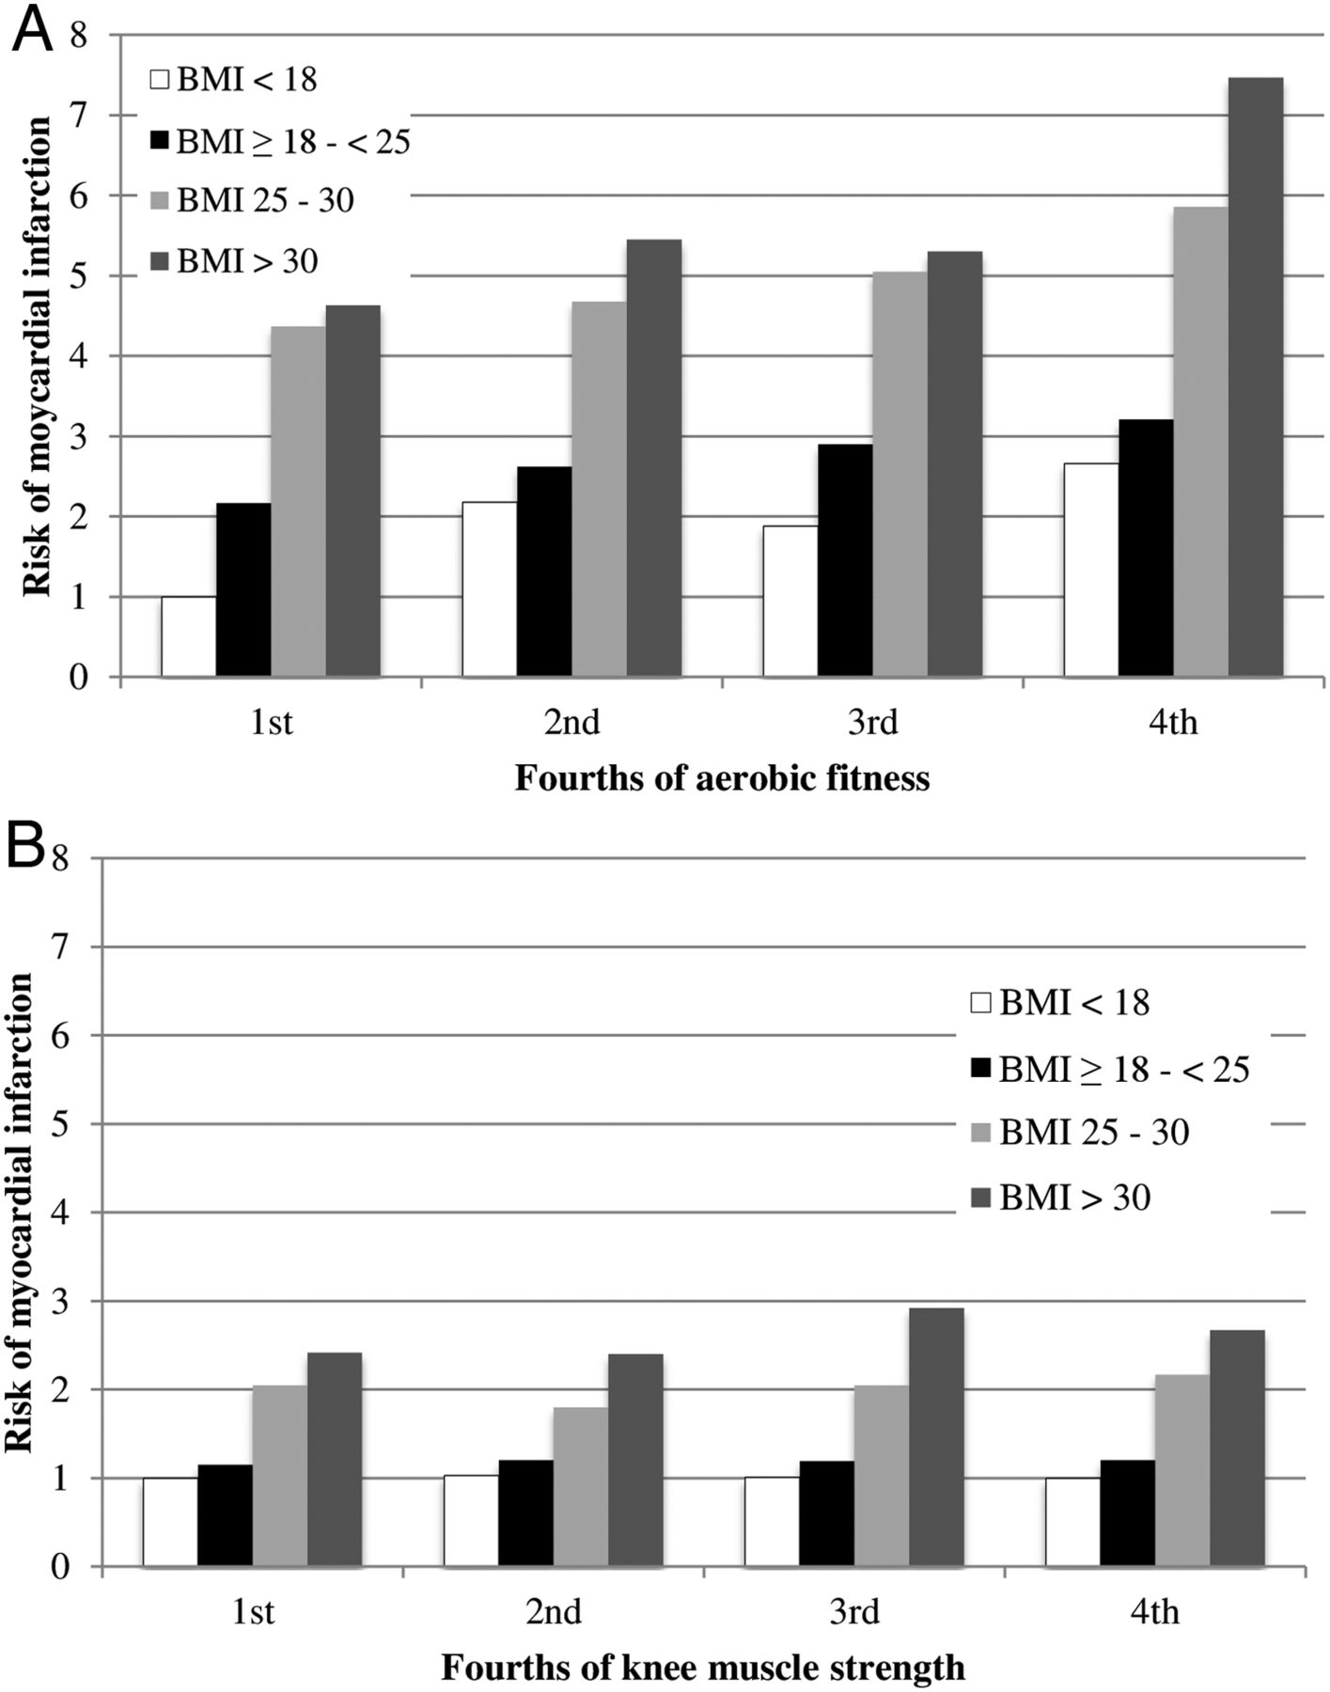
Figure 3 The joint effects of aerobic fitness (A), knee extension strength (B), and BMI on the risk of myocardial ...
Notes:
Figure 3 The joint effects of aerobic fitness (A), knee extension strength (B), and BMI on the risk of myocardial infarction. Estimates of physical performance were analysed in fourth, with the 1st fourth representing men with the highest performance. Body mass index groups where analysed according to the WHO's definitions for underweight/lean (BMI < 18.5), normal weight (BMI 18.5– 30). Cox regression analyses were adjusted for age at baseline, place and year of conscription, income, disability pension, education, the 12 most common diagnoses, and blood pressure. Hazard ratios and 95% confidence intervals are presented. *P < 0.05, **P < 0.01, ***P < 0.001.
Unless provided in the caption above, the following copyright applies to the content of this slide: Published on behalf of the European Society of Cardiology. All rights reserved. © The Author 2013. For permissions please email: journals.permissions@oup.com

