Slide 1
Figure 1. Study design and plasma sample collection schedule. ªControlled single cannabis smoking occurred ...
Notes:
Figure 1. Study design and plasma sample collection schedule. aControlled single cannabis smoking occurred approximately 11:30 on the last day of each treatment phase. bThis study evaluated plasma data collected in the first two ad libitum smoking phases and the abstinence (placebo dronabinol) phase; the plasma data during the active dronabinol phases were presented in a previously published paper (10).
Unless provided in the caption above, the following copyright applies to the content of this slide: Published by Oxford University Press 2015. This work is written by (a) US Government employee(s) and is in the public domain in the US.

Slide 2
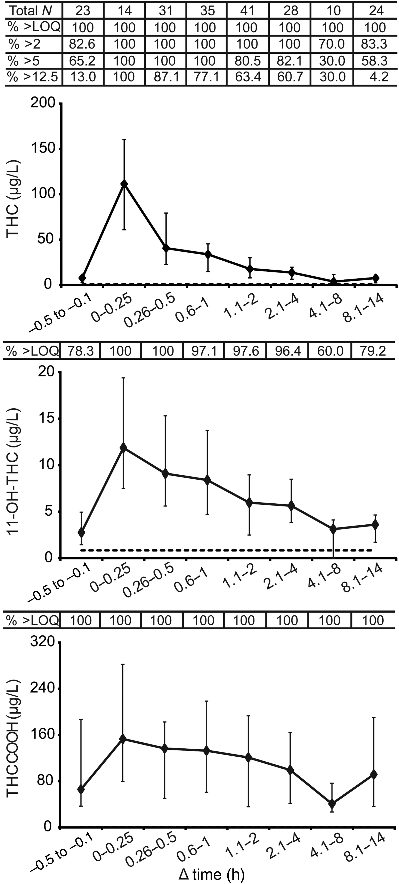
Figure 2. Median plasma cannabinoid concentrations in 11 participants collected during ad libitum cannabis smoking. ...
Notes:
Figure 2. Median plasma cannabinoid concentrations in 11 participants collected during ad libitum cannabis smoking. X-axis specifies eight time intervals equaling the time difference between the last cigarette smoked and sample collection time (Δtime) during ad libitum smoking. Error bars represent interquartile range. Dotted lines indicate LOQ (0.5 μg/L for THC and THCCOOH and 1.0 μg/L for 11-OH-THC). N, number of samples; LOQ, limit of quantification; % >2, % of plasma samples positive for THC at 2 µg/L cutoff; % >5, % of plasma samples positive for THC at 5 µg/L cutoff; % >12.5, % of plasma samples positive for THC at 12.5 µg/L cutoff, approximately equivalent to 5 µg/L in whole blood.
Unless provided in the caption above, the following copyright applies to the content of this slide: Published by Oxford University Press 2015. This work is written by (a) US Government employee(s) and is in the public domain in the US.

Slide 3
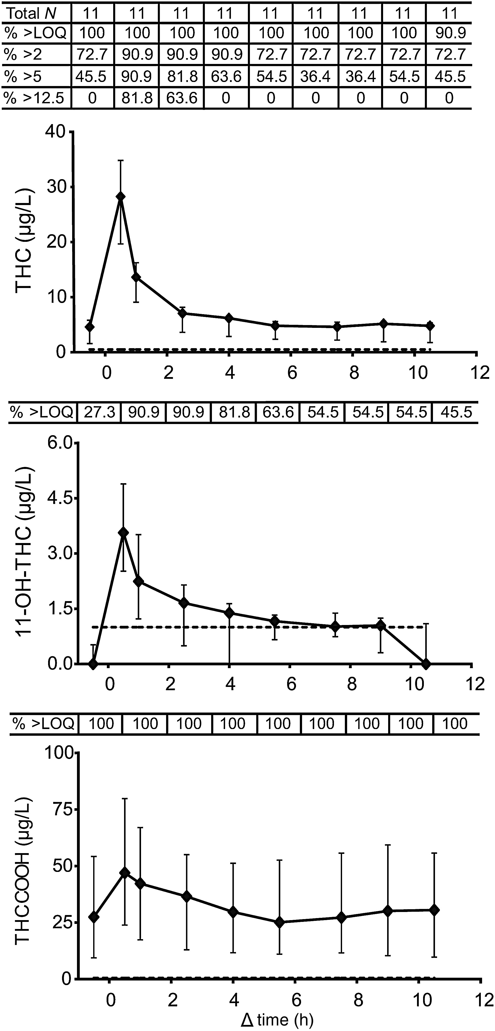
Figure 3. Median plasma cannabinoid concentrations in 11 participants following controlled paced smoking of one ...
Notes:
Figure 3. Median plasma cannabinoid concentrations in 11 participants following controlled paced smoking of one cannabis cigarette on the last day of the abstinence phase. Error bars represent interquartile range. Δtime indicates time between the controlled cannabis cigarette smoking and sample collection. Dotted lines indicate LOQ (0.5 μg/L for THC and THCCOOH and 1.0 μg/L for 11-OH-THC). N, number of samples; LOQ, limit of quantification; % >2, % of plasma samples positive for THC at 2 µg/L cutoff; % >5, % of plasma samples positive for THC at 5 µg/L cutoff; % >12.5, % of plasma samples positive for THC at 12.5 µg/L cutoff, approximately equivalent to 5 µg/L in whole blood.
Unless provided in the caption above, the following copyright applies to the content of this slide: Published by Oxford University Press 2015. This work is written by (a) US Government employee(s) and is in the public domain in the US.

Slide 4
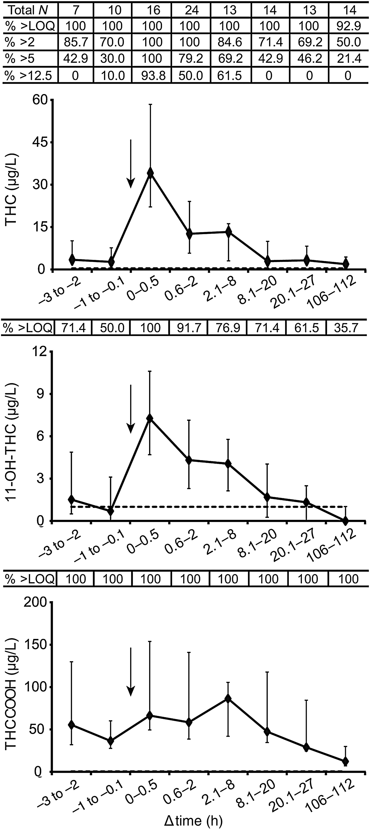
Figure 4. Median plasma cannabinoid concentrations in seven participants during ad libitum cannabis smoking followed by ...
Notes:
Figure 4. Median plasma cannabinoid concentrations in seven participants during ad libitum cannabis smoking followed by the 5-day abstinence phase. X-axis specifies eight time intervals equaling the time difference between the last cigarette smoked and sample collection time (Δtime) during ad libitum smoking. Error bars represent interquartile range. Dotted lines indicate LOQ (0.5 μg/L for THC and THCCOOH and 1.0 μg/L for 11-OH-THC). N, number of samples; LOQ, limit of quantification; % >2, % of plasma samples positive for THC at 2 µg/L cutoff; % >5, % of plasma samples positive for THC at 5 µg/L cutoff; % >12.5, % of plasma samples positive for THC at 12.5 µg/L cutoff, approximately equivalent to 5 µg/L in whole blood. Arrows represent start of the ad libitum smoking phase.
Unless provided in the caption above, the following copyright applies to the content of this slide: Published by Oxford University Press 2015. This work is written by (a) US Government employee(s) and is in the public domain in the US.

