Slide 1
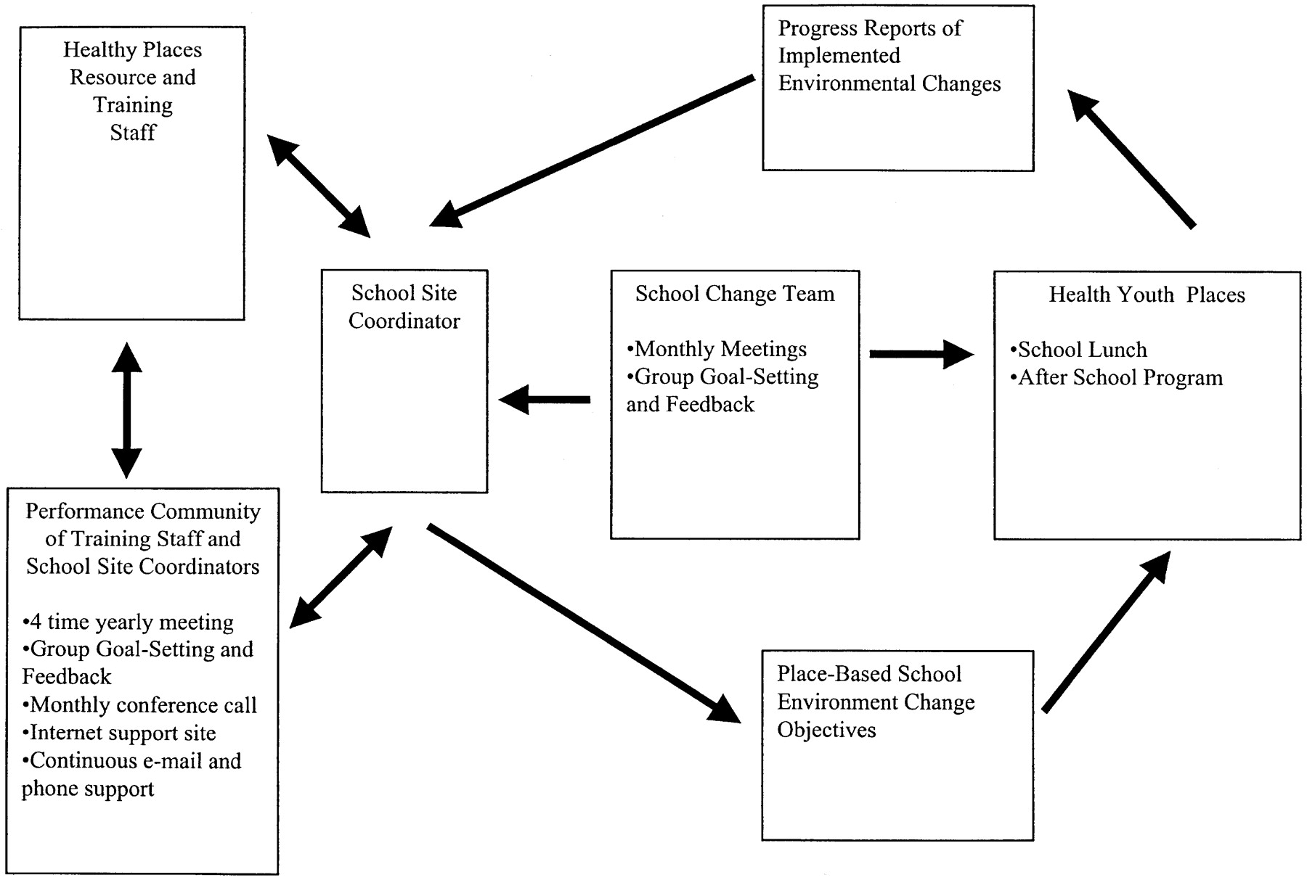
Fig. 1. Place-based diffusion system.
Notes:
Fig. 1. Place-based diffusion system.
Unless provided in the caption above, the following copyright applies to the content of this slide: © Oxford University Press

Slide 2
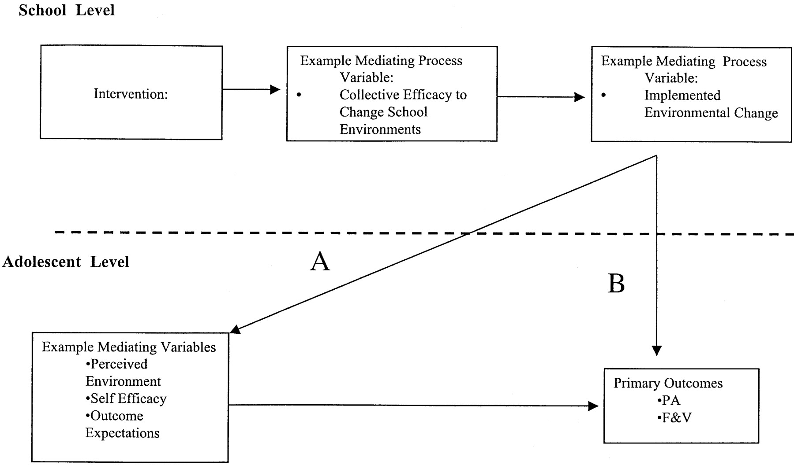
Fig. 2. Multilevel mediation research model.
Notes:
Fig. 2. Multilevel mediation research model.
Unless provided in the caption above, the following copyright applies to the content of this slide: © Oxford University Press

