Slide 1
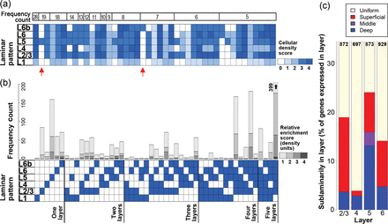
Figure 1. Global molecular patterning across layers of S1. Laminar (a,b) and sublaminar (c) distribution of the 1053 ...
Notes:
Figure 1. Global molecular patterning across layers of S1. Laminar (a,b) and sublaminar (c) distribution of the 1053 most heterogeneous, predominantly neuronal genes, based on scored densities of labeled neurons in each layer of S1. (a) Forty-three most commonly observed patterns. Red arrows indicate layer-specific expression in layer 5 and 6b. (b) Frequency of laminar enrichment in each layer and combination of layers, as a function of the degree of enrichment (difference in density score between layer(s) of interest compared with all other layers). (c) Frequency of sublaminar enrichment among scored genes for layers 2/3, 4, 5, and 6, broken down into superficial, middle, and deep partitions.
Unless provided in the caption above, the following copyright applies to the content of this slide: © The Author 2013. Published by Oxford University Press. All rights reserved. For Permissions, please e-mail: journals.permissions@oup.com

Slide 2
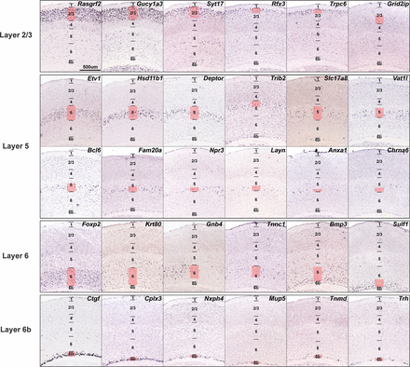
Figure 2. Spectrum of laminar gene expression patterns in projection neuron layers of S1. Colorimetric ISH images from ...
Notes:
Figure 2. Spectrum of laminar gene expression patterns in projection neuron layers of S1. Colorimetric ISH images from the Allen Mouse Brain Atlas demonstrating the diversity of expression patterns observed in layers 2/3, 5, 6, and 6b. Black lines mark layer boundaries, with pink coloring delineating the portion of the layer of interest with densest labeling to highlight sublaminar enrichments. Genes in each layer demonstrate a wide range of cell densities and sublaminar distributions. Scale bar: 500 μm.
Unless provided in the caption above, the following copyright applies to the content of this slide: © The Author 2013. Published by Oxford University Press. All rights reserved. For Permissions, please e-mail: journals.permissions@oup.com

Slide 3
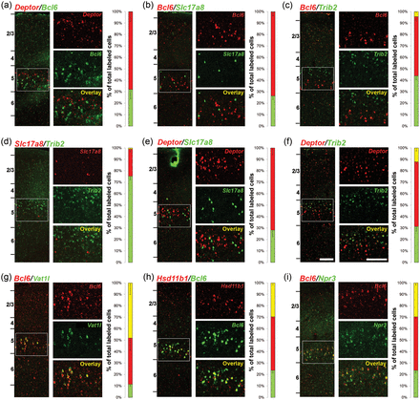
Figure 3. Colabeling identifies layer 5 enriched genes with overlapping and mutually exclusive expression. (a–i) ...
Notes:
Figure 3. Colabeling identifies layer 5 enriched genes with overlapping and mutually exclusive expression. (a–i) Fluorescent ISH data for the gene pair indicated in a coronal section through S1, with raw dFISH data in the left panels and quantification of single and double labeling on the right. The left-most dFISH panel is a low-magnification image with layers indicated, and the right panels show high-magnification single and double labeling within layer 5 corresponding to the boxed region. Histograms shows quantitative data for single (red, green) and double (yellow) labeled cells as mean percentages of total labeled cells (±SEM). Panels (a–f) show minimal to no overlap between Deptor, Bcl6, Trib2, and Slc17a8. Panels (g–i) show partially overlapping expression between Bcl6 and Vat1l, Hsd11b1, and Npr3, respectively. Scale bars: 125 μm (low magnification), 125 μm (high magnification).
Unless provided in the caption above, the following copyright applies to the content of this slide: © The Author 2013. Published by Oxford University Press. All rights reserved. For Permissions, please e-mail: journals.permissions@oup.com

Slide 4
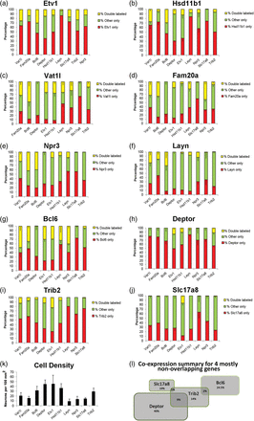
Figure 4. Quantification of systematic dFISH analysis among 10 layer 5-selective genes. Each graph shows the ...
Notes:
Figure 4. Quantification of systematic dFISH analysis among 10 layer 5-selective genes. Each graph shows the relationship between a “parent” gene (red) and the remaining 9 layer 5-selective genes (green) as the percentage of the total number of cells (±SEM) that were single- or double-labeled (yellow) by dFISH. Gene comparisons are shown from top to bottom roughly ordered from the least to the most selective. Etv1 was least selective (a), and exhibited some coexpression with all other genes assayed, while Hsd11b1 9 (b) and Vat1l (c) partially overlapped with all genes except Slc17a8. Bcl6, Deptor, Trib2, and Slc17a8 were much more selective in their expression, and displayed mutually exclusive or largely nonoverlapping (Trib2) expression as illustrated in Venn diagram form (l), based on the labeled cell densities in layer 5 (mean number of neurons per 100 µm2 ± SEM). The mean density of labeled cells for each gene in layer 5 is shown in (k).
Unless provided in the caption above, the following copyright applies to the content of this slide: © The Author 2013. Published by Oxford University Press. All rights reserved. For Permissions, please e-mail: journals.permissions@oup.com

Slide 5
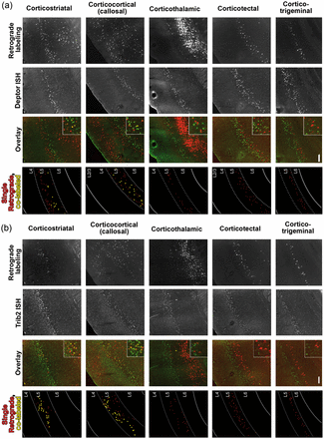
Figure 5. Combined layer 5 marker ISH with fluorescent retrograde labeling demonstrates correlations between gene ...
Notes:
Figure 5. Combined layer 5 marker ISH with fluorescent retrograde labeling demonstrates correlations between gene expression and target specificity. S1 FISH labeling for Deptor (a), Trib2 (b), Bcl6 (c), and Slc17a8 (d), combined with CTB retrograde labeling from the striatum (corticostriatal; Row (1), contralateral S1 (callosal; Row (2), thalamus (corticothalamic; Row (3), superior colliculus (corticotectal; Row (4), and trigeminal nucleus (corticotrigeminal; Row (5). From the left within each panel, images show retrogradely labeled cells, cells labeled by ISH, the fluorescent overlay with high-magnification inset in layer 5, and a schematic of single retrogradely labeled cells (red) and colabeled cells (yellow). In the schematic view, layer 5 is delineated by dotted lines, and cells labeled by ISH but not CTB are not displayed. Deptor was expressed by a substantial portion of corticostriatal and callosal neurons, and rarely or not at all by deep brain-projecting neurons (corticothalamics, corticotectals, and corticotrigeminals). Trib2 also labeled a high proportion of corticostriatal and callosal neurons, but few of the deep brain-projecting neurons. In contrast, Bcl6 only rarely labeled these intracerebral populations, but labeled the majority of deep brain-projecting neurons. Slc17a8 did not label any of these populations except a small proportion of corticostriatal neurons. Scale bar: 100 μm.
Unless provided in the caption above, the following copyright applies to the content of this slide: © The Author 2013. Published by Oxford University Press. All rights reserved. For Permissions, please e-mail: journals.permissions@oup.com

Slide 6
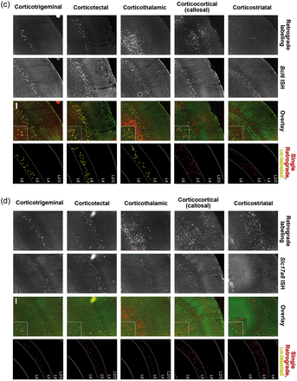
Figure 5. Combined layer 5 marker ISH with fluorescent retrograde labeling demonstrates correlations between gene ...
Notes:
Figure 5. Combined layer 5 marker ISH with fluorescent retrograde labeling demonstrates correlations between gene expression and target specificity. S1 FISH labeling for Deptor (a), Trib2 (b), Bcl6 (c), and Slc17a8 (d), combined with CTB retrograde labeling from the striatum (corticostriatal; Row (1), contralateral S1 (callosal; Row (2), thalamus (corticothalamic; Row (3), superior colliculus (corticotectal; Row (4), and trigeminal nucleus (corticotrigeminal; Row (5). From the left within each panel, images show retrogradely labeled cells, cells labeled by ISH, the fluorescent overlay with high-magnification inset in layer 5, and a schematic of single retrogradely labeled cells (red) and colabeled cells (yellow). In the schematic view, layer 5 is delineated by dotted lines, and cells labeled by ISH but not CTB are not displayed. Deptor was expressed by a substantial portion of corticostriatal and callosal neurons, and rarely or not at all by deep brain-projecting neurons (corticothalamics, corticotectals, and corticotrigeminals). Trib2 also labeled a high proportion of corticostriatal and callosal neurons, but few of the deep brain-projecting neurons. In contrast, Bcl6 only rarely labeled these intracerebral populations, but labeled the majority of deep brain-projecting neurons. Slc17a8 did not label any of these populations except a small proportion of corticostriatal neurons. Scale bar: 100 μm.
Unless provided in the caption above, the following copyright applies to the content of this slide: © The Author 2013. Published by Oxford University Press. All rights reserved. For Permissions, please e-mail: journals.permissions@oup.com

Slide 7
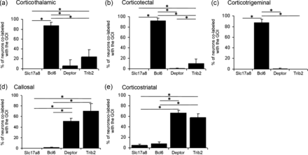
Figure 6. Mutually exclusive layer 5 genes distinguish broad classes of projection neurons. Graphs display the mean % ...
Notes:
Figure 6. Mutually exclusive layer 5 genes distinguish broad classes of projection neurons. Graphs display the mean % of CTB-labeled cells in S1 projecting to the thalamus (a), superior colliculus (b), spinal trigeminal nucleus (c), contralateral S1 (d), or ipsilateral striatum (e) that also express Slc17a8, Bcl6, Deptor, and Trib2. (a) The great majority (∼85%) of corticothalamic neurons expressed Bcl6, with a smaller percentage that expressed Trib2 (∼20%) and Deptor (∼5%) and no cells that expressed Slc17a8. The majority of corticotectal neurons (b) and corticotrigeminal neurons (c) also expressed Bcl6 (∼90%) and rarely any of the other genes. Callosal (d) and corticostriatal (e) neurons exhibited the opposite expression pattern. Few of these cells expressed Bcl6, while ∼50% and ∼60% of callosal and corticostriatal neurons, respectively, expressed Deptor and Trib2. Approximately 5% of corticostriatal neurons expressed Slc17a8. *P < 0.01.
Unless provided in the caption above, the following copyright applies to the content of this slide: © The Author 2013. Published by Oxford University Press. All rights reserved. For Permissions, please e-mail: journals.permissions@oup.com

Slide 8
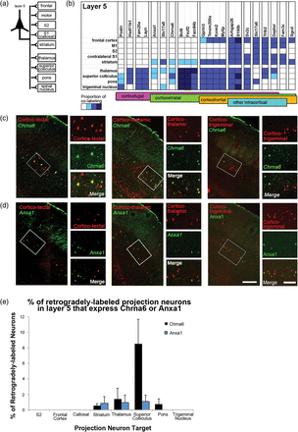
Figure 7. Target specificity of molecularly defined projection neuron classes in layer 5 of S1. (a) Schematic of ...
Notes:
Figure 7. Target specificity of molecularly defined projection neuron classes in layer 5 of S1. (a) Schematic of different cortical and subcortical targets of layer 5 projection neurons tested. (b) Summary of projection targets for layer 5 neurons expressing specific marker genes, based on CTB retrograde labeling with FISH for that gene. The approximate proportion of neurons projecting to each target labeled by each gene is indicated by color, including no labeling (white), sparse (light blue), low to medium (blue), and high (dark blue). Generally, individual genes labeled neurons projecting to specific combinations of possible projection targets. A subset of genes selectively labeled corticofugal neurons, while the majority of genes labeled some striatally projecting neurons. Several genes selectively labeled neurons projecting to frontal cortex among the possible cortical targets. (c,d) Target specificity for neurons expressing Chrna6 (c) and Anxa1 (d). For each gene, double labeling with FISH (green) and CTB retrograde labeling (red) from superior colliculus (corticotectal, left), thalamus (corticothalamic, middle), and spinal trigeminal nucleus (corticotrigeminal, right) is shown. Within each panel, left image is a low-magnification image spanning the thickness of S1, while the right panels show high-magnification single and double labeling corresponding to the boxed regions in layer 5. (e) Quantification of the percentage of retrogradely labeled neurons from each target expressing Chrna6 and Anxa1, demonstrating that a small subset of projection neurons express each gene, specificity for specific subcortical targets, and selectivity for superior colliculus projecting neurons for Chrna6. Animal numbers for Chrna6 analysis, S2/Frontal: N = 3, Callosal/Striatum/Pons: N = 4, Thalamus/Trigeminal: N = 5, Superior Colliculus: N = 9; animal numbers for Anxa1 analysis, S2/Frontal/Callosal: N = 1, Striatum/Pons/Trigeminal: N = 3, Thalamus: N = 4. Scale bars in (c,d): low magnification: 250 μm, high magnification: 75 μm.
Unless provided in the caption above, the following copyright applies to the content of this slide: © The Author 2013. Published by Oxford University Press. All rights reserved. For Permissions, please e-mail: journals.permissions@oup.com

Slide 9
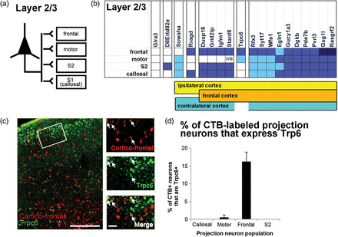
Figure 8. Target specificity of molecularly defined projection neuron classes in layer 2/3 of S1. (a) Schematic of ...
Notes:
Figure 8. Target specificity of molecularly defined projection neuron classes in layer 2/3 of S1. (a) Schematic of different cortical targets of layer 2/3 projection neurons tested. (b) Summary of projection targets for layer 2/3 neurons expressing specific marker genes, based on CTB retrograde labeling with FISH for that gene. The approximate proportion of neurons projecting to each target labeled by each gene is indicated by color, including no labeling (white), sparse (light blue), low to medium (blue), and high (dark blue). Many genes labeled at least some neurons projecting to all cortical targets, while others selectively labeled neurons projecting to specific cortical regions or subsets of regions. For example, D8Ertd82e selectively labeled neurons projecting to ipsilateral S2, while Trpc6 predominantly labeled frontal cortex-projecting neurons and a small percentage of motor cortex-projecting neurons. Glra3 did not label neurons projecting to any of these target regions. (c,d) Target specificity for neurons expressing Trpc6. Double labeling with FISH (green) and CTB retrograde labeling (red) from frontal cortex. Left image is a low-magnification image spanning the thickness of S1, while the right panels show high-magnification single and double labeling corresponding to the boxed regions in layer 2/3. Arrows denote double-labeled cells. (e) Quantification of the percentage of retrogradely labeled neurons from each target expressing Trpc6, demonstrating specificity for frontal cortex (N = 3 for all cortical populations analyzed). Scale bars: low magnification: 250 μm, high magnification: 50 μm.
Unless provided in the caption above, the following copyright applies to the content of this slide: © The Author 2013. Published by Oxford University Press. All rights reserved. For Permissions, please e-mail: journals.permissions@oup.com

Slide 10
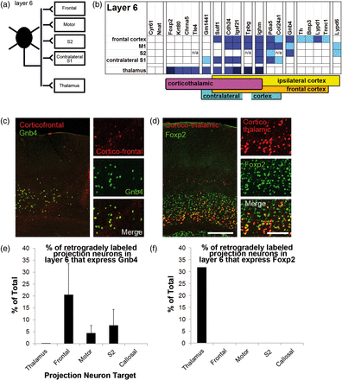
Figure 9. Target specificity of molecularly defined projection neuron classes in layer 6 of S1. (a) Schematic of ...
Notes:
Figure 9. Target specificity of molecularly defined projection neuron classes in layer 6 of S1. (a) Schematic of different cortical and subcortical targets of layer 6 projection neurons tested. (b) Summary of projection targets for layer 6 neurons expressing specific marker genes, based on CTB retrograde labeling with FISH for that gene. The approximate proportion of neurons projecting to each target labeled by each gene is indicated by color, including no labeling (white), sparse (light blue), low to medium (blue), and high (dark blue). Generally, individual genes labeled neurons projecting to specific combinations of possible projection targets. A subset of genes selectively labeled thalamocortical neurons, while others selectively labeled corticocortical neurons. Several genes selectively labeled neurons projecting to frontal cortex among the possible cortical targets. (c–f) Target specificity for neurons expressing Gnb4 and Foxp2. Double labeling with FISH (green) and CTB retrograde labeling (red) from frontal cortex is shown for Gnb4 (c) and from thalamus for Foxp2 (d). Within each panel, the left image is a low-magnification image spanning the thickness of S1, while the right panels show high-magnification single and double labeling corresponding to the boxed regions in layer 6. (e,f) Quantification of the percentage of retrogradely labeled neurons from each target expressing Gnb4 and Foxp2 (mean ± SEM). Gnb4 selectively labels neurons projecting to ipsilateral cortical areas, while Foxp2 selectively labels corticothalamic neurons. For Gnb4 analysis, all cortical targets: N = 3, Thalamus: N = 1. For Foxp2 analysis, Frontal: N = 3, M1/callosal: N = 2, S2/Thalamus: N = 1. Scale bars in (c,d): low magnification: 250 μm, high magnification: 125 μm.
Unless provided in the caption above, the following copyright applies to the content of this slide: © The Author 2013. Published by Oxford University Press. All rights reserved. For Permissions, please e-mail: journals.permissions@oup.com

