Slide 1
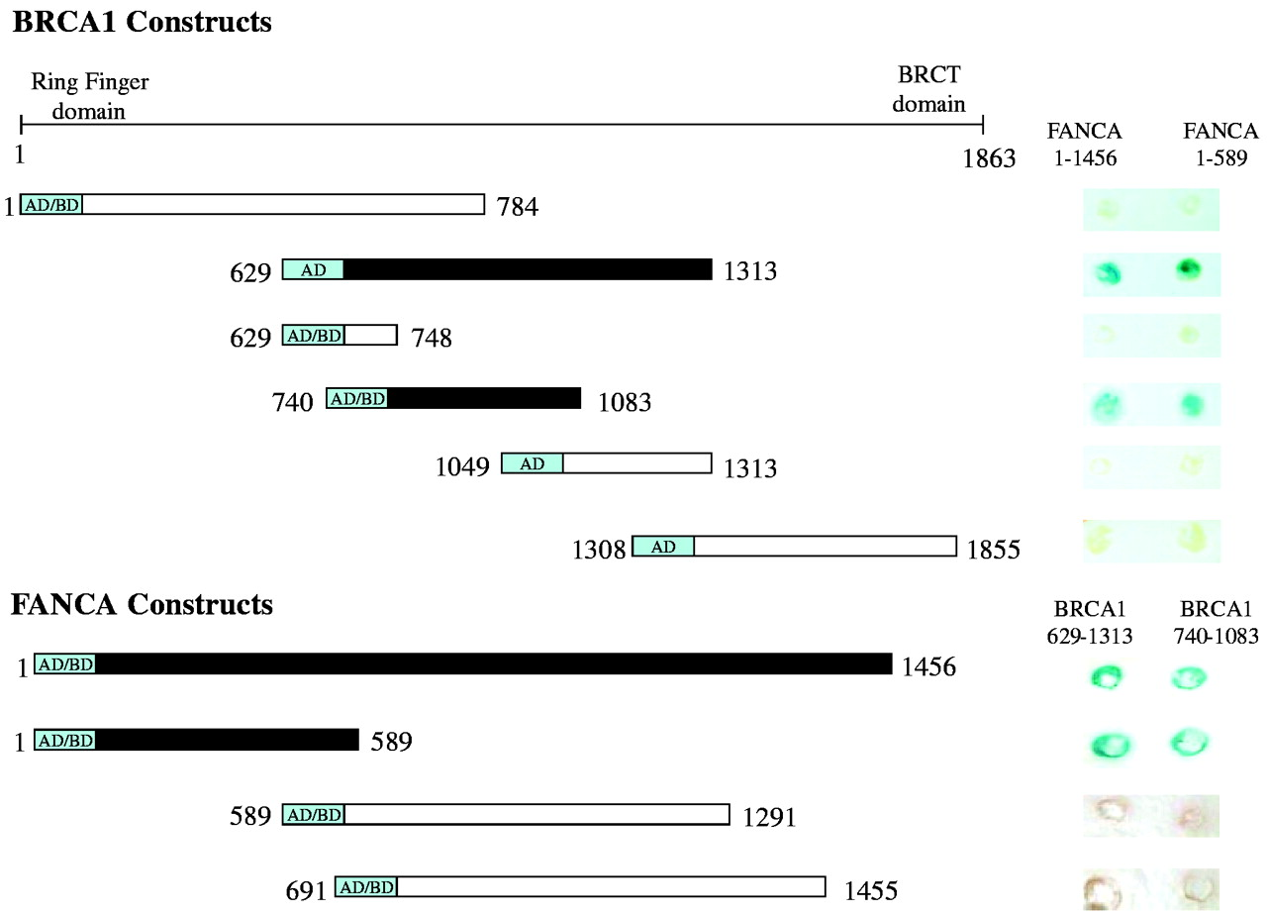
Figure 1. Two-hybrid analysis of BRCA1 and FANCA. Domains of BRCA1 (17) are indicated. Constructs producing ...
Notes:
Figure 1. Two-hybrid analysis of BRCA1 and FANCA. Domains of BRCA1 (17) are indicated. Constructs producing interaction are filled; those not producing interaction are open. Numbers refer to amino acid position of the proteins. Fusions to the activation domain or binding domain are indicated by AD or BD, respectively. Colony staining for β-galactosidase activity is shown on the right.
Unless provided in the caption above, the following copyright applies to the content of this slide:

Slide 2
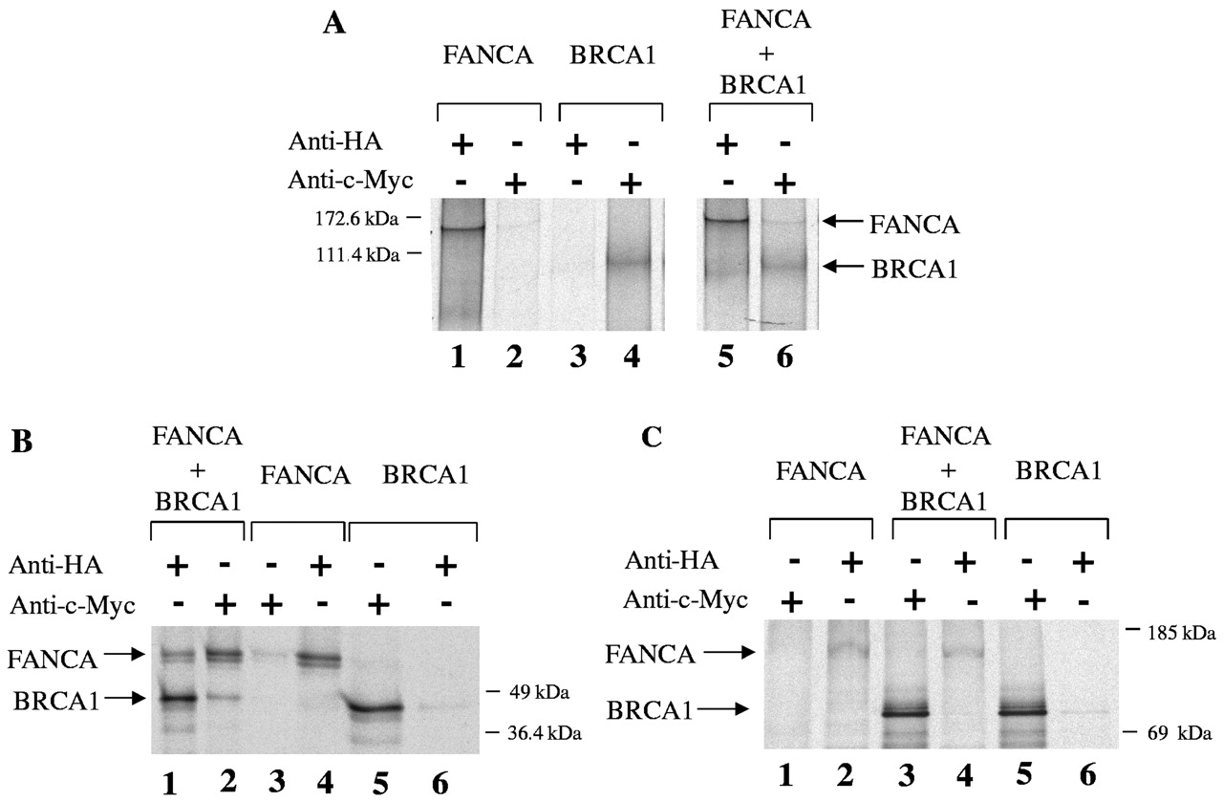
Figure 2.In vitro coimmunoprecipitation of ³⁵S-labeled proteins. Samples were precipitated with ...
Notes:
Figure 2.In vitro coimmunoprecipitation of 35S-labeled proteins. Samples were precipitated with either HA or c-Myc antibody as indicated. (A) HA-fused full length FANCA and c-Myc-fused BRCA1 (aa 629–1313). (B) HA-fused FANCA (aa 1–589) and c-Myc-fused BRCA1 (aa 740–1083). (C) HA-fused FANCA (aa 1–589) and c-Myc-fused BRCA1 (aa 1308–1855).
Unless provided in the caption above, the following copyright applies to the content of this slide:

Slide 3
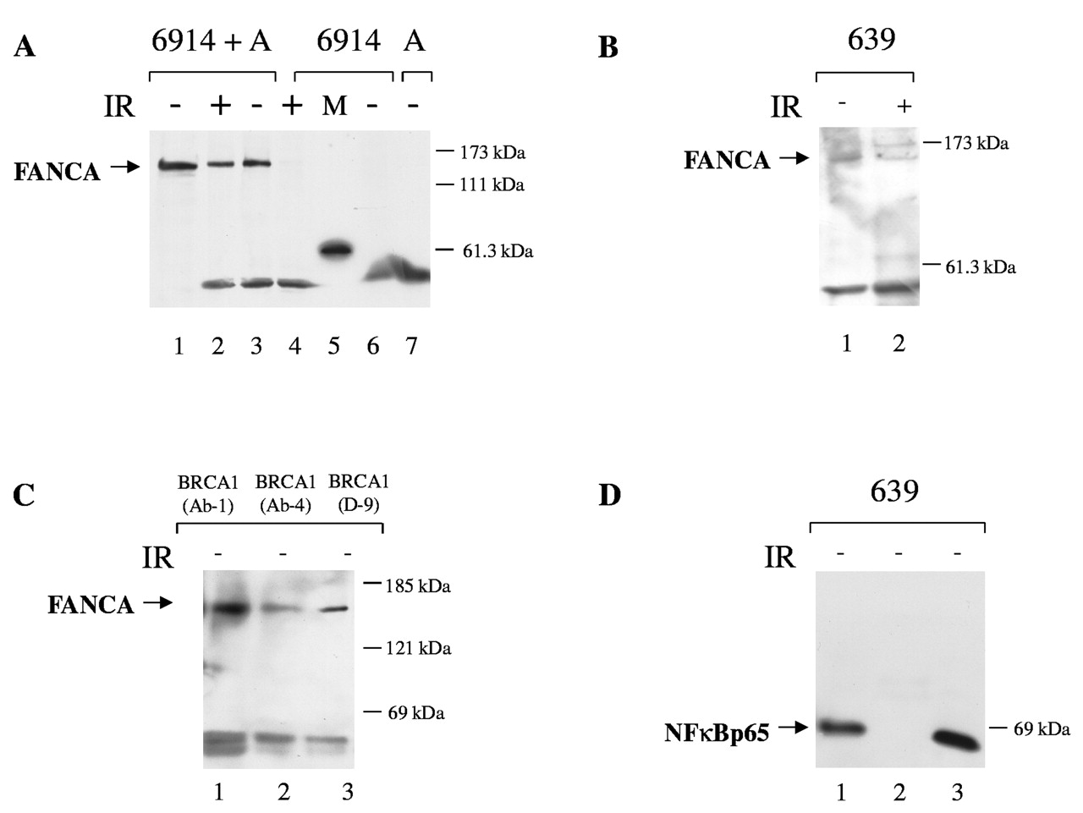
Figure 3. Coimmunoprecipitation of BRCA1 and FANCA from human fibroblasts. (A) Coimmunoprecipitation of FANCA ...
Notes:
Figure 3. Coimmunoprecipitation of BRCA1 and FANCA from human fibroblasts. (A) Coimmunoprecipitation of FANCA with BRCA1 from corrected and uncorrected FANCA mutant cell line GM6914. Cells were treated with 15 Gy γ-radiation as shown and harvested after 16 hours, immunoprecipitated with anti-BRCA1 and western analysis performed. Blots were probed with anti-FANCA. Lane 1—whole cell extract, nonirradiated, corrected; lane 2—immunoprecipitate, irradiated, corrected; lane 3—immunoprecipitate, nonirradiated, corrected; lane 4—immunoprecipitate, irradiated, non-corrected; lane 5—marker; lane 6—immunoprecipitate, nonirradiated, non-corrected; lane 7—immunoprecipitate, corrected, using beads without anti-BRCA1. (B) Coimmunoprecipitation of FANCA with BRCA1 from cell line GM639. Lanes 1 and 2 are without and with 15 Gy g irradiation respectively. (C) Coimmunoprecipitation of FANCA with three independent monoclonal antibodies against BRCA1 from the FANCA negative cell line GM6914, corrected with a FANCA retrovirus. Lane 1—Ab-1; lane 2—Ab-4 (Oncogene); lane 3—D-9 (Santa Cruz). (D) Anti-NFκBp65 probe of BRCA1 immunoprecipitation from GM639. Lane 1—whole cell extract; lane 2—immunoprecipitate; lane 3—supernatant from immunopreciptitation.
Unless provided in the caption above, the following copyright applies to the content of this slide:

Slide 4
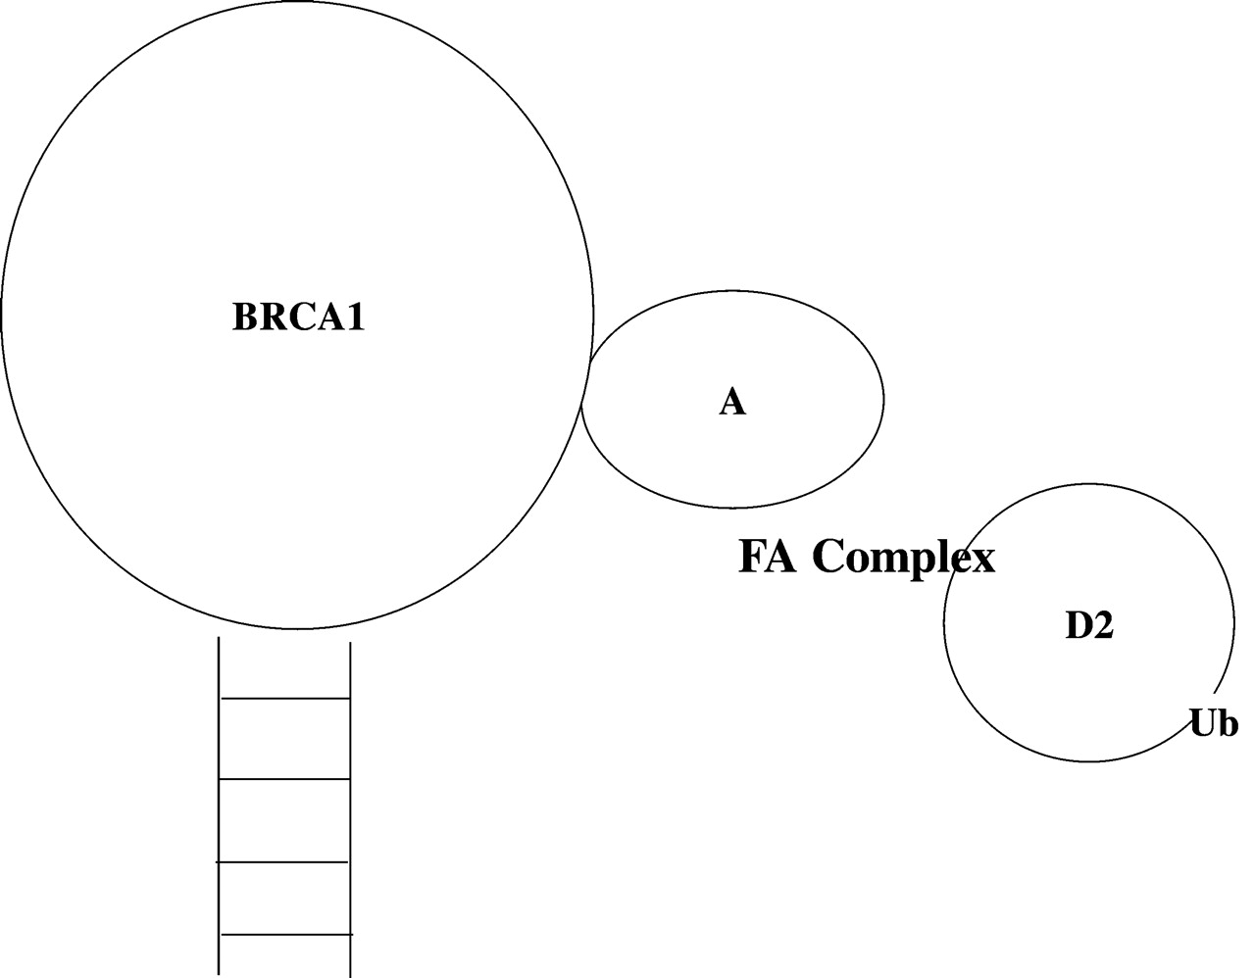
Figure 4. Model of FANCA action with BRCA1.
Notes:
Figure 4. Model of FANCA action with BRCA1.
Unless provided in the caption above, the following copyright applies to the content of this slide:

