Slide 1
Fig. 1. Example image including comparison between human operators. Neutrophils were induced to form NETs followed by ...
Notes:
Fig. 1. Example image including comparison between human operators. Neutrophils were induced to form NETs followed by exposure to degrading agents derived from bacterial cultures. NETs were visualized using an Alexa 488-labelled antibody against H2A-H2B-DNA complexes in combination with DAPI to stain the nuclei; white lines depict human operator segmentation. The first operator marked 8.7% of the area as NETs, the second operator 5.8%. Scalebar corresponds to 50 μm. Images have been contrast stretched for publication, original data is available for download
Unless provided in the caption above, the following copyright applies to the content of this slide: © The Author 2015. Published by Oxford University Press. All rights reserved. For Permissions, please e-mail: journals.permissions@oup.com

Slide 2
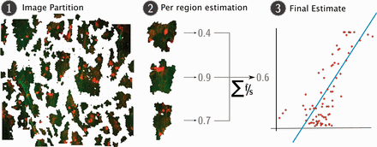
Fig. 2. Framework overview. (1) Input images are (explicitly or implicitly) partitioned into images (depicted is the ...
Notes:
Fig. 2. Framework overview. (1) Input images are (explicitly or implicitly) partitioned into images (depicted is the result of applying the technique described in Section 3.1.1). (2) A supervised approach estimates a local fraction for each region, which is summarized to a first global estimates by a weighted average. (3) This estimate is finally corrected for biases with a linear regression
Unless provided in the caption above, the following copyright applies to the content of this slide: © The Author 2015. Published by Oxford University Press. All rights reserved. For Permissions, please e-mail: journals.permissions@oup.com

Slide 3
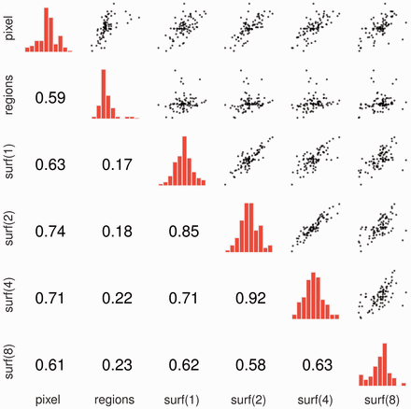
Fig. 3. Error correlations. For each cell above the diagonal, we depict a scatter plot of errors: each dot represents ...
Notes:
Fig. 3. Error correlations. For each cell above the diagonal, we depict a scatter plot of errors: each dot represents an image and we show the difference to the reference. If predictions exactly matched the references, all points would collapse to a single point in the centre The diagonal shows histograms depicting the density. Below the diagonal, the Pearson correlation is displayed. The method identified as regions is described in Section 3.1.1, the one as pixel in Section 3.1.2 and the SURF approach in Section 3.1.3
Unless provided in the caption above, the following copyright applies to the content of this slide: © The Author 2015. Published by Oxford University Press. All rights reserved. For Permissions, please e-mail: journals.permissions@oup.com

Slide 4
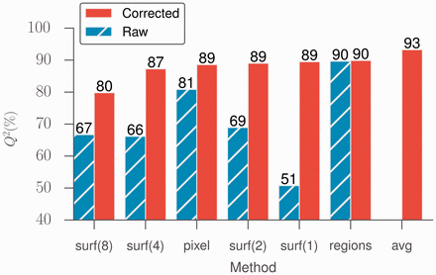
Fig. 4. Results for all of the methods. Methods are ordered by the quality of their corrected predictions
Notes:
Fig. 4. Results for all of the methods. Methods are ordered by the quality of their corrected predictions
Unless provided in the caption above, the following copyright applies to the content of this slide: © The Author 2015. Published by Oxford University Press. All rights reserved. For Permissions, please e-mail: journals.permissions@oup.com

Slide 5
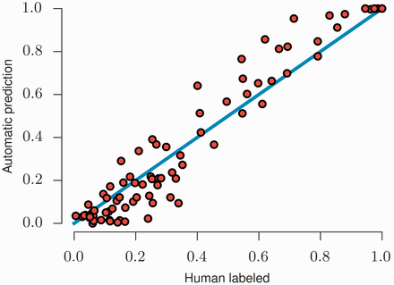
Fig. 5. Final combined prediction. Each dot represents an image, plotting the underlying gold standard on the ...
Notes:
Fig. 5. Final combined prediction. Each dot represents an image, plotting the underlying gold standard on the horizontal axis and the cross-validated prediction on the vertical axis. Prediction were obtained by cross-validation, i.e. the NET fraction of each image is estimated from a model which was trained on data not including that particular image nor any image from the same slide
Unless provided in the caption above, the following copyright applies to the content of this slide: © The Author 2015. Published by Oxford University Press. All rights reserved. For Permissions, please e-mail: journals.permissions@oup.com

Slide 6
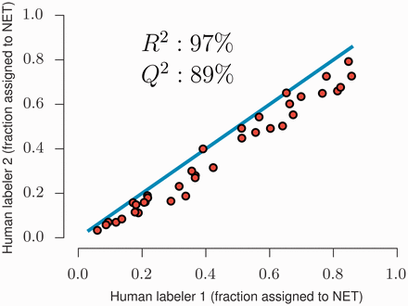
Fig. 6. Comparison between different human operators. Each circle represents a labeled image, the solid line shows ...
Notes:
Fig. 6. Comparison between different human operators. Each circle represents a labeled image, the solid line shows the diagonal (hypothetical perfect agreement)
Unless provided in the caption above, the following copyright applies to the content of this slide: © The Author 2015. Published by Oxford University Press. All rights reserved. For Permissions, please e-mail: journals.permissions@oup.com

