Slide 1
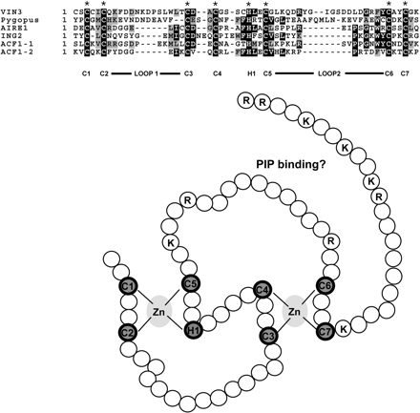
Fig. 1 Alignment comparison of the PHD finger of VIN3 with other PHD fingers (top). ‘Cross-brace’ model of the PHD ...
Notes:
Fig. 1 Alignment comparison of the PHD finger of VIN3 with other PHD fingers (top). ‘Cross-brace’ model of the PHD finger of VIN3 (lower). This representation of the VIN3 PHD finger is adapted from the cross-brace model of the PHD finger of Pygous (Bienz, 2006). Positively charged amino acids potentially used for phospholipids binding are indicated as R or K.
Unless provided in the caption above, the following copyright applies to the content of this slide: © The Author [2006]. Published by Oxford University Press [on behalf of the Society for Experimental Biology]. All rights reserved. For Permissions, please e-mail: journals.permissions@oxfordjournals.org

Slide 2
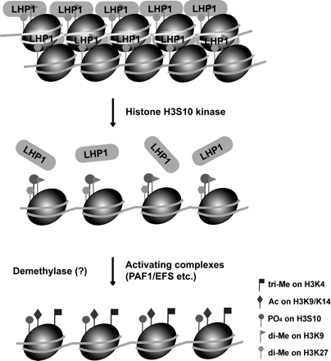
Fig. 2 Hypothetical mechanism for resetting FLC chromatin during meiosis. Vernalization causes LHP1 to associated ...
Notes:
Fig. 2 Hypothetical mechanism for resetting FLC chromatin during meiosis. Vernalization causes LHP1 to associated with FLC chromatin and to ‘lock-in’ stable FLC repression as discussed in the text (top). Increasing phosphorylation at H3S10 could prevent LHP1 from binding (middle). Activating components gain access to FLC chromatin to reactivate FLC expression in the next generation (lower).
Unless provided in the caption above, the following copyright applies to the content of this slide: © The Author [2006]. Published by Oxford University Press [on behalf of the Society for Experimental Biology]. All rights reserved. For Permissions, please e-mail: journals.permissions@oxfordjournals.org

