Slide 1
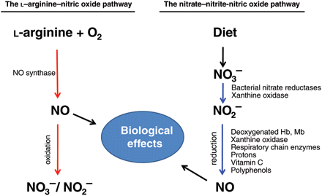
Figure 1 Two parallel pathways for NO formation in mammals. NO synthases (NOS) catalyse the formation of NO from the ...
Notes:
Figure 1 Two parallel pathways for NO formation in mammals. NO synthases (NOS) catalyse the formation of NO from the substrates l-arginine and molecular oxygen. NO is rapidly oxidized to form nitrite and nitrate , but a recycling of these anions may occur by which NO is formed again. Nitrate reduction to nitrite is mainly carried out by commensal bacteria in the oral cavity and to a lesser extent also by mammalian enzymes in tissues (xanthine oxidase). Once nitrite is formed, several pathways exist with the capacity to further metabolize nitrite to NO and other biologically active nitrogen oxides. Most of these pathways are greatly accelerated under hypoxic conditions. Thus, nitrite reduction represents an alternative to the classical NOS pathway for the generation of NO. Our diet (mainly green leafy vegetables) is a major contributor to the body pool of nitrate and ingestion of nitrate may fuel the nitrate–nitrite–NO pathway. Dietary nitrate supplementation is associated with robust NO-like effects including a reduction in blood pressure and inhibition of oxygen consumption in humans. In addition, nitrate or nitrite administration is protective in numerous animal models of cardiovascular disease.
Unless provided in the caption above, the following copyright applies to the content of this slide: Published on behalf of the European Society of Cardiology. All rights reserved. © The Author 2010. For permissions please email: journals.permissions@oxfordjournals.org.

