Slide 1
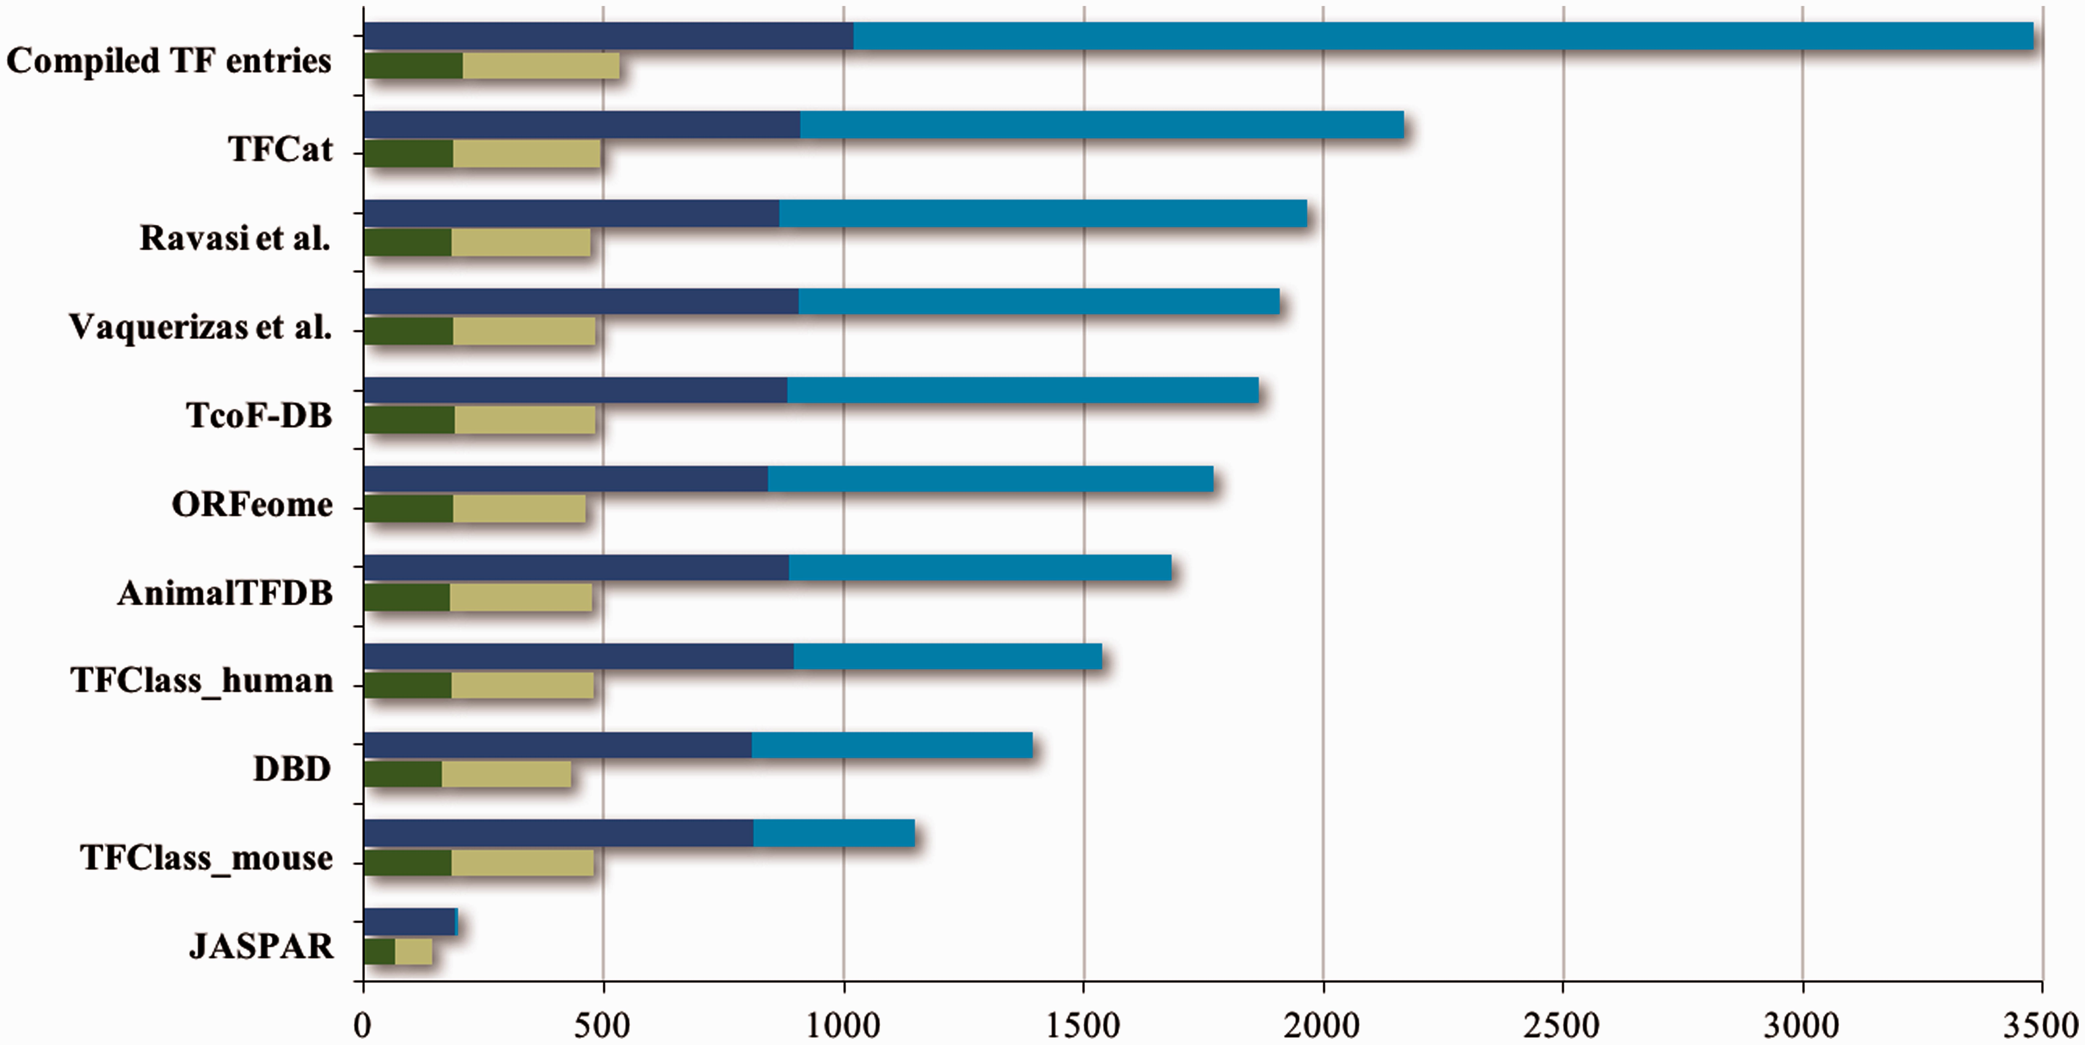
Figure 1. Contents of TF resources. For each TF database resource two bars are shown: the total number of unique ...
Notes:
Figure 1. Contents of TF resources. For each TF database resource two bars are shown: the total number of unique entries is indicated by blue bars, the dark blue part of which indicates specific DNA binding transcription factors (DbTFs) for which we have found literature evidence ( 3 ). The green bars below each blue bar represent the numbers of DbTFs present within that resource that are corroborated in the GO database by annotation with experimental evidence to the GO term GO:0000981, or child terms thereof. Dark green: DbTFs documented in the GO database at the start of our project March 2013 (205); Light green: new entries after March 2013 (328). Numbers in parentheses give the cumulative total in TFcheckpoint and refer to human, mouse or rat DbTFs, with orthologues counted only once. Of the 328 new experimentally documented DbTF annotations (light green), 301 were uniquely provided by our current project. The GO database version referenced here, which includes our new annotations, is dated 06 December 2014. Data versions for the other sources are given at www.tfcheckpoint.org .
Unless provided in the caption above, the following copyright applies to the content of this slide: © The Author(s) 2016. Published by Oxford University Press. This is an Open Access article distributed under the terms of the Creative Commons Attribution License ( http://creativecommons.org/licenses/by/4.0/ ), which permits unrestricted reuse, distribution, and reproduction in any medium, provided the original work is properly cited.

Slide 2
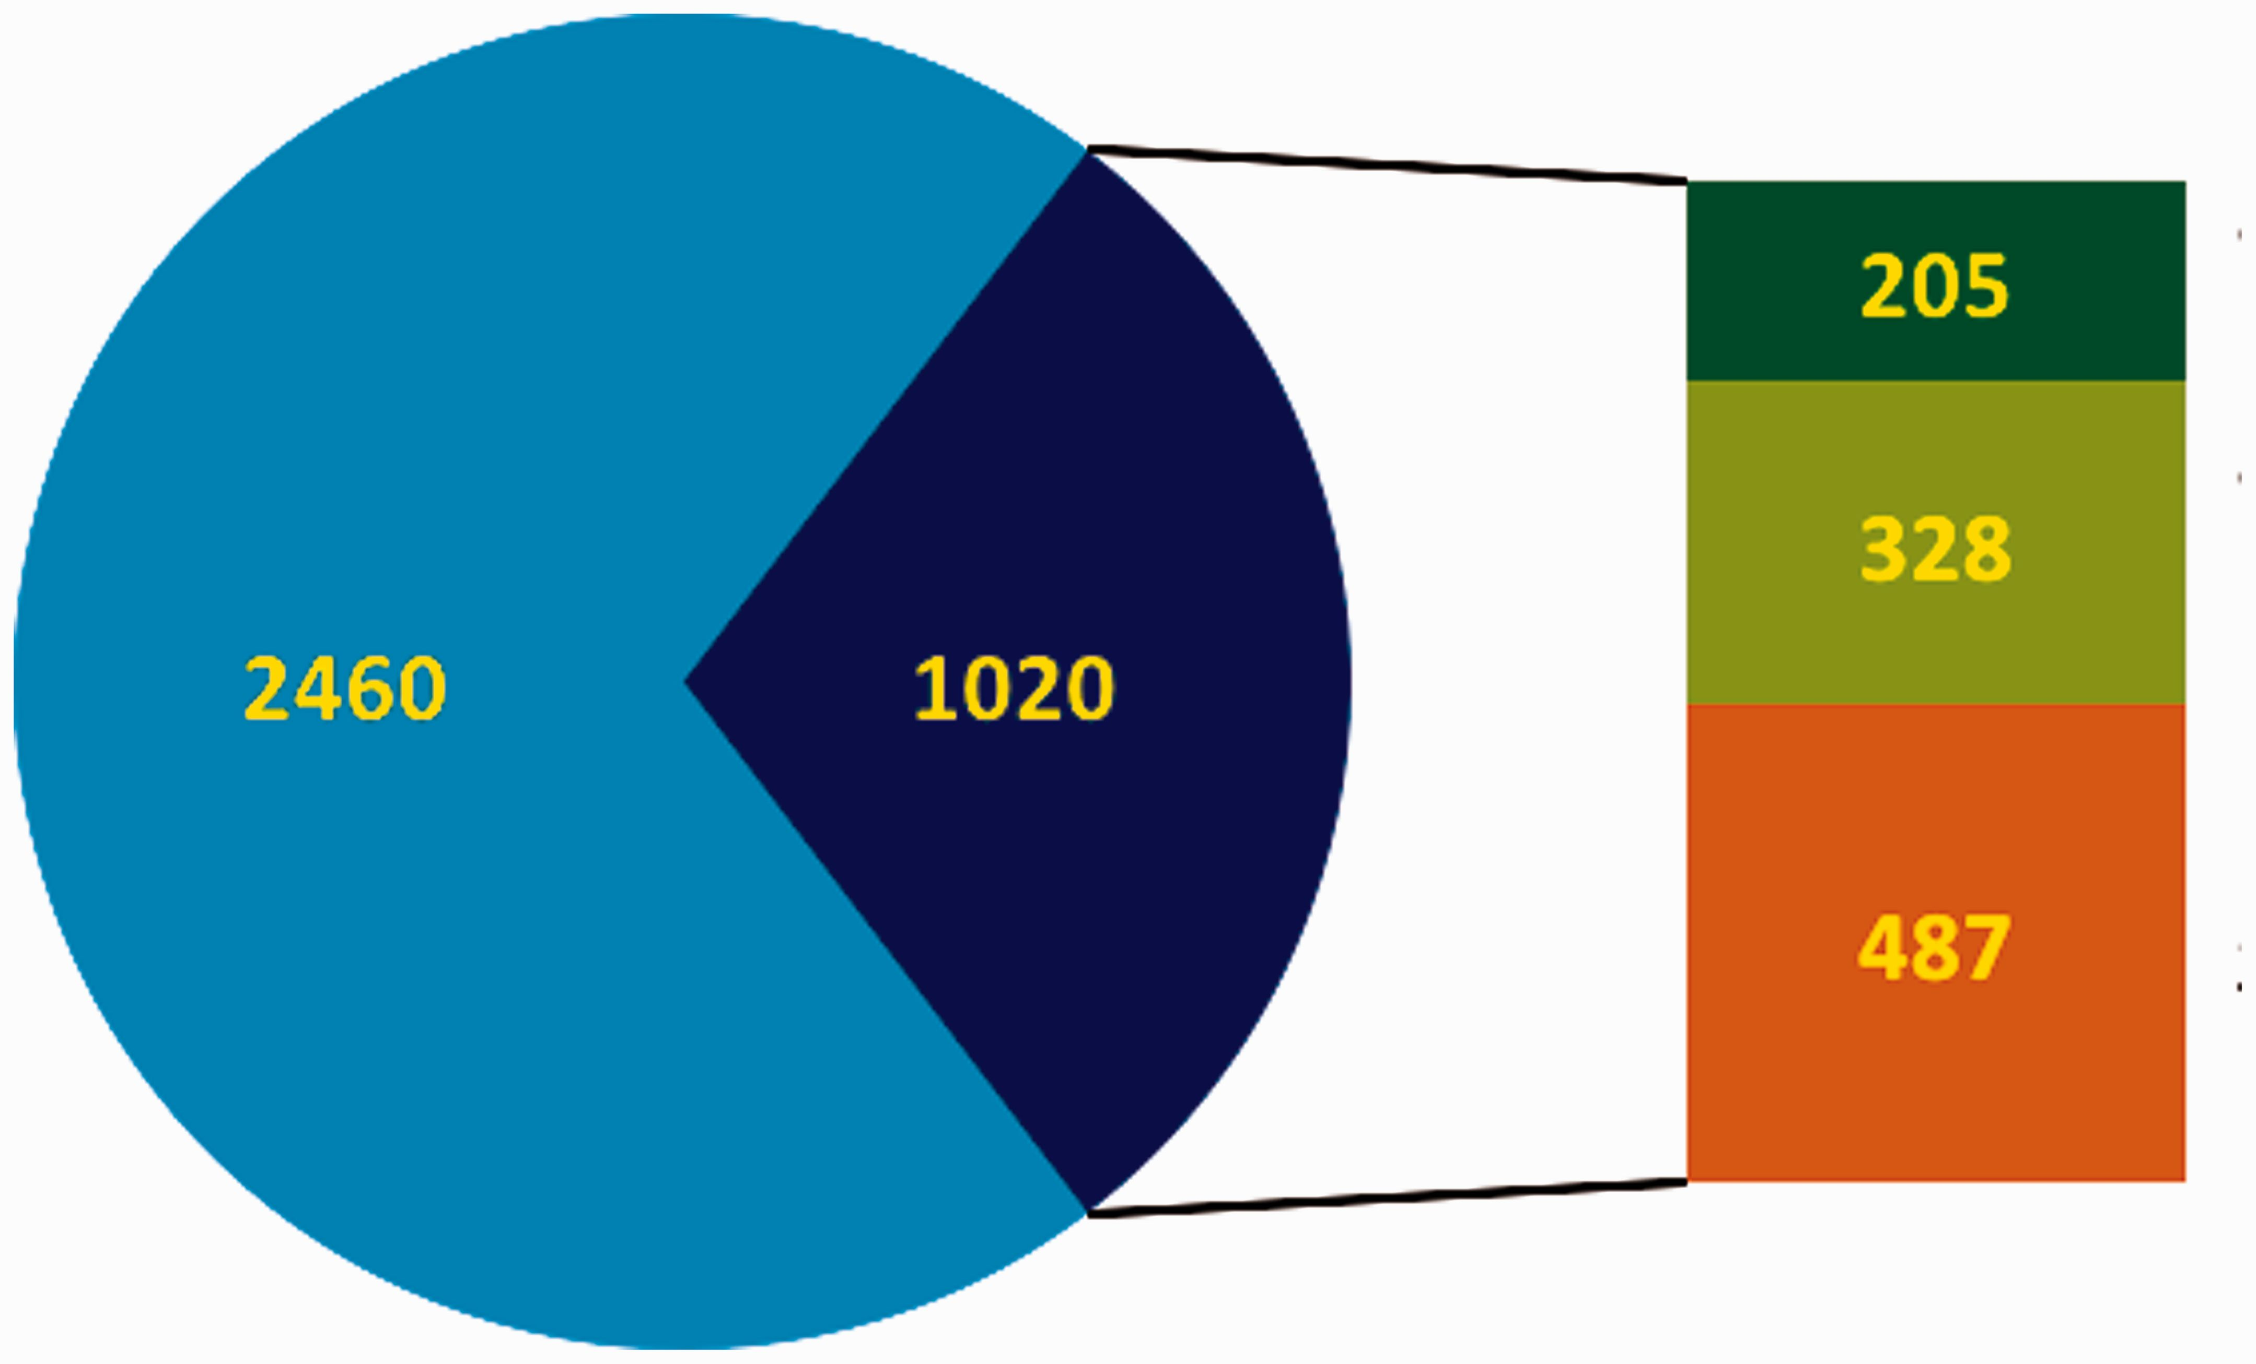
Figure 2. Overview of the curation status of DbTFs. In the pie chart blue represents the total number of candidate ...
Notes:
Figure 2. Overview of the curation status of DbTFs. In the pie chart blue represents the total number of candidate TFs, and the dark blue part indicates DbTFs with literature reference ( 3 ). Note that only 1700–1800 of the candidate TFs (blue) are considered DbTFs ( 1 , 2 ). In the bar to the right of the pie part green represents the number of curated DbTFs in the GO database (dark green: before March 2013, light green: after March 2013 when we started our community curation efforts. Orange indicates the number of DbTFs with literature reference ( 3 ) that still need to be curated.
Unless provided in the caption above, the following copyright applies to the content of this slide: © The Author(s) 2016. Published by Oxford University Press. This is an Open Access article distributed under the terms of the Creative Commons Attribution License ( http://creativecommons.org/licenses/by/4.0/ ), which permits unrestricted reuse, distribution, and reproduction in any medium, provided the original work is properly cited.

