Slide 1
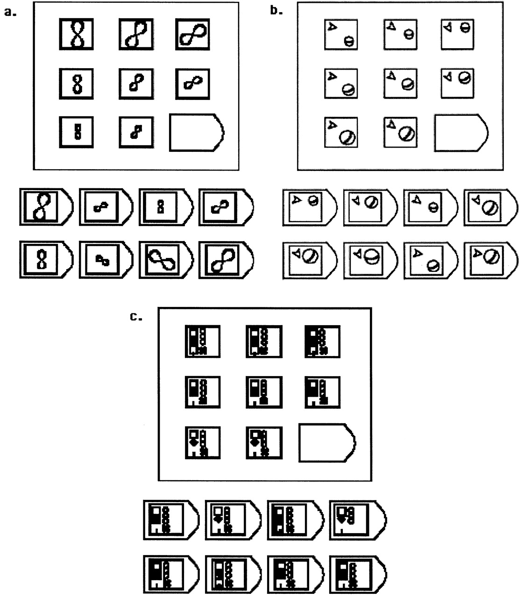
Figure 1. Examples of matrix problems. (a) A problem at complexity level 2. Two monotonic relations must be integrated ...
Notes:
Figure 1. Examples of matrix problems. (a) A problem at complexity level 2. Two monotonic relations must be integrated to solve the problem: the size of the object decreases towards the bottom of the matrix, and its orientation progressively changes horizontally across the matrix. (b) A problem at complexity level 4 (the highest level). Orientation, size, and position of the ball, as well as orientation of the arrow, all change across the matrix. (c) A problem at distractor level 4. The one relevant relation concerns the number of squares on the left. The other four objects are distractors that remain constant in all cells of the problem matrix.
Unless provided in the caption above, the following copyright applies to the content of this slide: © Oxford University Press

Slide 2
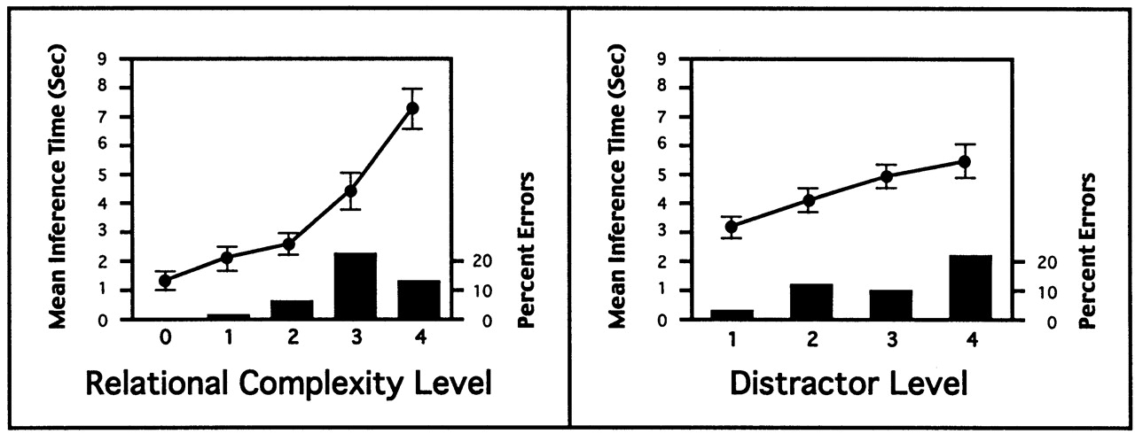
Figure 2. Mean solution times (correct trials only) and percent errors as a function of complexity and distractors. ...
Notes:
Figure 2. Mean solution times (correct trials only) and percent errors as a function of complexity and distractors. Error bars indicate 1 SE.
Unless provided in the caption above, the following copyright applies to the content of this slide: © Oxford University Press

Slide 3
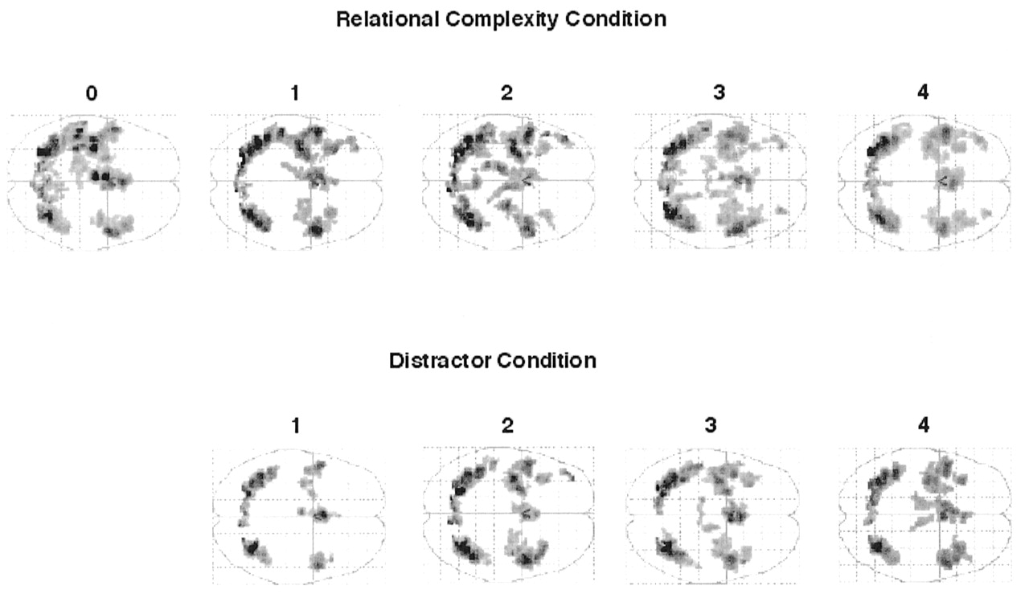
Figure 3. A subtraction analysis revealed responses to increasing levels of relational complexity (top row, increasing ...
Notes:
Figure 3. A subtraction analysis revealed responses to increasing levels of relational complexity (top row, increasing from left to right) and to increasing the number of distractors (bottom row, increasing from one on the left to four on the right). Each figure depicts an axial view of all brain voxels which were significantly (P < 0.001) more active during that block than during the resting baseline which was interspersed between blocks of matrix trials. The extent of frontal lobe activity appears to increase for both factors, but its consistent progression anteriorly occurs only for increasing relational complexity. The distractor conditions were created by adding distractors to a matrix with relational complexity level 1.
Unless provided in the caption above, the following copyright applies to the content of this slide: © Oxford University Press

Slide 4
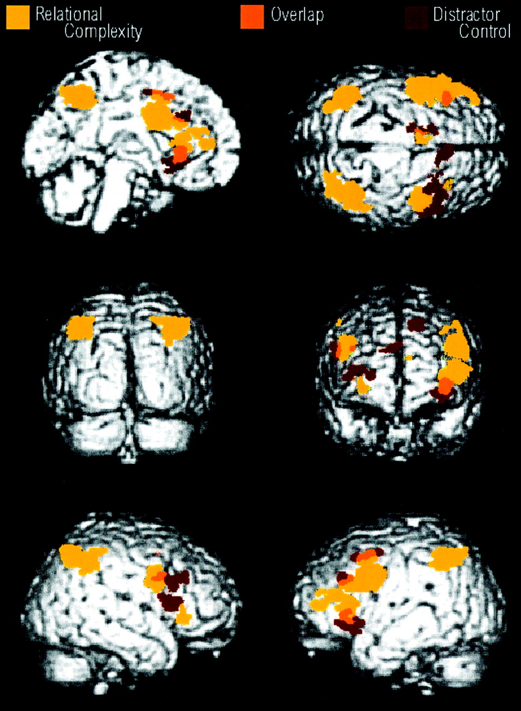
Figure 4. Linear trends for complexity and distractor contrasts on a rendered surface. Yellow represents the complexity ...
Notes:
Figure 4. Linear trends for complexity and distractor contrasts on a rendered surface. Yellow represents the complexity conditions; red the distractor; and orange the areas of overlap.
Unless provided in the caption above, the following copyright applies to the content of this slide: © Oxford University Press

Slide 5
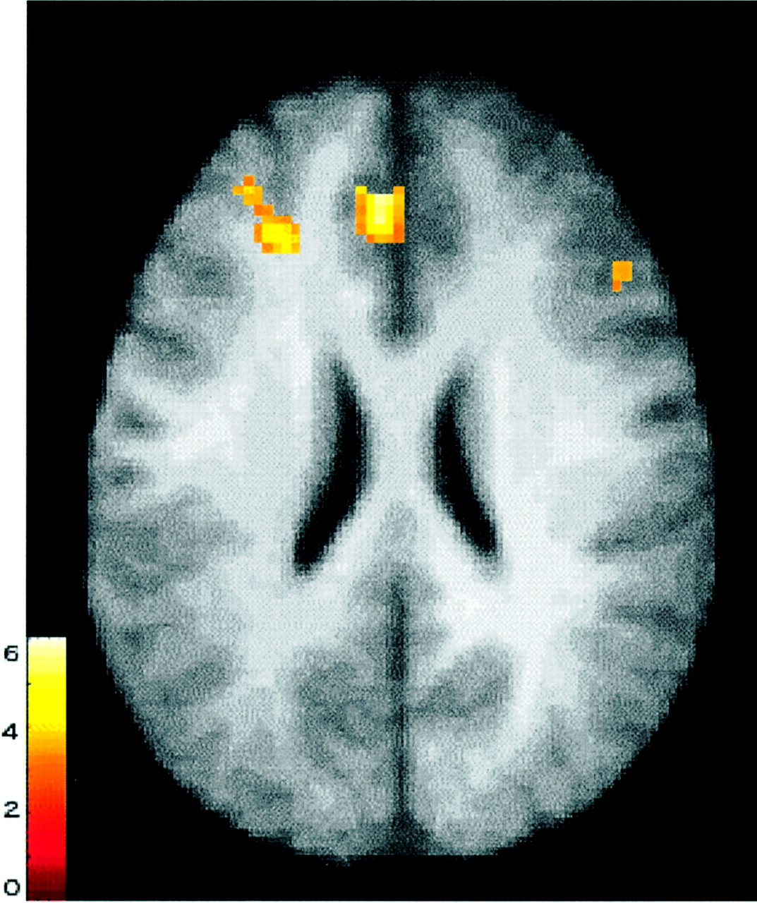
Figure 5. Difference map for the contrast subtracting distractor levels 3–4 from complexity levels 3–4. Slice selection ...
Notes:
Figure 5. Difference map for the contrast subtracting distractor levels 3–4 from complexity levels 3–4. Slice selection at Talairach z = 24. The bar depicts z-score for clusters. This contrast revealed a significant cluster in the anterior portion of the left middle frontal gyrus.
Unless provided in the caption above, the following copyright applies to the content of this slide: © Oxford University Press

Slide 6
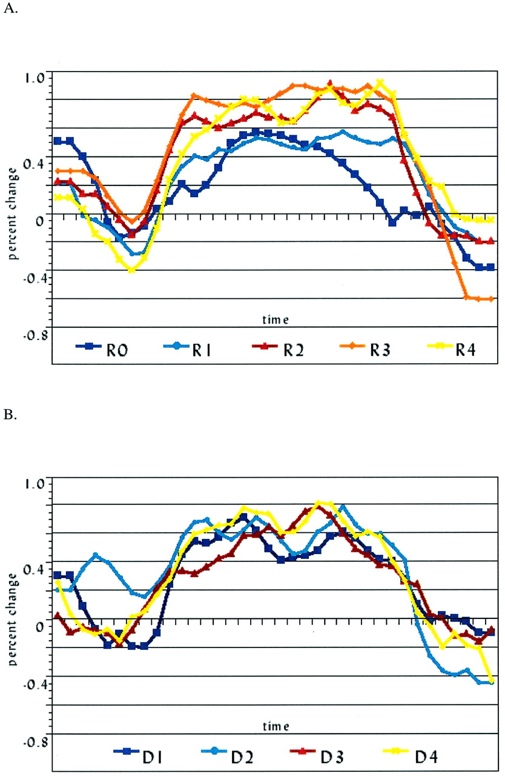
Figure 6. Time-series graphs for (A) relational complexity conditions and (B) distractor conditions, in bilateral ...
Notes:
Figure 6. Time-series graphs for (A) relational complexity conditions and (B) distractor conditions, in bilateral anterior prefrontal cortex (BA 10/46/47). Percent signal differences from resting baseline were computed for each subject and then averaged across all trials for all subjects. The x-axis depicts 36 images collected at 3 s intervals: eight images (24 s) of baseline period, 20 images (60 s) of task period, eight images (24 s) of subsequent baseline period.
Unless provided in the caption above, the following copyright applies to the content of this slide: © Oxford University Press

