Slide 1
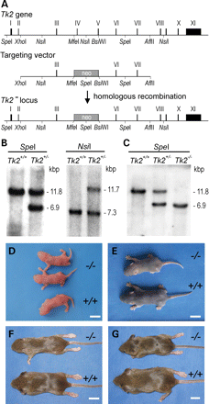
Figure 1. Targeted disruption of the Tk2 gene and generation of Tk2^{−/−} mice. (A) Homologous recombination of ...
Notes:
Figure 1. Targeted disruption of the Tk2 gene and generation of Tk2−/− mice. (A) Homologous recombination of the Tk2 gene with the targeting vector generated a Tk2− locus with replacement of exons IV and V (exons indicated with roman numbers) with a neomycin (neo) resistance cassette. (B) Genotyping of the Tk2 allele in the targeted embryonic stem cells. The DNA was digested with SpeI or NsiI that generated fragment of 6.9 or 11.7 kb in cells that had correctly incorporated the targeting vector. (C) Genotyping of mice by analysis of SpeI-digested DNA. Detection of a 6.9 kb DNA fragment indicated correct incorporation of the targeting vector. Photographs of genotyped Tk2+/+ (+/+) and Tk2−/− (−/−) littermates at 0 (D), 7 (E), 12 (F) and 17 (G) days of age. White bars indicate 10 mm distance.
Unless provided in the caption above, the following copyright applies to the content of this slide: © The Author 2008. Published by Oxford University Press. All rights reserved. For Permissions, please email: journals.permissions@oxfordjournals.org

Slide 2
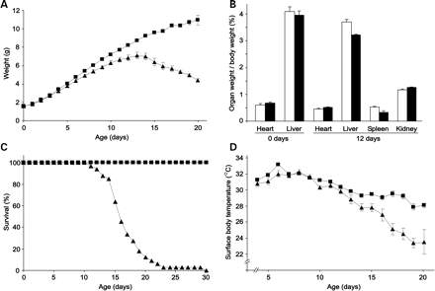
Figure 2. Growth retardation, early mortality and hypothermia of Tk2^{−/−} mice. (A) Body weight of ...
Notes:
Figure 2. Growth retardation, early mortality and hypothermia of Tk2−/− mice. (A) Body weight of Tk2+/+ (▪) (mean ± SD, n = 27) and Tk2−/− (▴) (mean ± SD, n = 5) mice. (B) Relative organ weight (organ weight/body weight, mean ± SD) of Tk2+/+ (white bars) and Tk2−/− (black bars). (C) Survival of Tk2+/+ (▪) and Tk2−/− (▴) mice. (D) Surface body temperature of Tk2+/+ (▪) (n = 27, mean ± SD) and Tk2−/− (▴) (n = 10, mean ± SD) mice.
Unless provided in the caption above, the following copyright applies to the content of this slide: © The Author 2008. Published by Oxford University Press. All rights reserved. For Permissions, please email: journals.permissions@oxfordjournals.org

Slide 3
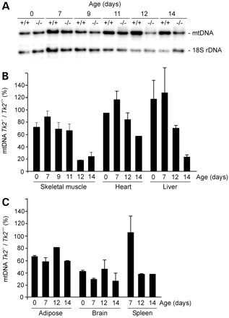
Figure 3. Depletion of mtDNA in Tk2-deficient mice. (A) Quantification of skeletal muscle mtDNA levels in ...
Notes:
Figure 3. Depletion of mtDNA in Tk2-deficient mice. (A) Quantification of skeletal muscle mtDNA levels in Tk2+/+ (+/+) and Tk2−/− (−/−) mice by Southern blot analysis. The mtDNA levels were correlated to nuclear genomic 18S rDNA. (B,C) mtDNA levels in Tk2−/− mice relative to mtDNA levels in Tk2+/+ mice (mean ± SD) in skeletal muscle, heart, liver, adipocytes, brain and spleen at different ages.
Unless provided in the caption above, the following copyright applies to the content of this slide: © The Author 2008. Published by Oxford University Press. All rights reserved. For Permissions, please email: journals.permissions@oxfordjournals.org

Slide 4
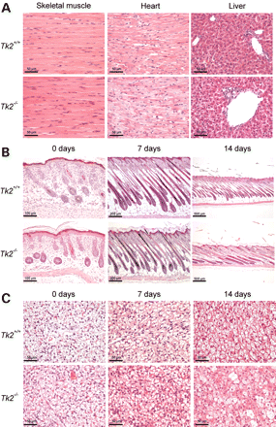
Figure 4. Histological analysis of tissues from Tk2-deficient mice. (A) Skeletal muscle, heart and liver from 14 ...
Notes:
Figure 4. Histological analysis of tissues from Tk2-deficient mice. (A) Skeletal muscle, heart and liver from 14 days-old Tk2+/+ and Tk2−/− mice. Section from skin (B) and brown adipose tissue (C) from 0, 7 and 14 days-old mice.
Unless provided in the caption above, the following copyright applies to the content of this slide: © The Author 2008. Published by Oxford University Press. All rights reserved. For Permissions, please email: journals.permissions@oxfordjournals.org

Slide 5
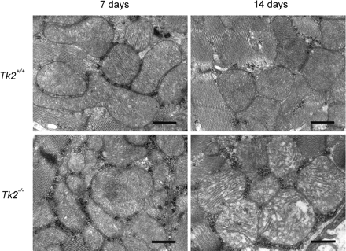
Figure 5. Electron microscopy images of heart mitochondria from 7 and 14 days-old Tk2^{+/+} and ...
Notes:
Figure 5. Electron microscopy images of heart mitochondria from 7 and 14 days-old Tk2+/+ and Tk2−/− mice. Black bars indicate 0.5 µm distance.
Unless provided in the caption above, the following copyright applies to the content of this slide: © The Author 2008. Published by Oxford University Press. All rights reserved. For Permissions, please email: journals.permissions@oxfordjournals.org

