Slide 1
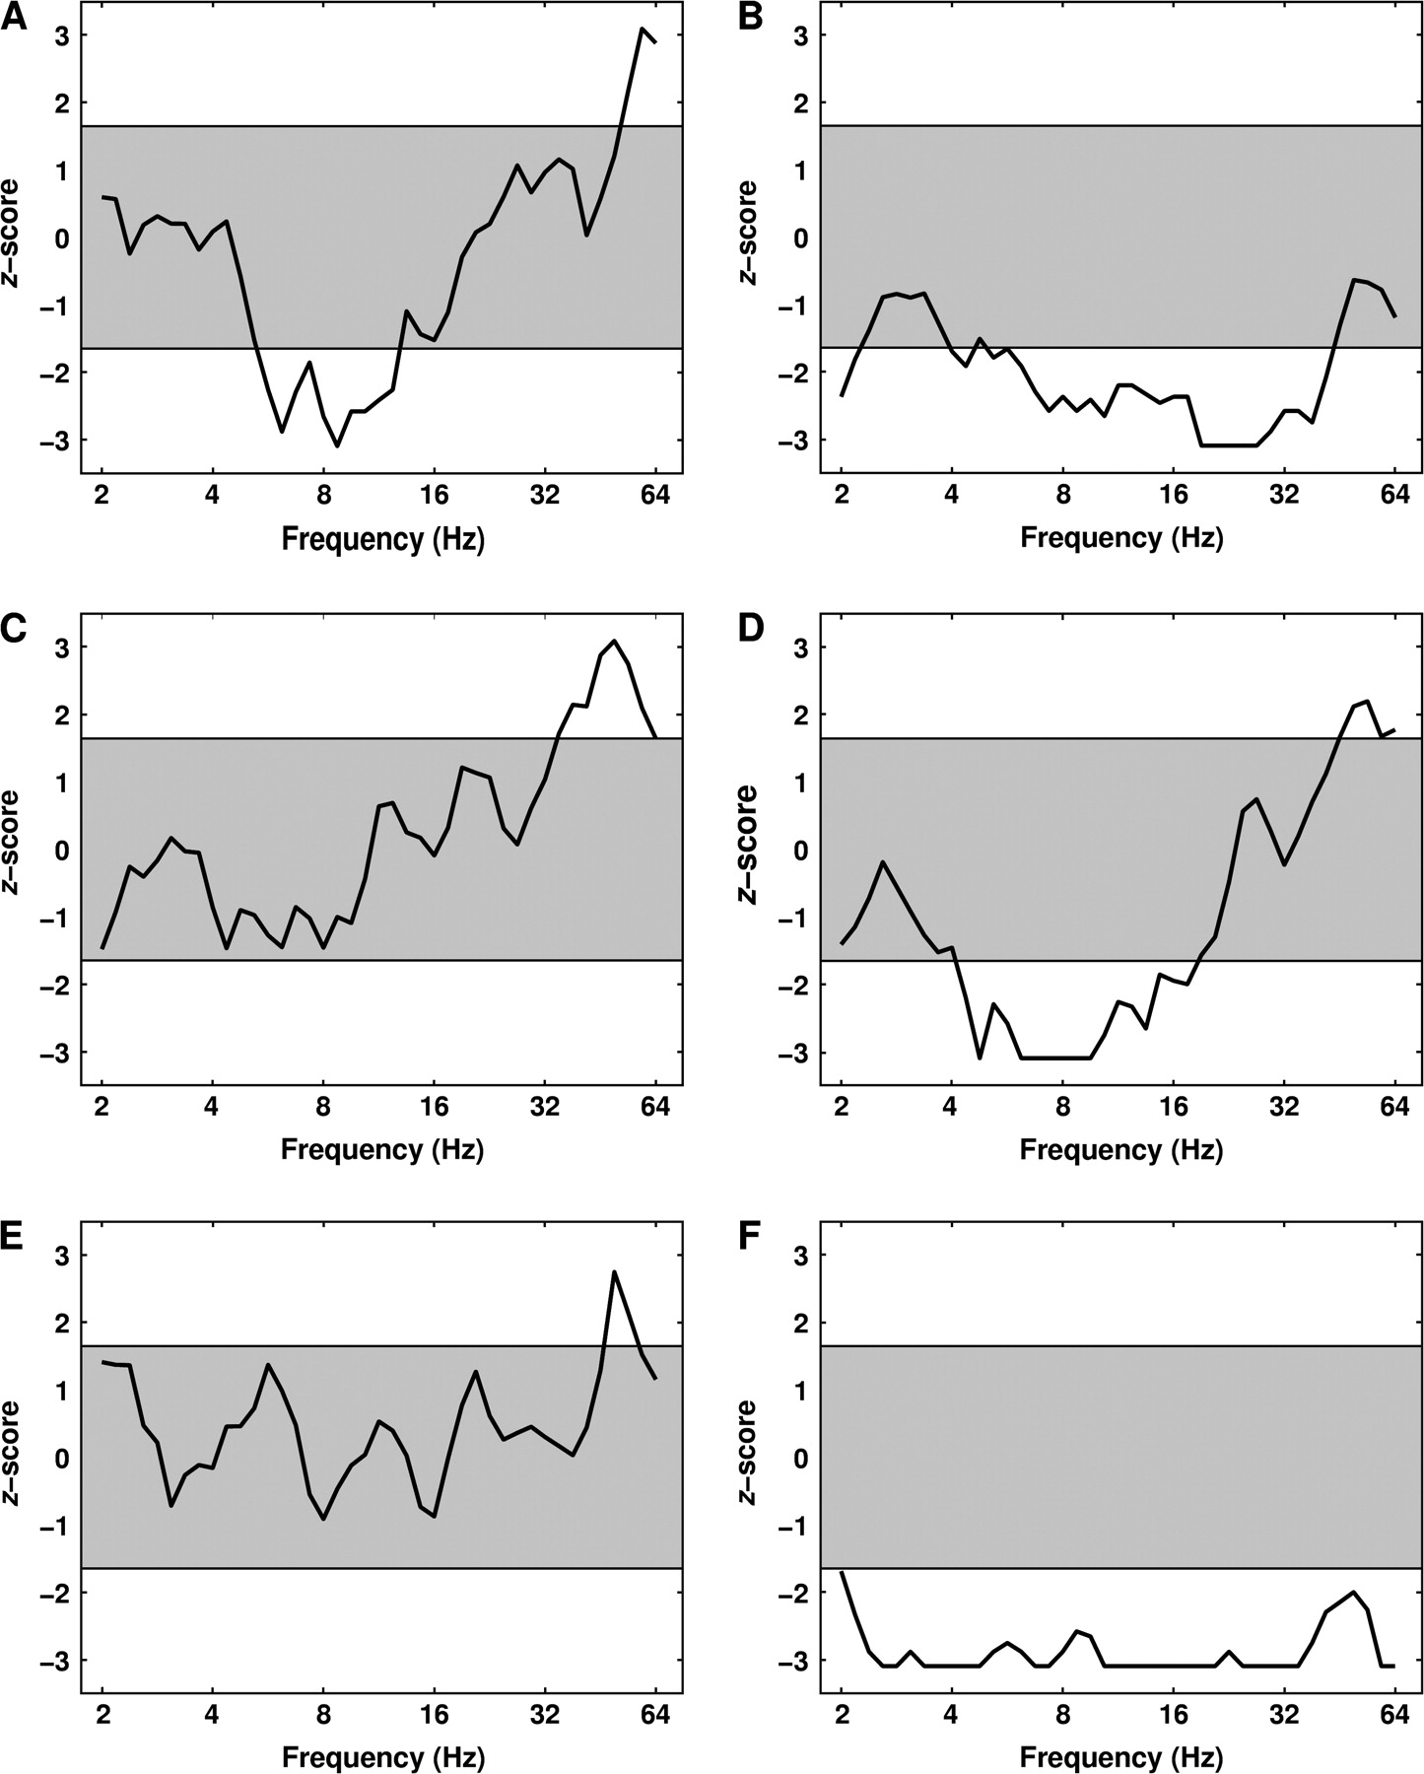
Figure 1. Example electrodes exhibiting oscillatory SMEs. Each panel shows the Z-transformed significance value of the ...
Notes:
Figure 1. Example electrodes exhibiting oscillatory SMEs. Each panel shows the Z-transformed significance value of the difference in power between recalled and not-recalled words across frequencies from 2 to 64 Hz for the 1 to 2-s time bin. The sign indicates the direction of the effect, and the gray area indicates the P > 0.05 significance threshold. (A, C, and E) Data from electrodes in the hippocampus, LIPC (BA47), and the left temporal lobe (BA21), respectively, exhibiting significant positive gamma SMEs. (B, D, and F) Results from hippocampal, LIPC, and left temporal lobe electrodes illustrating broadband negative SMEs. Electrodes are from 5 different patients (Talairach coordinates: [23,−27,−9], [−27,−27,10], [−42,41,−5], [−47,18,−1], [−50,−25,0], [−59,−13,−6]).
Unless provided in the caption above, the following copyright applies to the content of this slide: © The Author 2006. Published by Oxford University Press. All rights reserved. For permissions, please e-mail: journals.permissions@oxfordjournals.org

Slide 2
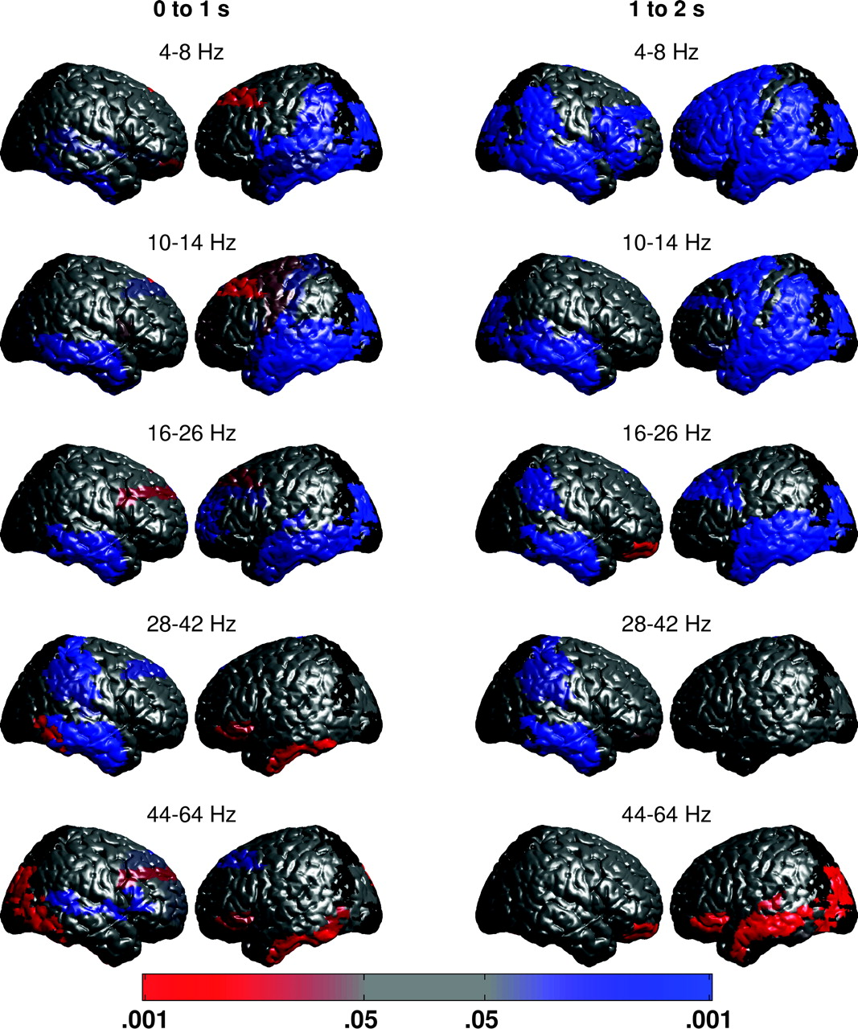
Figure 2. Cortical regions defined by BAs exhibiting across-subject differences between successful and unsuccessful ...
Notes:
Figure 2. Cortical regions defined by BAs exhibiting across-subject differences between successful and unsuccessful encoding for the 0 to 1-s (left) and the 1 to 2-s (right) time bins. The color indicates the direction of the effect (red = positive, blue = negative), and the intensity of the color indicates the significance from P < 0.05 to P < 0.001. Gray areas denote regions that did not exhibit a significant effect across subjects. Regions containing electrodes from fewer than 5 subjects are shown in black. Each row corresponds to a different frequency band: 4–8 Hz (theta), 10–14 Hz (alpha), 16–26 Hz (beta), 28–42 Hz (low gamma), and 44–64 Hz (high gamma).
Unless provided in the caption above, the following copyright applies to the content of this slide: © The Author 2006. Published by Oxford University Press. All rights reserved. For permissions, please e-mail: journals.permissions@oxfordjournals.org

Slide 3
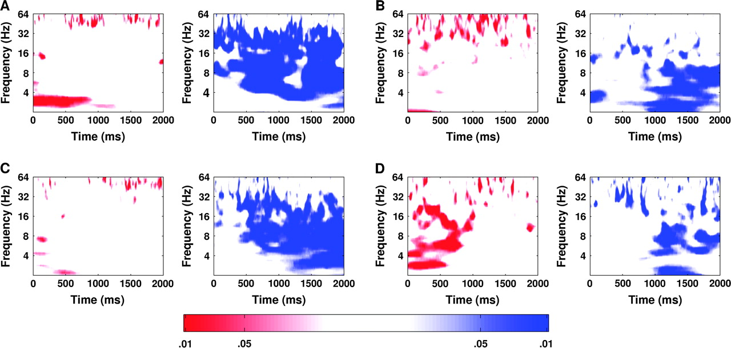
Figure 3. Time course of significant oscillatory activity for the hippocampus, LIPC, and the left temporal lobe. Each ...
Notes:
Figure 3. Time course of significant oscillatory activity for the hippocampus, LIPC, and the left temporal lobe. Each time course shows the significant increases (left column) or decreases (right column) in power for successful when compared with unsuccessful encoding at times ranging from 0 to 2000 ms and frequencies ranging from 2 to 64 Hz. The color indicates the direction of the effect (red = positive, blue = negative), and the intensity of the color indicates the significance. In the hippocampus, gamma oscillations increase early and late, whereas broadband power decreases during successful versus unsuccessful encoding (A). (B) The LIPC (BA47) exhibits heightened gamma oscillations throughout the encoding period and decreased broadband oscillatory power late in encoding of subsequently recalled items as compared with nonrecalled items. (C) Gamma oscillations in the left temporal lobe (BA21) ramp up late, whereas broadband power decreases, during encoding of subsequently recalled items. (D) Theta and alpha oscillations in the left frontal eye fields (BA8) increase for subsequently recalled relative to not-recalled items.
Unless provided in the caption above, the following copyright applies to the content of this slide: © The Author 2006. Published by Oxford University Press. All rights reserved. For permissions, please e-mail: journals.permissions@oxfordjournals.org

