Slide 1
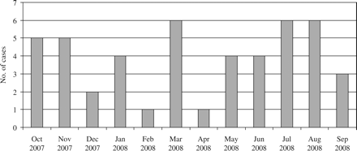
Figure 1 Graph showing the monthly prevalence of newly infected patients with KPC-producing K. pneumoniae isolates ...
Notes:
Figure 1 Graph showing the monthly prevalence of newly infected patients with KPC-producing K. pneumoniae isolates during the 1 year period of the survey.
Unless provided in the caption above, the following copyright applies to the content of this slide: © The Author 2009. Published by Oxford University Press on behalf of the British Society for Antimicrobial Chemotherapy. All rights reserved. For Permissions, please e-mail: journals.permissions@oxfordjournals.org

