Slide 1
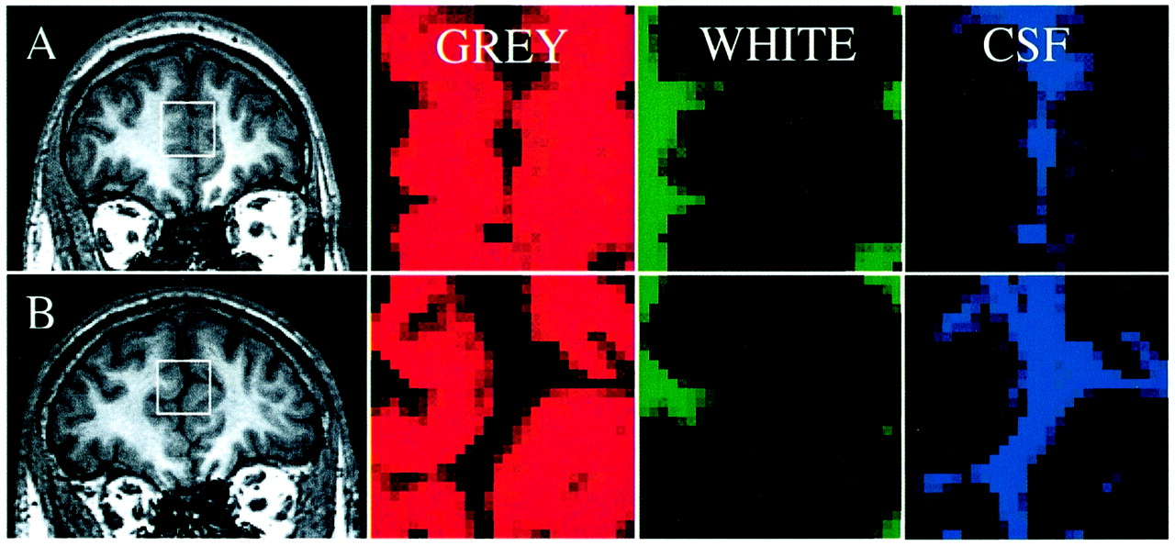
Figure 1. The position of the MRS voxel is illustrated for two subjects (A: aged 27 years, and B: aged 68 years) by ...
Notes:
Figure 1. The position of the MRS voxel is illustrated for two subjects (A: aged 27 years, and B: aged 68 years) by drawing its outline on the corresponding F-IRp-GRASS images (furthest left). The voxel was located on the interhemispheric fissure of the medial frontal lobe, such that it included a significant proportion of grey matter and, as far as possible, excluded white matter. The proportions of grey matter, white matter and CSF in the voxel were determined by SPM analysis, and are shown for the two subjects as quantitative tissue maps: these show reduced grey and white matter and correspondingly increased CSF in the elderly subject compared with the young subject.
Unless provided in the caption above, the following copyright applies to the content of this slide: © Oxford University Press

Slide 2
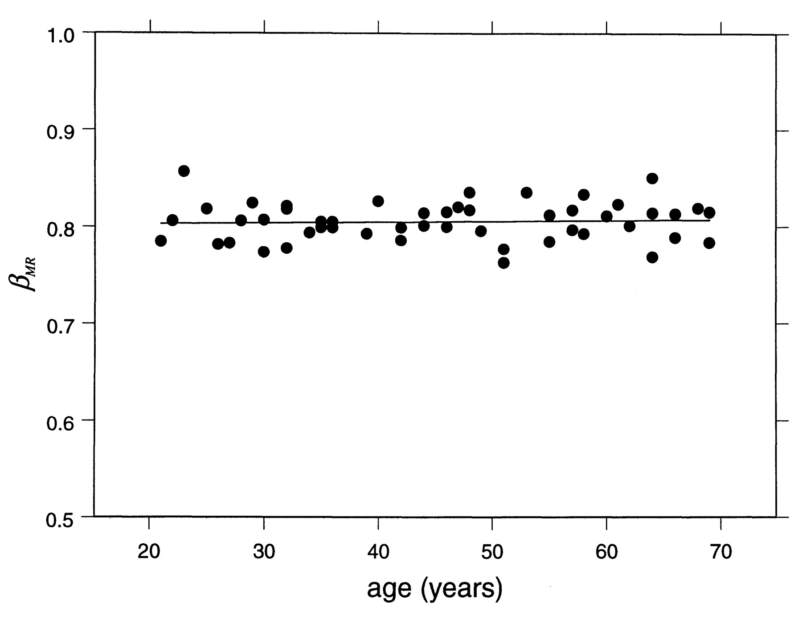
Figure 2. Variation in brain water content (β_{MR}) with age. No significant change with respect to age is ...
Notes:
Figure 2. Variation in brain water content (βMR) with age. No significant change with respect to age is observed: P = 0.65, n = 50.
Unless provided in the caption above, the following copyright applies to the content of this slide: © Oxford University Press

Slide 3
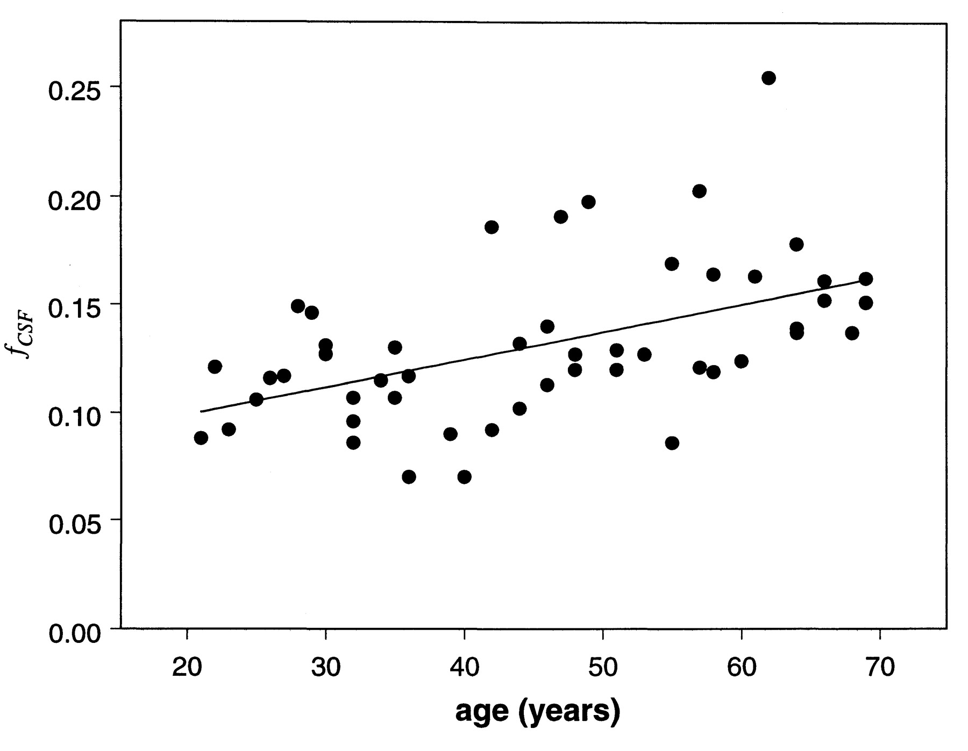
Figure 3. Variation in the voxel fraction of CSF (f_{CSF}) with age. There is a significant change with ...
Notes:
Figure 3. Variation in the voxel fraction of CSF (fCSF) with age. There is a significant change with respect to age: P < 0.001, n = 50.
Unless provided in the caption above, the following copyright applies to the content of this slide: © Oxford University Press

Slide 4
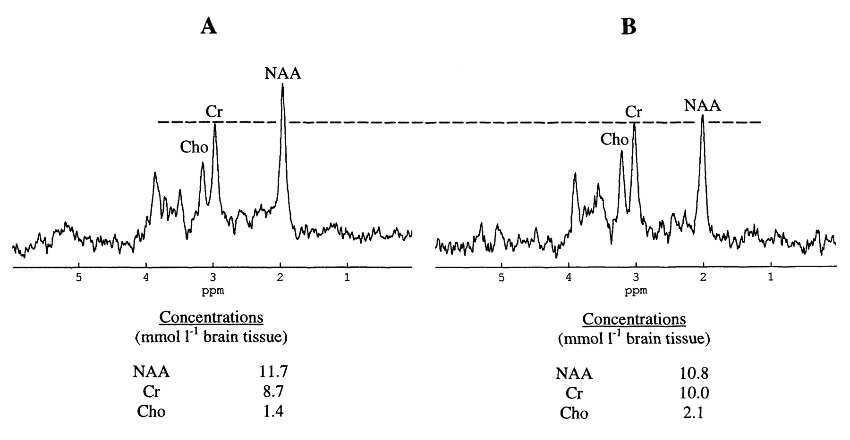
Figure 4. Representative STEAM spectra (T_{E} = 72 ms) acquired from the frontal lobe grey matter of the same ...
Notes:
Figure 4. Representative STEAM spectra (TE = 72 ms) acquired from the frontal lobe grey matter of the same subjects as Figure 1 (spectra are scaled such that the height of the creatine peaks are equal). To allow quantitative assessment of age-related changes in the metabolites absolute concentrations are also shown.
Unless provided in the caption above, the following copyright applies to the content of this slide: © Oxford University Press

Slide 5
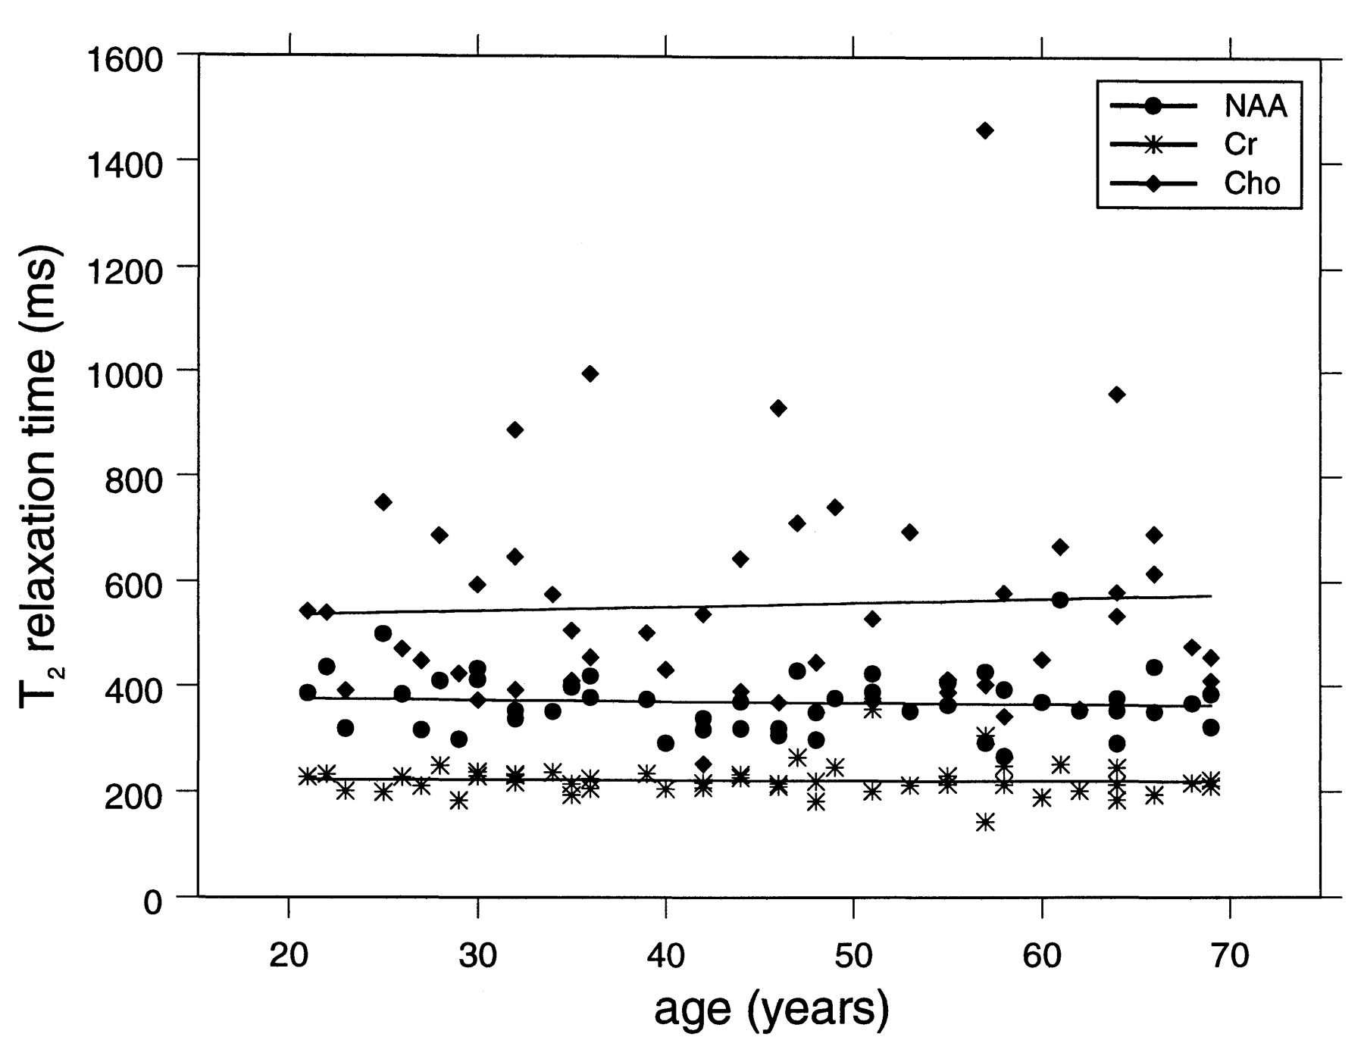
Figure 5. Linear regression of metabolite T₂ relaxation times with age for NAA, Cr and Cho. No significant ...
Notes:
Figure 5. Linear regression of metabolite T2 relaxation times with age for NAA, Cr and Cho. No significant change with respect to age is observed: P = 0.63, 0.80 and 0.72, respectively, n = 50.
Unless provided in the caption above, the following copyright applies to the content of this slide: © Oxford University Press

Slide 6
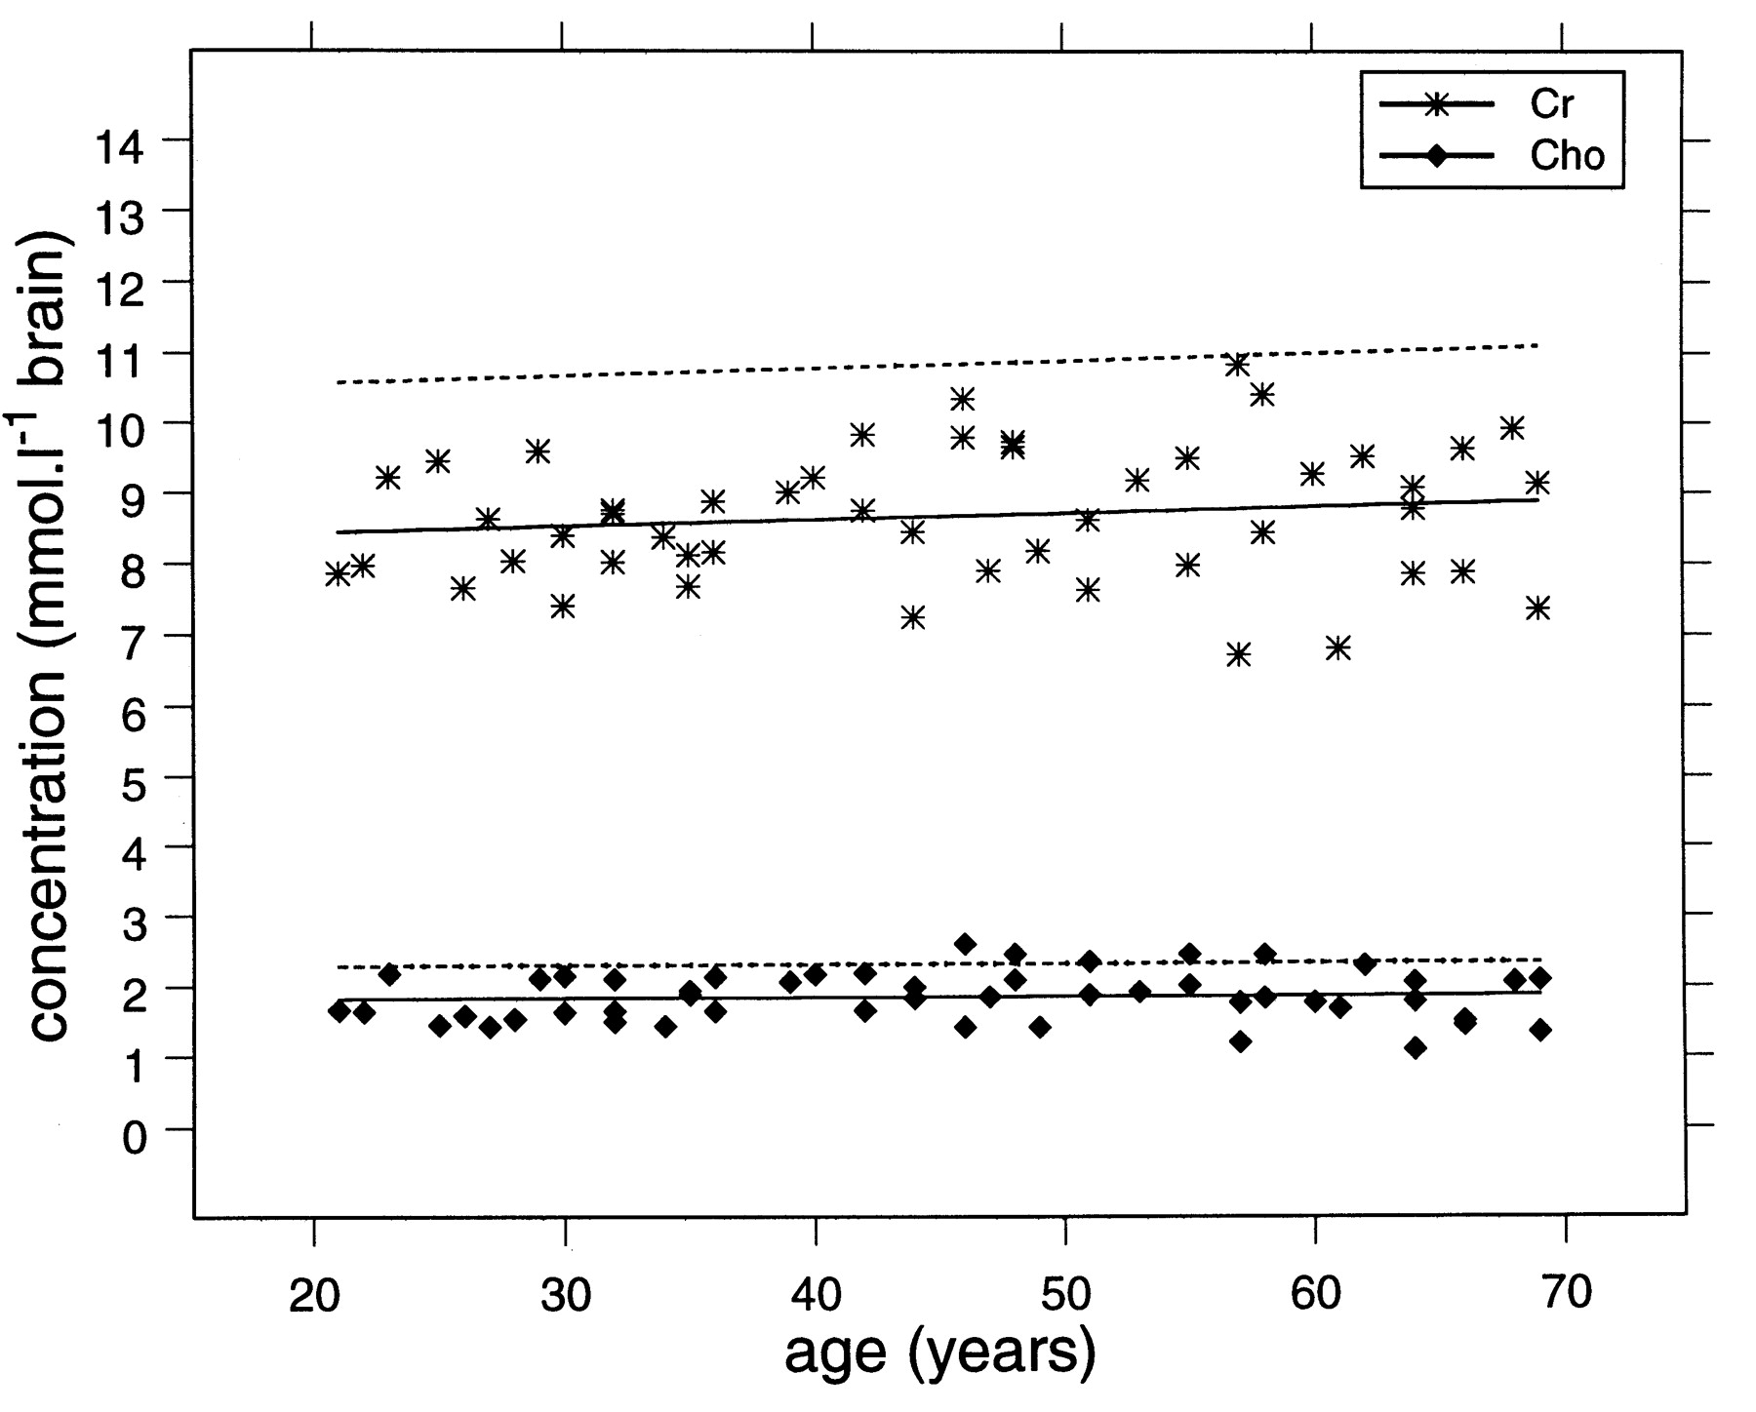
Figure 6. The concentrations of Cr and Cho per litre brain tissue, measured in frontal lobe voxels of 50 male ...
Notes:
Figure 6. The concentrations of Cr and Cho per litre brain tissue, measured in frontal lobe voxels of 50 male subjects, are plotted with respect to age and the corresponding regression line is shown as a full line. The dashed line is the regression line for concentrations estimated per litre brain water (data points omitted for clarity). No significant effect of age on either Cr or Cho concentration is observed.
Unless provided in the caption above, the following copyright applies to the content of this slide: © Oxford University Press

Slide 7
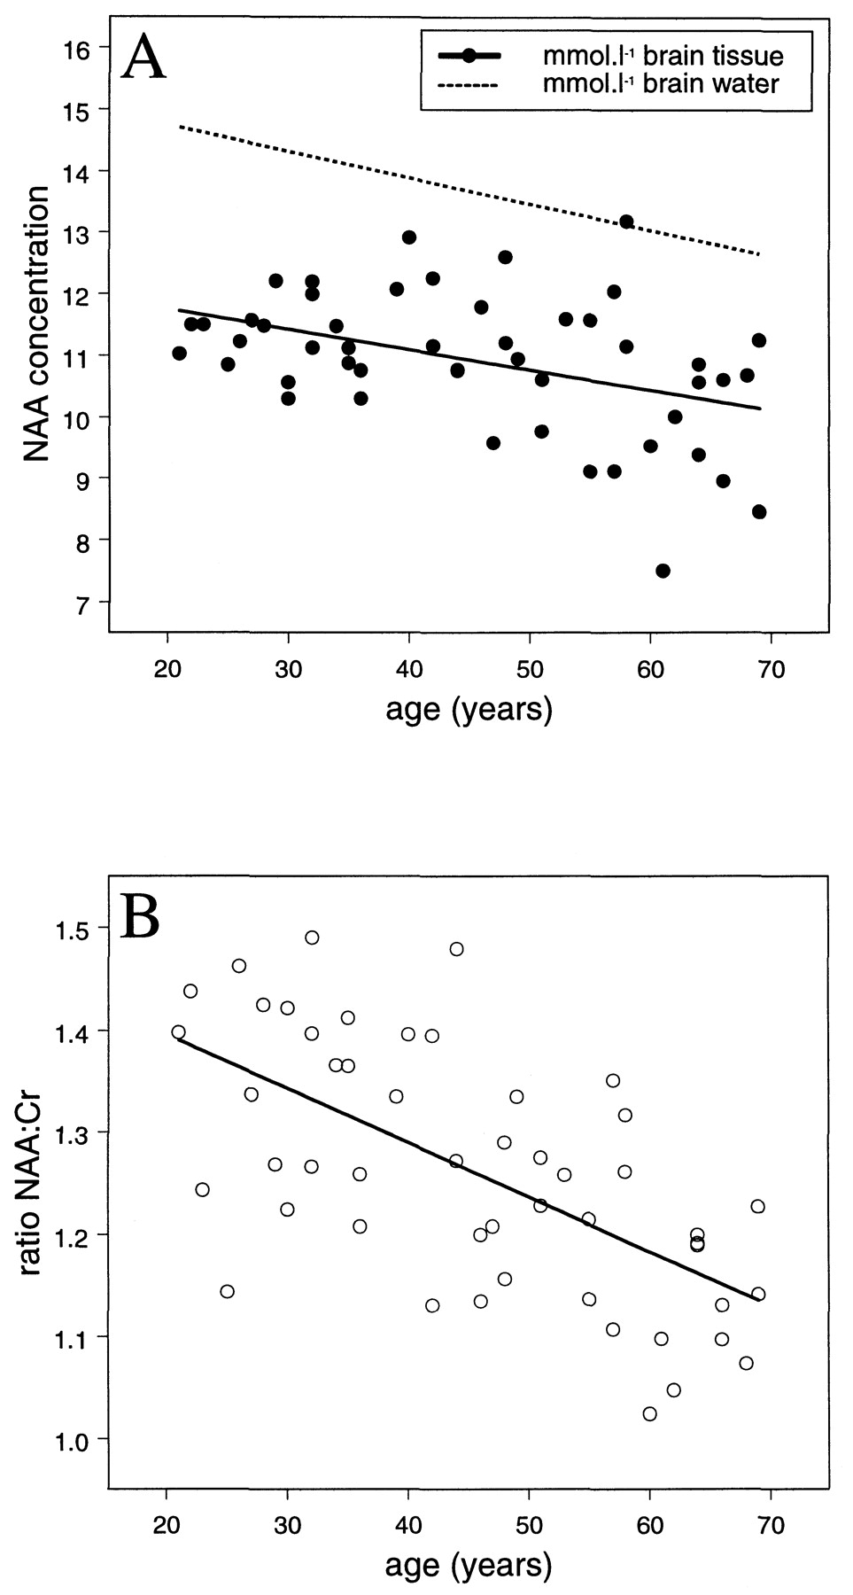
Figure 7. The concentration of NAA per litre brain tissue, measured in frontal lobe voxels of 50 male subjects, is ...
Notes:
Figure 7. The concentration of NAA per litre brain tissue, measured in frontal lobe voxels of 50 male subjects, is plotted with respect to age and the corresponding regression line is shown as a full line (a). The dashed line is the regression line for concentrations estimated per litre brain water (data points have been omitted for clarity). NAA decreased significantly with age according to either concentration estimation scheme (see Table 1 for details). Also plotted is the ratio of NAA:Cr (b) based on T2-corrected signal amplitudes (S0); the observed reduction with age is highly significant (P < 0.001).
Unless provided in the caption above, the following copyright applies to the content of this slide: © Oxford University Press

