Slide 1
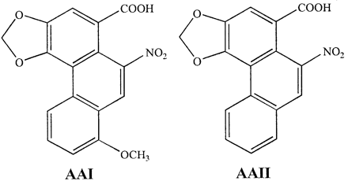
Fig. 1. Chemical structures of aristolochic acid I (AAI) and II (AAII).
Notes:
Fig. 1. Chemical structures of aristolochic acid I (AAI) and II (AAII).
Unless provided in the caption above, the following copyright applies to the content of this slide: © UK Environmental Mutagen Society/Oxford University Press 2002

Slide 2
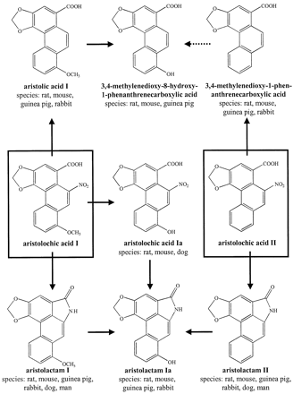
Fig. 2. Metabolism of aristolochic acid I and II (from Krumbiegel et al., 1987).
Notes:
Fig. 2. Metabolism of aristolochic acid I and II (from Krumbiegel et al., 1987).
Unless provided in the caption above, the following copyright applies to the content of this slide: © UK Environmental Mutagen Society/Oxford University Press 2002

Slide 3
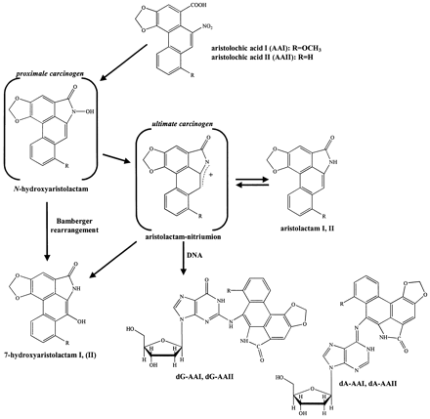
Fig. 3. Metabolic activation and DNA adduct formation of aristolochic acid I (AAI, R = OCH₃) and II (AAII, ...
Notes:
Fig. 3. Metabolic activation and DNA adduct formation of aristolochic acid I (AAI, R = OCH3) and II (AAII, R = H); 7-(deoxyadenosin-N6-yl)aristolactam I or II (dA–AAI or dA–AAII), 7-(deoxyguanosin-N2-yl)aristolactam I or II (dG–AAI or dG–AAII).
Unless provided in the caption above, the following copyright applies to the content of this slide: © UK Environmental Mutagen Society/Oxford University Press 2002

Slide 4
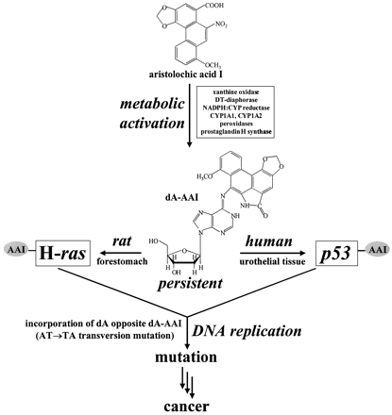
Fig. 4. Postulated mechanism for the carcinogenicity of aristolochic acid in rodents and humans. AAI, aristolochic ...
Notes:
Fig. 4. Postulated mechanism for the carcinogenicity of aristolochic acid in rodents and humans. AAI, aristolochic acid I; dA–AAI, 7-(deoxyadenosin-N6-yl)aristolactam I; dA, deoxyadenosine.
Unless provided in the caption above, the following copyright applies to the content of this slide: © UK Environmental Mutagen Society/Oxford University Press 2002

