Slide 1
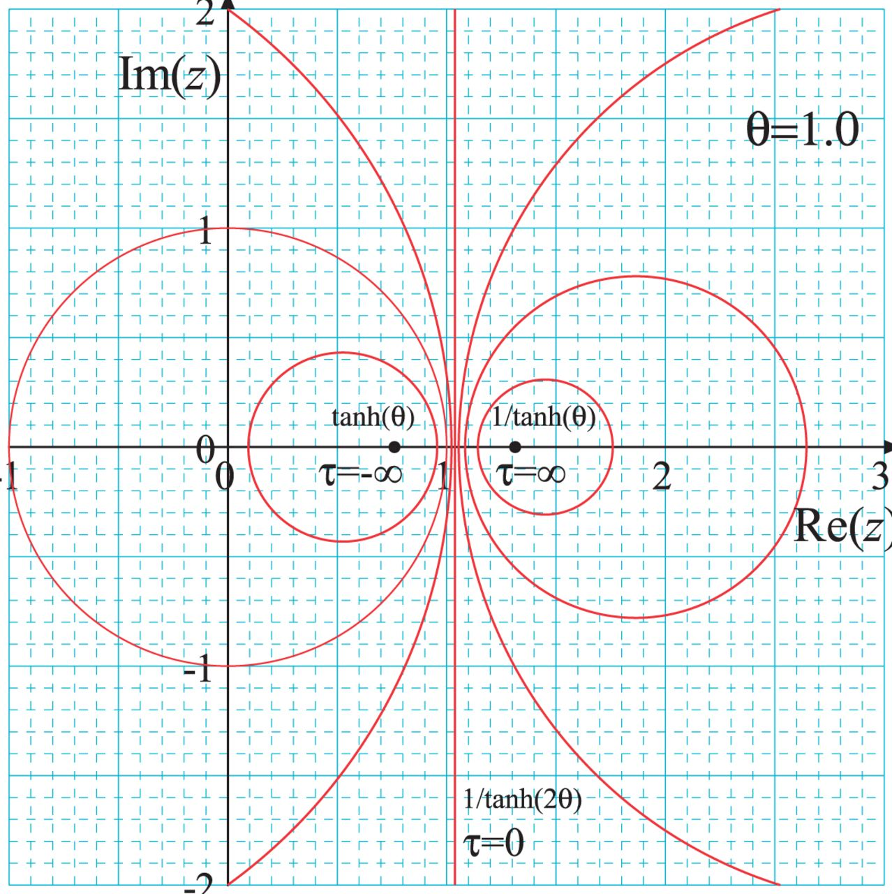
Fig 1. The time flow in the Möbius coordinate and constant-$\tau$ contours for $\theta=1$.
Notes:
Fig 1. The time flow in the Möbius coordinate and constant-$\tau$ contours for $\theta=1$.
Unless provided in the caption above, the following copyright applies to the content of this slide: © The Author(s) 2016. Published by Oxford University Press on behalf of the Physical Society of Japan.This is an Open Access article distributed under the terms of the Creative Commons Attribution License (http://creativecommons.org/licenses/by/4.0/), which permits unrestricted reuse, distribution, and reproduction in any medium, provided the original work is properly cited.Funded by SCOAP3

Slide 2
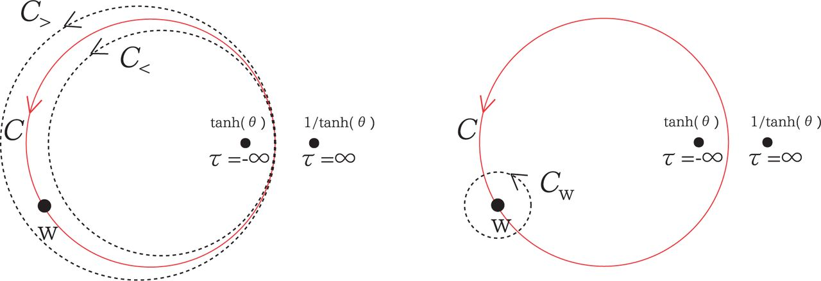
Fig 2. The contours in the left panel can be deformed to those in the right panel.
Notes:
Fig 2. The contours in the left panel can be deformed to those in the right panel.
Unless provided in the caption above, the following copyright applies to the content of this slide: © The Author(s) 2016. Published by Oxford University Press on behalf of the Physical Society of Japan.This is an Open Access article distributed under the terms of the Creative Commons Attribution License (http://creativecommons.org/licenses/by/4.0/), which permits unrestricted reuse, distribution, and reproduction in any medium, provided the original work is properly cited.Funded by SCOAP3

