Slide 1
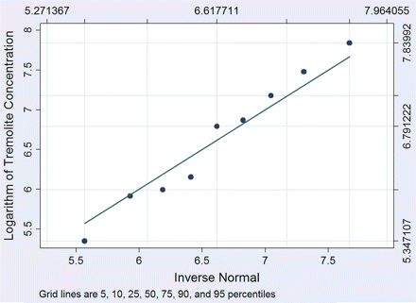
Fig. 1. The fit of the observed tremolite data to a lognormal distribution.
Notes:
Fig. 1. The fit of the observed tremolite data to a lognormal distribution.
Unless provided in the caption above, the following copyright applies to the content of this slide: © The Author 2008. Published by Oxford University Press on behalf of the British Occupational Hygiene Society

Slide 2
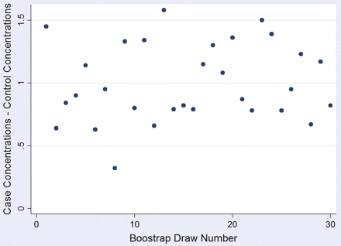
Fig. 4. For tremolite, the results of the subtraction of the estimates of the mean log(concentrations) for the ...
Notes:
Fig. 4. For tremolite, the results of the subtraction of the estimates of the mean log(concentrations) for the controls from those of the cases for each of 30 bootstrap samples.
Unless provided in the caption above, the following copyright applies to the content of this slide: © The Author 2008. Published by Oxford University Press on behalf of the British Occupational Hygiene Society

Slide 3
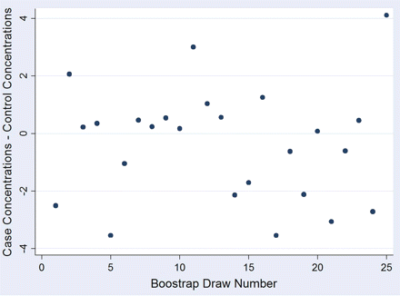
Fig. 3. For chrysotile, the results of the subtraction of the estimates of the mean log(concentrations) for the ...
Notes:
Fig. 3. For chrysotile, the results of the subtraction of the estimates of the mean log(concentrations) for the controls from those of the cases for each of 25 bootstrap samples.
Unless provided in the caption above, the following copyright applies to the content of this slide: © The Author 2008. Published by Oxford University Press on behalf of the British Occupational Hygiene Society

Slide 4
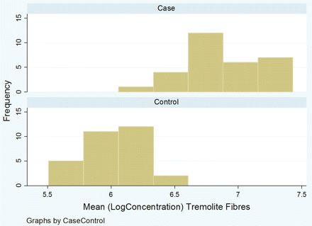
Fig. 2. Comparison, for brake workers and controls, of the distributions of ML-estimated means from 30 bootstrap ...
Notes:
Fig. 2. Comparison, for brake workers and controls, of the distributions of ML-estimated means from 30 bootstrap results using tremolite data as source.
Unless provided in the caption above, the following copyright applies to the content of this slide: © The Author 2008. Published by Oxford University Press on behalf of the British Occupational Hygiene Society

