Slide 1
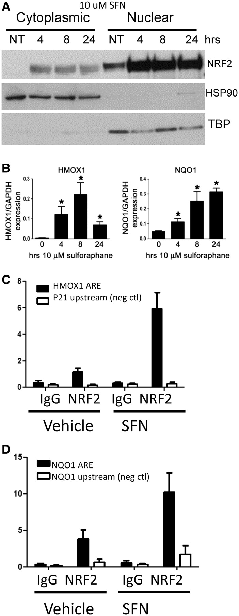
Figure 1. SFN activates NRF2 nuclear translocation, downstream ARE gene expression and binding to ARE genes in ...
Notes:
Figure 1. SFN activates NRF2 nuclear translocation, downstream ARE gene expression and binding to ARE genes in lymphoblastoid cell lines. (A) NRF2 protein levels increase in nucleus after 4-h 10 -µM SFN treatment, and these levels persist through 24 h. TBP, TATA-binding protein, HSP90. (B) Gene expression of known NRF2-regulated genes, HMOX1 and NQO1, significantly increase after 4-, 8- and 24-h 10 -µM SFN exposures. Gene expression values are normalized to GAPDH. Bars represent average of six independent experiments ± SEM; *P < 0.05. (C) ChIP-PCR analysis demonstrates that 5-h 10 -µM SFN treatment increases NRF2 binding at known ARE loci in the promoter regions of HMOX1 and (D) NQO1. A small, but significant, amount of binding was also seen in vehicle control-treated cells. Bars represent amplified target loci normalized to input DNA, as described in ‘Materials and Methods’ section. Controls: immunoprecipitation (IP) with non-specific, species-matched IgG antibody and amplification of loci lacking a functional ARE motif (NQO1 promoter 2-kb upstream of functional AREs and p21 promoter region). Data in (C) are means ± SEM of seven independent experiments in a single cell line; (D) displays mean ± SEM of six independent ChIP experiments in six different LCLs. Enrichment graphs for several individual experiments are shown in Supplementary File 1, Supplementary Figure S2. Each ChIP experiment was tested in this way before sequencing.
Unless provided in the caption above, the following copyright applies to the content of this slide: Published by Oxford University Press 2012.This is an Open Access article distributed under the terms of the Creative Commons Attribution Non-Commercial License (http://creativecommons.org/licenses/by-nc/3.0), which permits unrestricted non-commercial use, distribution, and reproduction in any medium, provided the original work is properly cited.

Slide 2
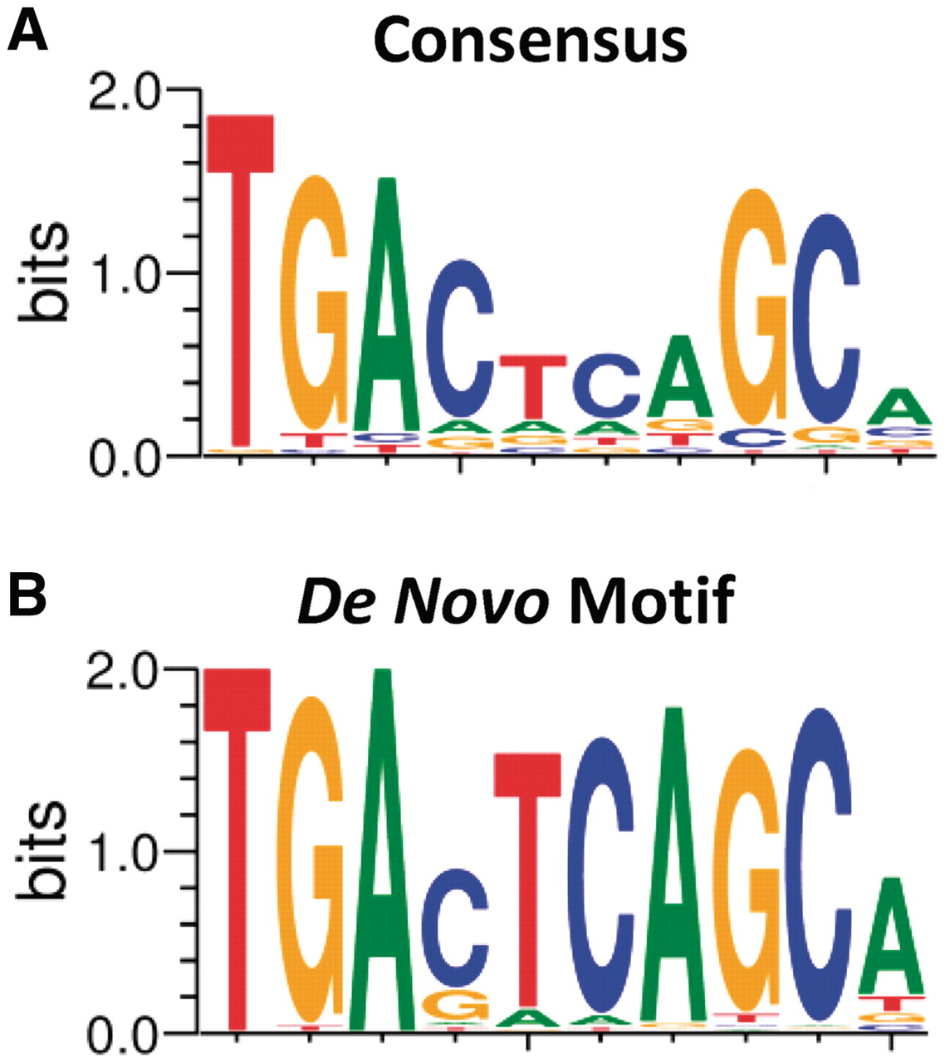
Figure 2. ChIP-seq peaks contain NRF2-binding motif. (A) NRF2-binding motif based on known AREs and (B) most enriched ...
Notes:
Figure 2. ChIP-seq peaks contain NRF2-binding motif. (A) NRF2-binding motif based on known AREs and (B) most enriched sequence pattern in the 849 ChIP-seq peak regions based on a de novo analysis using Gibbs motif sampler.
Unless provided in the caption above, the following copyright applies to the content of this slide: Published by Oxford University Press 2012.This is an Open Access article distributed under the terms of the Creative Commons Attribution Non-Commercial License (http://creativecommons.org/licenses/by-nc/3.0), which permits unrestricted non-commercial use, distribution, and reproduction in any medium, provided the original work is properly cited.

Slide 3
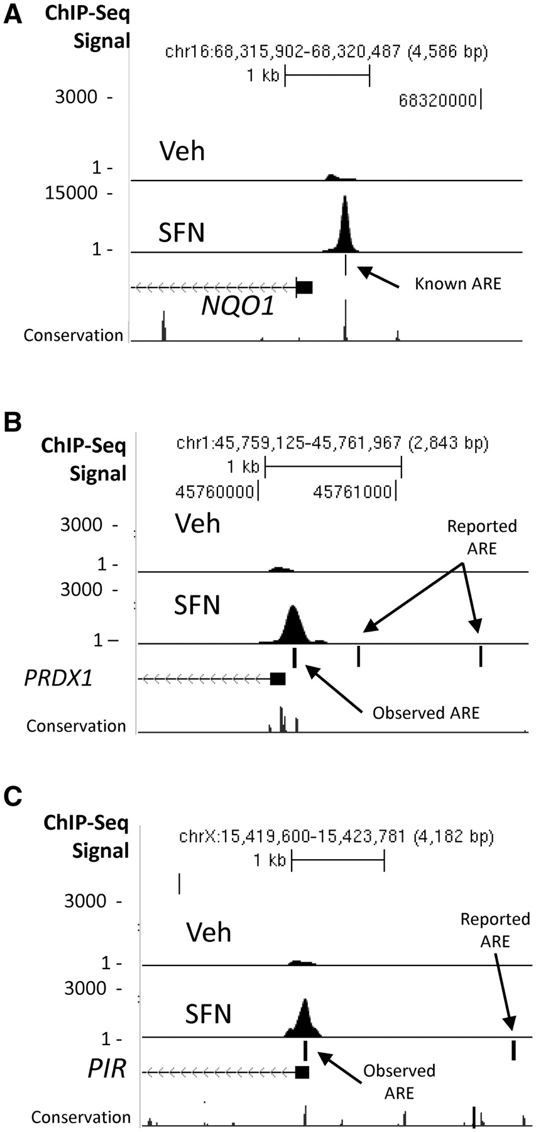
Figure 3. Examples of NRF2 ChIP-seq peaks at AREs in the gene promoter regions of (A) NQO1, (B) PIR and (C) PRDX1. ...
Notes:
Figure 3. Examples of NRF2 ChIP-seq peaks at AREs in the gene promoter regions of (A) NQO1, (B) PIR and (C) PRDX1. Control reads from IgG IP are shown in the first track (IgG), vehicle-treated samples in the second track (Veh) and SFN-treated samples in the third track (SFN). Ticks represent reported ARE sites, based on previous literature (Supplementary File 1 and Supplementary Table S4) or observed AREs.
Unless provided in the caption above, the following copyright applies to the content of this slide: Published by Oxford University Press 2012.This is an Open Access article distributed under the terms of the Creative Commons Attribution Non-Commercial License (http://creativecommons.org/licenses/by-nc/3.0), which permits unrestricted non-commercial use, distribution, and reproduction in any medium, provided the original work is properly cited.

Slide 4
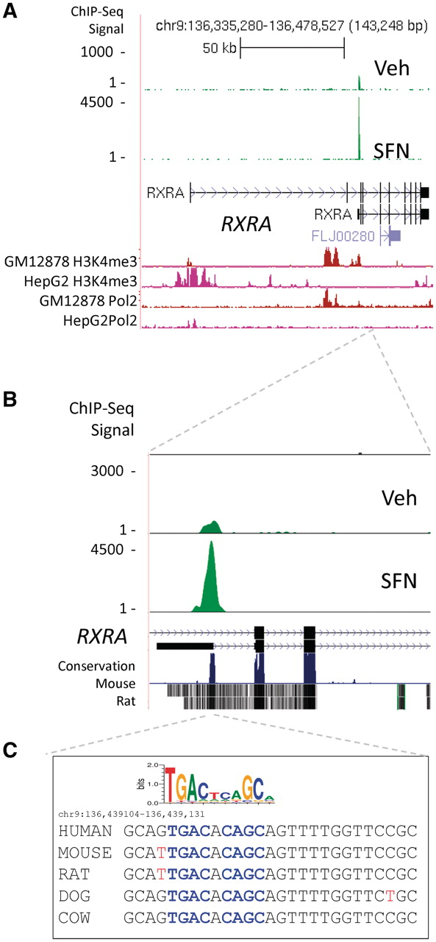
Figure 4. ChIP-seq peak region near an alternative TSS for the RXRA gene. (A) ChIP-seq peak region is mapped ∼80-kb ...
Notes:
Figure 4. ChIP-seq peak region near an alternative TSS for the RXRA gene. (A) ChIP-seq peak region is mapped ∼80-kb downstream of the RXRA TSS as defined by NCBI genome build 36.3. Tracks displaying ENCODE H3K4me3 and RNAPol2 ChIPseq data indicate open chromatin and active transcription near the alternate start site (Supplementary Figure S6). The peak region is within 1 kb of an alternative TSS of RXRA, seen in more detail in (B). (C) Sequence under the peak region contains a highly conserved ARE sequence, which closely matches the consensus sequence (blue) as shown by the sequence logo. Mouse and rat nucleotides not matching the human sequence are displayed in red.
Unless provided in the caption above, the following copyright applies to the content of this slide: Published by Oxford University Press 2012.This is an Open Access article distributed under the terms of the Creative Commons Attribution Non-Commercial License (http://creativecommons.org/licenses/by-nc/3.0), which permits unrestricted non-commercial use, distribution, and reproduction in any medium, provided the original work is properly cited.

Slide 5
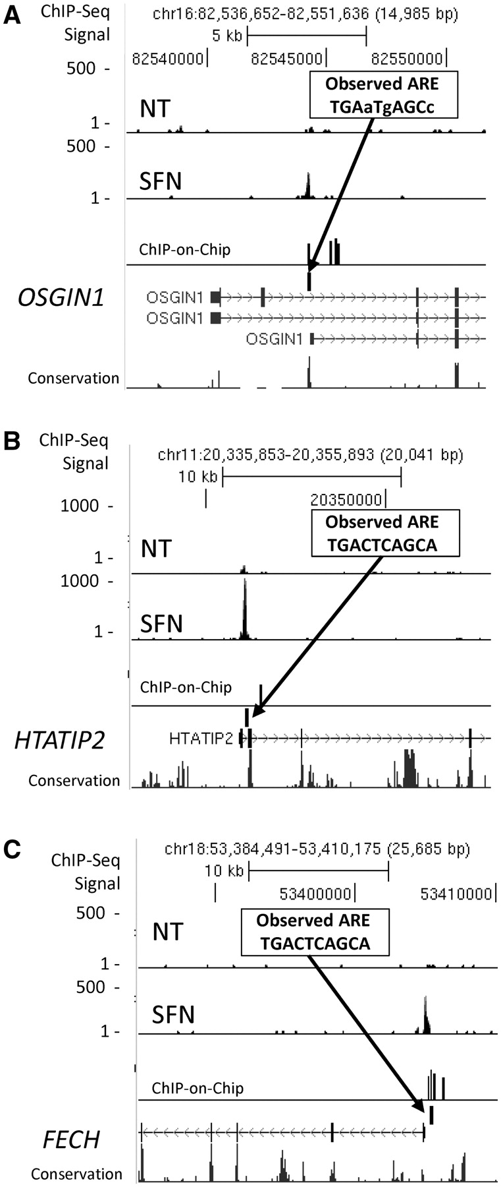
Figure 5. Peak regions that matched in ChIP-seq and ChIP-on-chip. Three examples of genes, OSGIN1 (A), HTATIP2 (B) and ...
Notes:
Figure 5. Peak regions that matched in ChIP-seq and ChIP-on-chip. Three examples of genes, OSGIN1 (A), HTATIP2 (B) and FECH (C), which have not been previously described as regulated by NRF2. Insets display ARE motif under the ChIP-peak regions. Lower case nucleotides represent mismatch with ARE consensus.
Unless provided in the caption above, the following copyright applies to the content of this slide: Published by Oxford University Press 2012.This is an Open Access article distributed under the terms of the Creative Commons Attribution Non-Commercial License (http://creativecommons.org/licenses/by-nc/3.0), which permits unrestricted non-commercial use, distribution, and reproduction in any medium, provided the original work is properly cited.

Slide 6
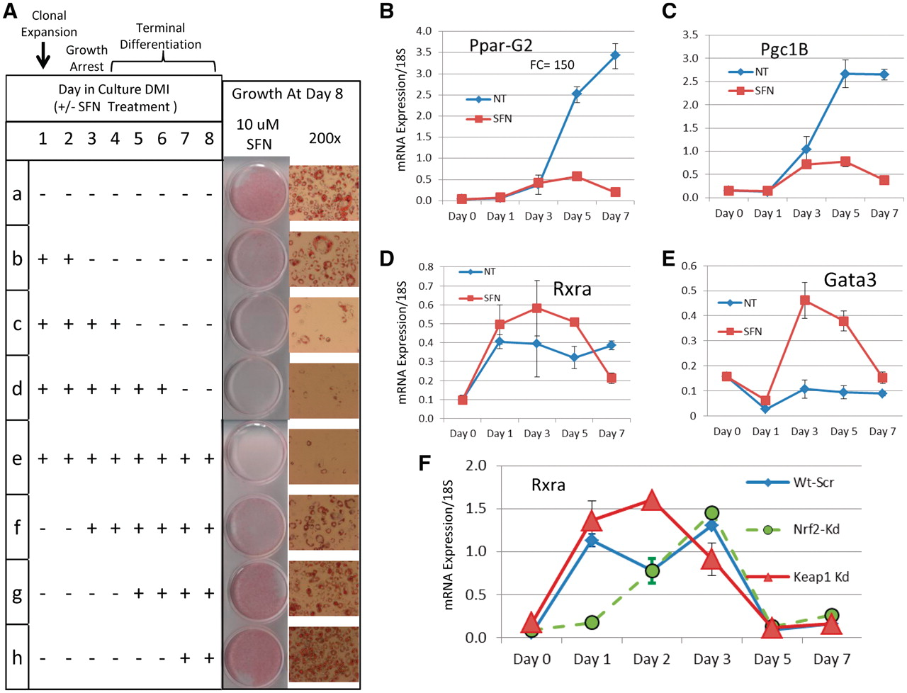
Figure 6. Effects of SFN treatment on 3T3-L1 adipocytes during differentiation. (A) Table displays eight treatment ...
Notes:
Figure 6. Effects of SFN treatment on 3T3-L1 adipocytes during differentiation. (A) Table displays eight treatment conditions (SFN ± starting and ending on different days). Growth at day 8 is shown in photographs at two magnifications. Treatment for 2, 4, 6 or 8 days inhibits adipogenesis. Treatments starting at day 2 or later have less effect. (B) PparG2 expression by real-time PCR increases rapidly after day 3 under standard differentiation conditions indicating commitment to terminal adipocyte state. Continuous SFN treatment prevents differentiation. (C) Rxra expression is higher under SFN treatment conditions. (D) Expression of Pgc1B, the PPAR coactivator (homolog of human PPARGC1B), is similar to Pparg2 both untreated and treated. (E) Gata3, a negative regulator of adipogenesis, dips initially, then increases dramatically by Day 3 with SFN treatment. (F) Rxra expression was tested in 3T3-L1 adipocytes with shRNA knockdown of Nrf2 (Nrf2-Kd, green) and Keap1 (Keap1-Kd, red). Keap1 knockdown genetically activates Nrf2. The Rxra expression profile under Keap1 knockdown (red triangles) is very similar to that observed for SFN treatment (C, red squares). Nrf2 knockdown (green) delays the rise in Rxra expression. This is accompanied by impaired adipogenesis (32).
Unless provided in the caption above, the following copyright applies to the content of this slide: Published by Oxford University Press 2012.This is an Open Access article distributed under the terms of the Creative Commons Attribution Non-Commercial License (http://creativecommons.org/licenses/by-nc/3.0), which permits unrestricted non-commercial use, distribution, and reproduction in any medium, provided the original work is properly cited.

