Slide 1
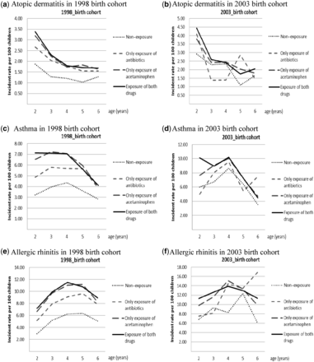
Figure 1 Incidence rate of acetaminophen and/or antibiotic use for three examined atopic diseases (atopic dermatitis, ...
Notes:
Figure 1 Incidence rate of acetaminophen and/or antibiotic use for three examined atopic diseases (atopic dermatitis, asthma, allergic rhinitis) in the 1998 and 2003 birth cohorts, separately
Unless provided in the caption above, the following copyright applies to the content of this slide: Published by Oxford University Press on behalf of the International Epidemiological Association © The Author 2013; all rights reserved.

