Slide 1
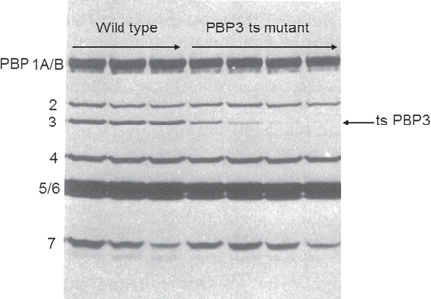
Figure 1. Identifying the function of an E. coli PBP using temperature-sensitive mutants. Most penicillins and ...
Notes:
Figure 1. Identifying the function of an E. coli PBP using temperature-sensitive mutants. Most penicillins and cephalosporins inhibit E. coli cell division at low concentrations and one of the PBPs should be essential for this process. Mutants that could not divide at 42°C were isolated and screened for the production of a thermolabile PBP, by pre-incubating cell envelopes for increasing times at 42°C and examining their subsequent ability to bind radioactive penicillin when returned to 30°C. Whereas pre-incubation at 42°C does not reduce penicillin binding in the wild type (left three lanes), in this cell division mutant pre-incubation at 42°C rapidly reduces the ability of PBP 3 to bind penicillin at 30°C (right four lanes). This PBP was therefore assigned an essential role in peptidoglycan synthesis at cell division. Reproduced from reference 36 with kind permission from the American Society for Microbiology.
Unless provided in the caption above, the following copyright applies to the content of this slide: © The Author 2012. Published by Oxford University Press on behalf of the British Society for Antimicrobial Chemotherapy. All rights reserved. For Permissions, please e-mail: journals.permissions@oup.com

Slide 2
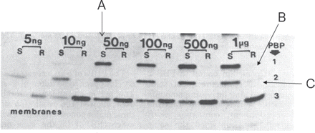
Figure 2. Alterations of PBP 1 and PBP 2 in a non-β-lactamase-producing penicillin-resistant clinical isolate of N. ...
Notes:
Figure 2. Alterations of PBP 1 and PBP 2 in a non-β-lactamase-producing penicillin-resistant clinical isolate of N. gonorrhoeae. In a penicillin-susceptible strain (S) radioactive penicillin binds to all three gonococcal PBPs at concentrations ≥50 ng/mL (A), whereas in the resistant clinical isolate no binding to PBP 1 or PBP 2 is observed even at 1 μg/mL (B, C). Reproduced from reference 8 with kind permission from the American Society for Microbiology.
Unless provided in the caption above, the following copyright applies to the content of this slide: © The Author 2012. Published by Oxford University Press on behalf of the British Society for Antimicrobial Chemotherapy. All rights reserved. For Permissions, please e-mail: journals.permissions@oup.com

Slide 3
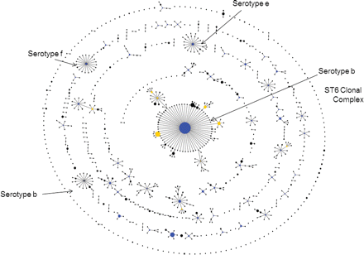
Figure 3. The use of an eBURST population snapshot to display the clonal complexes, and those isolates not closely ...
Notes:
Figure 3. The use of an eBURST population snapshot to display the clonal complexes, and those isolates not closely related to others (singletons), within the current Haemophilus influenzae MLST database. The arrows identify the major serotype b ST6 clonal complex, a minor serotype b clonal complex and clonal complexes of serotype e and f strains (see reference 23 for details).
Unless provided in the caption above, the following copyright applies to the content of this slide: © The Author 2012. Published by Oxford University Press on behalf of the British Society for Antimicrobial Chemotherapy. All rights reserved. For Permissions, please e-mail: journals.permissions@oup.com

Slide 4
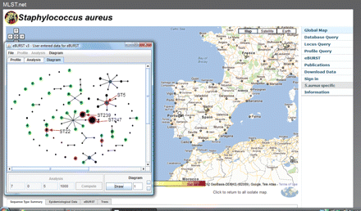
Figure 4. Geographic eBURST available within the current version of the Imperial College MLST web site. Isolates of S. ...
Notes:
Figure 4. Geographic eBURST available within the current version of the Imperial College MLST web site. Isolates of S. aureus from Spain were compared with those from Portugal. The population snapshot shows strains in the MLST database from Spain as black circles, those from Portugal as green circles, and those found in both countries as magenta. Some of the STs that correspond to major MRSA clones are indicated, all of which are found in both Spain and Portugal.
Unless provided in the caption above, the following copyright applies to the content of this slide: © The Author 2012. Published by Oxford University Press on behalf of the British Society for Antimicrobial Chemotherapy. All rights reserved. For Permissions, please e-mail: journals.permissions@oup.com

Slide 5
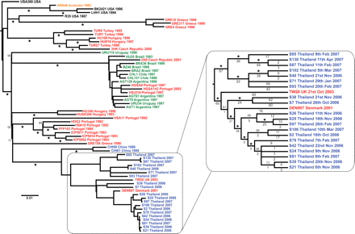
Figure 5. Intercontinental spread and hospital transmission of MRSA ST239 isolates. Maximum likelihood phylogenetic ...
Notes:
Figure 5. Intercontinental spread and hospital transmission of MRSA ST239 isolates. Maximum likelihood phylogenetic tree based on differences (SNPs) in the core genomes of 63 ST239 isolates. The continent from which each isolate was obtained is indicated by the colour of the isolate name: blue, Asia; black, North America; green, South America; red, Europe; and yellow, Australasia. The Thai cluster, representing isolates from a single hospital, is displayed in greater resolution. Two of the isolates in this cluster were from Europe; however, one was recovered from a Thai patient. Even though the isolates are all the same by MLST, among the 63 isolates, variation is found at 4310 nucleotide positions and the sequence of each isolate is different. Reproduced from reference 14 with kind permission from the American Association for the Advancement of Science.
Unless provided in the caption above, the following copyright applies to the content of this slide: © The Author 2012. Published by Oxford University Press on behalf of the British Society for Antimicrobial Chemotherapy. All rights reserved. For Permissions, please e-mail: journals.permissions@oup.com

Slide 6
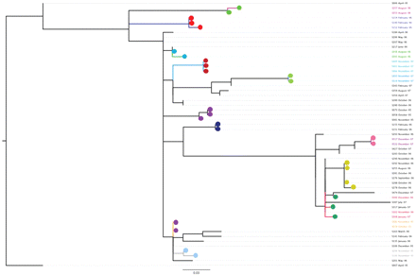
Figure 6. Genome sequences of gonococci from known sexual contacts. A maximum likelihood tree is shown, based on ...
Notes:
Figure 6. Genome sequences of gonococci from known sexual contacts. A maximum likelihood tree is shown, based on differences in the core genome of a subset of isolates of a single strain of N. gonorrhoeae (ST12, as defined by NG-MAST) that was circulating in Sheffield in the mid-1990s. All isolates were obtained between April 1995 and December 1997 and included some that were from mutually named sexual contacts, obtained in the clinic within 1 month of each other37 (indicated as those with filled circles of the same colour). N. Bilek, C. J. Bishop, T. R. Connor, S. D. Bentley, B. G. Spratt et al., unpublished data.
Unless provided in the caption above, the following copyright applies to the content of this slide: © The Author 2012. Published by Oxford University Press on behalf of the British Society for Antimicrobial Chemotherapy. All rights reserved. For Permissions, please e-mail: journals.permissions@oup.com

Slide 7
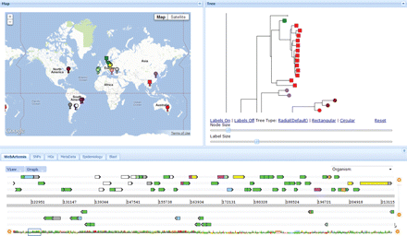
Figure 7. Collaborator's tool for analysis of sets of bacterial genome sequences. The web application has been loaded ...
Notes:
Figure 7. Collaborator's tool for analysis of sets of bacterial genome sequences. The web application has been loaded with the genome sequences, and genome assemblies, of the 63 isolates of MRSA ST239 shown in Figure 5. The three main panels are fully interactive, so that clicking on an isolate or node on the tree (right panel), which is zoomed in to show the cluster of isolates from the same Thai hospital, automatically shows the map location of the source of the isolate(s) (left panel), and the nucleotide differences in a genome browser (Web Artemis, bottom panel). Phenotypic data (for example, MRSA or MSSA status for S. aureus genomes) and the distribution of any accessory gene (for example, the Panton–Valentine leucocidin genes) can be shown by differential colouring of the terminal nodes on the tree and the flags on the map. The tabs below the map provide additional information on the isolates and further functionalities to help analyse the genome data. D. Aanensen, C. Powell, B. G. Spratt et al., unpublished data.
Unless provided in the caption above, the following copyright applies to the content of this slide: © The Author 2012. Published by Oxford University Press on behalf of the British Society for Antimicrobial Chemotherapy. All rights reserved. For Permissions, please e-mail: journals.permissions@oup.com

Slide 8
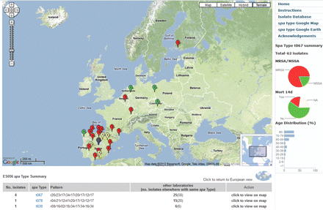
Figure 8. Web application to analyse the distribution of spa types of 2890 S. aureus isolates isolated in 450 hospitals ...
Notes:
Figure 8. Web application to analyse the distribution of spa types of 2890 S. aureus isolates isolated in 450 hospitals in 28 countries across Europe by the EARSS Consortium.35 An individual spa type (t067) has been selected showing its distribution mainly in Spain and Portugal. Red markers are MRSA, green are MSSA. These data, preloaded in the web application, are available at http://www.spatialepidemiology.net/srl-maps.
Unless provided in the caption above, the following copyright applies to the content of this slide: © The Author 2012. Published by Oxford University Press on behalf of the British Society for Antimicrobial Chemotherapy. All rights reserved. For Permissions, please e-mail: journals.permissions@oup.com

