Slide 1
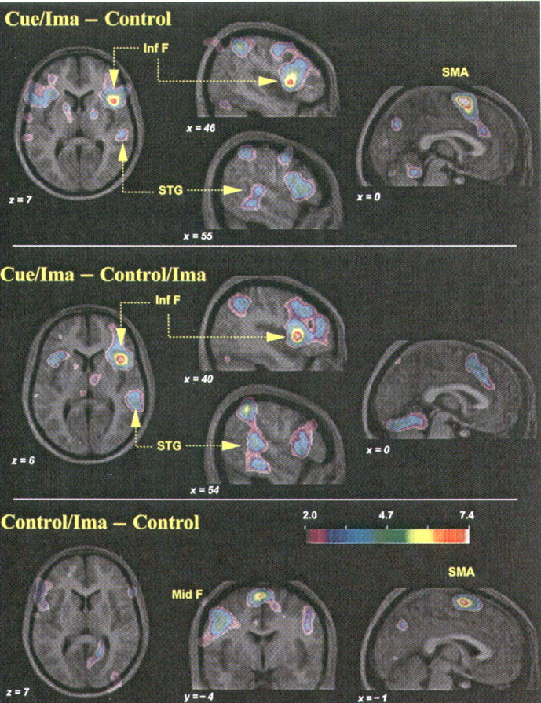
Figure 2. Merged PET/MRI images illustrating selected regions of significant increase in CBF in each of three ...
Notes:
Figure 2. Merged PET/MRI images illustrating selected regions of significant increase in CBF in each of three comparisons. (Top panel) Areas of CBF increase in the Cue/Image – Control subtraction (keyed to Table 2). The leftmost image corresponds to a horizontal section (z = 7) and shows the activity in the right and left inferior frontal gyrus, corresponding to foci 2 and 5 respectively in Table 2. Also visible in the horizontal section is activation in the right superior temporal gyrus (focus 9 in Table 2). The right frontal and temporal areas of activity are also shown in the two parasagittal sections through the right hemisphere shown in the middle of the top panel (x = 46 and 55). The positions of the dotted lines indicate corresponding planes of section in the figures. The rightmost image in the top panel shows the SMA activity in a midsaggital section (focus 11 in Table 2). (Middle panel) Areas of CBF increasein the Cue/Image – Control/Image subtraction (keyed to Table 3). The horizontal section (z = 6) and the two parasagittal sections (x = 40 and 54) illustrate the activation in right and left frontal areas (foci 2 and 4 of Table 3), and in the right superior temporal cortex (focus 6). Note the similarity of activation in right and left inferior frontal areas and right superior temporal cortex to the upper panel. Note also the absence of SMA activity in the midsaggital section (far right). (Bottom panel) Images associated with the Control/Image – Control subtraction (keyed to Table 4). The horizontal section (z = 7) is included to demonstrate the absence of activation in frontal or temporal areas comparable to those shown in the other two panels. The middle image is a coronal section (y = 4) to show the region of left midfrontal activity (focus 3 in Table 4). Also visible in this section and in the midsaggital section (far right) is activity within the SMA (focus 7 in Table 4).
Unless provided in the caption above, the following copyright applies to the content of this slide: © Oxford University Press

Slide 2
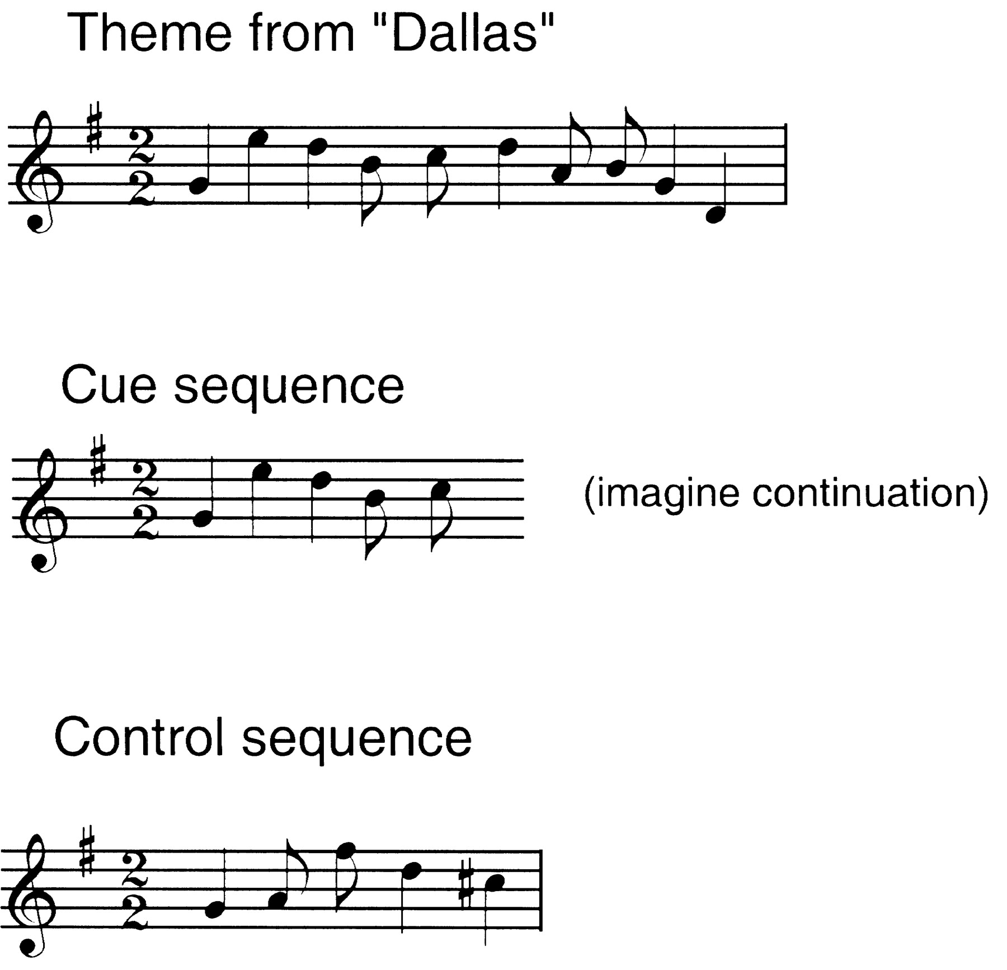
Figure 1. Illustration of the stimuli used, in musical notation. The first line illustrates a melodic theme taken from ...
Notes:
Figure 1. Illustration of the stimuli used, in musical notation. The first line illustrates a melodic theme taken from the television show Dallas which was played to subjects during screening sessions and prior to scanning. The second line illustrates the cue sequence for this item (consisting of the first five notes of the theme), which was used during the Cue/Image condition. Subjects were instructed to imagine the rest of the theme continuing from the cue sequence. The third line shows a control sequence (consisting of a random permutation of the five notes), which was used during the Control and Control/Image conditions.
Unless provided in the caption above, the following copyright applies to the content of this slide: © Oxford University Press

