Slide 1
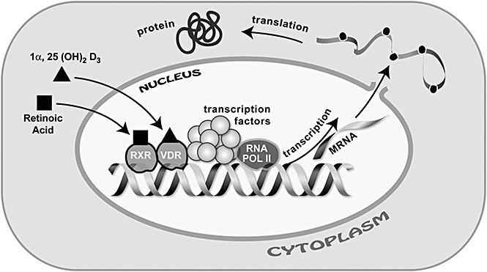
Figure 1 Molecular functions of vitamin D in neuronal stem cells. The hormonal form of vitamin D acts as a ligand for ...
Notes:
Figure 1 Molecular functions of vitamin D in neuronal stem cells. The hormonal form of vitamin D acts as a ligand for the nuclear vitamin D receptor (VDR). Heterodimerization of VDR with the retinoic acid receptor RXR results in DNA binding that, together with other cell-specific transcription factors and RNA polymerase II (RNA POL II) regulate transcription of mRNA that codes for cellular proteins. These mechanisms are responsible for the role of vitamin D in the regulation of stem cell proliferation, survival, and differentiation in the developing brain.
Unless provided in the caption above, the following copyright applies to the content of this slide: © 2008 International Life Sciences Institute

