Slide 1
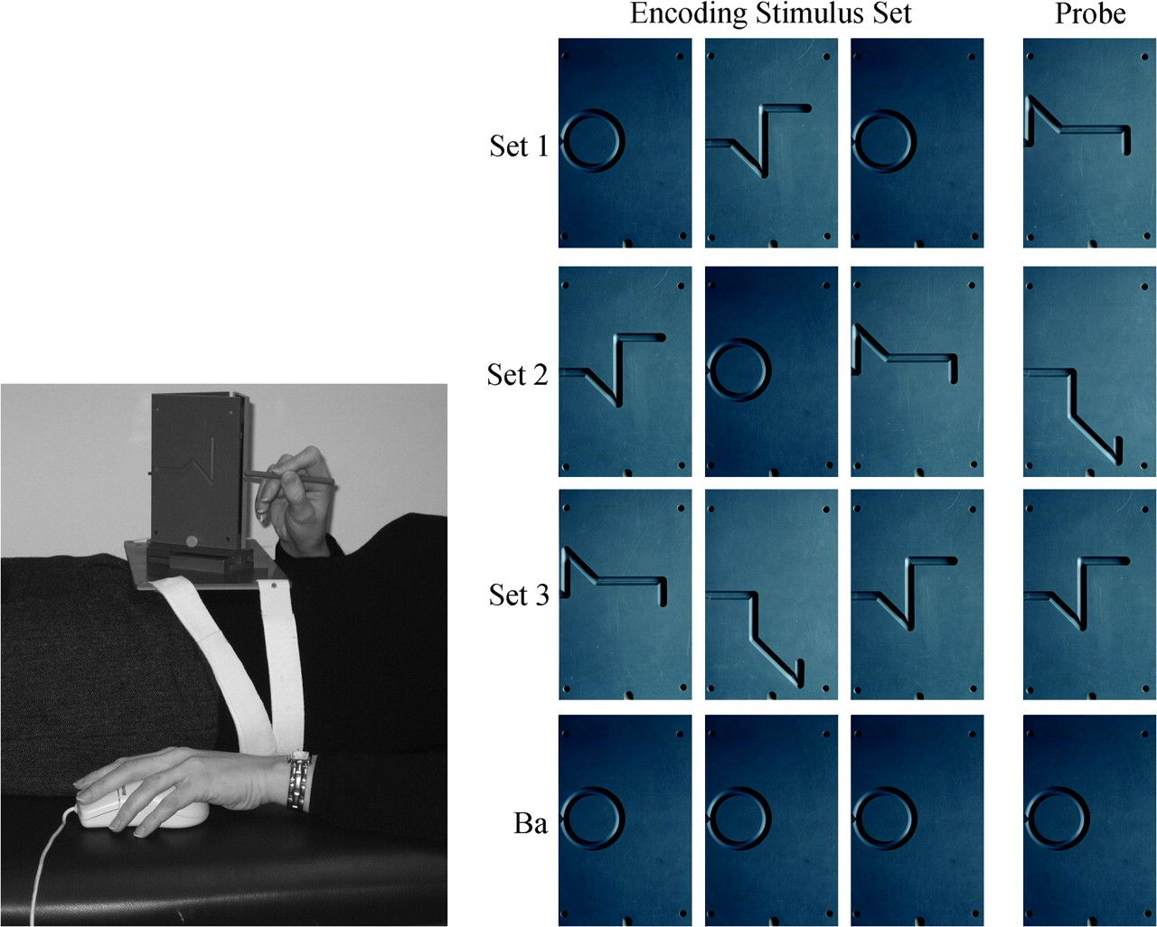
Figure 1. Experimental setup und task conditions. Left: The experimental setup shown as used in the training session ...
Notes:
Figure 1. Experimental setup und task conditions. Left: The experimental setup shown as used in the training session outside the scanner. The same device was used in the scanner. Task stimuli were different line patterns engraved in plastic cards. The cards were attached to a triangular cardholder which could be turned such that one side was oriented toward the hand of the participant. Participants were blindfolded. They traced the line patterns with a stylus with their right hand and performed task-related button presses with their left hand. Right: Sample stimuli of the delayed-recognition task. Stimuli presented during encoding contained 0 (Ba, baseline), 1 (Set 1), 2 (Set 2), or 3 (Set 3) multisegment line patterns and 3, 2, 1, or 0 circular line patterns, respectively. An increasing number of multisegment line patterns reflects an increase in task difficulty. During recognition, one probe stimulus was presented which matched a stimulus from the memory set in 50% of the trials.
Unless provided in the caption above, the following copyright applies to the content of this slide: © The Author 2007. Published by Oxford University Press. All rights reserved. For permissions, please e-mail: journals.permissions@oxfordjournals.org

Slide 2
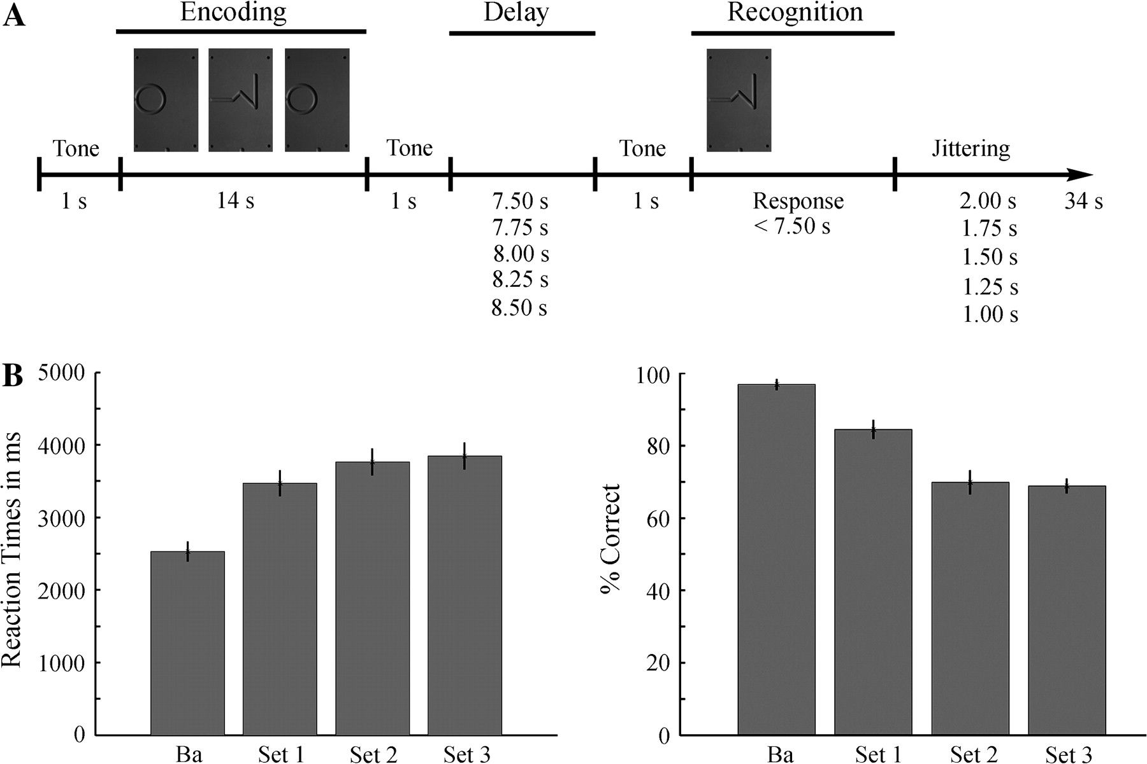
Figure 2. Schematic outline of the delayed-recognition task and behavioral results. (A) The task schedule is ...
Notes:
Figure 2. Schematic outline of the delayed-recognition task and behavioral results. (A) The task schedule is illustrated for a trial of the Set 1 condition. Three different line patterns had to be traced with a stylus and encoded. The hand movements had to be maintained in working memory for a variable delay of 7500–8500 ms. Then a probe stimulus had to be traced and a motor response had to be given indicating whether the probe matched one of the stimulus from the memory set. (B) Reaction times (left) and percent correct responses (right) for the 4 task conditions (N = 14).
Unless provided in the caption above, the following copyright applies to the content of this slide: © The Author 2007. Published by Oxford University Press. All rights reserved. For permissions, please e-mail: journals.permissions@oxfordjournals.org

Slide 3
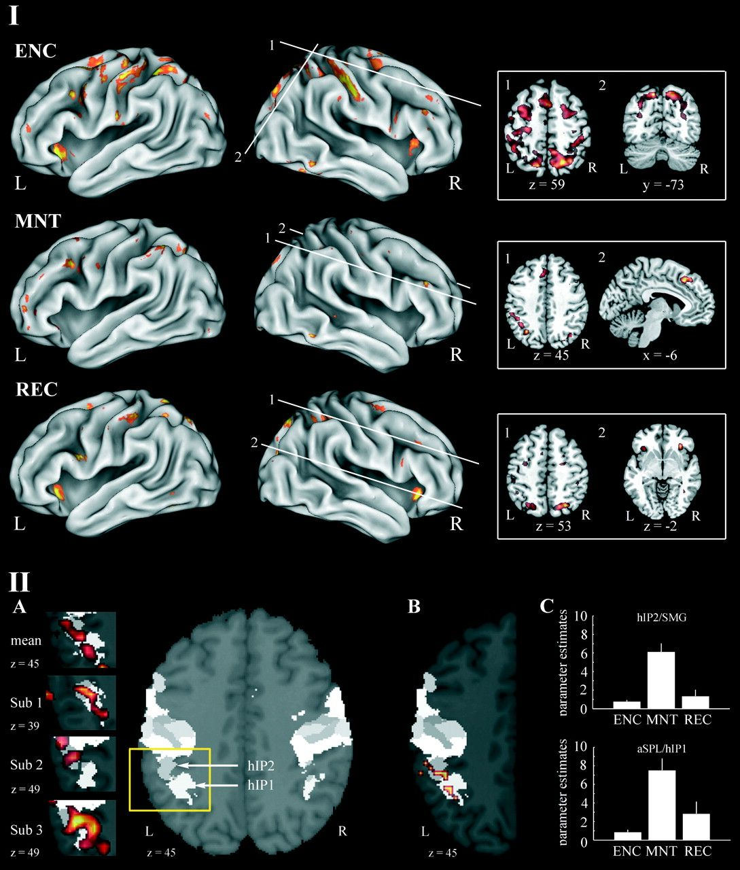
Figure 3. (I) BOLD responses in the delayed-recognition task during movement encoding (ENC) maintenance (MNT), and ...
Notes:
Figure 3. (I) BOLD responses in the delayed-recognition task during movement encoding (ENC) maintenance (MNT), and recognition (REC). Group-averaged (N = 14) statistic maps of significantly activated areas are depicted for the contrast Set 3 versus baseline. Selected coronal axial and saggital slices are shown on the right panel. Cluster size was set at 10 contiguous voxels and activation threshold was set at P < 0.001, uncorrected. Figures were created with the software packages Caret (http://brainmap.wustl.edu/resources/caretnew.html) and MRIcro (http://www.sph.sc.edu/comd/rorden/mricro.html). L, left; R, right. (II) Activation within the aIPS. (A) Maximum probability map (MPM) on axial section at z = 45. hIP1 and hIP2 of the aIPS are coded by different gray levels. The left panel shows neural activation of the contrast Set 3 versus baseline during the delay period for group-averaged data (mean N = 14) and for 3 participants (sub 1, sub 2, and sub 3). BOLD effects are superimposed on a section view zoomed into the region around the aIPS as indicated by the yellow box. (B) Activation within hIP1 and hIP2 as revealed by the parametrical analysis is overlaid on axial section at z = 45 of the MPM. The illustration is restricted to the left hemisphere because no significant activation occurred in the right IPS. (C) Bar plots show parameter estimates of the contrast Set 3 versus baseline for areas aSPL/hIP1 and hIP2/SMG for the encoding (ENC), maintenance (MNT), and recognition (REC) periods.
Unless provided in the caption above, the following copyright applies to the content of this slide: © The Author 2007. Published by Oxford University Press. All rights reserved. For permissions, please e-mail: journals.permissions@oxfordjournals.org

Slide 4
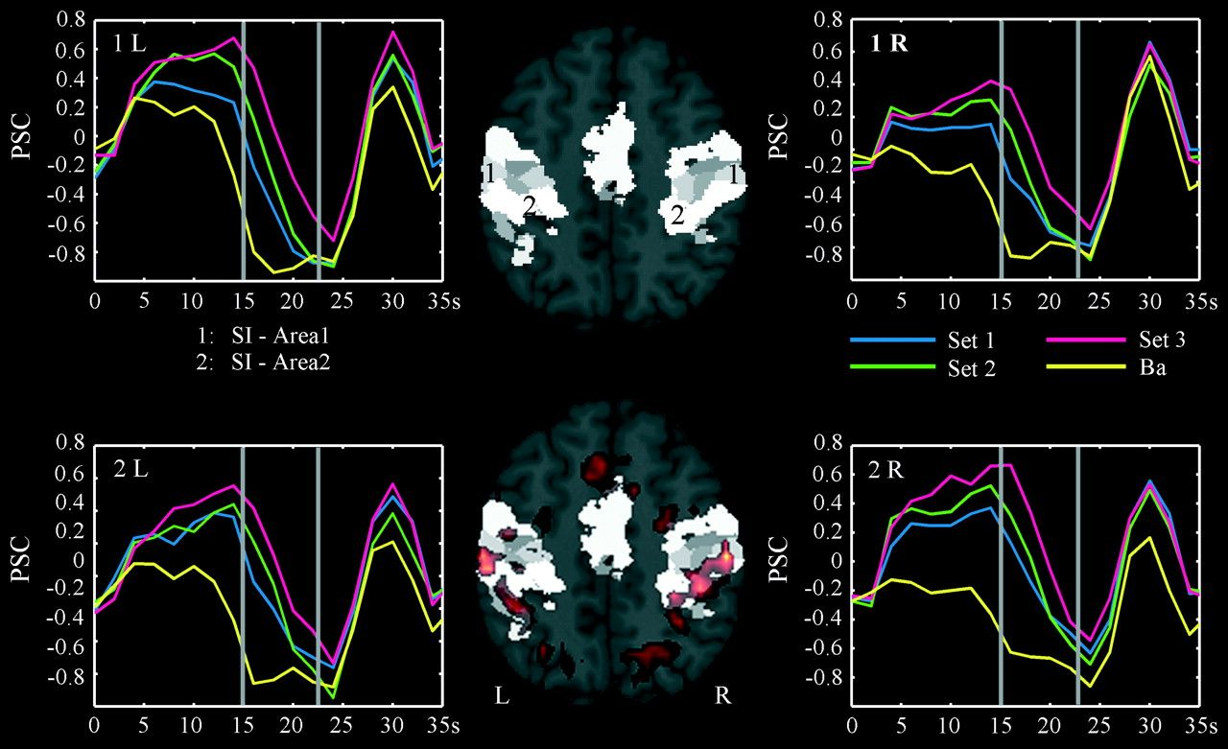
Figure 4. Cortical activity and its trial-averaged time courses in SI. Brain activation of the contrast Set 3 versus ...
Notes:
Figure 4. Cortical activity and its trial-averaged time courses in SI. Brain activation of the contrast Set 3 versus baseline during the encoding period is superimposed on the maximum probability map (MPM) for primary somatosensory cortex on axial section at z = 51. The numbers of the MPM indicate the anatomical locations of Area 1 and Area 2 of the coded by different gray levels. Percent signal change (PSC) of selected voxels within Area 1 and Area 2 of SI are depicted for the 4 task conditions. The first and second vertical gray lines mark the end of the encoding period and the beginning of the recognition period respectively. L, left; R, right. Figures were created with the software packages Anatomy toolbox (Eickhoff et al. 2005; http://www.fz-juelich.de/ime/spm_anatomy_toolbox) and MRIcro (http://www.sph.sc.edu/comd/rorden/mricro.html).
Unless provided in the caption above, the following copyright applies to the content of this slide: © The Author 2007. Published by Oxford University Press. All rights reserved. For permissions, please e-mail: journals.permissions@oxfordjournals.org

