Slide 1
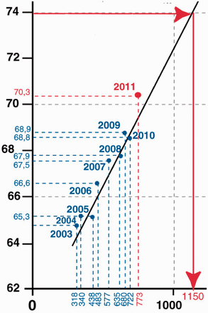
Figure1 Life expectancy in Russia at birth (ordinate, years) vs. state health care spending (abscissa, Russian ...
Notes:
Figure1 Life expectancy in Russia at birth (ordinate, years) vs. state health care spending (abscissa, Russian roubles in US dollars equivalent purchasing capacity). Prepared using data from RosStat (Russian State Statistics Committee, gks.ru,) by G.E. Ulumbekova and V. V. Vlassov
Unless provided in the caption above, the following copyright applies to the content of this slide: © The Author 2012. Published by Oxford University Press on behalf of the European Public Health Association. All rights reserved.

