Slide 1
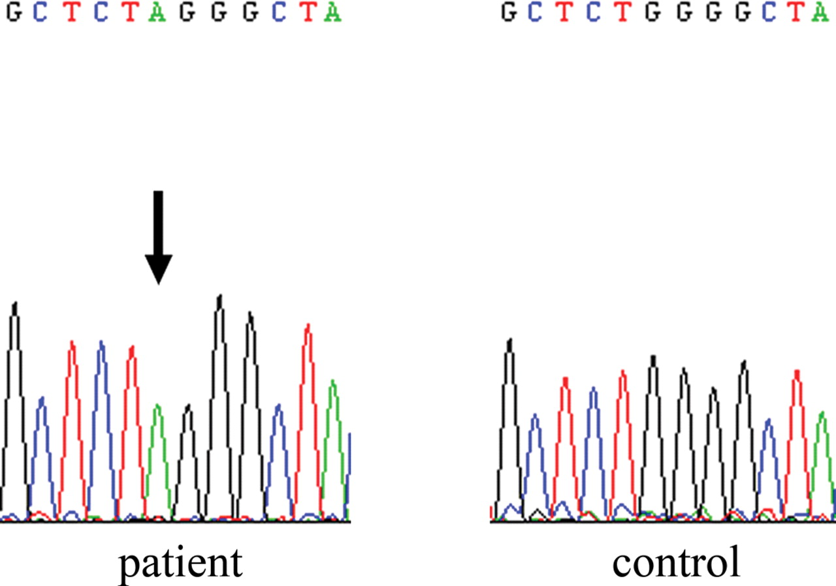
Figure 1. The sequence analysis of the SCARB2 gene revealed homozygosity for c.533G>A mutation. Direct sequencing of ...
Notes:
Figure 1. The sequence analysis of the SCARB2 gene revealed homozygosity for c.533G>A mutation. Direct sequencing of exon 4 of the patient and a control revealed the homozygous G-to-A substitution at position 533, resulting in a tryptophan-to-stop codon change. Arrow indicates the G-to-A mutation in the patient.
Unless provided in the caption above, the following copyright applies to the content of this slide: © The Author 2008. Published by Oxford University Press. All rights reserved. For Permissions, please email: journals.permissions@oxfordjournals.org

Slide 2
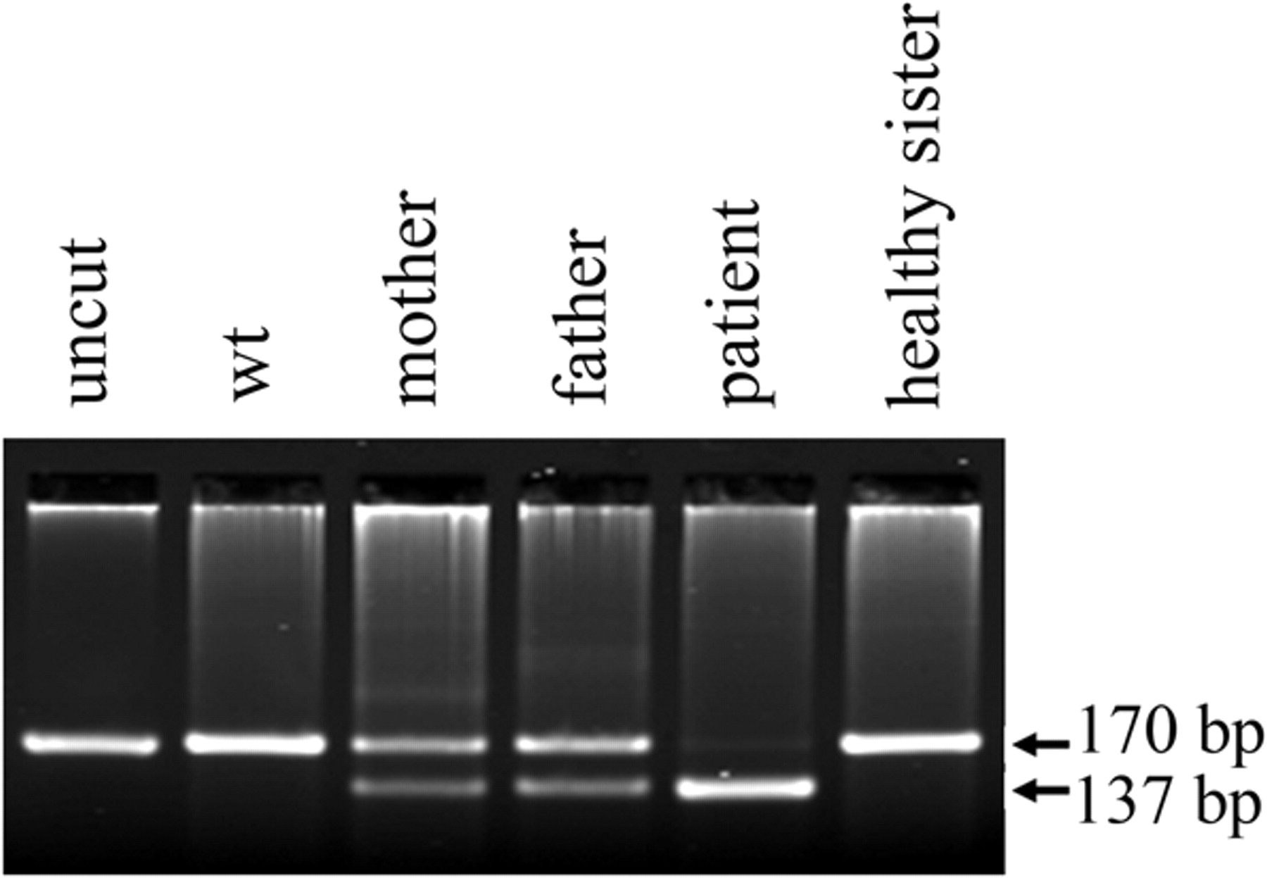
Figure 2. Detection of the c.533G>A mutation by restriction analysis. G-to-A transition at position 533 creates a ...
Notes:
Figure 2. Detection of the c.533G>A mutation by restriction analysis. G-to-A transition at position 533 creates a cleavage site for FspBI. The mutant 170 bp fragment is digested giving two fragments of 137 and 33 bp, whereas wild-type (wt) fragments remain uncleaved. Arrows indicate the 170 and 137 bp fragments.
Unless provided in the caption above, the following copyright applies to the content of this slide: © The Author 2008. Published by Oxford University Press. All rights reserved. For Permissions, please email: journals.permissions@oxfordjournals.org

Slide 3
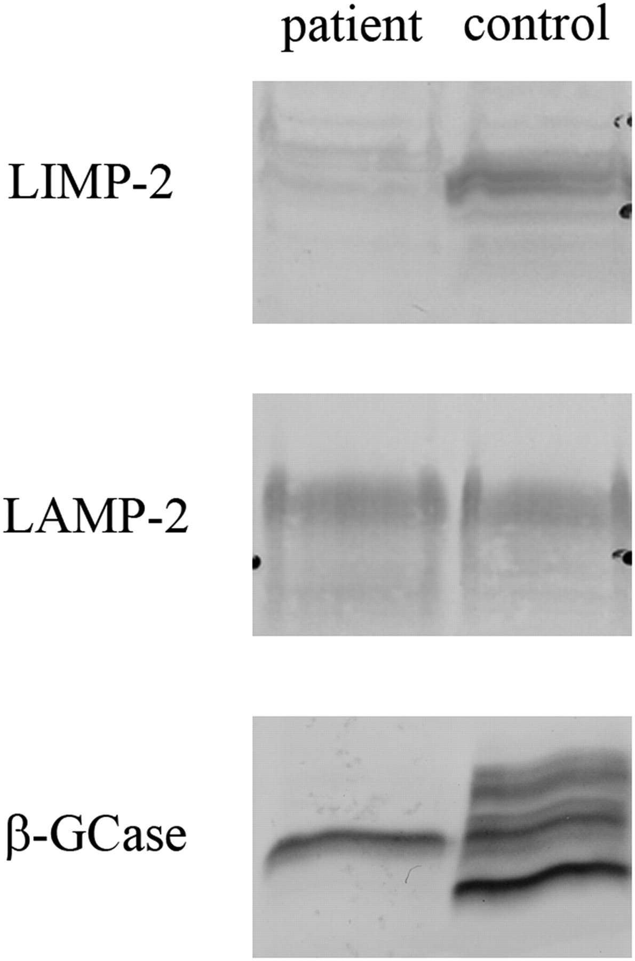
Figure 3. Western blotting analysis of LIMP-2, LAMP-2 and β-GCase in fibroblasts extracts. Fibroblast homogenates with ...
Notes:
Figure 3. Western blotting analysis of LIMP-2, LAMP-2 and β-GCase in fibroblasts extracts. Fibroblast homogenates with the same amount of protein (80 µg) from the patient and a healthy control were immunoblotted for LIMP-2 (upper panel), LAMP-2 (middle panel) and β-Gcase (lower panel).
Unless provided in the caption above, the following copyright applies to the content of this slide: © The Author 2008. Published by Oxford University Press. All rights reserved. For Permissions, please email: journals.permissions@oxfordjournals.org

Slide 4
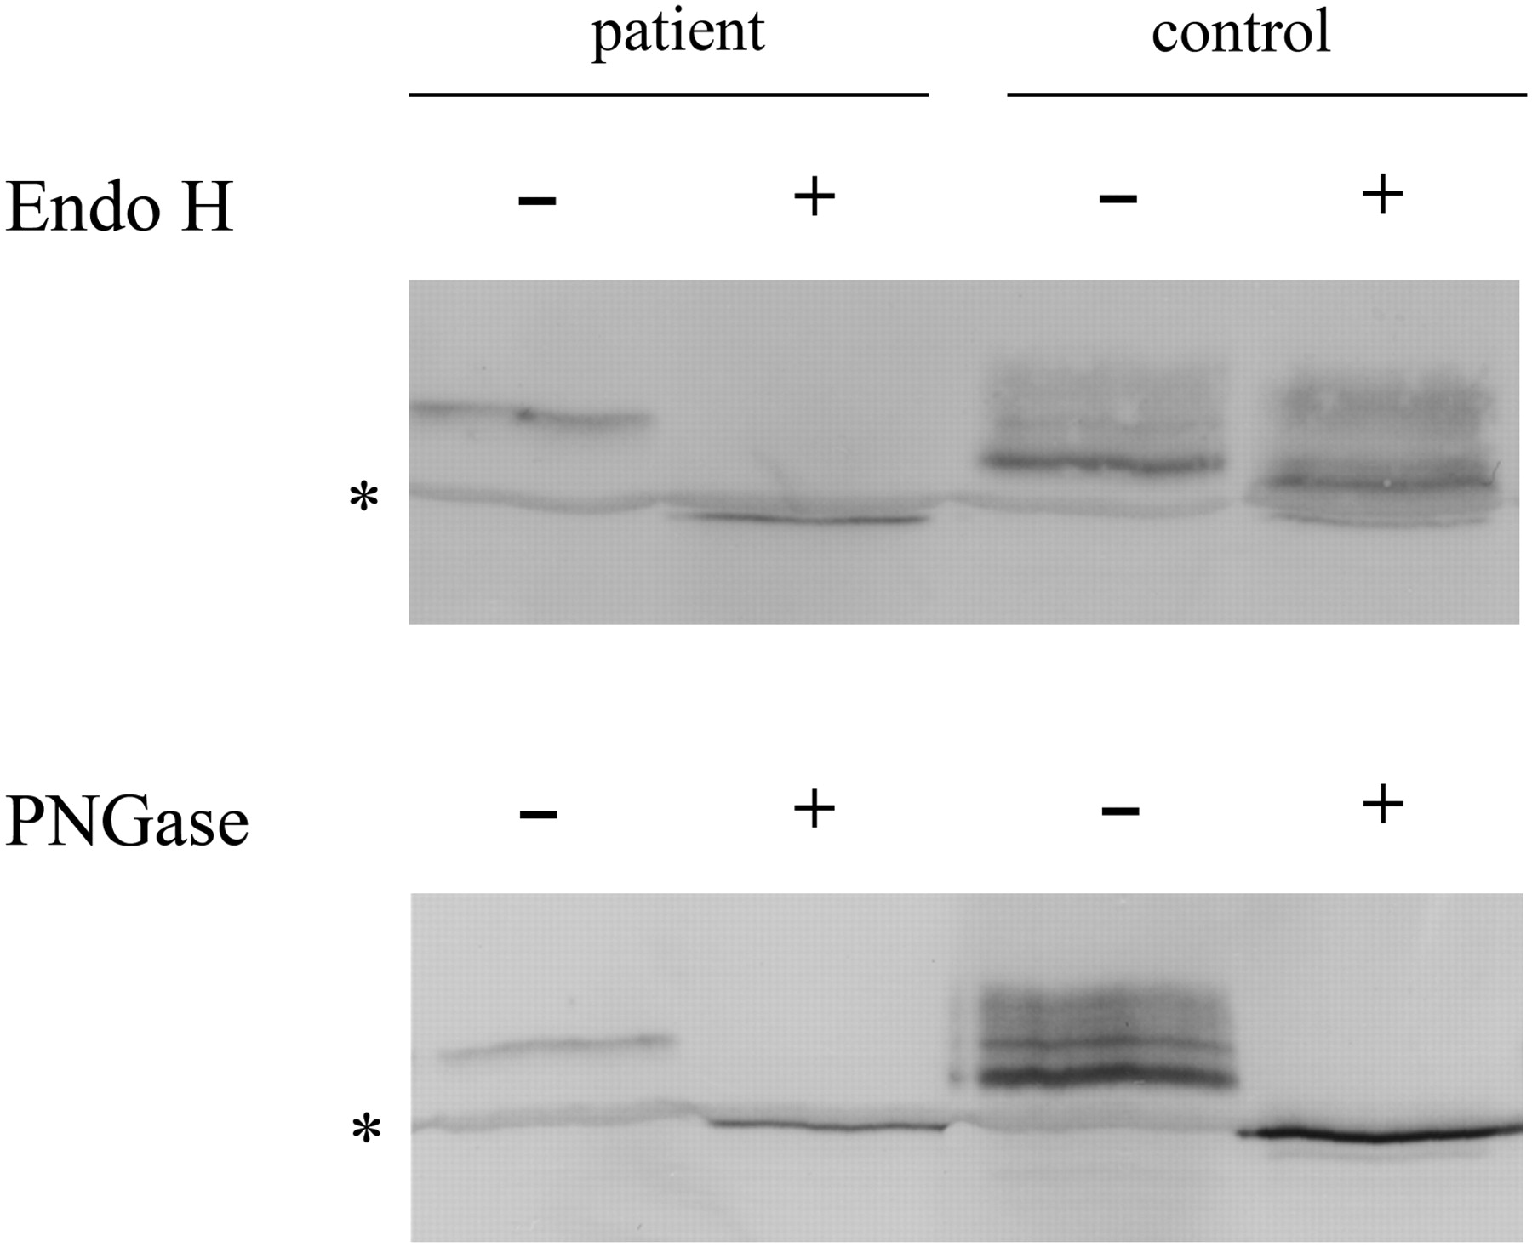
Figure 4. ER retention of β-GCase in LIMP-2-deficient fibroblasts. Fibroblast lysates with the same amount of protein ...
Notes:
Figure 4. ER retention of β-GCase in LIMP-2-deficient fibroblasts. Fibroblast lysates with the same amount of protein (15 µg) from the patient and a control were treated with Endo-H (upper panel) and PNGase F (lower panel) and immunoblotted for β-GCase. *Unspecific band occasionally detected by the antibody.
Unless provided in the caption above, the following copyright applies to the content of this slide: © The Author 2008. Published by Oxford University Press. All rights reserved. For Permissions, please email: journals.permissions@oxfordjournals.org

