Slide 1
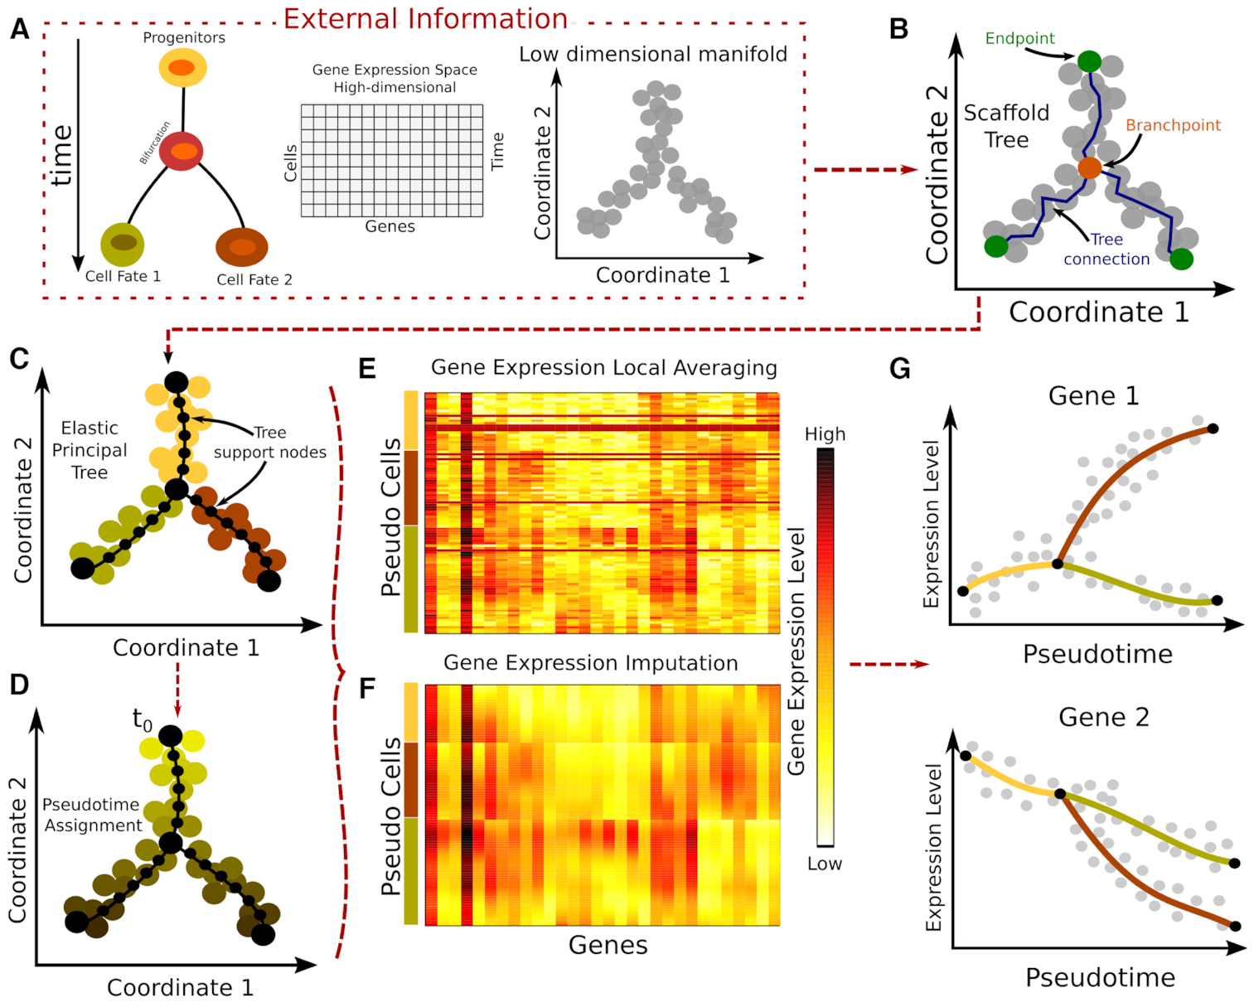
Figure 1. MERLoT’s workflow: (A) Input to MERLoT is a gene expression matrix sampled from a dynamic process in which ...
Notes:
Figure 1. MERLoT’s workflow: (A) Input to MERLoT is a gene expression matrix sampled from a dynamic process in which several cell types are present. MERLoT uses diffusion maps to reduce the dimensionality of the expression vectors for each cell to a few components (typically between 2 and 20). Users can provide any low-dimensional manifold set of coordinates to MERLoT as input. (B) A scaffold tree is calculated given the low-dimensional manifold coordinates. (C) The scaffold tree is used to initialize a principal elastic tree, composed of k support nodes (default: 100), on which cells are assigned to the different branches of the tree. (D) Given a cell or tree node as the initial pseudotime t0, pseudotime values propagate to the rest of cells/support nodes proportional to the distance along the tree that separates them from t0. (E) Expression values from cells assigned to a given support node or pseudocells (see main text) are averaged to provide the expression profile of each gene. (F) Gene expression values after imputation and interpolation in the gene expression space: A high-dimensional principal elastic tree is initialized with the connectivity from the low dimensional principal elastic tree plus the averaged expression values from the support nodes to impute smoothed gene gene expression data for each gene in the gene expression space. (G) MERLoT imputes the pseudotime-dependent expression profile of each gene along each branch in the tree. Gene expression can be visualized as a function of pseudotime.
Unless provided in the caption above, the following copyright applies to the content of this slide: © The Author(s) 2019. Published by Oxford University Press on behalf of Nucleic Acids Research.This is an Open Access article distributed under the terms of the Creative Commons Attribution License (http://creativecommons.org/licenses/by/4.0/), which permits unrestricted reuse, distribution, and reproduction in any medium, provided the original work is properly cited.

Slide 2
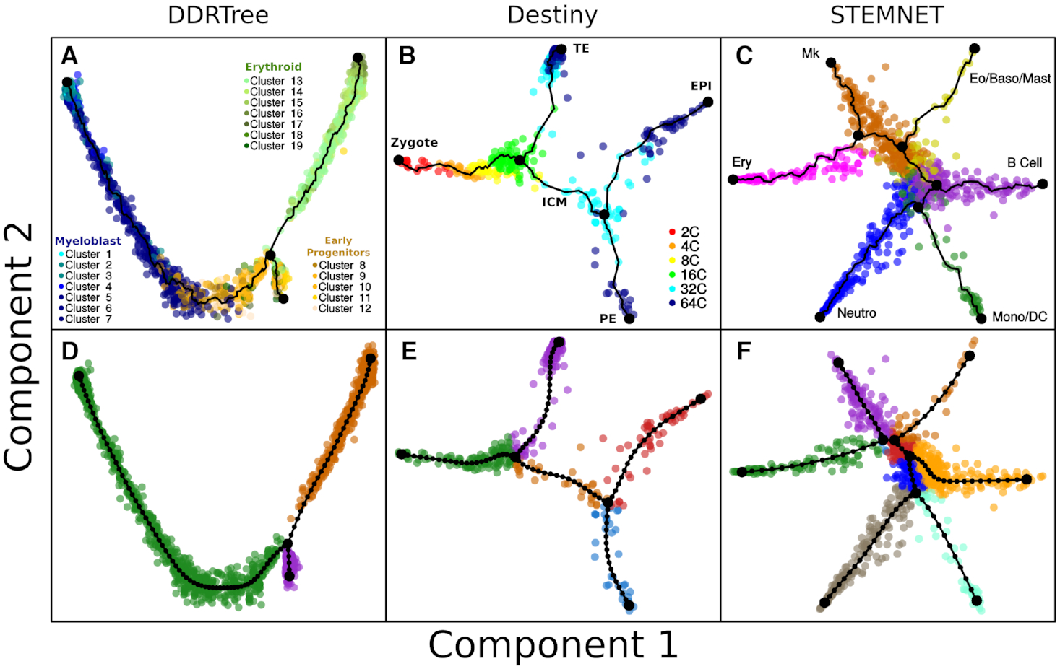
Figure 2. MERLoT’s scaffold tree reconstructions: in combination with (A) DDRTree coordinates for analyzing the data ...
Notes:
Figure 2. MERLoT’s scaffold tree reconstructions: in combination with (A) DDRTree coordinates for analyzing the data from Paul et al. (22); (B) diffusion maps coordinates for analyzing the data from Guo et al. (23) (diffusion components 2 and 3 rotated around component 1 for better visualization of the data); (C) STEMNET coordinates for analyzing the data from Velten et al. (24). Cells are colored according to cell type annotations provided by the authors of each dataset. (D–F) EPT reconstructions using the scaffold trees from panels A–C, respectively, as an initialization point. Cells are colored according to MERLoT’s branch assignments.
Unless provided in the caption above, the following copyright applies to the content of this slide: © The Author(s) 2019. Published by Oxford University Press on behalf of Nucleic Acids Research.This is an Open Access article distributed under the terms of the Creative Commons Attribution License (http://creativecommons.org/licenses/by/4.0/), which permits unrestricted reuse, distribution, and reproduction in any medium, provided the original work is properly cited.

Slide 3
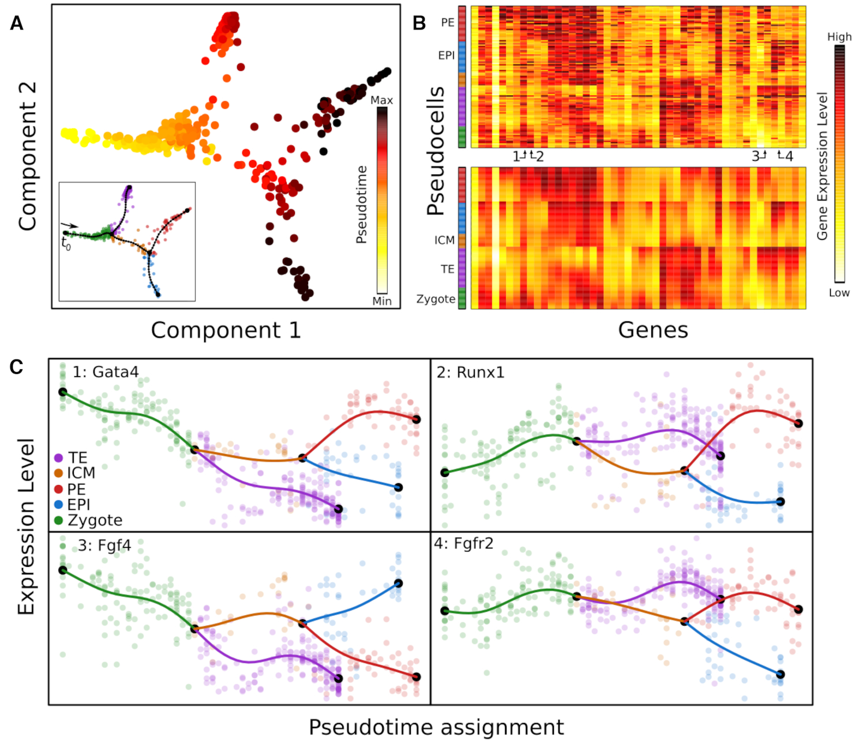
Figure 3. Pseudotime assignment and interpolation of gene expression profiles: (A) Pseudotime assignment in color code ...
Notes:
Figure 3. Pseudotime assignment and interpolation of gene expression profiles: (A) Pseudotime assignment in color code for cells from Figure 2B and E, taking the zygote state as t0. (B) Color-coded matrix of gene expression values for tree pseudo cells (rows) times genes (columns) before (top) and after (bottom) the gene expression space interpolation using the EPT. Pseudo cells are ordered according to their pseudotime and genes were hierarchically clustered. Numbers indicate specific genes shown in panel C. The color code in the bar on the left side of the heatmaps refers to pseudo cells branch assignments. (C) Gene expression profiles over pseudotime for four genes that are differentially expressed between the EPI and PE lineages. Semi-transparent circles represent the expression values of individual cells and solid lines correspond to MERLoT’s interpolations. Colors as in Figure 2E.
Unless provided in the caption above, the following copyright applies to the content of this slide: © The Author(s) 2019. Published by Oxford University Press on behalf of Nucleic Acids Research.This is an Open Access article distributed under the terms of the Creative Commons Attribution License (http://creativecommons.org/licenses/by/4.0/), which permits unrestricted reuse, distribution, and reproduction in any medium, provided the original work is properly cited.

Slide 4
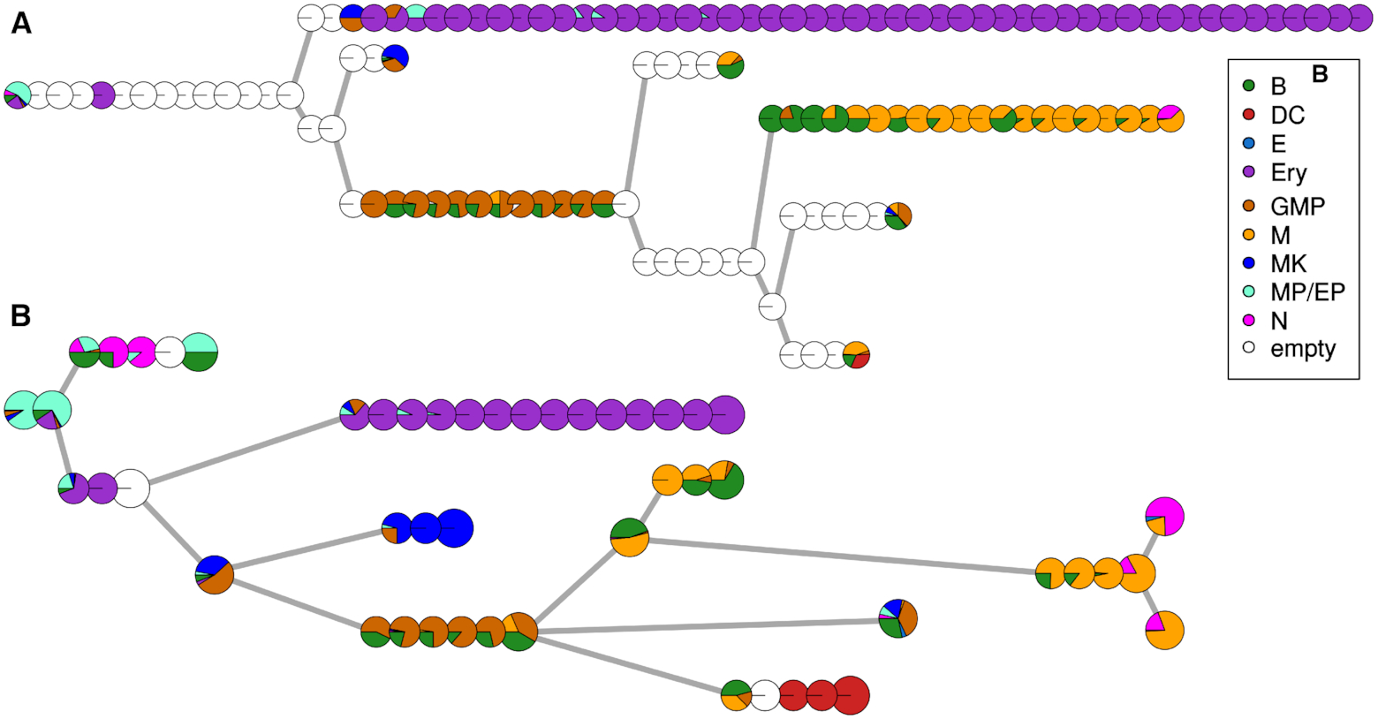
Figure 4. Reconstruction of haematopoietic system B: basophil (green); DC: dendritic cell (red); E: eosinophil (light ...
Notes:
Figure 4. Reconstruction of haematopoietic system B: basophil (green); DC: dendritic cell (red); E: eosinophil (light blue); Ery: erythrocyte (purple); GMP: granulocyte and monocyte progenitor (brown); M: monocyte; MK: megakaryocyte; MP/EP: multipotent myeloid and erythroid progenitors; N: neutrophil (orange). Each pie chart represents a tree node, and the colors denote the different cell types mapped to it. (A) The Monocle2 reconstruction of the process. Each pie chart is one of the nodes of the minimum spanning tree. (B) The MERLoT reconstruction of the process. Each pie chart is a node of the EPT. Pie charts corresponding to branchpoints and endpoints are larger just for aesthetic purposes
Unless provided in the caption above, the following copyright applies to the content of this slide: © The Author(s) 2019. Published by Oxford University Press on behalf of Nucleic Acids Research.This is an Open Access article distributed under the terms of the Creative Commons Attribution License (http://creativecommons.org/licenses/by/4.0/), which permits unrestricted reuse, distribution, and reproduction in any medium, provided the original work is properly cited.

Slide 5
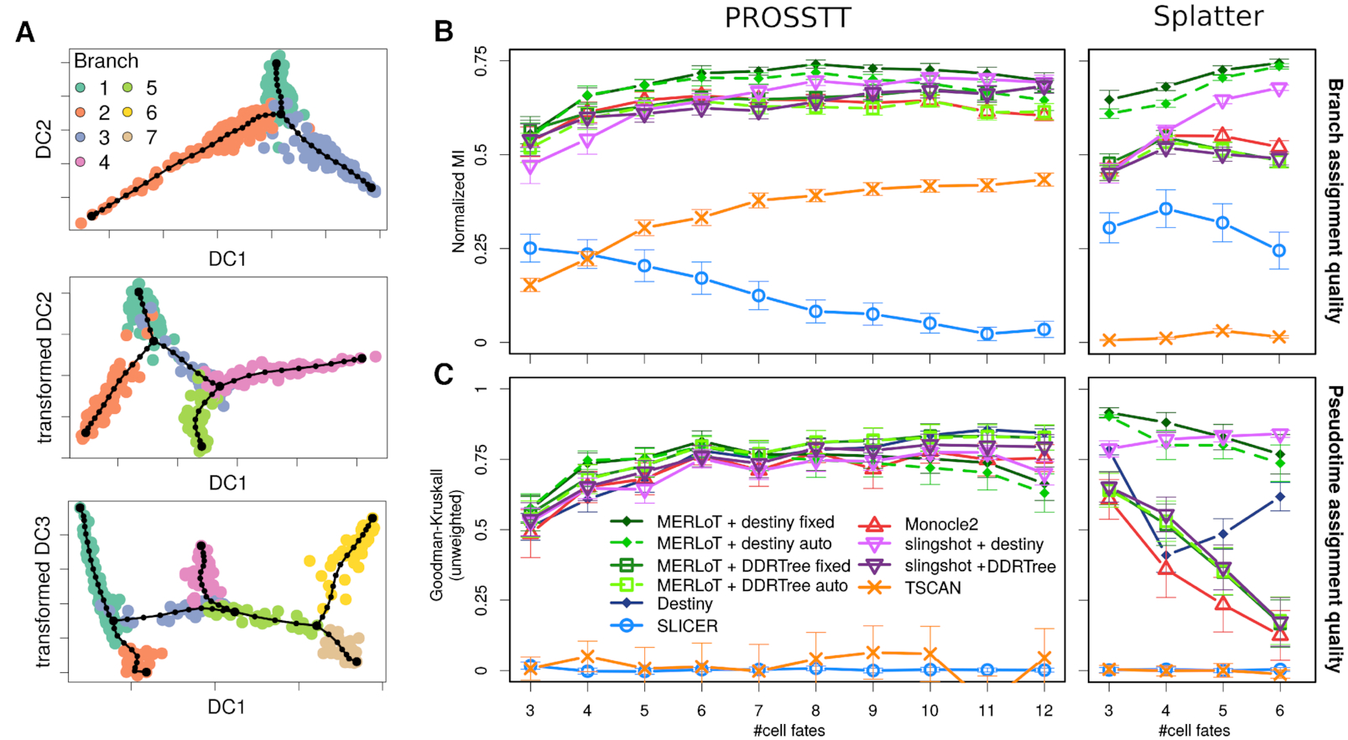
Figure 5. Simulated datasets and benchmarking: (A) Examples for diffusion map embeddings of PROSSTT simulations. From ...
Notes:
Figure 5. Simulated datasets and benchmarking: (A) Examples for diffusion map embeddings of PROSSTT simulations. From top to bottom: one, two and three bifurcations. Cell colors the labeled branch assignments. The double bifurcation is plotted by rotating diffusion components 2 and 3 around component 1. The triple bifurcation is plotted by rotating diffusion components 3 and 4 around component 1. (B) Branch assignment comparison using Monocle2, SLICER, TSCAN, Slingshot and MERLoT using both PROSSTT (left) and Splatter (right) simulations. Slingshot and MERLoT are used in combination with DDRTree and diffusion map (Destiny) coordinates. (C) Pseudotime assignment comparison. The error bars are 95% confidence intervals assuming the prediction scores are normally distributed.
Unless provided in the caption above, the following copyright applies to the content of this slide: © The Author(s) 2019. Published by Oxford University Press on behalf of Nucleic Acids Research.This is an Open Access article distributed under the terms of the Creative Commons Attribution License (http://creativecommons.org/licenses/by/4.0/), which permits unrestricted reuse, distribution, and reproduction in any medium, provided the original work is properly cited.

Slide 6
Figure 6. ‘Deep’ benchmark set: Branch assignment (left) and pseudotime prediction (right) performance in the ‘deep’ ...
Notes:
Figure 6. ‘Deep’ benchmark set: Branch assignment (left) and pseudotime prediction (right) performance in the ‘deep’ PROSSTT benchmark. Slingshot and MERLoT are used only in combination with diffusion map (Destiny) coordinates, since this combination performed best in the ‘lean’ benchmark. The error bars are 95% confidence intervals assuming the prediction scores are normally distributed.
Unless provided in the caption above, the following copyright applies to the content of this slide: © The Author(s) 2019. Published by Oxford University Press on behalf of Nucleic Acids Research.This is an Open Access article distributed under the terms of the Creative Commons Attribution License (http://creativecommons.org/licenses/by/4.0/), which permits unrestricted reuse, distribution, and reproduction in any medium, provided the original work is properly cited.

Slide 7
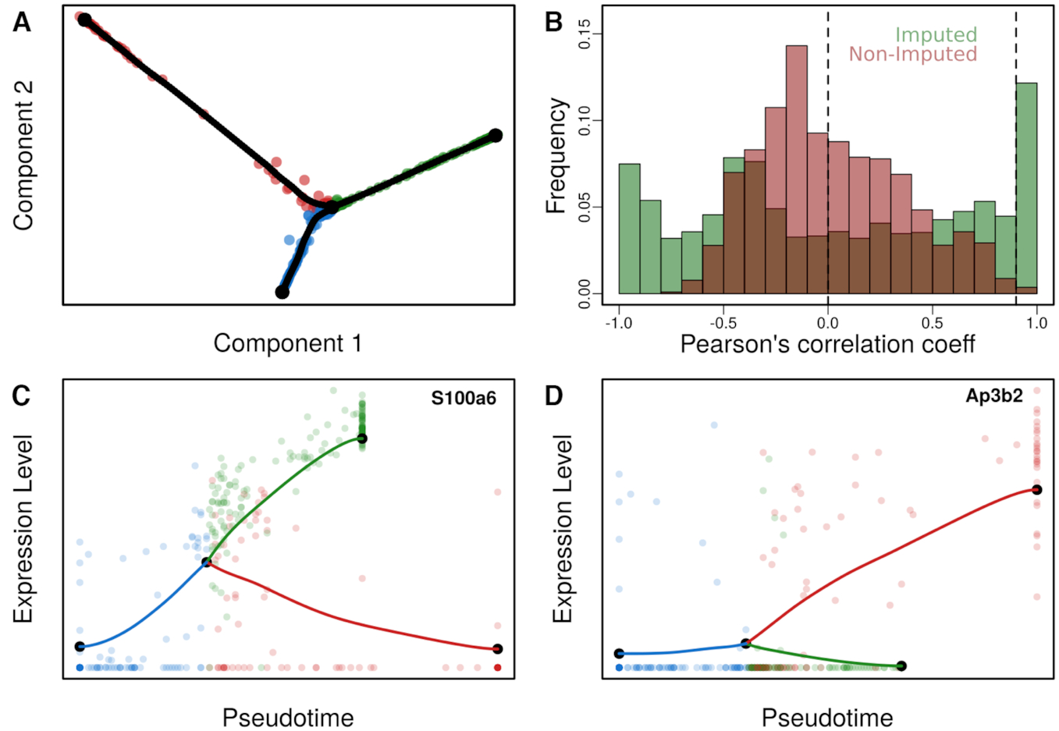
Figure 7. Lineage tree reconstruction of fibroblasts to neurons transdifferentiation: (A) Two-dimensional diffusion map ...
Notes:
Figure 7. Lineage tree reconstruction of fibroblasts to neurons transdifferentiation: (A) Two-dimensional diffusion map embedding of cells together with the reconstructed lineage tree (tree support nodes shown in black). We observe a single bifurcated tree containing three branches corresponding to fibroblasts, neurons and myocytes. (B) Pairwise Pearson’s correlation coefficients for gene expression profiles using imputed (green) and non-imputed (red) values. The dashed line at x = 0 represents the separation between positively and negatively correlated genes. The dashed line at x = 0.9 points at the threshold for reconstructing the GCN in Figure 8. (C) Pseudotime gene expression profile of differentially expressed gene in myocytes. (D) Pseudotime gene expression profile of a differentially expressed gene in neurons.
Unless provided in the caption above, the following copyright applies to the content of this slide: © The Author(s) 2019. Published by Oxford University Press on behalf of Nucleic Acids Research.This is an Open Access article distributed under the terms of the Creative Commons Attribution License (http://creativecommons.org/licenses/by/4.0/), which permits unrestricted reuse, distribution, and reproduction in any medium, provided the original work is properly cited.

Slide 8
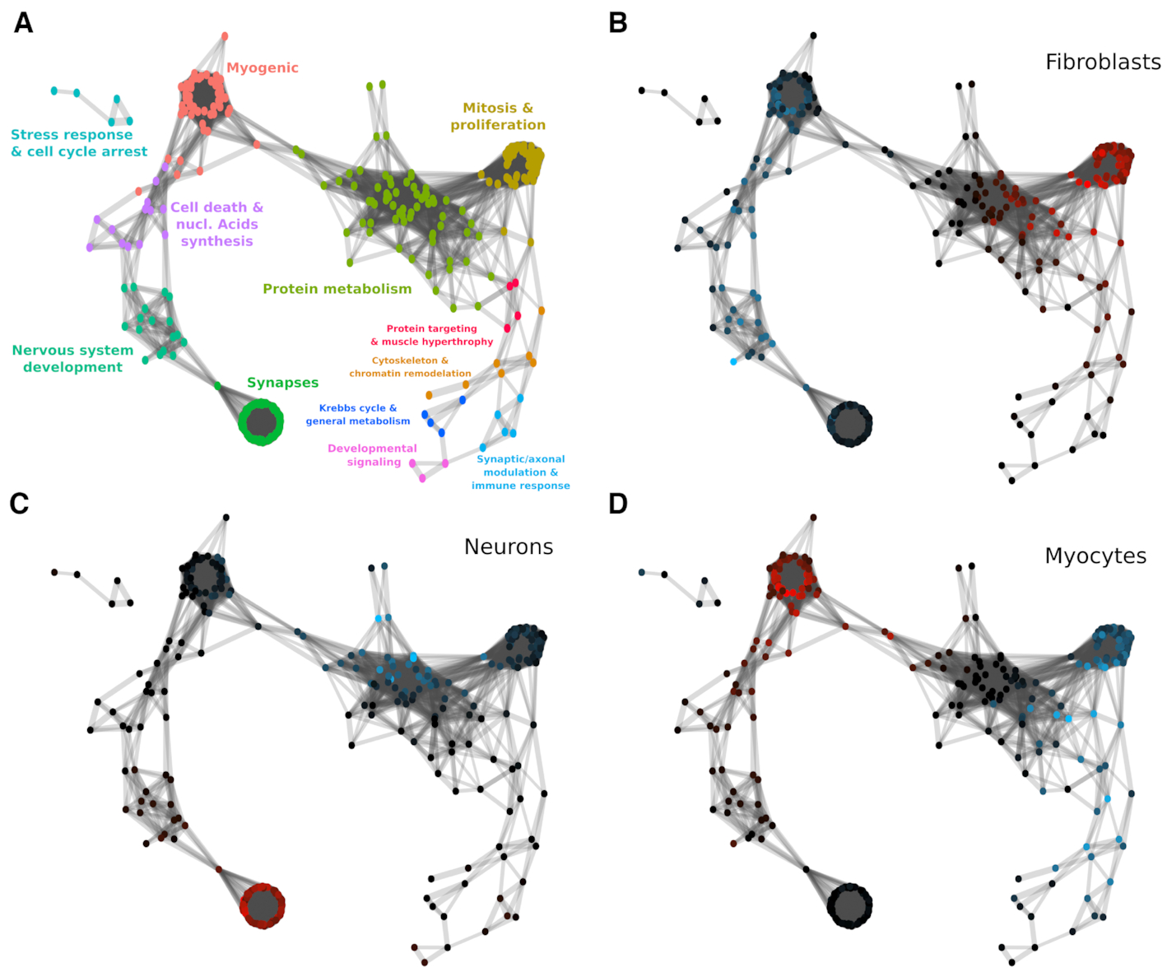
Figure 8. Reconstructed gene association network: (A) Gene clusters given the network connectivity were calculated and ...
Notes:
Figure 8. Reconstructed gene association network: (A) Gene clusters given the network connectivity were calculated and colored. Enriched GO terms were retrieved for each cluster and a general label summarizing their main implications are assigned to each cluster. (B) Differentially expressed genes in the fibroblast branch. (C) Differentially expressed genes in the neurons branch. (D) Differentially expressed genes in the myocytes branch. Genes that are differentially expressed with an e-value e < 10−3 are colored according to the mean difference in expression, shades of blue indicating downregulation and shades of red upregulation. Intensity corresponds to log fold change of gene expression (see color scale).
Unless provided in the caption above, the following copyright applies to the content of this slide: © The Author(s) 2019. Published by Oxford University Press on behalf of Nucleic Acids Research.This is an Open Access article distributed under the terms of the Creative Commons Attribution License (http://creativecommons.org/licenses/by/4.0/), which permits unrestricted reuse, distribution, and reproduction in any medium, provided the original work is properly cited.

