Slide 1
Fig. 1. Western blot analysis of the localization of 3MST, CSE and CBS in the thoracic aorta. (A) 3MST is localized ...
Notes:
Fig. 1. Western blot analysis of the localization of 3MST, CSE and CBS in the thoracic aorta. (A) 3MST is localized to endothelium and smooth muscle in rat thoracic aorta. Western blot analysis showed that 3MST is localized to endothelium (ECs) and smooth muscle (SMCs) in thoracic aorta, rat aortic endothelial cells (RAECs, Toyobo), rat liver and brain. (B and C) Neither CSE nor CBS is localized to thoracic endothelium. Note that CSE is localized to the liver but not to the brain (B), and CBS is localized both to the liver and the brain (C).
Unless provided in the caption above, the following copyright applies to the content of this slide: © The Authors 2009. Published by Oxford University Press on behalf of the Japanese Biochemical Society. All rights reserved

Slide 2
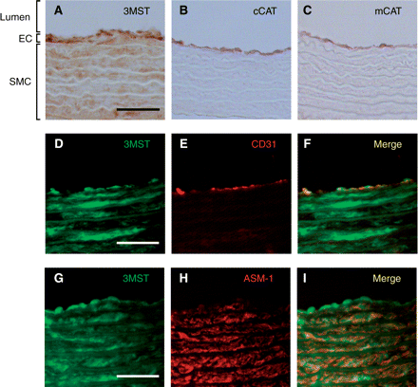
Fig. 2. Immunohistochemistry of 3MST in thoracic aorta. (A–C) Localization of 3MST (A), cCAT (B) and mCAT (C). 3MST ...
Notes:
Fig. 2. Immunohistochemistry of 3MST in thoracic aorta. (A–C) Localization of 3MST (A), cCAT (B) and mCAT (C). 3MST is localized to both endothelium and smooth muscle (A). EC: endothelial cells, SMC: smooth muscle cells. cCAT and mCAT are localized to endothelium but not to smooth muscle (B and C). (D–I) Co-localization of 3MST with a marker for endothelium (CD31) and a marker for smooth muscle (ASM-1). The merge (F) shows that 3MST (D) is co-localized with an endothelium marker, CD31 (E). The merge (I) shows that 3MST (G) is also co-localized with a smooth muscle marker, ASM-1 (H). Scale bars indicate 50 μm.
Unless provided in the caption above, the following copyright applies to the content of this slide: © The Authors 2009. Published by Oxford University Press on behalf of the Japanese Biochemical Society. All rights reserved

Slide 3
Fig. 3. Aortic endothelial cells produce H₂S. (A) Endothelial cells produce H₂S from 3MP as a ...
Notes:
Fig. 3. Aortic endothelial cells produce H2S. (A) Endothelial cells produce H2S from 3MP as a substrate. Lysates of rat aortic endothelial cells (RAECs) were incubated with 3MP, and released H2S was measured. (B) Requirement of α-KG for H2S production from cysteine in the aortic endothelial cells. Lysates of RAECs were incubated with combinations of cysteine, α-KG. Note that H2S is not produced in the absence of α-KG. (C) H2S production is suppressed by aspartate, a CAT inhibitor. H2S production from lysates of RAECs incubated with 2 mM cysteine, 0.5 mM α-KG and 0.05 mM pyridoxal-5′-phosphate was suppressed by aspartate (Asp), a CAT inhibitor in a dose-dependent manner. All data are represented as the mean ± SEM of three experiments.
Unless provided in the caption above, the following copyright applies to the content of this slide: © The Authors 2009. Published by Oxford University Press on behalf of the Japanese Biochemical Society. All rights reserved

