Slide 1
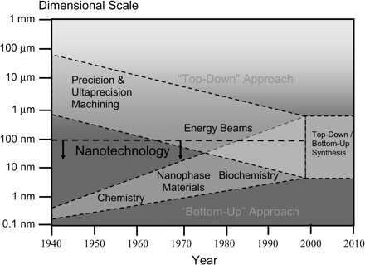
Figure 1. The convergence between top-down and bottom-up nanotechnologies.
Notes:
Figure 1. The convergence between top-down and bottom-up nanotechnologies.
Unless provided in the caption above, the following copyright applies to the content of this slide: © The Author 2006. Published by Oxford University Press on behalf of the Society of Occupational Medicine. All rights reserved. For Permissions, please email: journals.permissions@oxfordjournals.org

