Slide 1
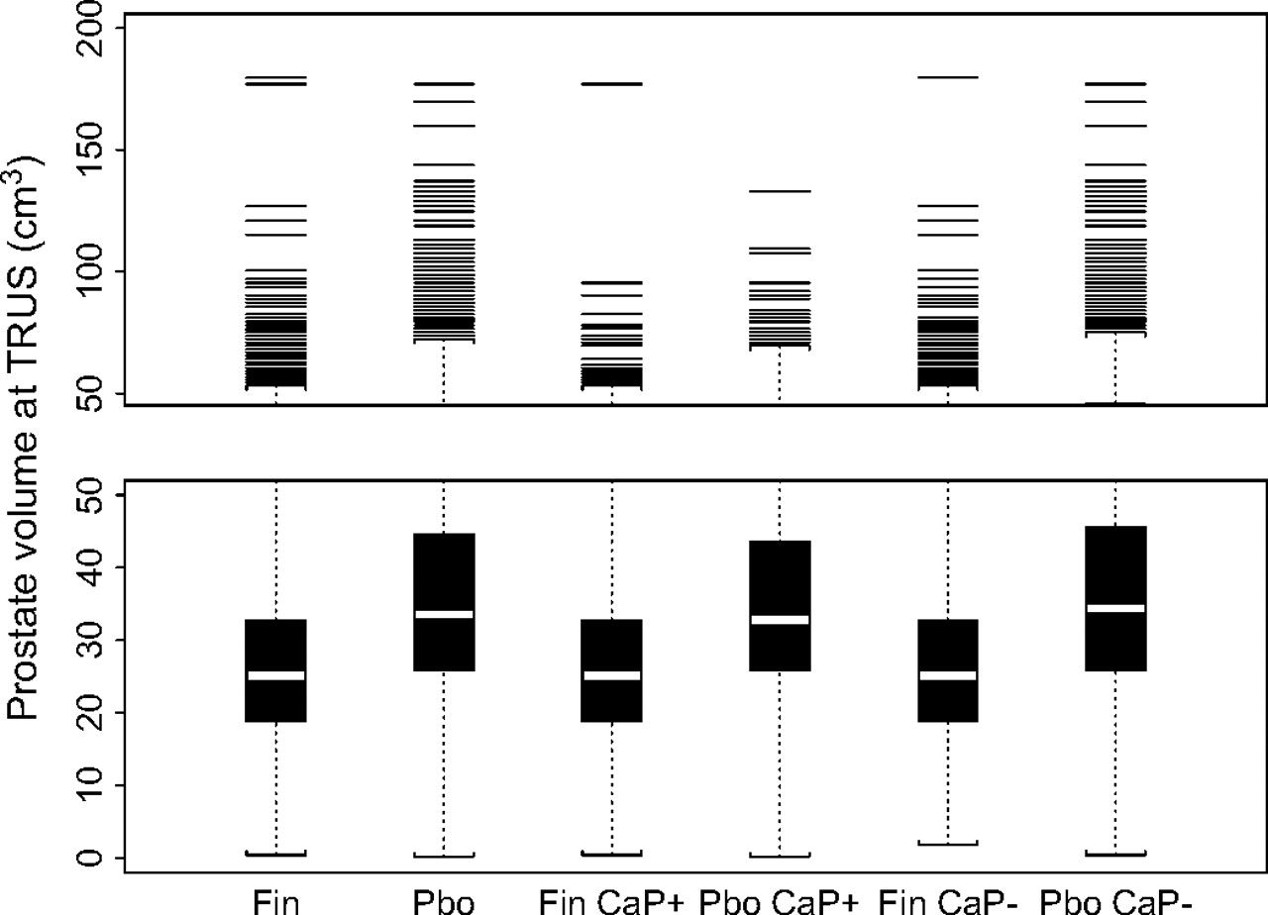
Fig. 1 Effect of finasteride on prostate volume at transrectal ultrasound (TRUS) in the Prostate Cancer Prevention ...
Notes:
Fig. 1 Effect of finasteride on prostate volume at transrectal ultrasound (TRUS) in the Prostate Cancer Prevention Trial. Box plots of prostate volume by treatment group (Fin = finasteride, Pbo = placebo) and prostate cancer status (CaP+ = positive or CaP− = negative) are shown for those participants in the extended Southwest Oncology Group population who had prostate volume measurements (n = 4285 in the finasteride group and n = 4591 in the placebo group). These numbers exclude five participants with prostate volumes considered to be out of range (≥200 cm3). Box plots depict the median (white horizontal line), 75th percentile, and 25th percentile (box limits). Volumes greater than 50 cm3 are displayed on a continuous but compressed scale.
Unless provided in the caption above, the following copyright applies to the content of this slide: © The Author 2007. Published by Oxford University Press.

Slide 2
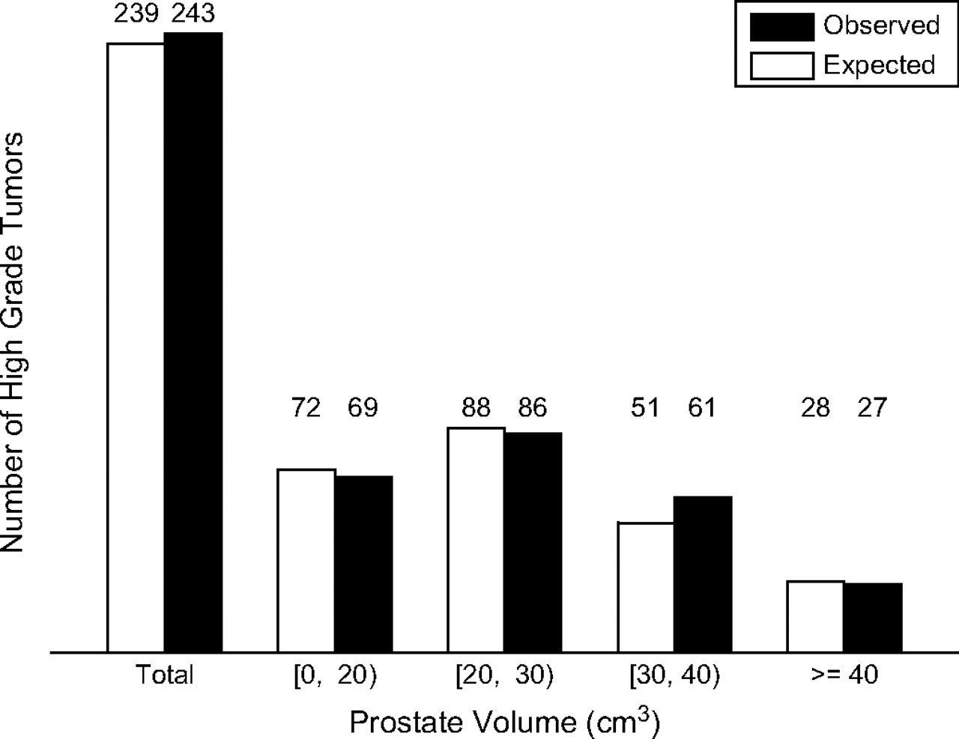
Fig. 2 Expected versus observed number of prostate cancer cases with Gleason score 7–10 in the finasteride group of ...
Notes:
Fig. 2 Expected versus observed number of prostate cancer cases with Gleason score 7–10 in the finasteride group of the Prostate Cancer Prevention Trial. The logistic regression model developed on the placebo group of the extended Southwest Oncology Group population was used to predict the number of high-grade tumors in the finasteride group of this population based on the Peters–Belson approach (10) for different prostate volumes.
Unless provided in the caption above, the following copyright applies to the content of this slide: © The Author 2007. Published by Oxford University Press.

