Slide 1
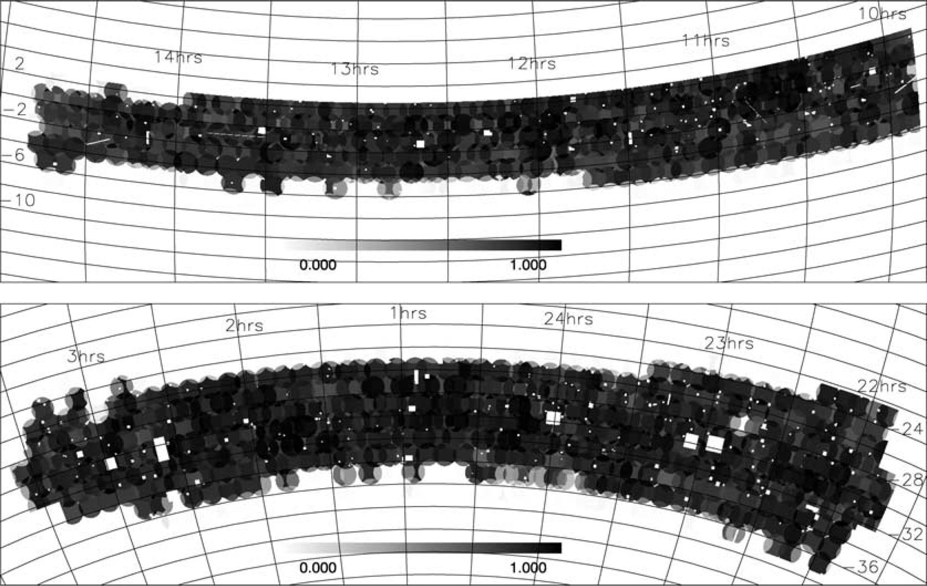
Figure 1. The redshift completeness masks for the NGP (top) and SGP (bottom). The grey-scale shows the completeness ...
Notes:
Figure 1. The redshift completeness masks for the NGP (top) and SGP (bottom). The grey-scale shows the completeness fraction.
Unless provided in the caption above, the following copyright applies to the content of this slide: © 2003 RAS

Slide 2
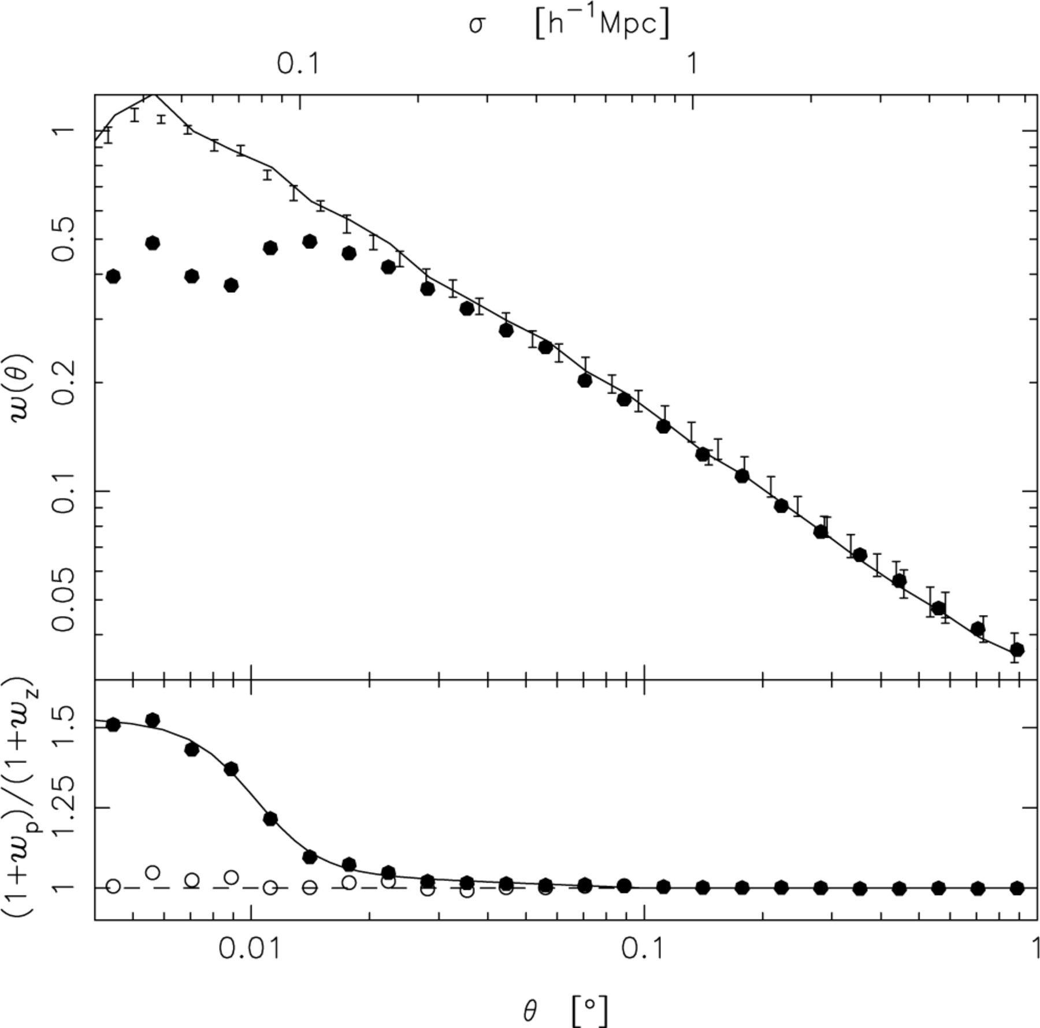
Figure 2. Top panel: w(θ) for the mean of the NGP and SGP redshift catalogues (solid points), the mean of the masked ...
Notes:
Figure 2. Top panel: w(θ) for the mean of the NGP and SGP redshift catalogues (solid points), the mean of the masked parent catalogues (solid line), and the full APM result (error bars). Bottom panel: the parent catalogue result divided by the redshift catalogue results (uncorrected — solid points; collision corrected (see Section 3.3) – open points). The solid line is the curve used to correct the fibre collisions. The top axis converts θ into a projected separation, σ, at the effective redshift of the survey, zs= 0.15.
Unless provided in the caption above, the following copyright applies to the content of this slide: © 2003 RAS

Slide 3
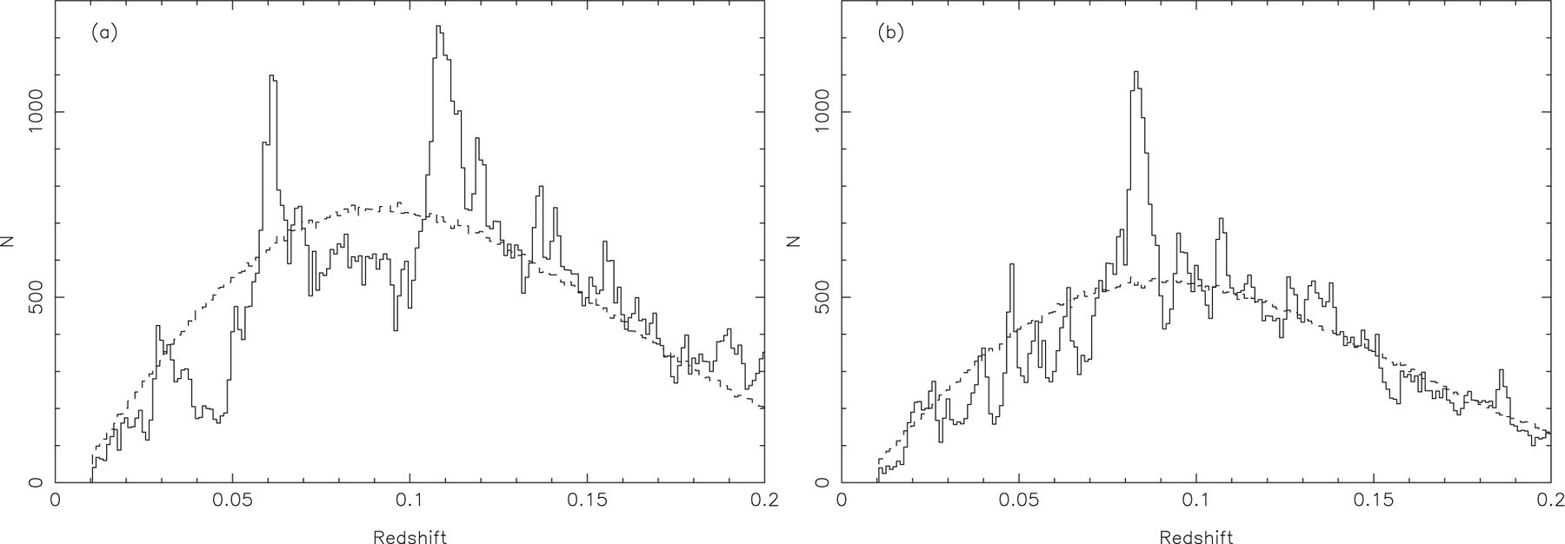
Figure 3. Redshift distributions, N(z), for the 2dFGRS data (solid lines) and the normalized random catalogues ...
Notes:
Figure 3. Redshift distributions, N(z), for the 2dFGRS data (solid lines) and the normalized random catalogues generated using the survey luminosity function (dashed lines) for the (a) SGP and (b) NGP.
Unless provided in the caption above, the following copyright applies to the content of this slide: © 2003 RAS

Slide 4
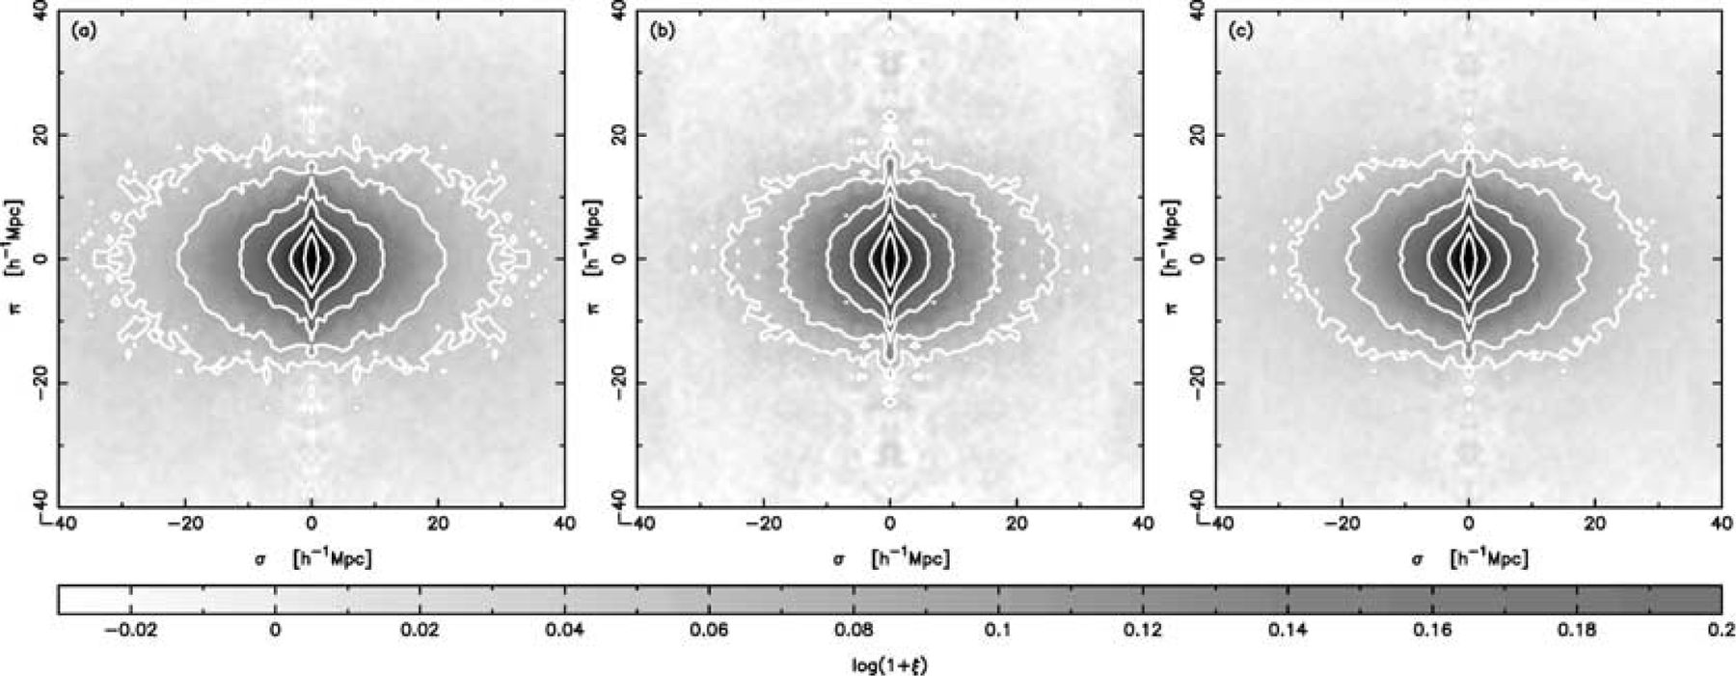
Figure 4. Grey-scale plots of the 2dFGRS ξ(σ, π) (in 1 h⁻¹ Mpc bins) for (a) the SGP region, (b) the NGP ...
Notes:
Figure 4. Grey-scale plots of the 2dFGRS ξ(σ, π) (in 1 h−1 Mpc bins) for (a) the SGP region, (b) the NGP region and (c) the combined data. Contours are overlaid at ξ= 4.0, 2.0, 1.0, 0.5, 0.2 and 0.1.
Unless provided in the caption above, the following copyright applies to the content of this slide: © 2003 RAS

Slide 5
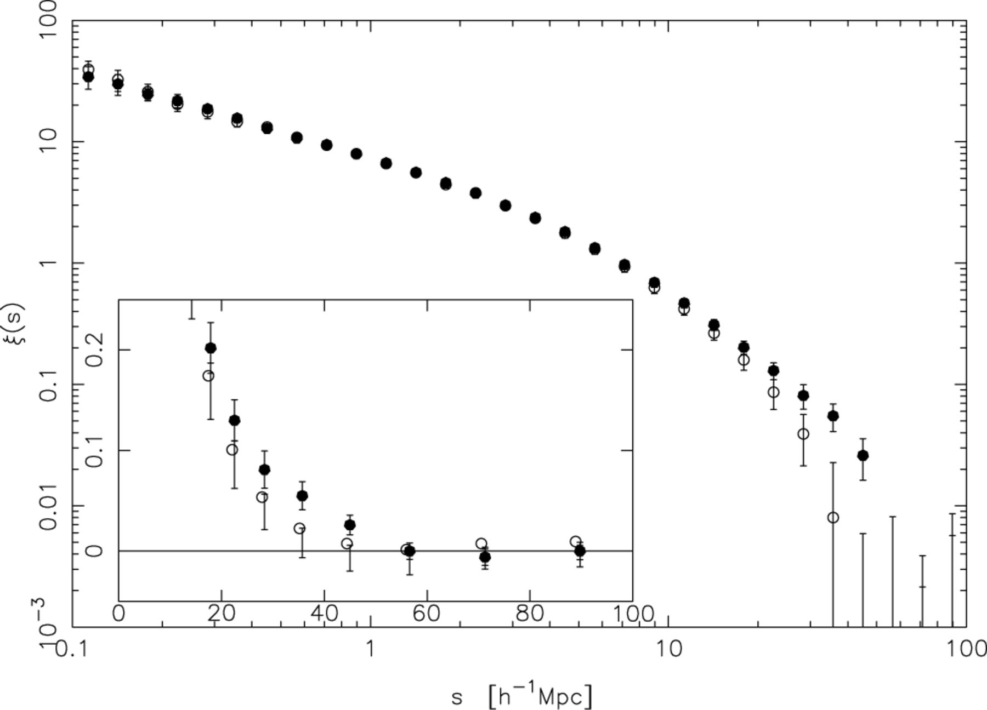
Figure 5. The redshift-space correlation function for the NGP (open points) and SGP (solid points) 2dFGRS data with ...
Notes:
Figure 5. The redshift-space correlation function for the NGP (open points) and SGP (solid points) 2dFGRS data with error bars from the rms of mock catalogue results. The inset is plotted on a linear scale.
Unless provided in the caption above, the following copyright applies to the content of this slide: © 2003 RAS

Slide 6
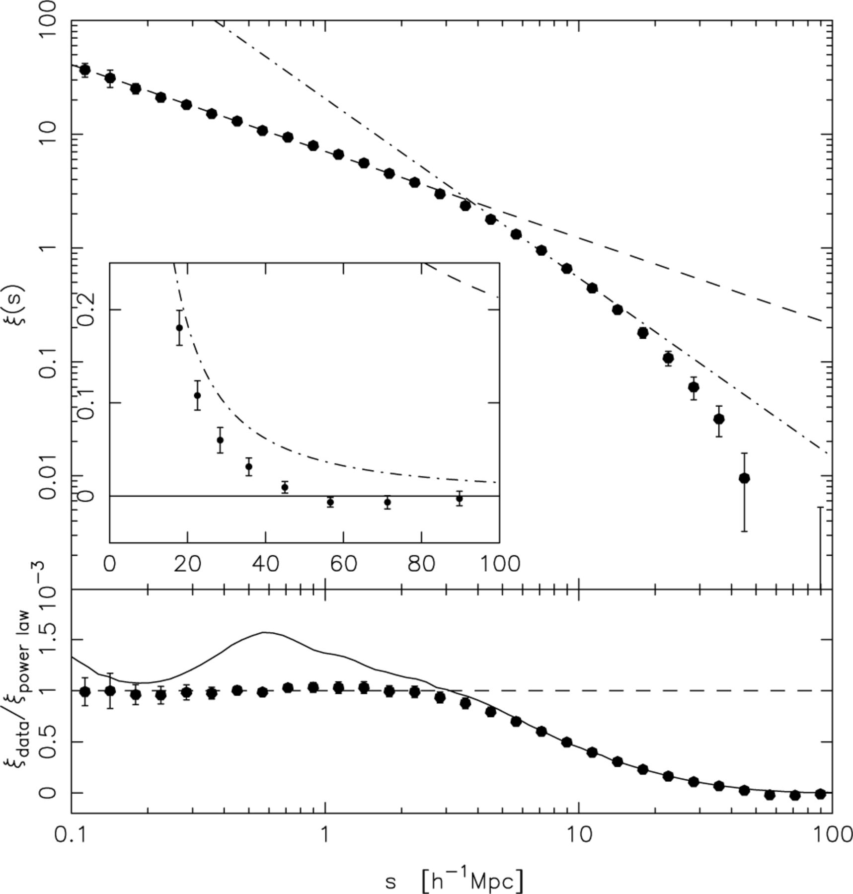
Figure 6. Top panel: the redshift-space correlation function for the combined data (points) with error bars from the ...
Notes:
Figure 6. Top panel: the redshift-space correlation function for the combined data (points) with error bars from the rms of the mock catalogue results. The dashed line is a small-scale power-law fit (s0= 13 h−1 Mpc, γs= 0.75) and the dot-dashed line is the best fit to points around s0 (s0= 6.82 h−1 Mpc, γs= 1.57). The inset is on a linear scale. Bottom panel: as above, divided by the small-scale power law. The solid line shows the result from the Hubble Volume simulation.
Unless provided in the caption above, the following copyright applies to the content of this slide: © 2003 RAS

Slide 7
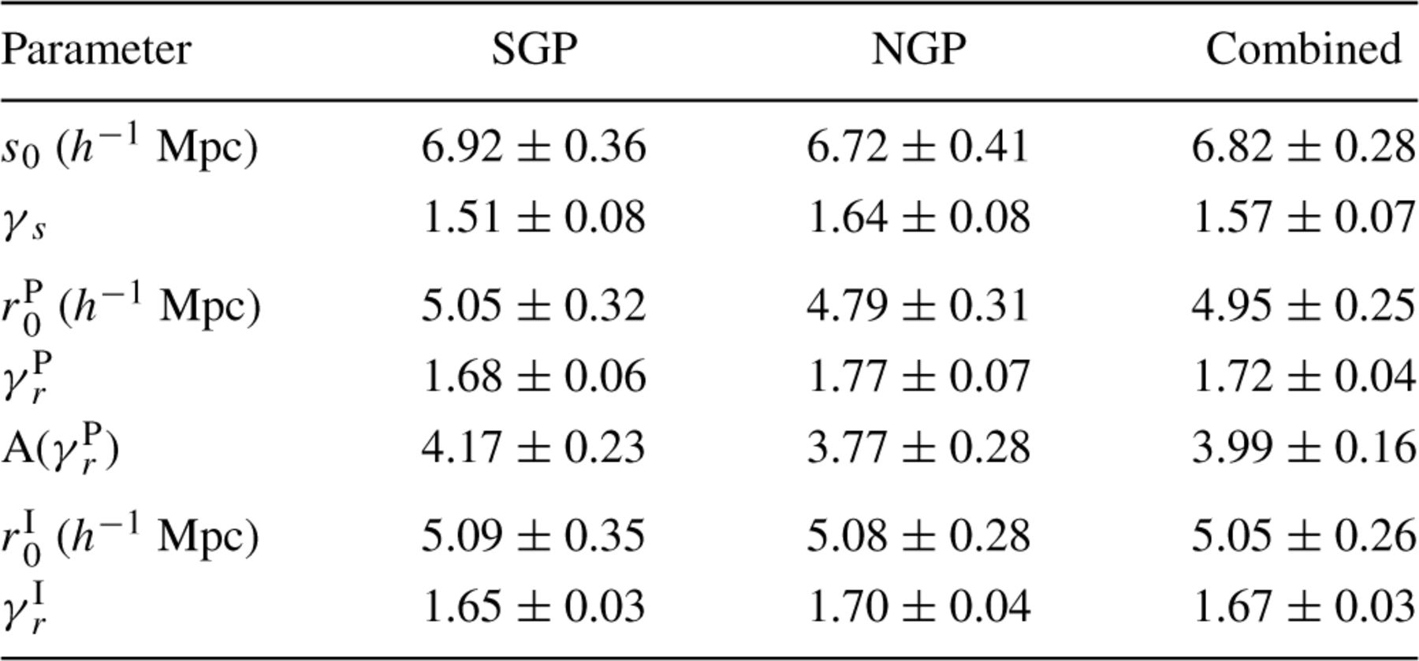
Table 1. Best-fitting parameters to ξ. For s₀ and γ_{s} the fit to ξ (s) uses only points around s ...
Notes:
Table 1. Best-fitting parameters to ξ. For s0 and γs the fit to ξ (s) uses only points around s = s0. For r0P, γrP and A(γrP) the fit to Θ(σ)/σ uses all points with 0.1 < s <12 h−1 Mpc. For r0I and γrI the fit to the inverted ξ(r) uses all points with 0.1 < r < 12 h−1 Mpc. In each case, the errors quoted are the rms spread in the results obtained from the same analysis with the mock catalogues.
Unless provided in the caption above, the following copyright applies to the content of this slide: © 2003 RAS

Slide 8
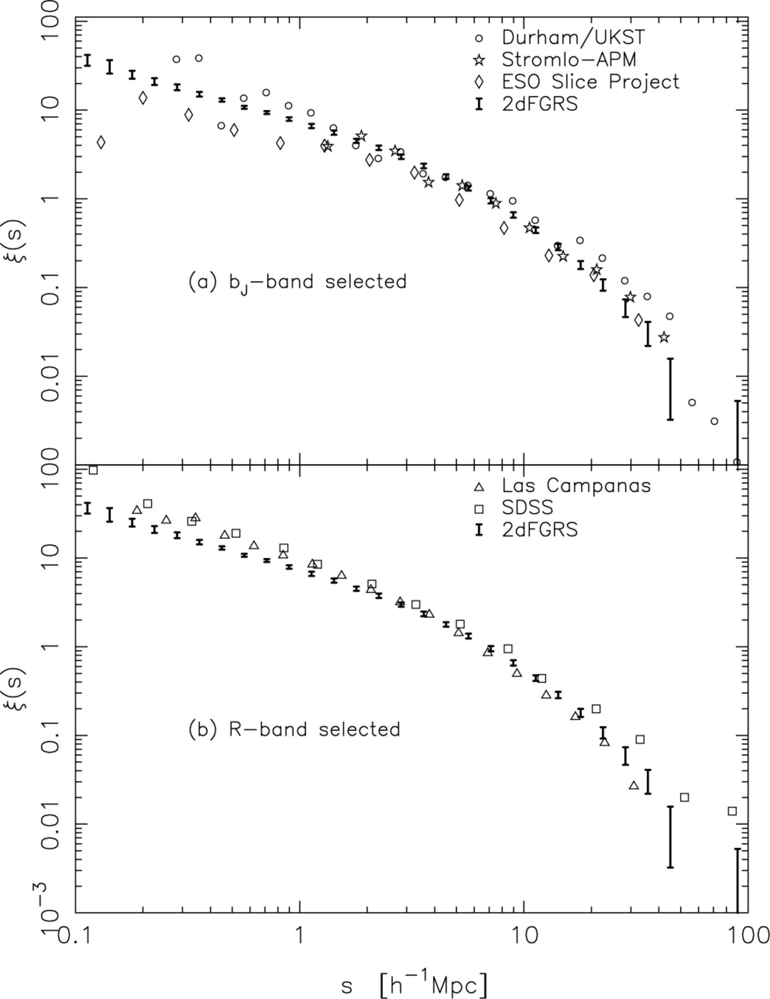
Figure 7. Comparison of 2dFGRS ξ(s) with (a) other b_{J}-band selected surveys as indicated and (b) R-band ...
Notes:
Figure 7. Comparison of 2dFGRS ξ(s) with (a) other bJ-band selected surveys as indicated and (b) R-band selected surveys as indicated. These results are discussed in the text.
Unless provided in the caption above, the following copyright applies to the content of this slide: © 2003 RAS

Slide 9
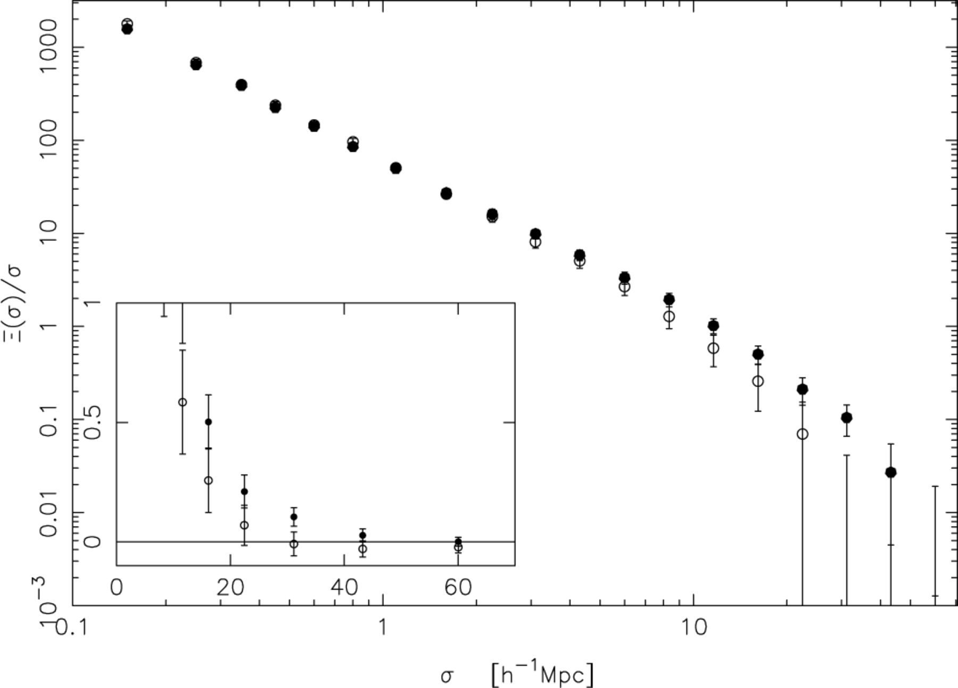
Figure 8. The projected correlation functions for the NGP (open points) and SGP (solid points) 2dFGRS data with error ...
Notes:
Figure 8. The projected correlation functions for the NGP (open points) and SGP (solid points) 2dFGRS data with error bars from the rms spread between mock catalogue results. The inset is plotted on a linear scale.
Unless provided in the caption above, the following copyright applies to the content of this slide: © 2003 RAS

Slide 10
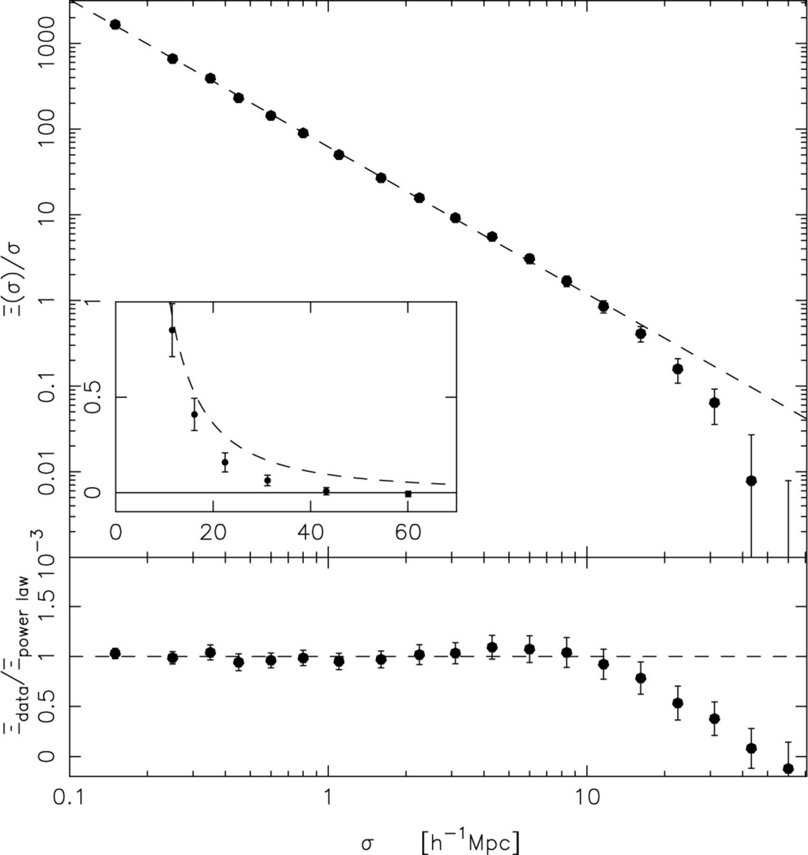
Figure 9. Top panel: the projected correlation function of the combined data with error bars from the rms spread ...
Notes:
Figure 9. Top panel: the projected correlation function of the combined data with error bars from the rms spread between mock catalogue results. The dashed line is the best-fitting power law for 0.1 < σ < 12 h−1 Mpc (r0= 4.98, γr= 1.72, A= 3.97). The inset is plotted on a linear scale. Bottom panel: the combined data divided by the power-law fit.
Unless provided in the caption above, the following copyright applies to the content of this slide: © 2003 RAS

Slide 11
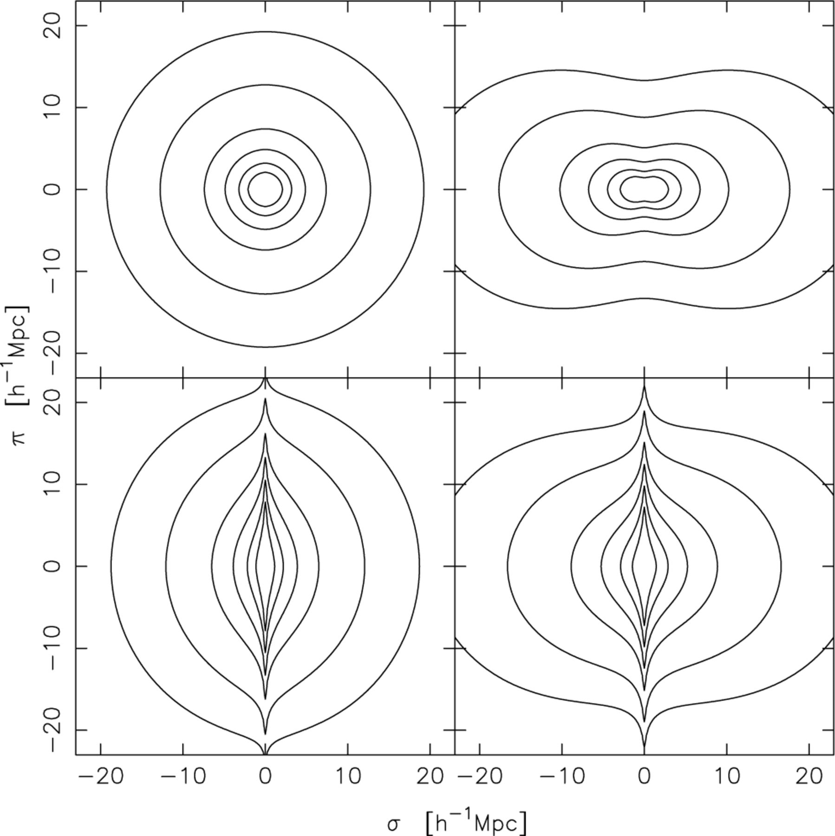
Figure 12. Plot of model ξ(σ, π) calculated as described in Section 4. The lines represent contours of constant ξ(σ, π) ...
Notes:
Figure 12. Plot of model ξ(σ, π) calculated as described in Section 4. The lines represent contours of constant ξ(σ, π) = 4.0, 2.0, 1.0, 0.5, 0.2 and 0.1 for different models. The top left-hand panel represents an undistorted correlation function (a= 0, β= 0), the top right-hand panel is a model with coherent infall added (a= 0, β= 0.4), the bottom left-hand panel is a model with just random pairwise velocities added (a= 500 km s−1, β= 0) and the bottom right-hand panel has both infall and random motions added (a= 500 km s−1, β= 0.4). These four models have r0= 5.0 h−1 Mpc and γr= 1.7.
Unless provided in the caption above, the following copyright applies to the content of this slide: © 2003 RAS

Slide 12
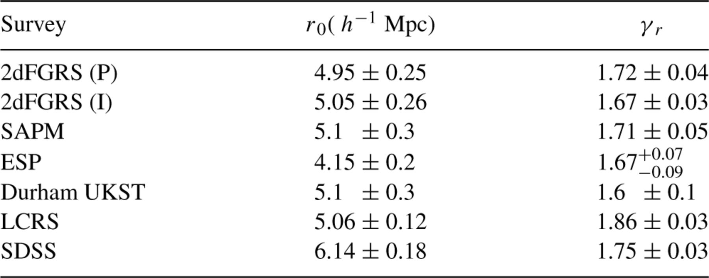
Table 2. Measurements of ξ(r) from 2dFGRS and other surveys, with the quoted uncertainties as published. The various ...
Notes:
Table 2. Measurements of ξ(r) from 2dFGRS and other surveys, with the quoted uncertainties as published. The various authors have used very different ways to estimate errors although none has included the effects of cosmic variance. Because we have used the scatter between mock catalogues to take account of this, our estimates are actually dominated by cosmic variance. These results are measured at different effective luminosities, redshifts and for different galaxy types.
Unless provided in the caption above, the following copyright applies to the content of this slide: © 2003 RAS

Slide 13
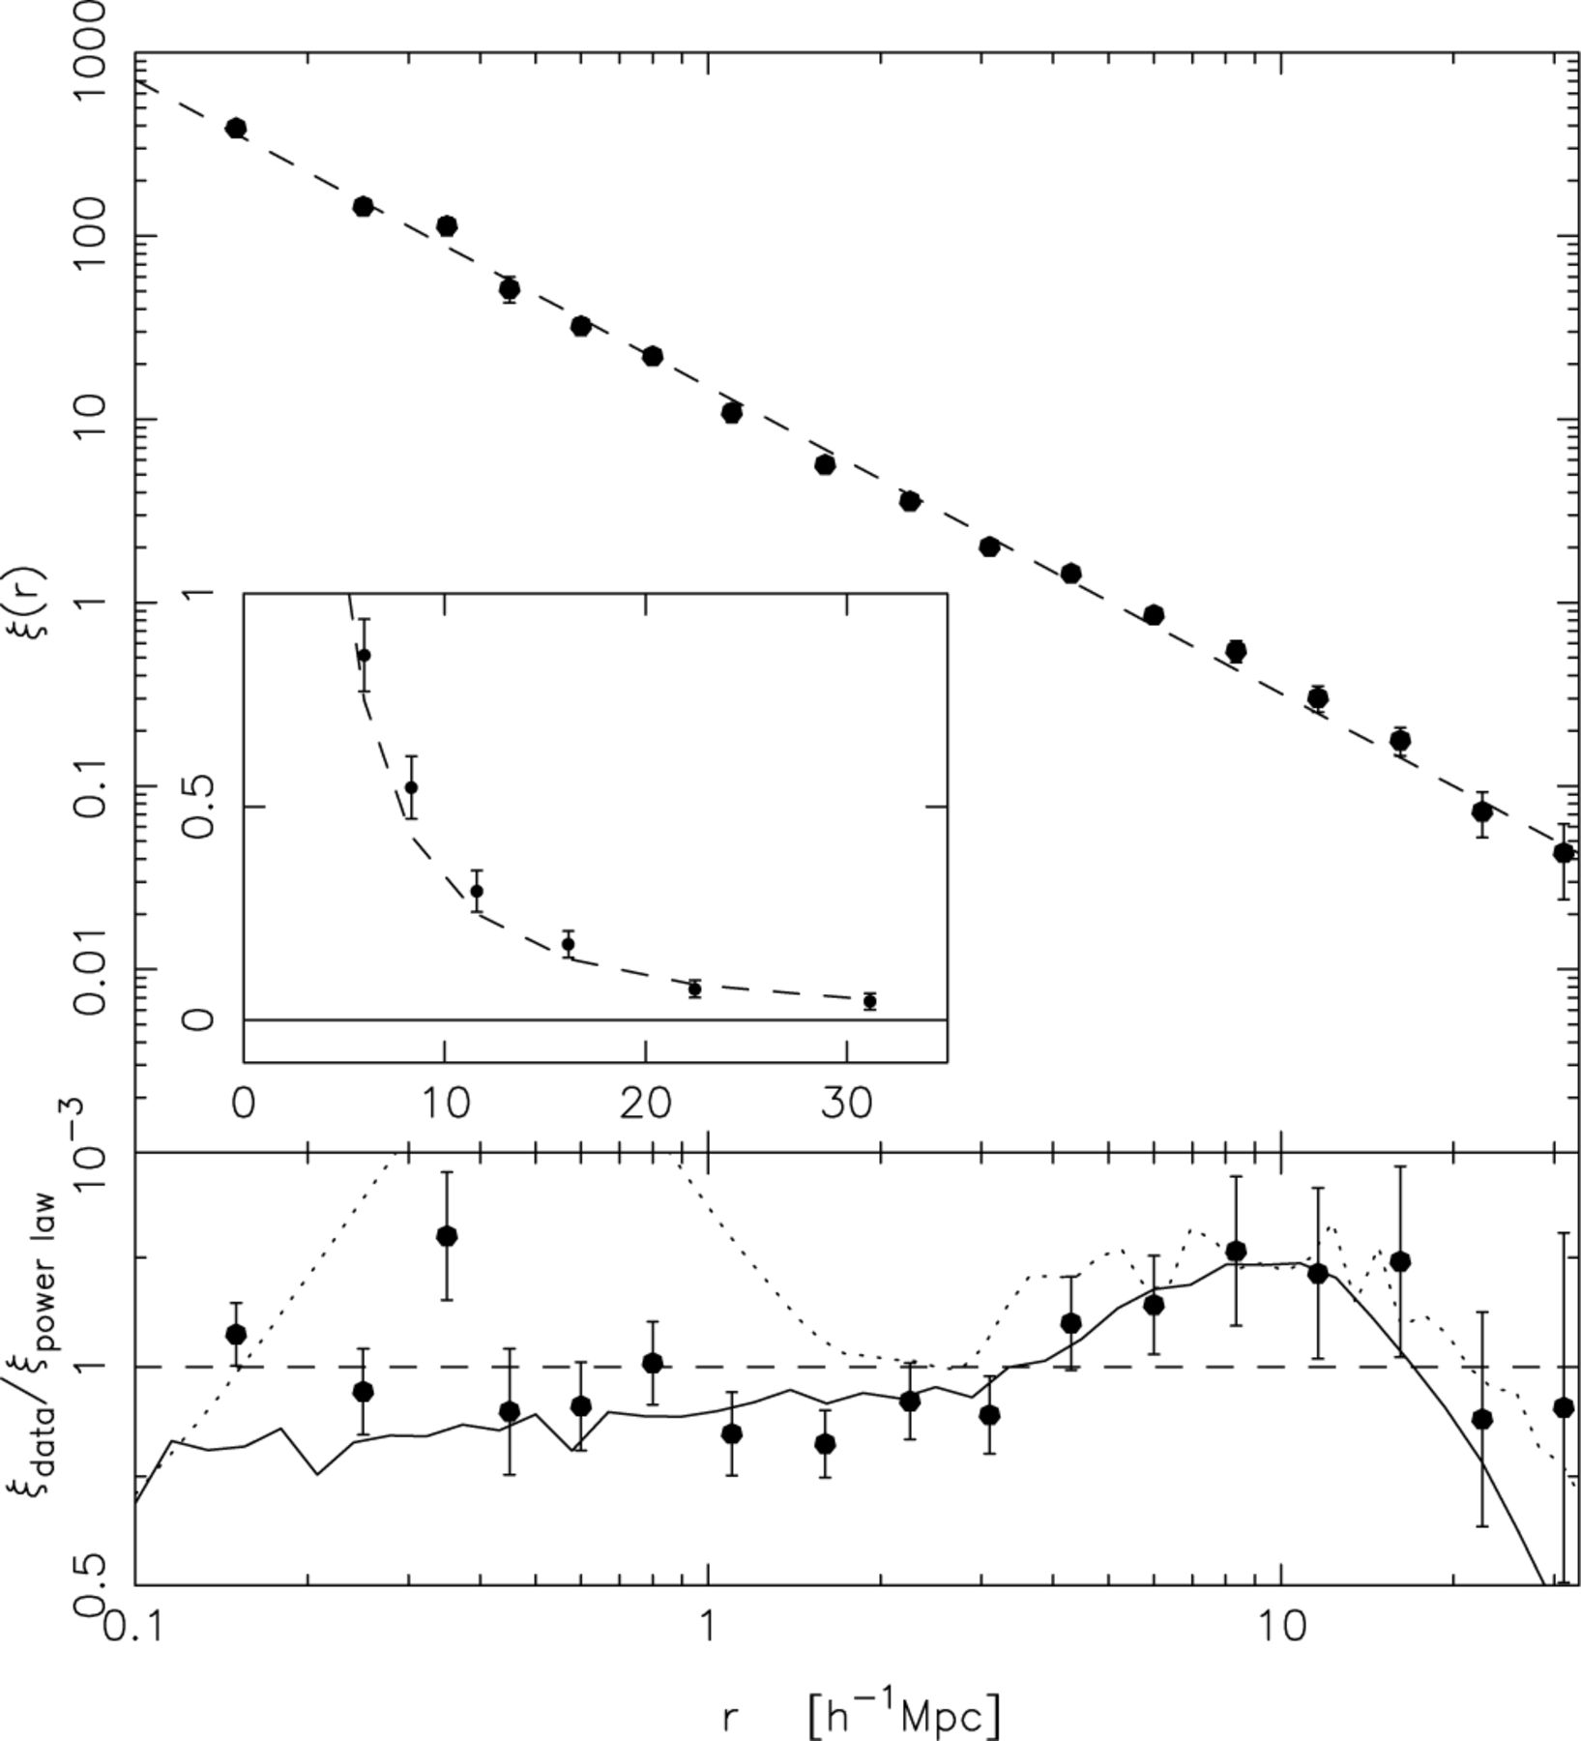
Figure 11. Top panel: the real-space correlation function of the combined 2dFGRS using the method of S92, with error ...
Notes:
Figure 11. Top panel: the real-space correlation function of the combined 2dFGRS using the method of S92, with error bars from the rms spread between mock catalogues. The dashed line is the best-fitting power law (r0= 5.05, γr= 1.67). The inset is plotted on a linear scale. Bottom panel: the data divided by the power-law fit. The solid line is the deprojected APM result (Padilla & Baugh 2003) as discussed in the text. The dotted line is the result from the Hubble Volume.
Unless provided in the caption above, the following copyright applies to the content of this slide: © 2003 RAS

Slide 14
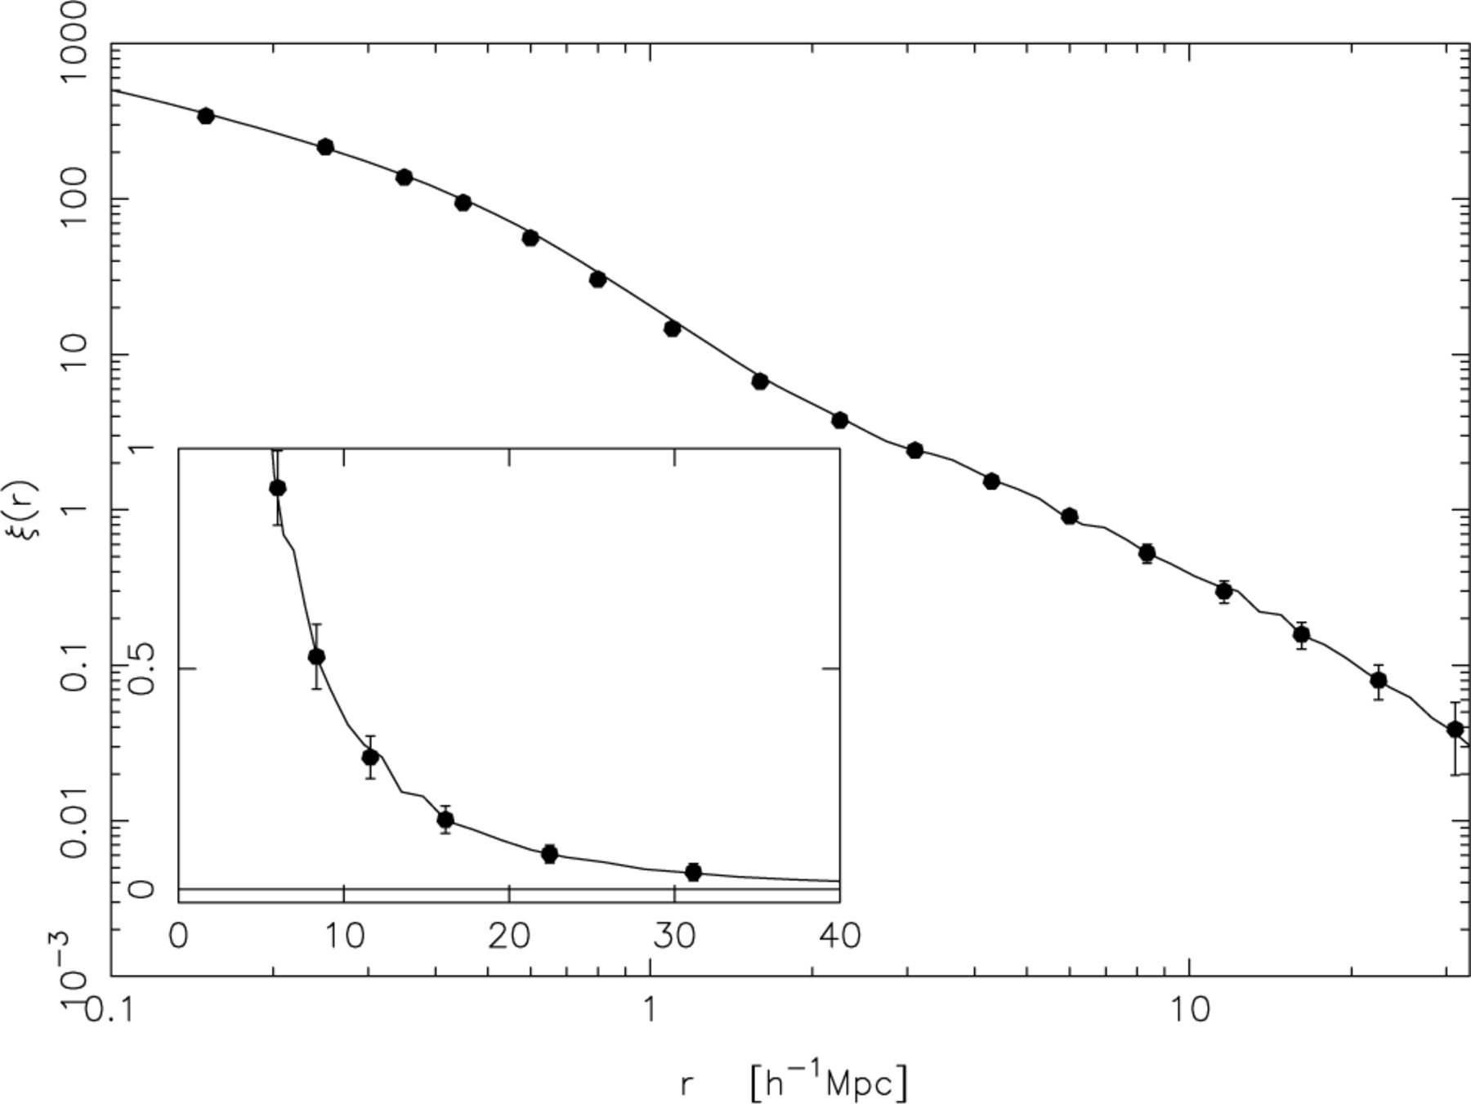
Figure 10. The mean real-space correlation function determined from the 22 mock catalogues using the method of S92. The ...
Notes:
Figure 10. The mean real-space correlation function determined from the 22 mock catalogues using the method of S92. The solid line is the true ξ(r) from the Hubble Volume and the agreement is excellent. Note the changed scale from previous plots.
Unless provided in the caption above, the following copyright applies to the content of this slide: © 2003 RAS

Slide 15
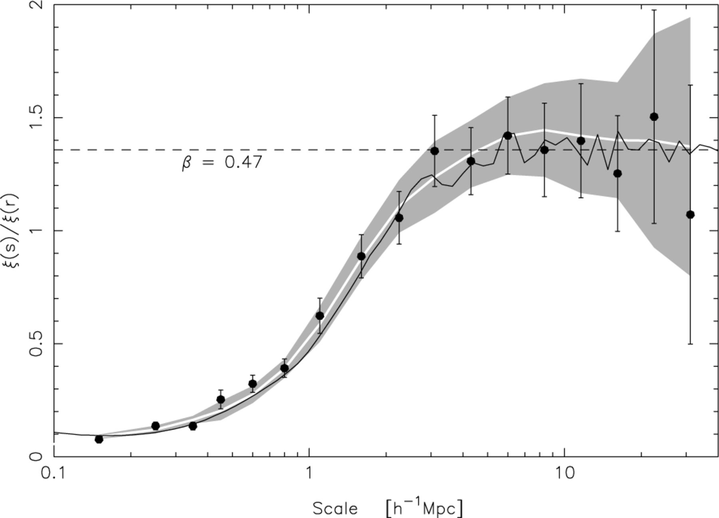
Figure 13. The ratio of ξ(s) to ξ(r) for the 2dFGRS combined data (solid points), and the Hubble Volume (solid line). ...
Notes:
Figure 13. The ratio of ξ(s) to ξ(r) for the 2dFGRS combined data (solid points), and the Hubble Volume (solid line). The mean of the mock catalogue results is also shown (white line), with the rms errors shaded. The error bars on the 2dFGRS data are from the rms spread in mock catalogue results.
Unless provided in the caption above, the following copyright applies to the content of this slide: © 2003 RAS

Slide 16
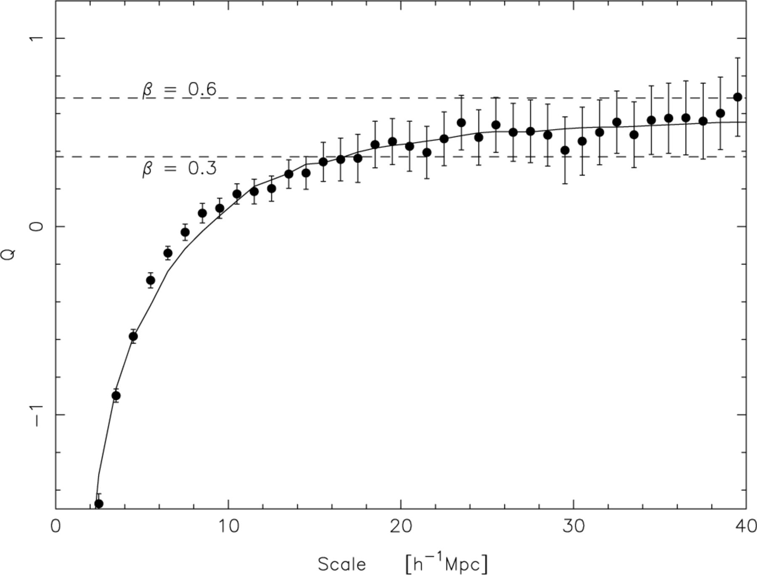
Figure 14. The Q factor for the combined 2dFGRS data, restricted to scales not dominated by noise with error bars from ...
Notes:
Figure 14. The Q factor for the combined 2dFGRS data, restricted to scales not dominated by noise with error bars from the rms spread in mock catalogue results. The two dashed lines show the expected answer for different values of β which approximate the 1σ errors. The solid line shows a model with β= 0.49 and a= 506 km s−1 (see Section 7.1). The inset shows the result for the NGP (solid points) and SGP (open points); the error bars are placed alternately to avoid confusion.
Unless provided in the caption above, the following copyright applies to the content of this slide: © 2003 RAS

Slide 17
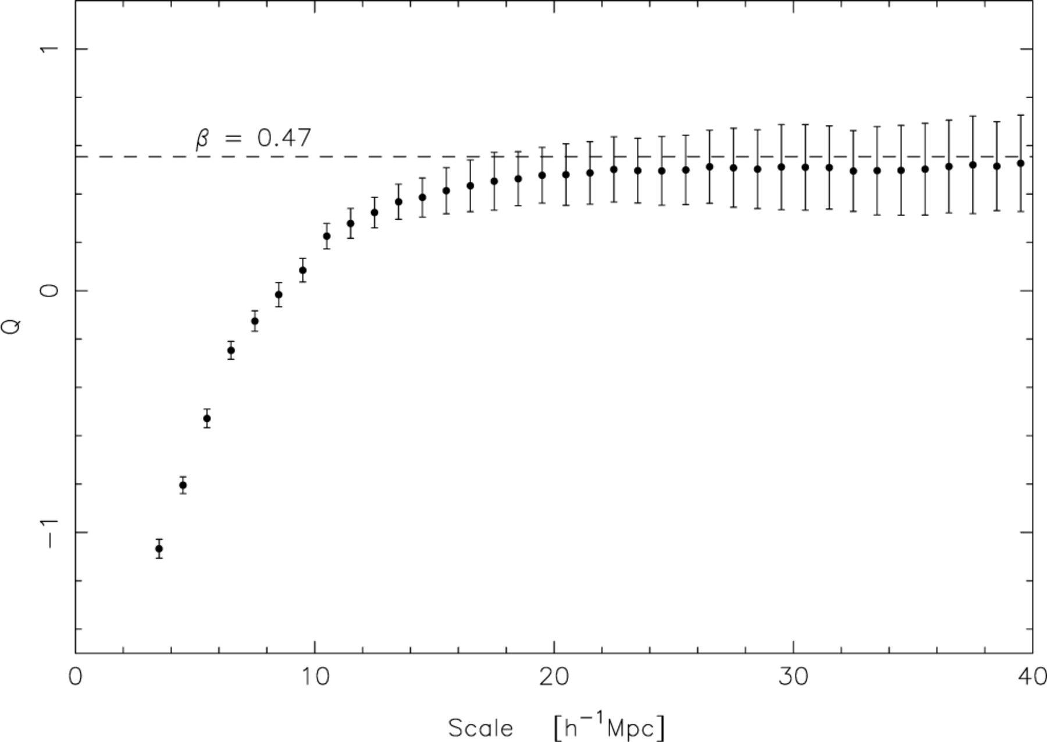
Figure 15. The mean Q factor for the mock catalogues with error bars from the rms spread in mock catalogue results. The ...
Notes:
Figure 15. The mean Q factor for the mock catalogues with error bars from the rms spread in mock catalogue results. The dashed line is the true value of β= 0.47. The slight bias is caused by the random peculiar velocities as discussed in the text.
Unless provided in the caption above, the following copyright applies to the content of this slide: © 2003 RAS

Slide 18
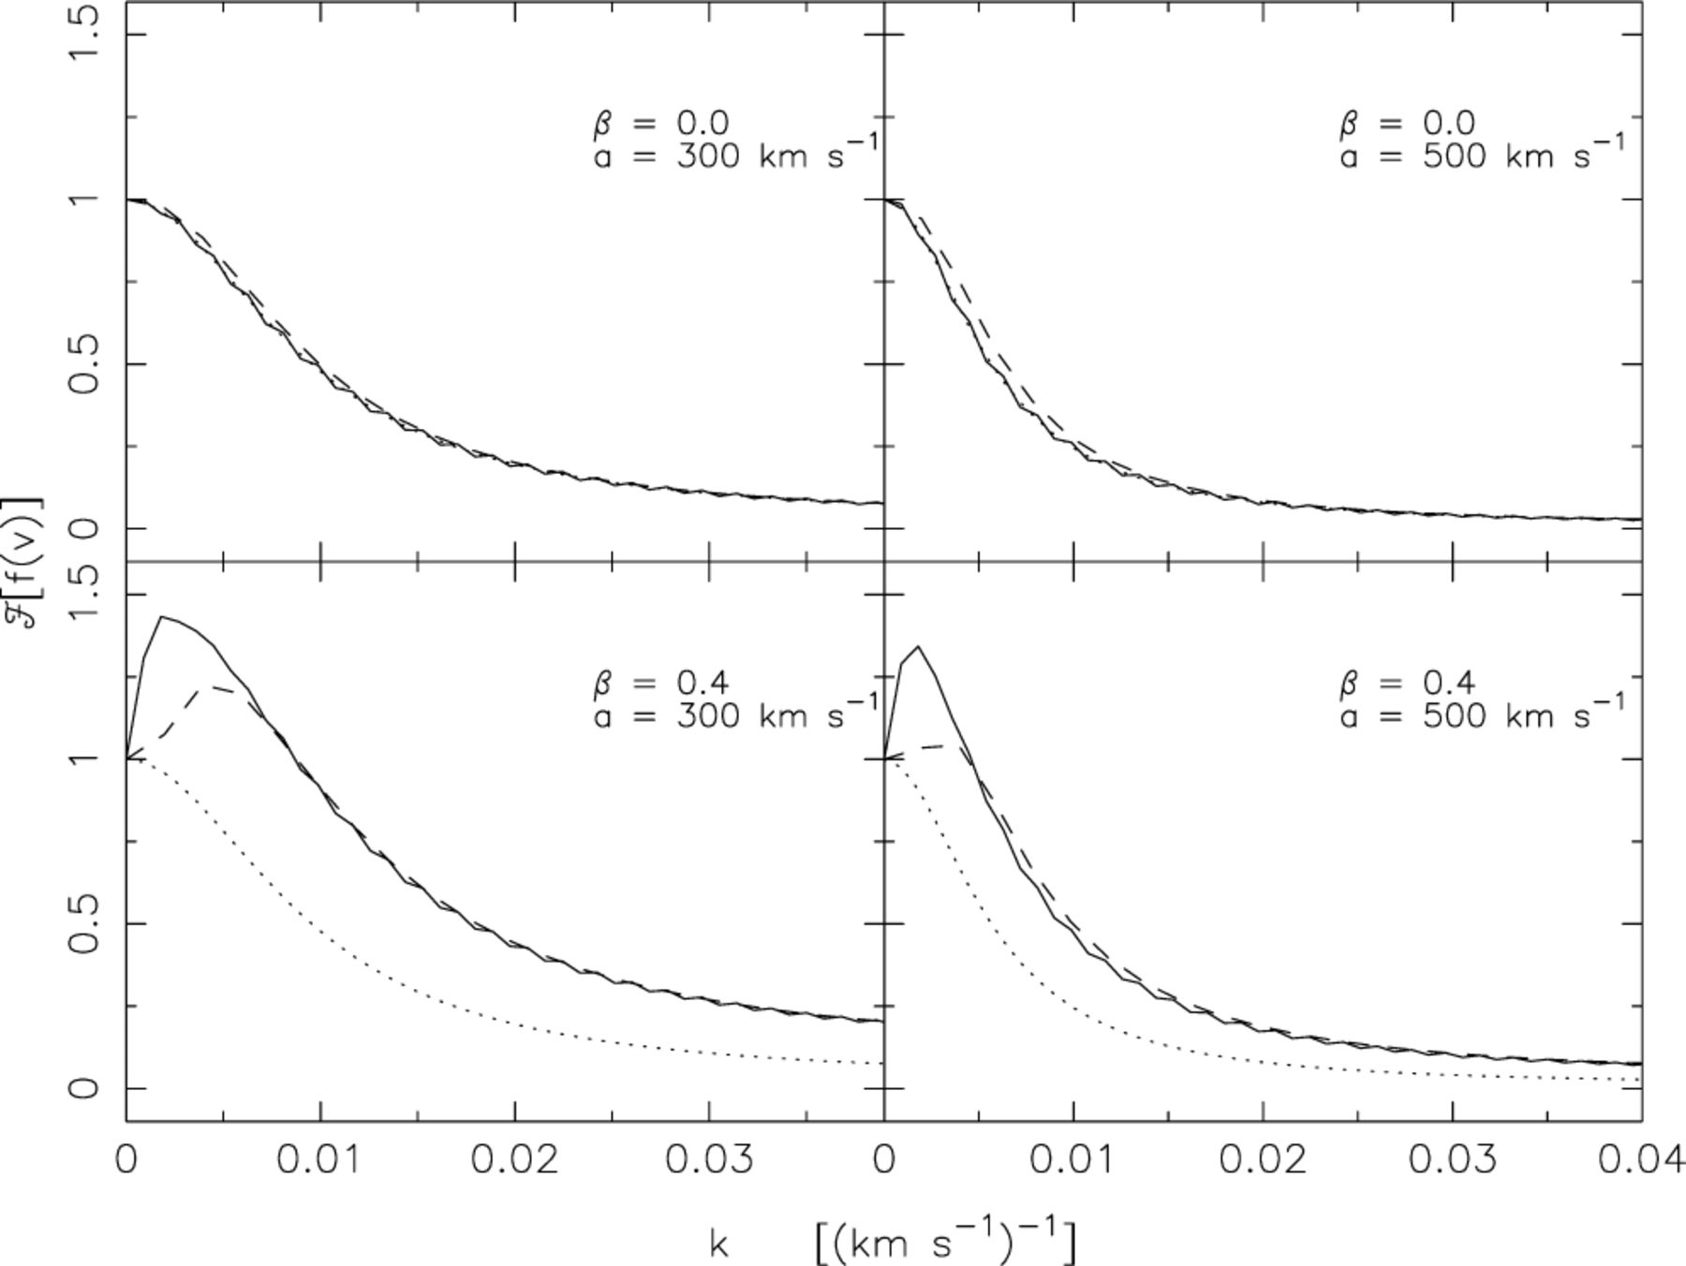
Figure 16. The Fourier transform of the peculiar velocity distribution for various parameters (see labels). The solid ...
Notes:
Figure 16. The Fourier transform of the peculiar velocity distribution for various parameters (see labels). The solid line is for a model with no smoothing and using all scales <70 h−1 Mpc. The dashed line is for a model cut at 32 h−1 Mpc and smoothed with a Hann window (as in L02). The dotted line is the Lorentzian equivalent of the input exponential peculiar velocity distribution (this coincides with the solid line in the top panels).
Unless provided in the caption above, the following copyright applies to the content of this slide: © 2003 RAS

Slide 19
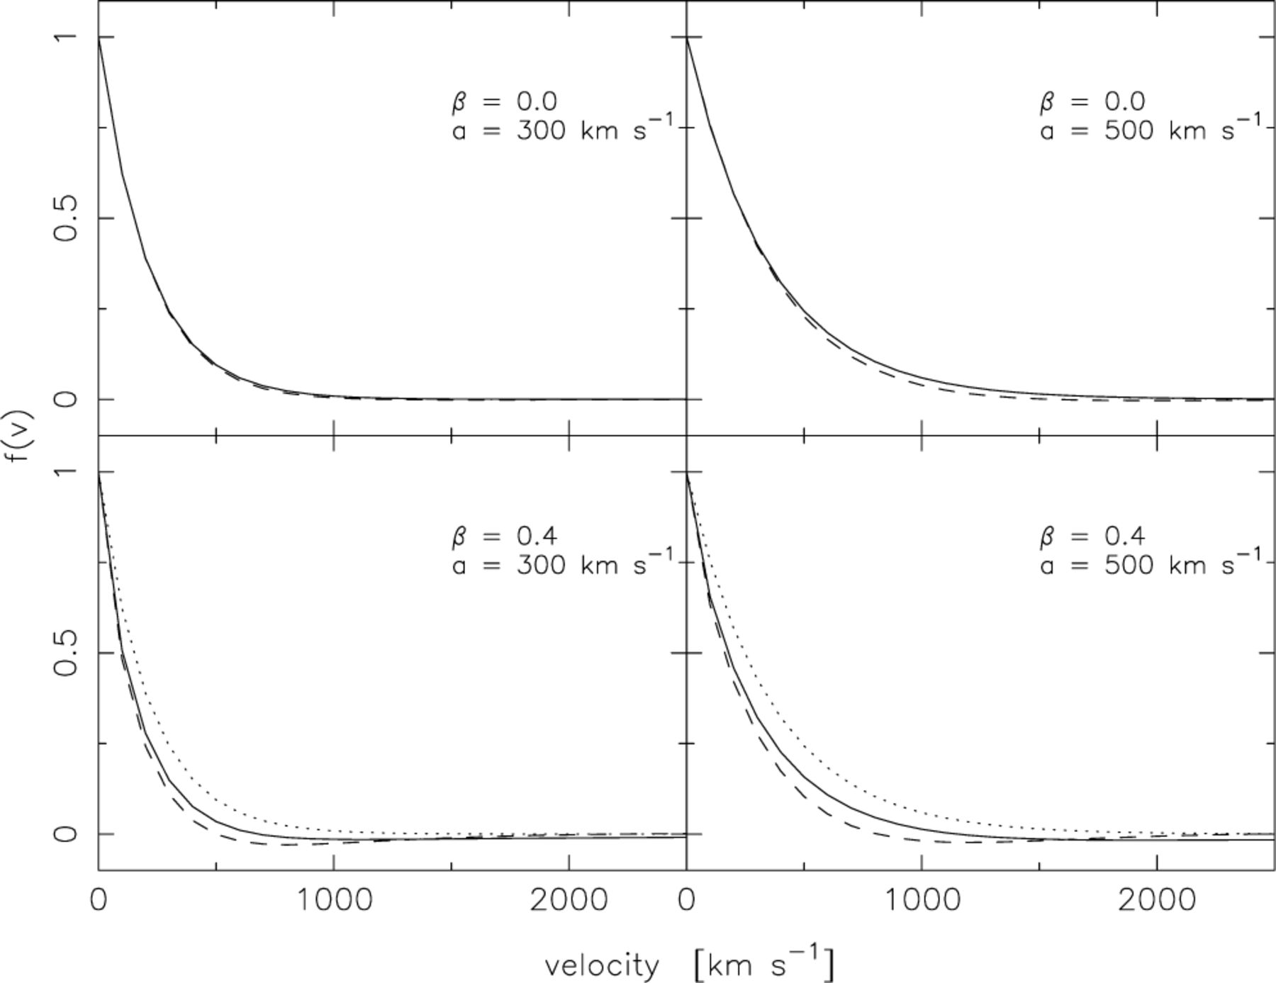
Figure 17. The peculiar velocity distribution for various models (see labels). The solid line is the recovered ...
Notes:
Figure 17. The peculiar velocity distribution for various models (see labels). The solid line is the recovered distribution for a model with no smoothing and using all scales <70 h−1 Mpc. The dashed line is the recovered distribution for a model cut at 32 h−1 Mpc and smoothed with a Hann window. The dotted line is the input exponential peculiar velocity distribution (this coincides with the solid line in the top panels).
Unless provided in the caption above, the following copyright applies to the content of this slide: © 2003 RAS

Slide 20
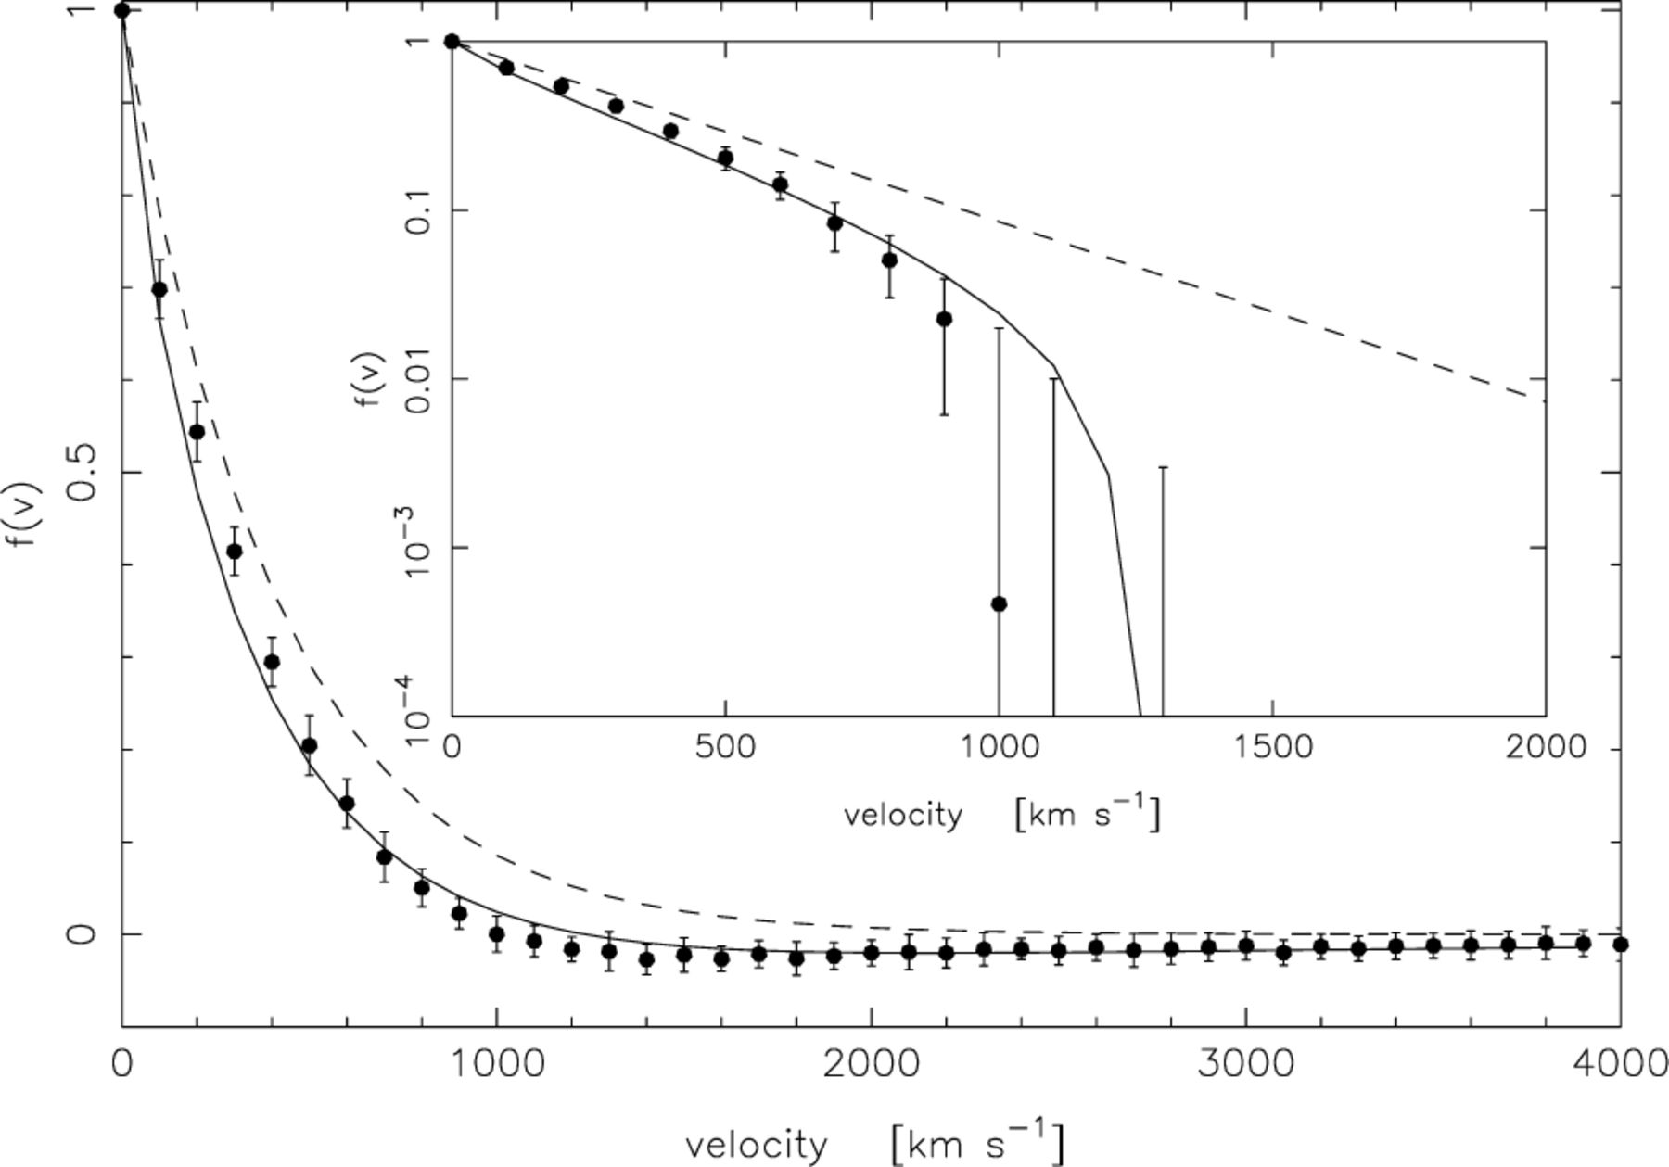
Figure 19. The recovered velocity distribution for the mock catalogues. Filled points are the mean result with error ...
Notes:
Figure 19. The recovered velocity distribution for the mock catalogues. Filled points are the mean result with error bars from the scatter between catalogues. This is compared to a pure exponential distribution with a= 575 km s−1 (dashed line) and a model with a= 575 km s−1 and β= 0.47 (solid line).
Unless provided in the caption above, the following copyright applies to the content of this slide: © 2003 RAS

Slide 21
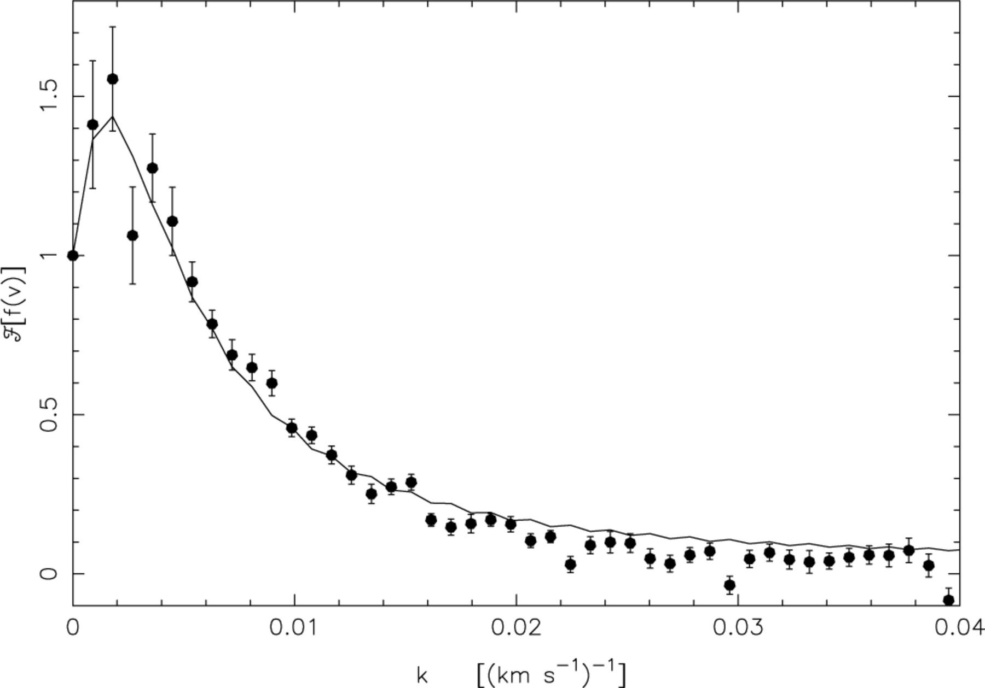
Figure 20. The Fourier transform of the peculiar velocity distribution for the combined 2dFGRS data (solid points) ...
Notes:
Figure 20. The Fourier transform of the peculiar velocity distribution for the combined 2dFGRS data (solid points) compared to a model distribution with a= 570 km s−1 and β= 0.49 (solid line).
Unless provided in the caption above, the following copyright applies to the content of this slide: © 2003 RAS

Slide 22
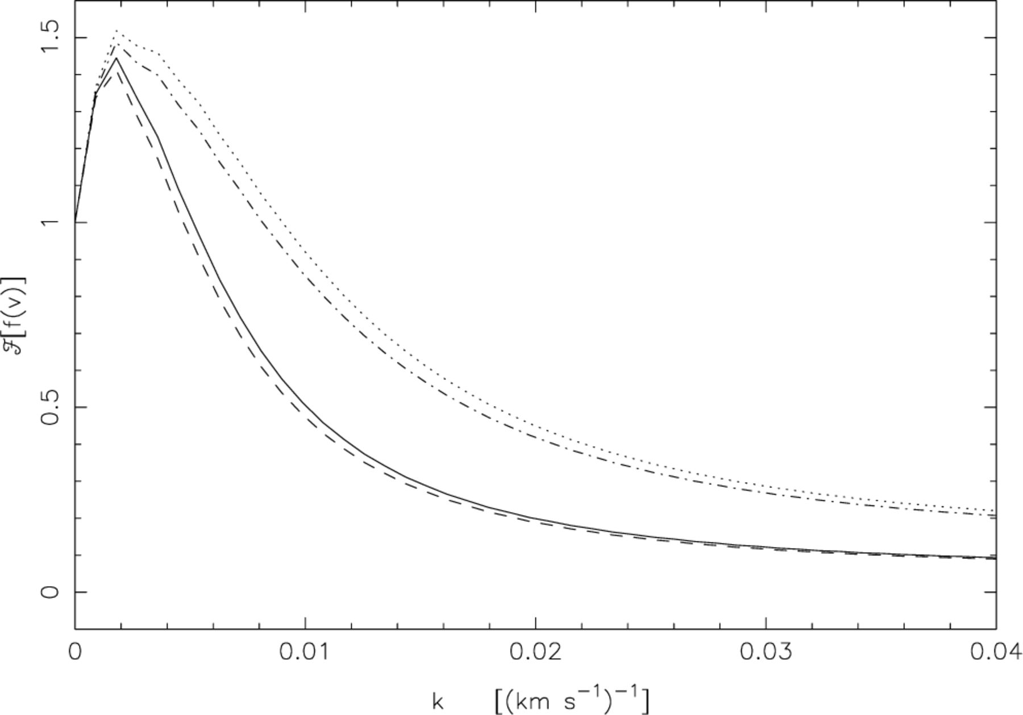
Figure 18. The Fourier transform of the peculiar velocity distribution for a model with a= 500 km s⁻¹ (dashed ...
Notes:
Figure 18. The Fourier transform of the peculiar velocity distribution for a model with a= 500 km s−1 (dashed line), a= 300 km s−1 (dotted line). Also shown is a model with a decreasing from 500 to 300 km s−1 from σ= 0 to σ= 20 h−1 Mpc (solid line) and a model with a increasing from 300 to 500 km s−1 from σ= 0 to σ= 20 h−1 Mpc (dot-dashed line). β= 0.5 for all four models.
Unless provided in the caption above, the following copyright applies to the content of this slide: © 2003 RAS

Slide 23
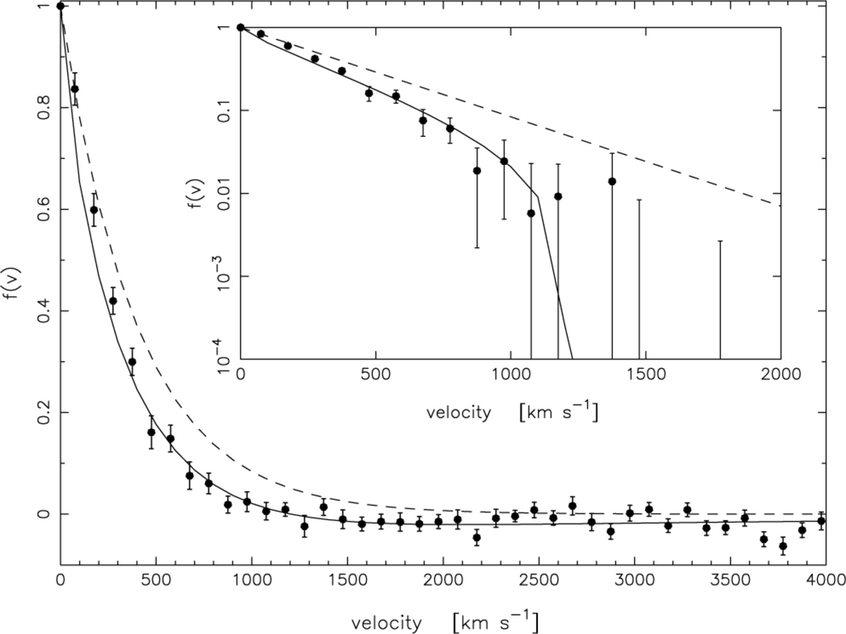
Figure 21. The combined 2dFGRS peculiar velocity distribution (solid points), compared to a pure exponential ...
Notes:
Figure 21. The combined 2dFGRS peculiar velocity distribution (solid points), compared to a pure exponential distribution with a= 570 km s−1 (dashed line) and a model with a= 570 km s−1 and β= 0.49 (solid line). The error bars are from the scatter in mock results.
Unless provided in the caption above, the following copyright applies to the content of this slide: © 2003 RAS

Slide 24
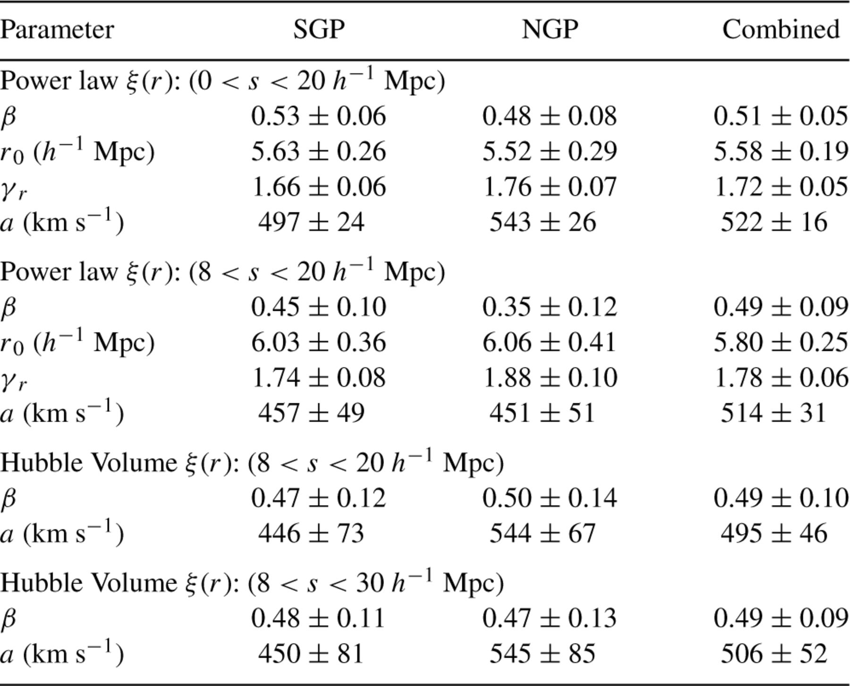
Table 3. Best fitting parameters to the ξ(σ, π) grids with errors from the rms spread in mock catalogue results.
Notes:
Table 3. Best fitting parameters to the ξ(σ, π) grids with errors from the rms spread in mock catalogue results.
Unless provided in the caption above, the following copyright applies to the content of this slide: © 2003 RAS

Slide 25
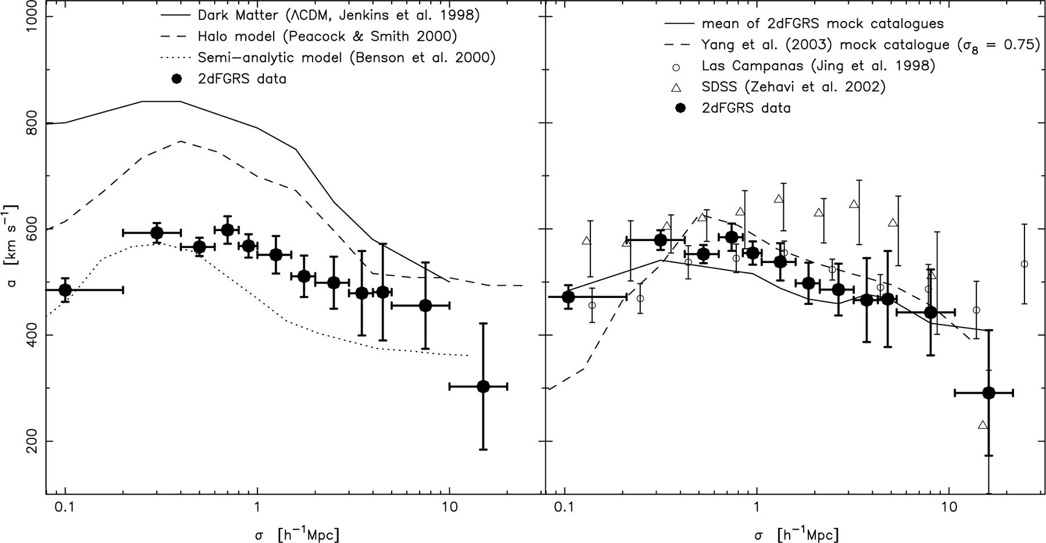
Figure 23. The variation of a with projected separation, σ. Left-hand panel: 2dFGRS data compared to some analytical ...
Notes:
Figure 23. The variation of a with projected separation, σ. Left-hand panel: 2dFGRS data compared to some analytical models, as indicated in the legend. Right-hand panel: 2dFGRS data compared to other redshift surveys and simulated catalogues, as indicated in the legend. The 2dFGRS data and simulated catalogue results use β to calculate the infall velocities whereas the other results assume a functional form (see discussion in Section 7.4).
Unless provided in the caption above, the following copyright applies to the content of this slide: © 2003 RAS

Slide 26
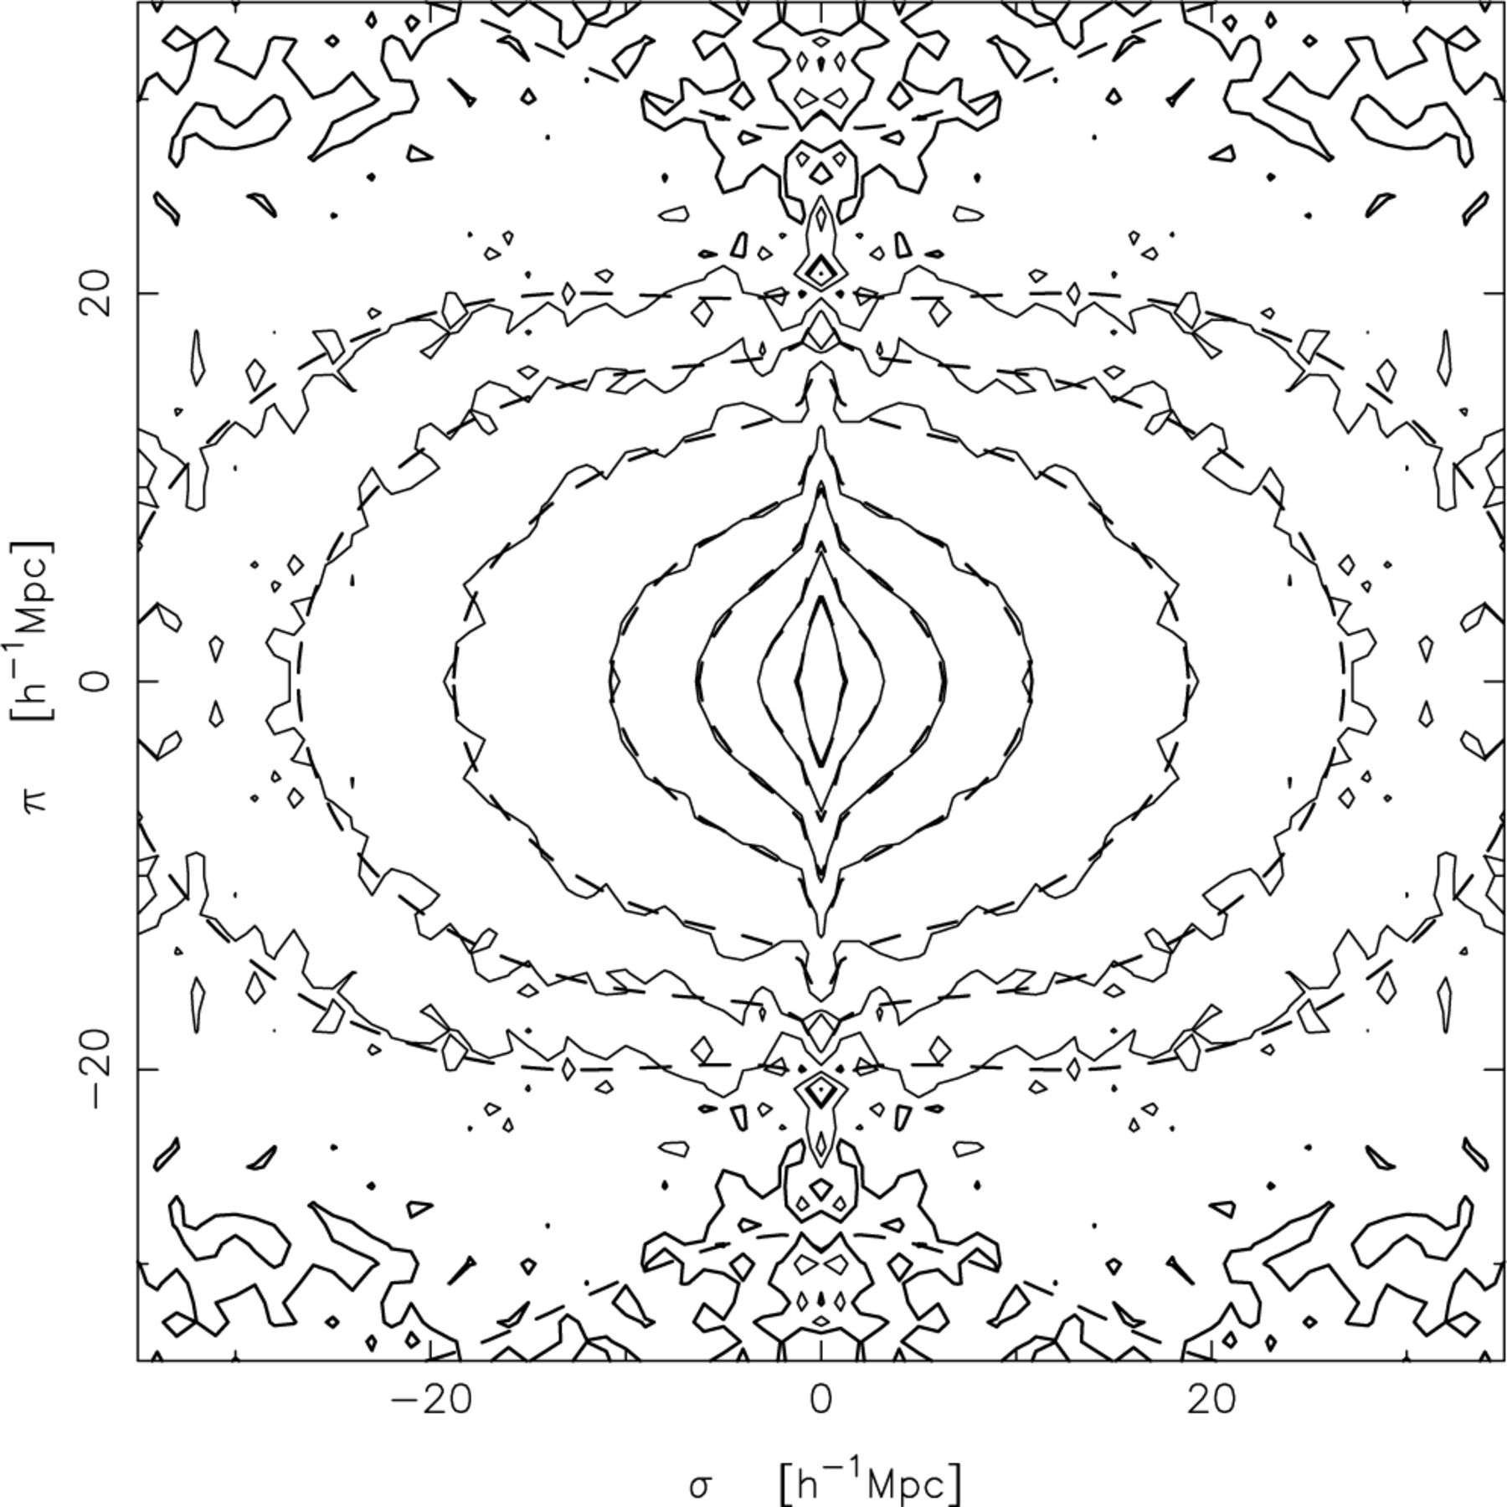
Figure 22. Contours of ξ(σ, π) for the 2dFGRS combined data (solid lines) and the best-fitting model (see Table 3) using ...
Notes:
Figure 22. Contours of ξ(σ, π) for the 2dFGRS combined data (solid lines) and the best-fitting model (see Table 3) using the Hubble Volume ξ(r) fitted to scales 8 < s < 30 h−1 Mpc (dashed lines). Contour levels are at ξ= 4.0, 2.0, 1.0, 0.5, 0.2, 0.1, 0.05 and 0.0 (thick line).
Unless provided in the caption above, the following copyright applies to the content of this slide: © 2003 RAS

Slide 27
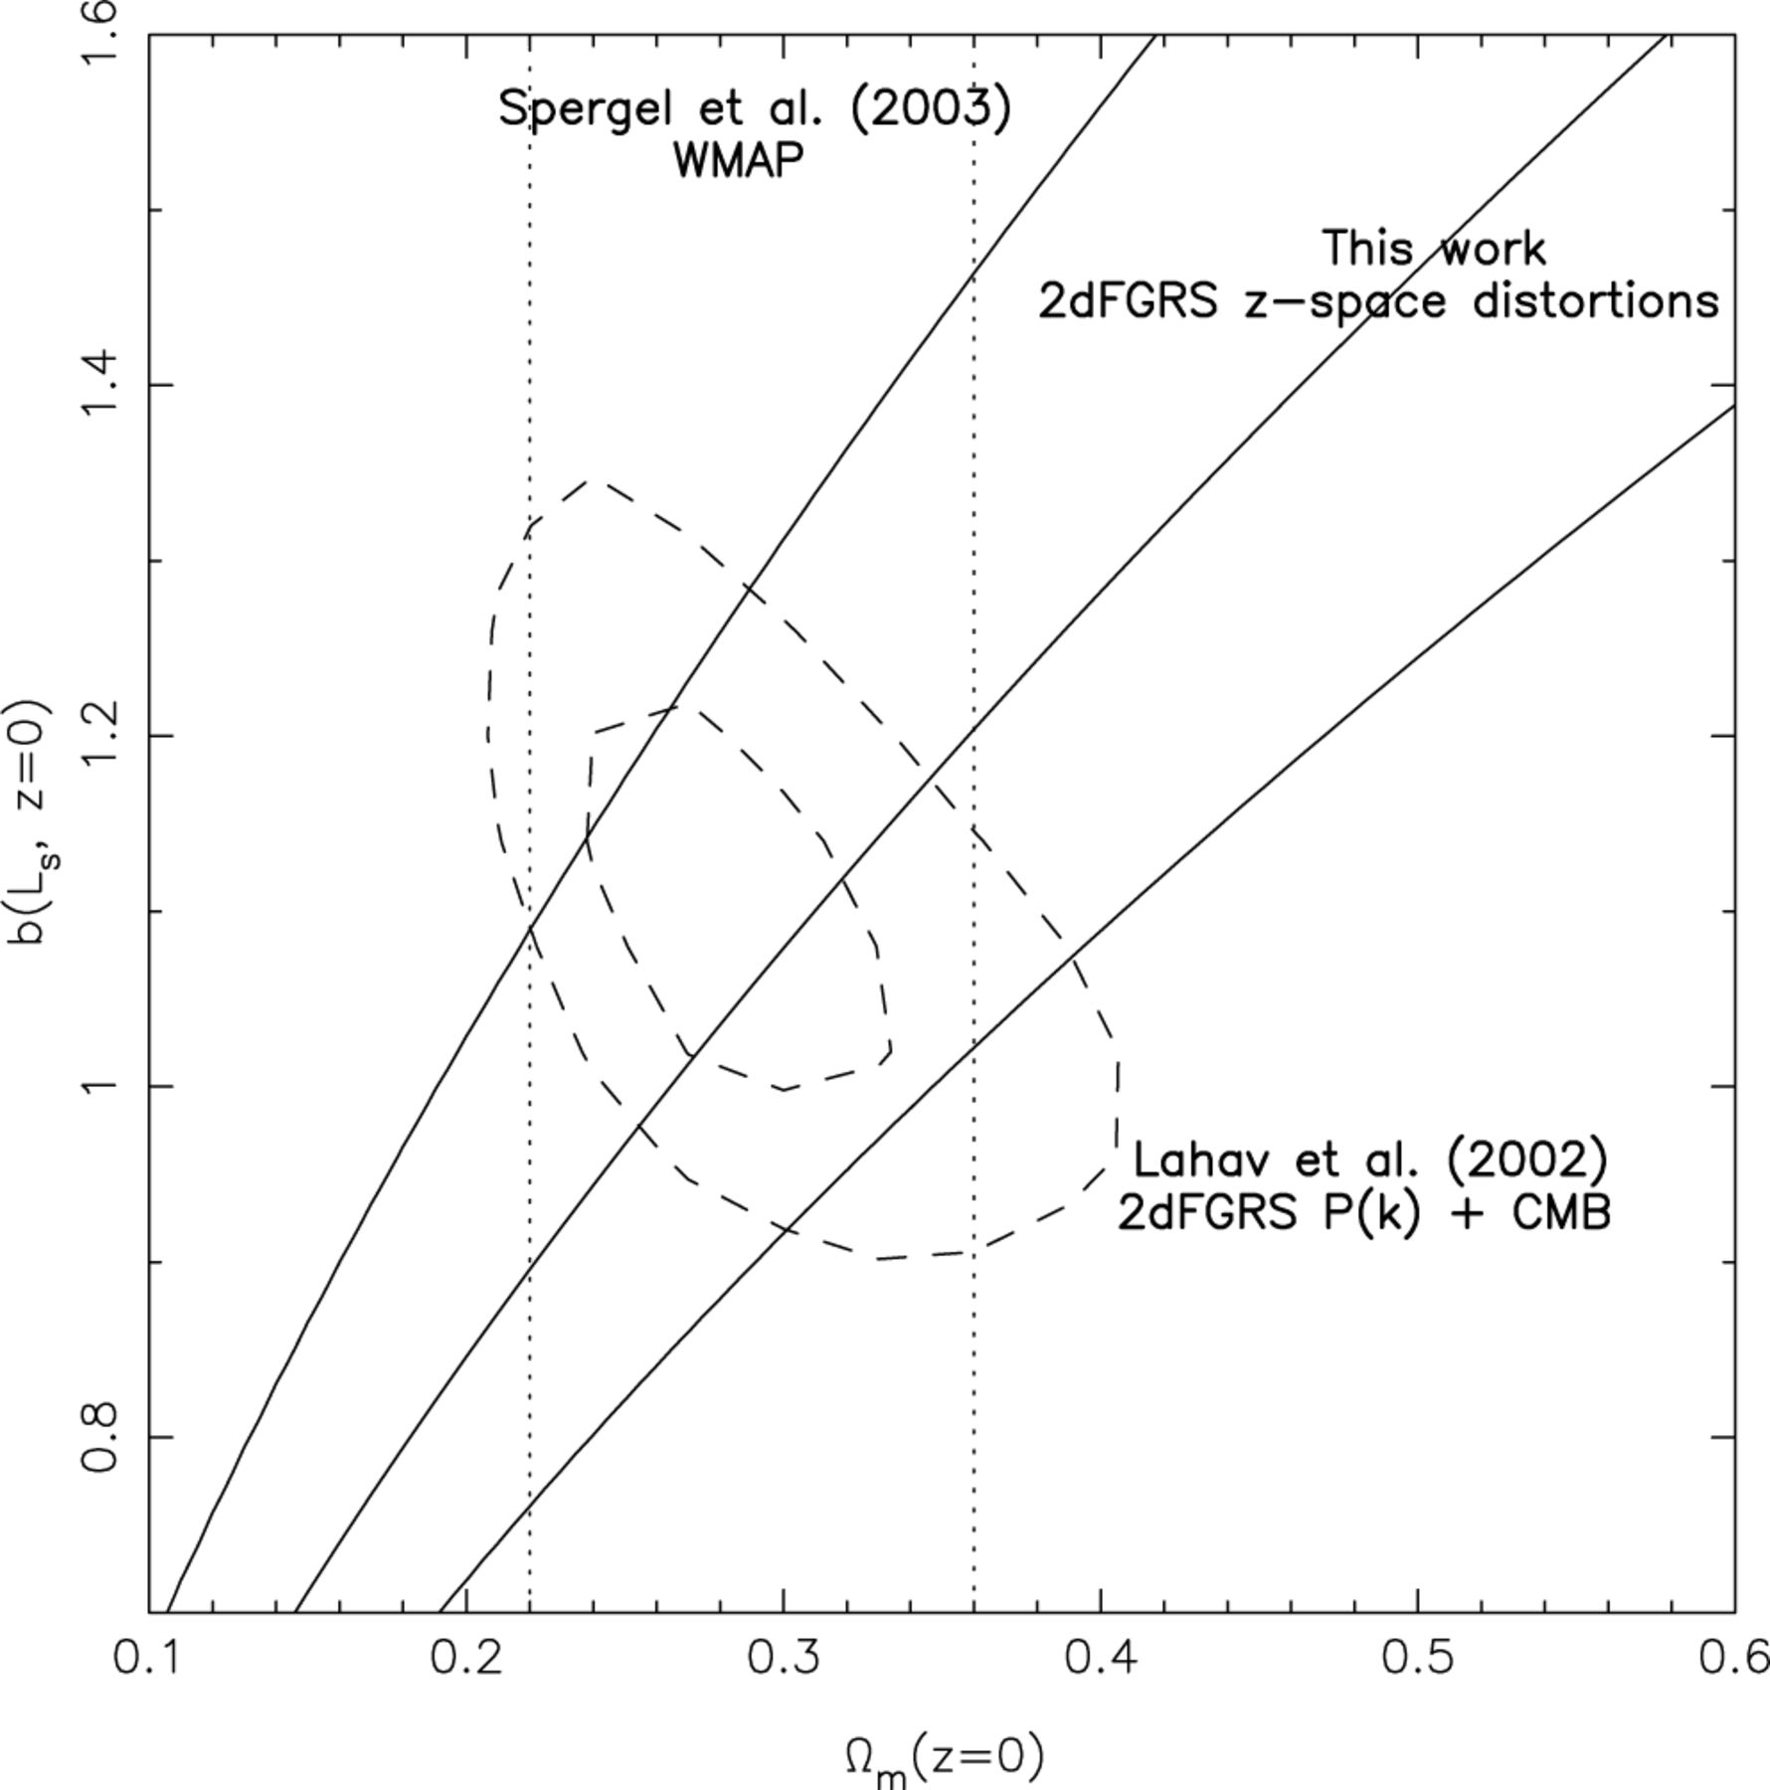
Figure 24. Constraints on Ω_{m} and b: solid lines, best fit and 1σ error contours on β from this work, evolved ...
Notes:
Figure 24. Constraints on Ωm and b: solid lines, best fit and 1σ error contours on β from this work, evolved to the present day (see Section 8.1); dashed lines, 1σ and 2σ error contours from Lahav et al. (2002); dotted lines, 1σ constraints from WMAP (Spergel et al. 2003).
Unless provided in the caption above, the following copyright applies to the content of this slide: © 2003 RAS

