Slide 1
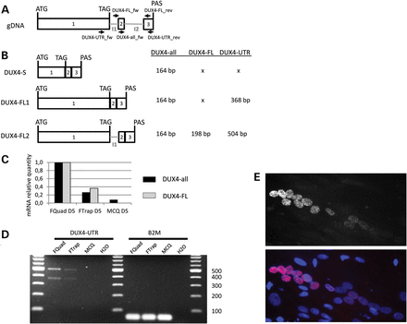
Figure 1. The expression of DUX4-FL mRNA in FSHD and control fetal myotubes. (A) Schematic representation of the DUX4 ...
Notes:
Figure 1. The expression of DUX4-FL mRNA in FSHD and control fetal myotubes. (A) Schematic representation of the DUX4 gene and the resulting DUX4 mRNA expression in muscle. The two primer locations that have been used are represented. (B) Representation of the DUX4 mRNA isoforms previously described (16). The primers for DUX4-all are able to amplify all of the DUX4 isoforms whereas the primers for DUX4-FL cannot amplify DUX4-s or DUX4-FL1. The PCR product sizes are indicated. (C) DUX4 relative expression in fetal-derived FSHD1 (FQuad and FTrap) and control (MCQ) myotubes after 5 days of differentiation. A RT-qPCR (taqman assay) was carried out on 1 µg of total RNA using either DUX4-all (black bars) or DUX4-FL (gray bars) primer sets. The results obtained with FQuad were used as a reference (and arbitrarily put at 1) and were normalized using B2M. (D) The amplification products using the DUX4-UTR or B2M primers were separated on a 2% agarose gel. The expected sizes of the PCR product were 368 bp when both introns 1 and 2 are spliced and 504 bp when intron 1 is retained. The molecular weight is a 100 bp ladder. The exons of DUX4 are indicated as gray boxes numbered 1 to 3. I: Intron; gDNA: genomic DNA. (E) Immunostaining against DUX4 was realized on FQuad 5 days after the induction of differentiation. On the upper panel, DUX4 was labeled with the E5.5 antibody (dilution 1/10). In the lower panel, nuclei have been counterstained with Dapi. The percentage of DUX4-positive nuclei represents 8.89% of the total number of nuclei within myotubes.
Unless provided in the caption above, the following copyright applies to the content of this slide: © The Author 2013. Published by Oxford University Press. All rights reserved. For Permissions, please email: journals.permissions@oup.com

Slide 2
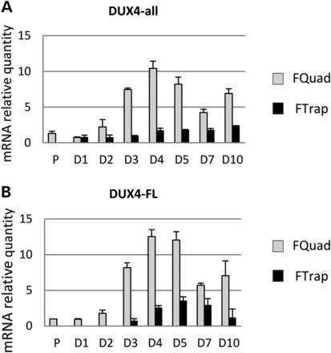
Figure 2. The expression of DUX4 mRNA in FTrap and FQuad during myotubes formation. Differentiation kinetics was ...
Notes:
Figure 2. The expression of DUX4 mRNA in FTrap and FQuad during myotubes formation. Differentiation kinetics was performed on FQuad and FTrap cultures. Cells were harvested at different time points. Total RNA was extracted using trizol, and RT-qPCRs using either Dux4-all (A) or DUX4-FL (B) primers were performed. The results obtained with FQuad in proliferation were used as a reference and were normalized to B2M. The experiments were repeated in duplicate. P: proliferation; D: day after the induction of differentiation. Error bars represent SD of PCR triplicate.
Unless provided in the caption above, the following copyright applies to the content of this slide: © The Author 2013. Published by Oxford University Press. All rights reserved. For Permissions, please email: journals.permissions@oup.com

Slide 3
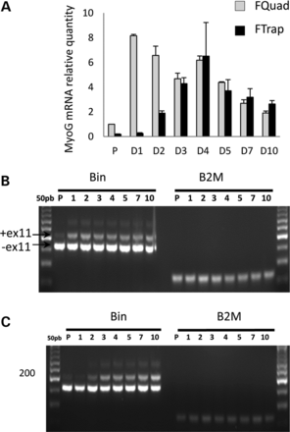
Figure 3. Characterization of the differentiation kinetics in FQuad and FTrap. To analyze differentiation kinetics on ...
Notes:
Figure 3. Characterization of the differentiation kinetics in FQuad and FTrap. To analyze differentiation kinetics on FQuad and FTrap, total RNA was extracted at different time points after the induction of differentiation by serum starvation. RT-qPCR was performed for the detection of MyoG (myogenin) (A) and BIN1 exon 11 (B FQuad; C FTrap). B2M was used as the normalizer.
Unless provided in the caption above, the following copyright applies to the content of this slide: © The Author 2013. Published by Oxford University Press. All rights reserved. For Permissions, please email: journals.permissions@oup.com

Slide 4
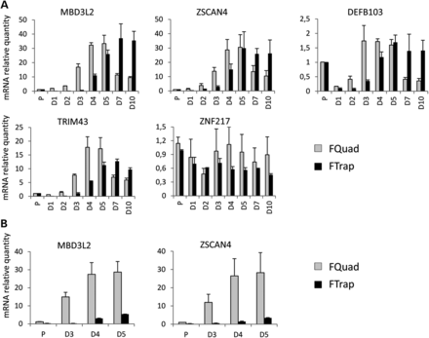
Figure 4. The expression level of genes downstream of DUX4 in FQuad and FTrap. Real-time RT-PCRs were carried out at ...
Notes:
Figure 4. The expression level of genes downstream of DUX4 in FQuad and FTrap. Real-time RT-PCRs were carried out at different time points after the induction of differentiation. Several genes described as being activated by DUX4 were tested. The experiment was made on FQuad (black bars) and FTrap (gray bars). (A) Values measured in each cell type were normalized to its level in proliferation condition. (B) The results are normalized to the level of expression in proliferating FQuad. FTrap expression level is thus relative to FQuad, which allows a better comparison between both differentiated cultures. Error bars represent SD of PCR triplicates carried out on two independent kinetic experiments.
Unless provided in the caption above, the following copyright applies to the content of this slide: © The Author 2013. Published by Oxford University Press. All rights reserved. For Permissions, please email: journals.permissions@oup.com

Slide 5
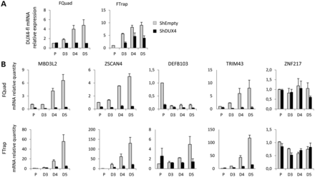
Figure 5. DUX4 inhibition using shDUX4 in FQuad and FTrap and activation of genes downstream of DUX4. A lentivirus ...
Notes:
Figure 5. DUX4 inhibition using shDUX4 in FQuad and FTrap and activation of genes downstream of DUX4. A lentivirus (pLL3.7) carrying both an shRNA directed against DUX4 and a CMV-GFP cassette was used to transduce FQuad (left panel) or FTrap (right panel) cultures. After sorting of the CD56+ (a marker for myogenic cells) and GFP+ double positive cells, a differentiation kinetic was carried out. (A) DUX4 mRNA expression was analyzed by real-time PCR using the DUX4-all primers in the Fquad (left panel) and FTrap (right panel) transduced cells. At day 5 of differentiation, a student's t-test reveals that P = 0.04 and 0.03 for FQuad and FTrap, respectively. (B) The mRNA expression level of the downstream target genes was assessed by real-time PCR on FQuad (upper panel) and FTrap (lower panel) cultures transduced with either the shDUX4 (black bar) or the shEmpty (gray bar). A T-test realized at day 5 of differentiation reveals that P < 0.05 for MBD3L2, ZSCAN4, TRIM43 and DEFB103. Error bars represent SD of PCR triplicate realized on two independent experiments.
Unless provided in the caption above, the following copyright applies to the content of this slide: © The Author 2013. Published by Oxford University Press. All rights reserved. For Permissions, please email: journals.permissions@oup.com

Slide 6
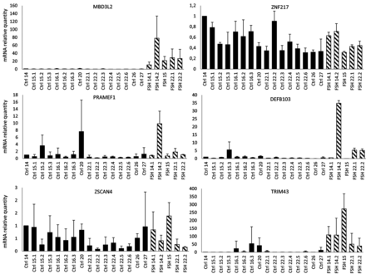
Figure 6. The expression level of genes downstream of DUX4 in quadriceps fetal biopsies. Quadriceps biopsies from five ...
Notes:
Figure 6. The expression level of genes downstream of DUX4 in quadriceps fetal biopsies. Quadriceps biopsies from five FSHD1 fetuses (hatched bars) and 16 quadriceps control biopsies obtained at different stages of development (back bars) were analyzed. A RT-q PCR was made on each mRNA preparation to determine their relative quantity. B2M was used as the normalizer gene. The result obtained with the Ctrl14 was used as the reference to generate arbitrary units in order to compare results between samples. Statistical analyses (T-test) revealed that the mean expression level for MBD3L2 and TRIM43 was different in control and FSHD1 samples (P = 0.02 and 0.03, respectively).
Unless provided in the caption above, the following copyright applies to the content of this slide: © The Author 2013. Published by Oxford University Press. All rights reserved. For Permissions, please email: journals.permissions@oup.com

Slide 7
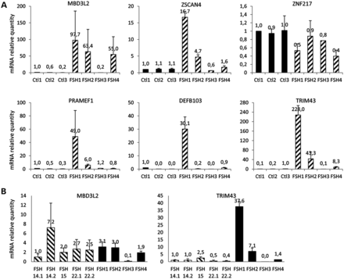
Figure 7. The expression level of genes downstream of DUX4 in quadriceps adult biopsies. (A) Four FSHD1 (hatched bars) ...
Notes:
Figure 7. The expression level of genes downstream of DUX4 in quadriceps adult biopsies. (A) Four FSHD1 (hatched bars) and three healthy control (black bars) adult quadriceps biopsies were analyzed. For each gene, the result obtained with the Ctrl1 was used as the reference for arbitrary quantification. B2M gene was used as normalizer. Statistical analysis (Student's T-test) reveals that P < 0.05 only for MBD3L2 and TRIM43. (B) MBD3L2 and TRIM43 expression levels were compared in five fetal (hatched bars) and four adult (black bars) FSHD1 biopsies. Statistical analysis (t-test) does not show any difference in adult and fetal samples (P = 0.22 for MBD3L2 and P = 0.16 for TRIM43).
Unless provided in the caption above, the following copyright applies to the content of this slide: © The Author 2013. Published by Oxford University Press. All rights reserved. For Permissions, please email: journals.permissions@oup.com

