Slide 1
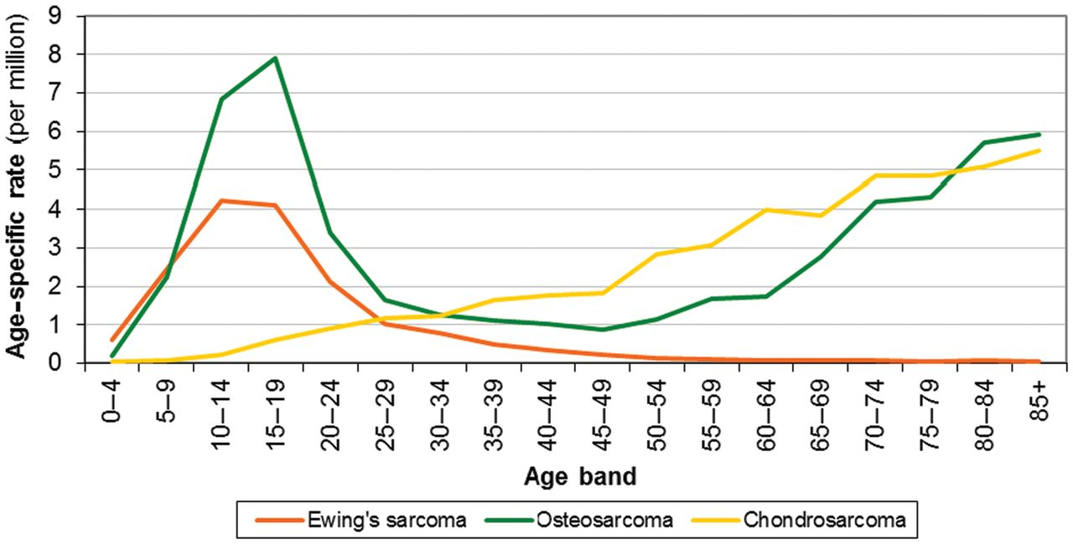
Figure 1 Age specific incidence rates by morphology, England, 1979–2004. Data from National Cancer Intelligence Unit, ...
Notes:
Figure 1 Age specific incidence rates by morphology, England, 1979–2004. Data from National Cancer Intelligence Unit, UK; http://www.ncin.org.uk/publications/data_briefings/bone_sarcomas_incidence_and_survival.aspx.
Unless provided in the caption above, the following copyright applies to the content of this slide: © The Author 2012. Published by Oxford University Press on behalf of the European Society for Medical Oncology. All rights reserved. For permissions, please email: journals.permissions@oup.com

