Slide 1
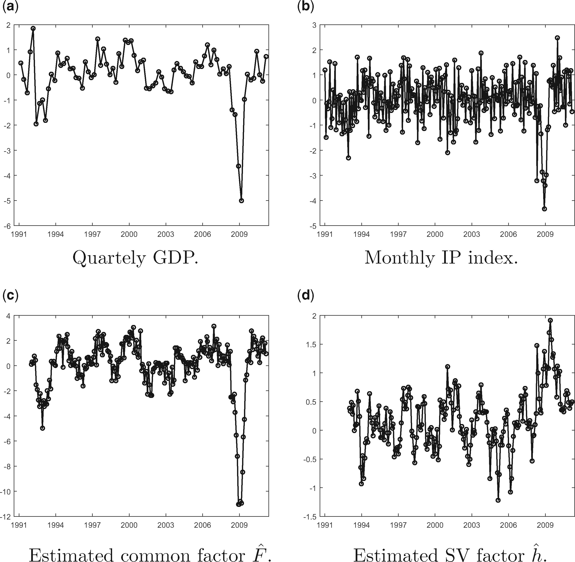
Figure 1 Time series of observables and estimated factors: SV model estimated on GDP and IP. (a) Quarterly GDP. (b) ...
Notes:
Figure 1 Time series of observables and estimated factors: SV model estimated on GDP and IP. (a) Quarterly GDP. (b) Monthly IP index. (c) Estimated common factor F^. (d) Estimated SV factor h^. Panels (a) and (b) display the time series of the (standardized) quarterly growth rate of European GDP, and the (standardized) monthly growth rate of aggregate European Industrial Production index. These series are used to estimate the mixed frequency state space model with SV specified as DGP 3 in Section 4, with flow sampling of the LF variable. The sample is from 1991-Q1 to 2011-Q1. Panels (c) and (d) display the estimated mean and idiosyncratic volatility factors F^ and h^. The parameters of the SV model are estimated via II, using the same auxiliary model as in the MC simulations of Section 4. The factors are filtered by reprojection.
Unless provided in the caption above, the following copyright applies to the content of this slide: © The Author, 2017. Published by Oxford University Press. All rights reserved. For Permissions, please email: journals.permissions@oup.com

Slide 2
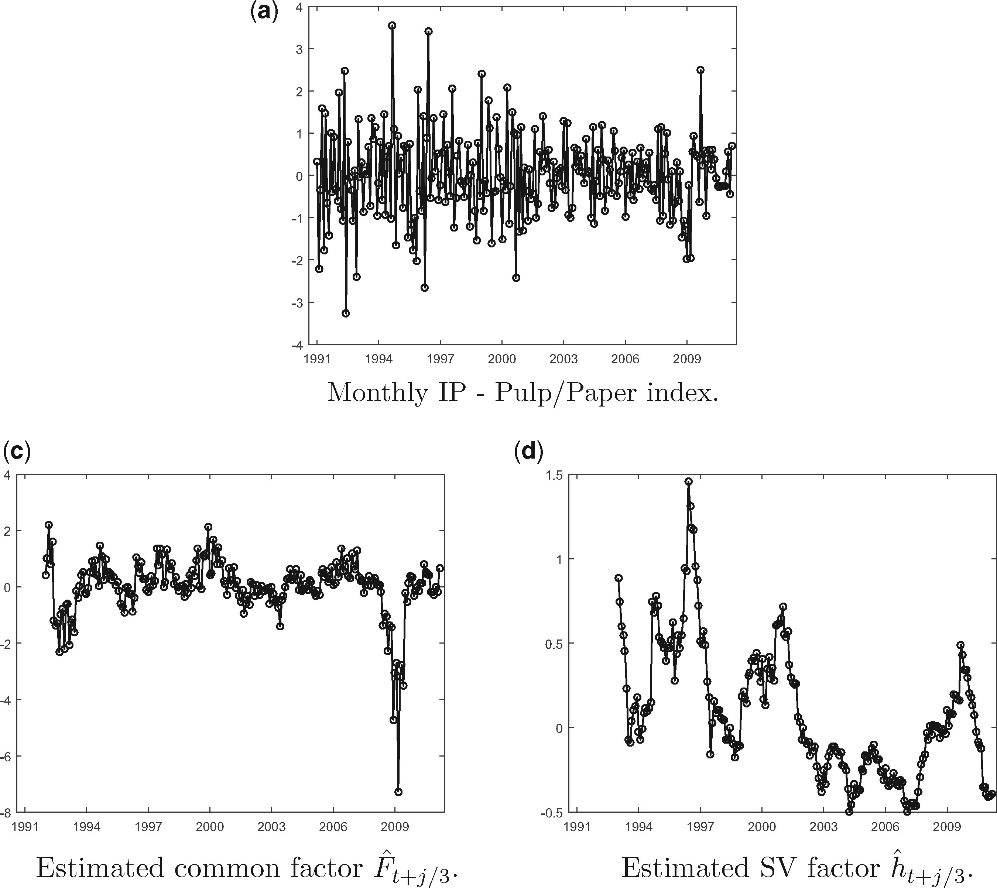
Figure 2 Time series of HF observable and estimated factors: SV model estimated on GDP and IP—Pulp/Paper. (a) Monthly ...
Notes:
Figure 2 Time series of HF observable and estimated factors: SV model estimated on GDP and IP—Pulp/Paper. (a) Monthly IP—Pulp/Paper index. (b) Estimated common factor F^t+j/3. (c) Estimated SV factor h^t+j/3. Panel (a) displays the (standardized) monthly growth rate of the European Industrial Production index for “Pulp and Paper sector.” These series are used to estimate the mixed frequency state space model with SV specified as DGP 3 in Section 4, with flow sampling of the LF variable (European GDP, represented in Figure 1a). The sample is from 1991-Q1 to 2011-Q1. Panels (b) and (c) display the estimated mean and idiosyncratic volatility factors F^ and h^. The parameters of the SV model are estimated via Indirect Inference, using the same auxiliary model as in the MC simulations of Section 4. The factors are filtered by reprojection.
Unless provided in the caption above, the following copyright applies to the content of this slide: © The Author, 2017. Published by Oxford University Press. All rights reserved. For Permissions, please email: journals.permissions@oup.com

Slide 3
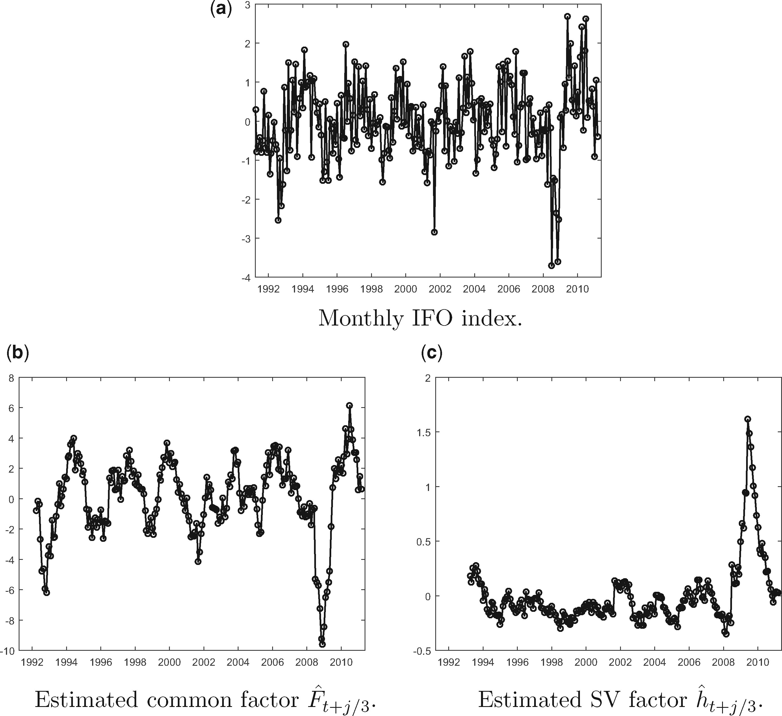
Figure 3 Time series of HF observables and estimated factors: SV model estimated on GDP and IFO. (a) Monthly IFO ...
Notes:
Figure 3 Time series of HF observables and estimated factors: SV model estimated on GDP and IFO. (a) Monthly IFO index. (b) Estimated common factor F^t+j/3. (c) Estimated SV factor h^t+j/3. Panel (a) displays the time series of the monthly (standardized first difference of) Germany IFO Business Climate index. These series are used to estimate the mixed frequency state space model with SV specified as DGP 3 in Section 4, with flow sampling of the LF variable (European GDP, represented in Figure 1a). The sample is from 1991-Q1 to 2011-Q1. Panels (b) and (c) display the estimated mean and idiosyncratic volatility factors F^ and h^. The parameters of the SV model are estimated via II, using the same auxiliary model as in the MC simulations of Section 4. The factors are filtered by reprojection.
Unless provided in the caption above, the following copyright applies to the content of this slide: © The Author, 2017. Published by Oxford University Press. All rights reserved. For Permissions, please email: journals.permissions@oup.com

Slide 4
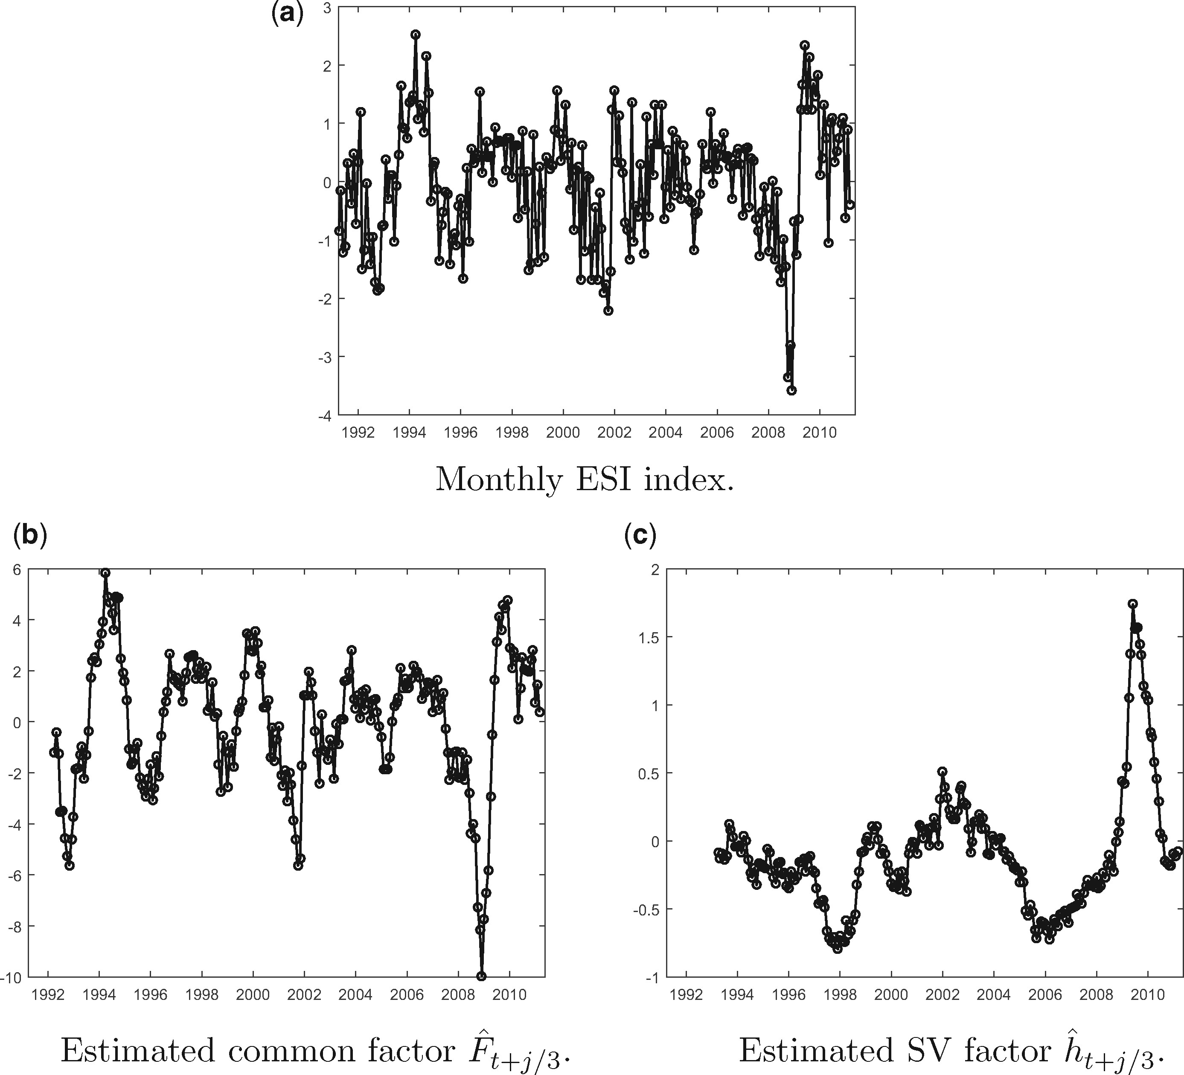
Figure 4 Time series of HF observable and estimated factors: SV model estimated on GDP and ESI. (a) Monthly ESI index. ...
Notes:
Figure 4 Time series of HF observable and estimated factors: SV model estimated on GDP and ESI. (a) Monthly ESI index. (b) Estimated common factor F^t+j/3. (c) Estimated SV factor h^t+j/3. Panel (a) displays the time series of the (standardized first difference of) monthly Euro-area Economic Sentiment index. These series are used to estimate the mixed frequency state space model with SV specified as DGP 3 in Section 4, with flow sampling of the LF variable (European GDP, represented in Figure 1a). The sample is from 1991-Q1 to 2011-Q1. Panels (b) and (c) display the estimated mean and idiosyncratic volatility factors F^ and h^. The parameters of the SV model are estimated via II, using the same auxiliary model as in the MC simulations of Section 4. The factors are filtered by reprojection.
Unless provided in the caption above, the following copyright applies to the content of this slide: © The Author, 2017. Published by Oxford University Press. All rights reserved. For Permissions, please email: journals.permissions@oup.com

Slide 5
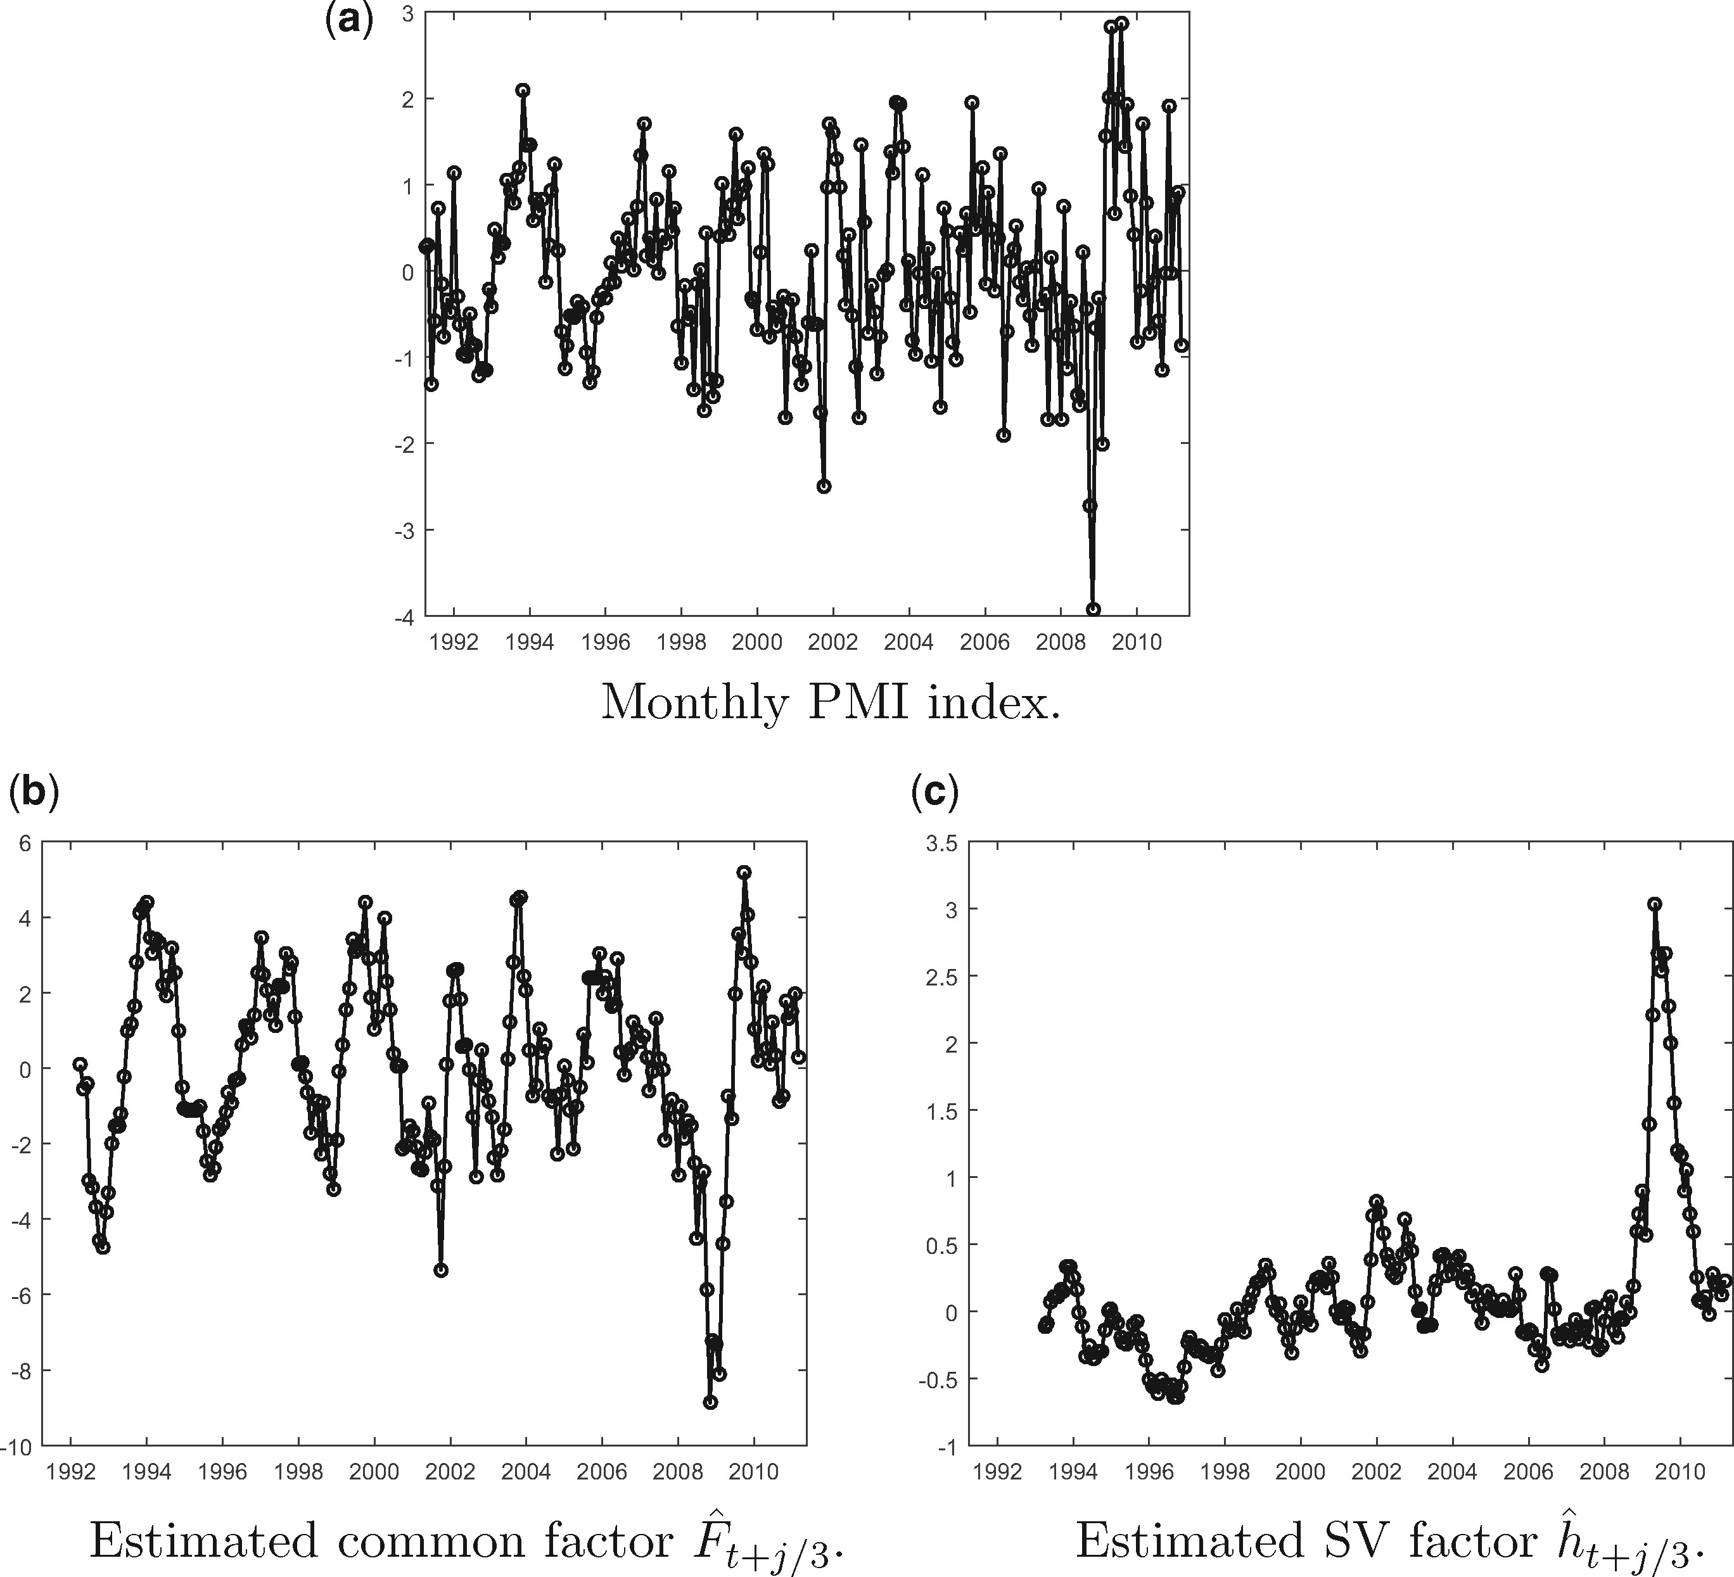
Figure 5 Time series of HF observable and estimated factors: SV model estimated on GDP and PMI. (a) Monthly PMI index. ...
Notes:
Figure 5 Time series of HF observable and estimated factors: SV model estimated on GDP and PMI. (a) Monthly PMI index. (b) Estimated common factor F^t+j/3. (c) Estimated SV factor h^t+j/3. Panel (a) displays the time series of the (standardized first difference of) monthly Euro-area Composite Purchasing Manager index. These series are used to estimate the mixed frequency state space model with SV specified as DGP 3 in Section 4, with flow sampling of the LF variable (European GDP, represented in Figure 1a). The sample is from 1991-Q1 to 2011-Q1. Panels (c) and (d) display the estimated mean and idiosyncratic volatility factors F^ and h^. The parameters of the SV model are estimated via II, using the same auxiliary model as in the MC simulations of Section 4. The factors are filtered by reprojection.
Unless provided in the caption above, the following copyright applies to the content of this slide: © The Author, 2017. Published by Oxford University Press. All rights reserved. For Permissions, please email: journals.permissions@oup.com

