Slide 1
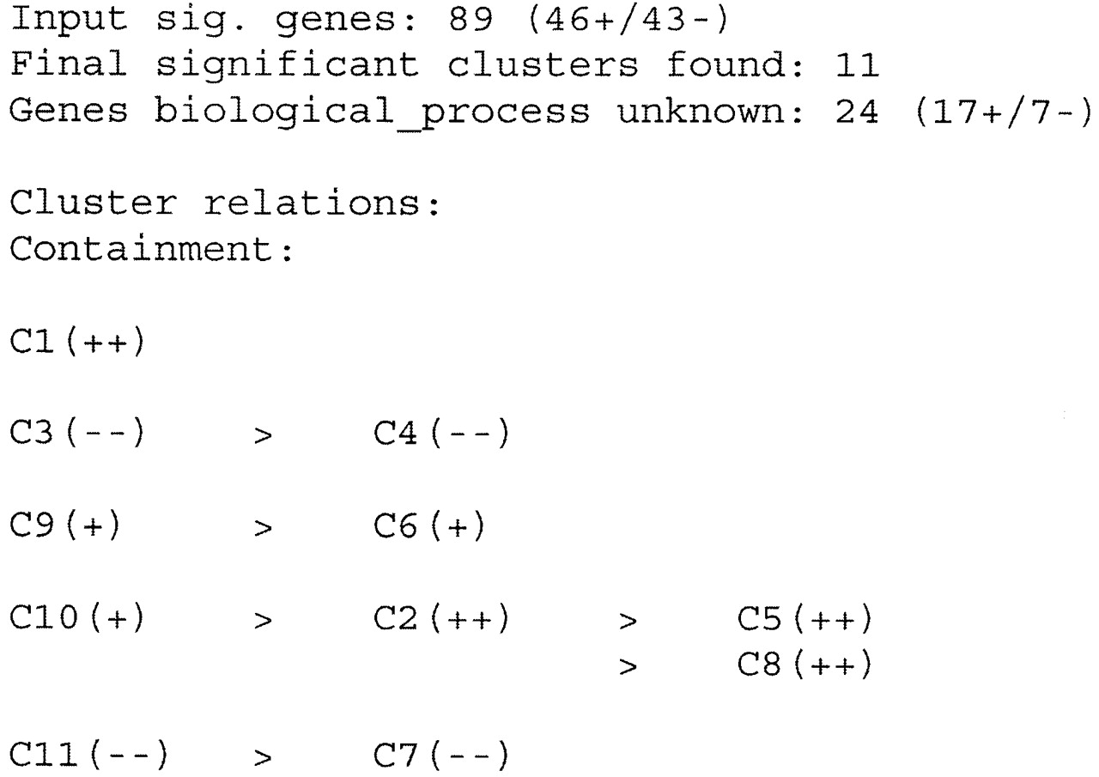
Figure 1. Relation and polarity of clusters obtained from mac1 array experiment when all the significant ...
Notes:
Figure 1. Relation and polarity of clusters obtained from mac1 array experiment when all the significant genes are used. Cn, cluster label; >, the cluster on the left completely contains the cluster on the right; ++, all the genes in the cluster are up‐regulated; +, at least 80% of the genes in the cluster are up‐regulated; – –, all the genes in the cluster are down‐regulated; –, at least 80% of the genes in the cluster are down‐regulated.
Unless provided in the caption above, the following copyright applies to the content of this slide:

