Slide 1
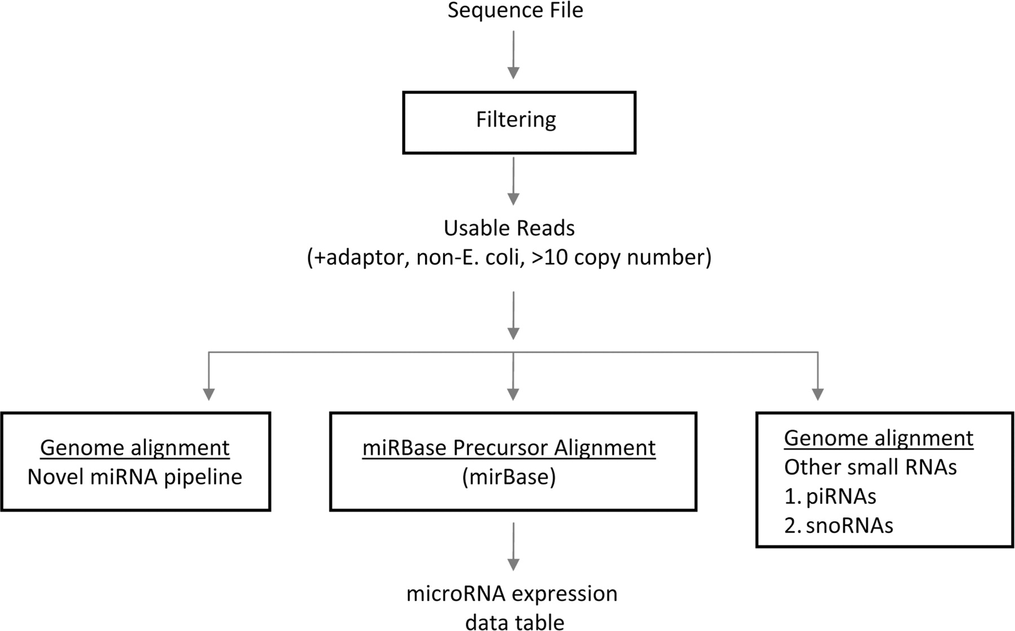
Figure 1: Analytical steps involved with microRNA profiling by deep sequencing. Raw sequences are first filtered to ...
Notes:
Figure 1: Analytical steps involved with microRNA profiling by deep sequencing. Raw sequences are first filtered to exclude those most likely to represent sequencing errors. Those sequence-reads that align to known microRNA precursor sequences are compiled into a data table with read counts (a measure of absolute expression level). Sequence reads that do not map to known microRNAs may be searched for potential novel microRNAs. In addition to microRNAs, the sequence reads may be searched for other small RNA species, such as piRNAs or snoRNAs.
Unless provided in the caption above, the following copyright applies to the content of this slide: © The Author 2009. Published by Oxford University Press. For Permissions, please email: journals.permissions@oxfordjournals.org

Slide 2
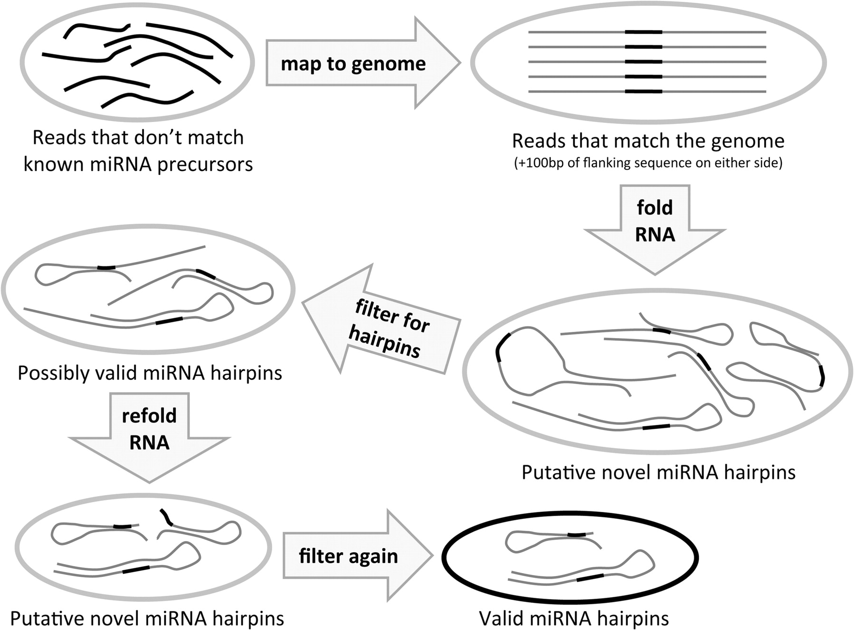
Figure 2: Novel microRNA discovery pipeline. Taking the sequence reads that do not map to known microRNA precursors, we ...
Notes:
Figure 2: Novel microRNA discovery pipeline. Taking the sequence reads that do not map to known microRNA precursors, we proceed by mapping them to the whole genome. Those reads that map (exactly) to the genome are taken (plus 100 bp of genomic sequence flanking either side of the read sequence) and folded as RNA using the Vienna package. The putative novel hairpins this produces are filtered for single-loop hairpins with the putative mature microRNA (read sequence) on one side of the hairpin, and those that pass are kept as possibly valid hairpins. These are trimmed down to only the putative hairpin sequence, refolded and filtered again with the Ambros criteria. The remaining hairpins are a valid microRNA hairpin whose putative mature microRNA sequence was found in the short RNA-ome of the sample, and thus are considered putative novel microRNA precursors.
Unless provided in the caption above, the following copyright applies to the content of this slide: © The Author 2009. Published by Oxford University Press. For Permissions, please email: journals.permissions@oxfordjournals.org

