Slide 1
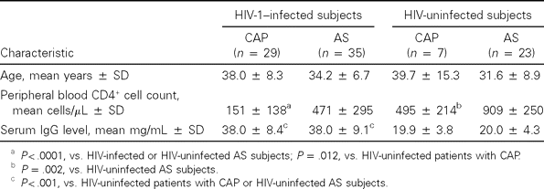
Table 1 Clinical characteristics and laboratory data for 64 subjects with community-acquired pneumonia (CAP) and 30 ...
Notes:
Table 1 Clinical characteristics and laboratory data for 64 subjects with community-acquired pneumonia (CAP) and 30 asymptomatic (AS) subjects in Uganda.
Unless provided in the caption above, the following copyright applies to the content of this slide: © 2003 by the Infectious Diseases Society of America

Slide 2
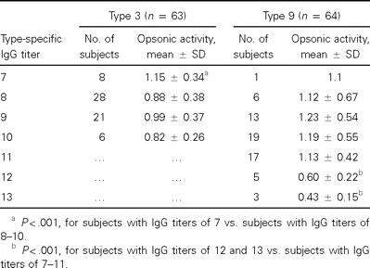
Table 2 Comparisons of opsonic activity against type 3 and type 9 Streptococcus pneumoniae in serum samples ...
Notes:
Table 2 Comparisons of opsonic activity against type 3 and type 9 Streptococcus pneumoniae in serum samples containing different levels of type-specific IgG from HIV-1–infected subjects in Uganda.
Unless provided in the caption above, the following copyright applies to the content of this slide: © 2003 by the Infectious Diseases Society of America

Slide 3
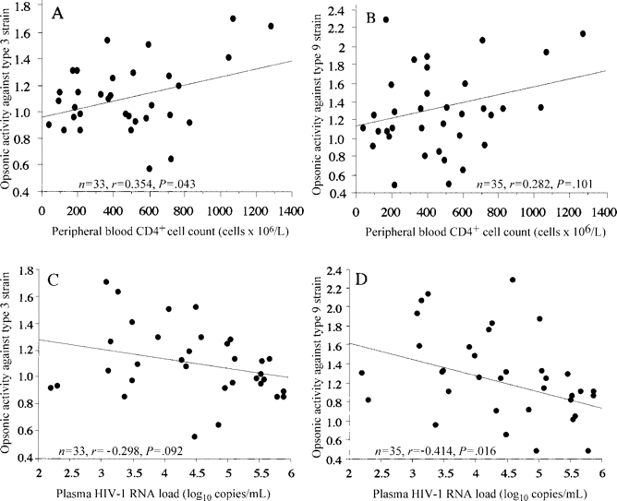
Figure 1 Correlation between peripheral blood CD4⁺ lymphocyte count and serum opsonic activity against type ...
Notes:
Figure 1 Correlation between peripheral blood CD4+ lymphocyte count and serum opsonic activity against type 3 (A) and type 9 (B) Streptococcus pneumoniae and correlation between plasma HIV-1 RNA load and serum opsonic activity against type 3 (C) and type 9 (D) strains among HIV-1–infected Ugandan adults.
Unless provided in the caption above, the following copyright applies to the content of this slide: © 2003 by the Infectious Diseases Society of America

Slide 4
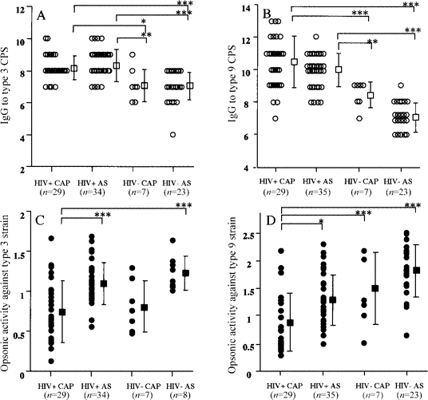
Figure 2 Comparison of levels of serum IgG to type 3 pneumococcal capsular polysaccharide (CPS) (A) and type 9 CPS (B) ...
Notes:
Figure 2 Comparison of levels of serum IgG to type 3 pneumococcal capsular polysaccharide (CPS) (A) and type 9 CPS (B) and serum opsonic activity against type 3 (C) and type 9 (D) Streptococcus pneumoniae among patients with community-acquired pneumonia (CAP) and asymptomatic subjects (AS) with (HIV+) or without (HIV-) HIV infection. *P < .05; **P < .01; ***P < .001, by Kruskal-Wallis test with Turkey's multiple comparison.
Unless provided in the caption above, the following copyright applies to the content of this slide: © 2003 by the Infectious Diseases Society of America

