Slide 1
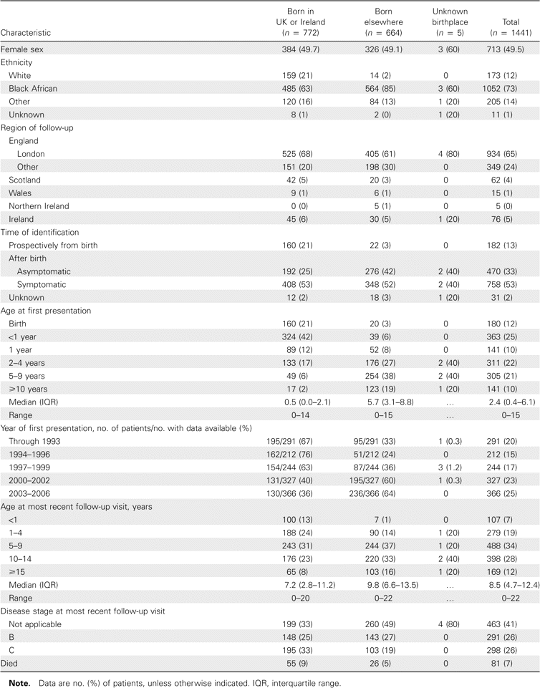
Table 1 Characteristics of children with perinatally acquired HIV-1 infection in the United Kingdom and Ireland ...
Notes:
Table 1 Characteristics of children with perinatally acquired HIV-1 infection in the United Kingdom and Ireland reported to mid-2006, according to birthplace.
Unless provided in the caption above, the following copyright applies to the content of this slide: © 2007 by the Infectious Diseases Society of America

Slide 2
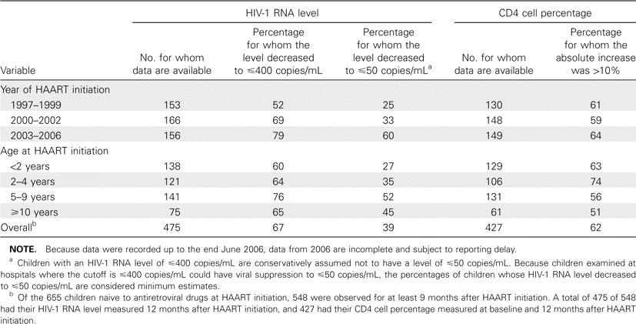
Table 2 HIV-1 RNA levels and CD4 cell percentages 12 months after initiation of HAART for children with HIV infection ...
Notes:
Table 2 HIV-1 RNA levels and CD4 cell percentages 12 months after initiation of HAART for children with HIV infection reported to mid-2006, according to year of and age at HAART initiation.
Unless provided in the caption above, the following copyright applies to the content of this slide: © 2007 by the Infectious Diseases Society of America

Slide 3
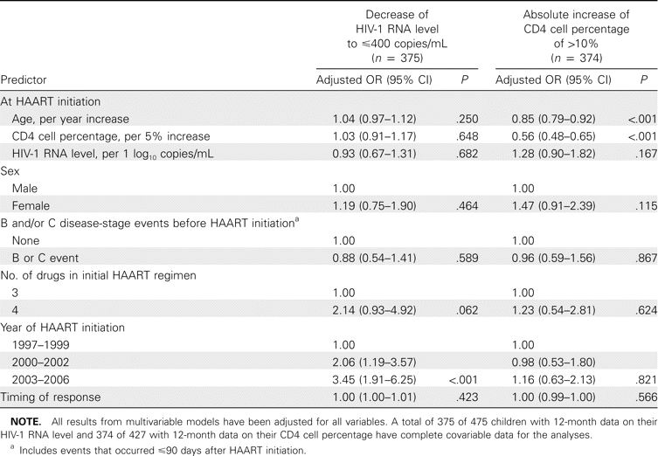
Table 3 Predictors of HIV-1 RNA level and CD4 cell percentage 12 months after HAART initiation.
Notes:
Table 3 Predictors of HIV-1 RNA level and CD4 cell percentage 12 months after HAART initiation.
Unless provided in the caption above, the following copyright applies to the content of this slide: © 2007 by the Infectious Diseases Society of America

Slide 4
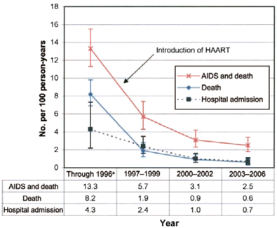
Figure 1 Rates of hospital admission, mortality, and AIDS and mortality combined, by year. ªHospital ...
Notes:
Figure 1 Rates of hospital admission, mortality, and AIDS and mortality combined, by year. aHospital admission rates are for 1996 only.
Unless provided in the caption above, the following copyright applies to the content of this slide: © 2007 by the Infectious Diseases Society of America

