Slide 1
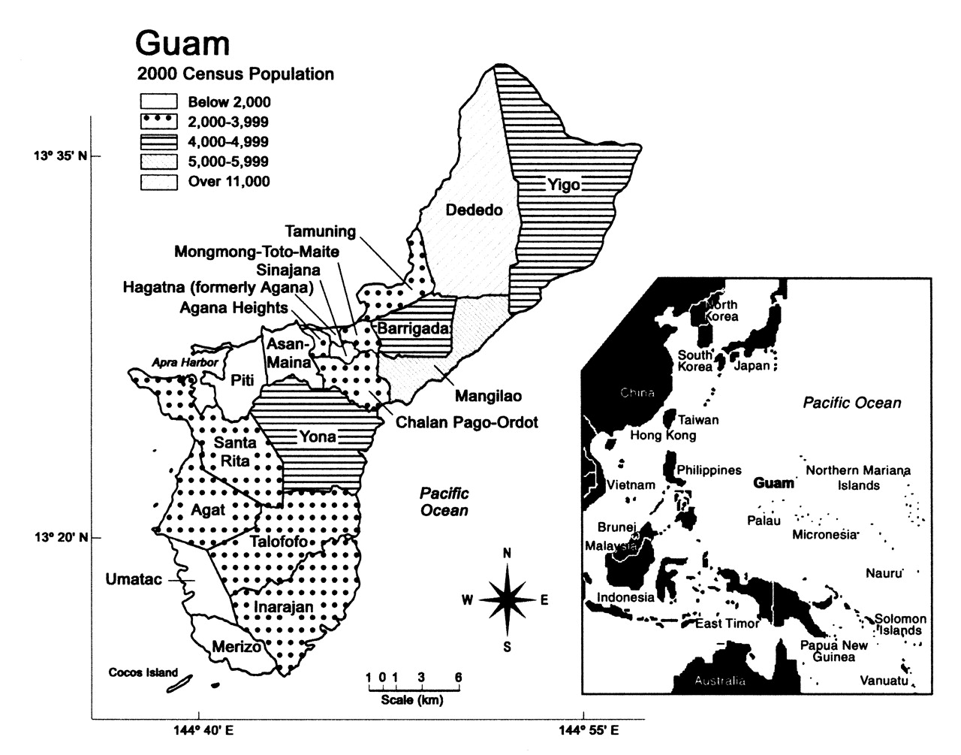
FIGURE 1. The island of Guam and the western Pacific Ocean. (From the 2000 US Census of Guam).
Notes:
FIGURE 1. The island of Guam and the western Pacific Ocean. (From the 2000 US Census of Guam).
Unless provided in the caption above, the following copyright applies to the content of this slide:

Slide 2
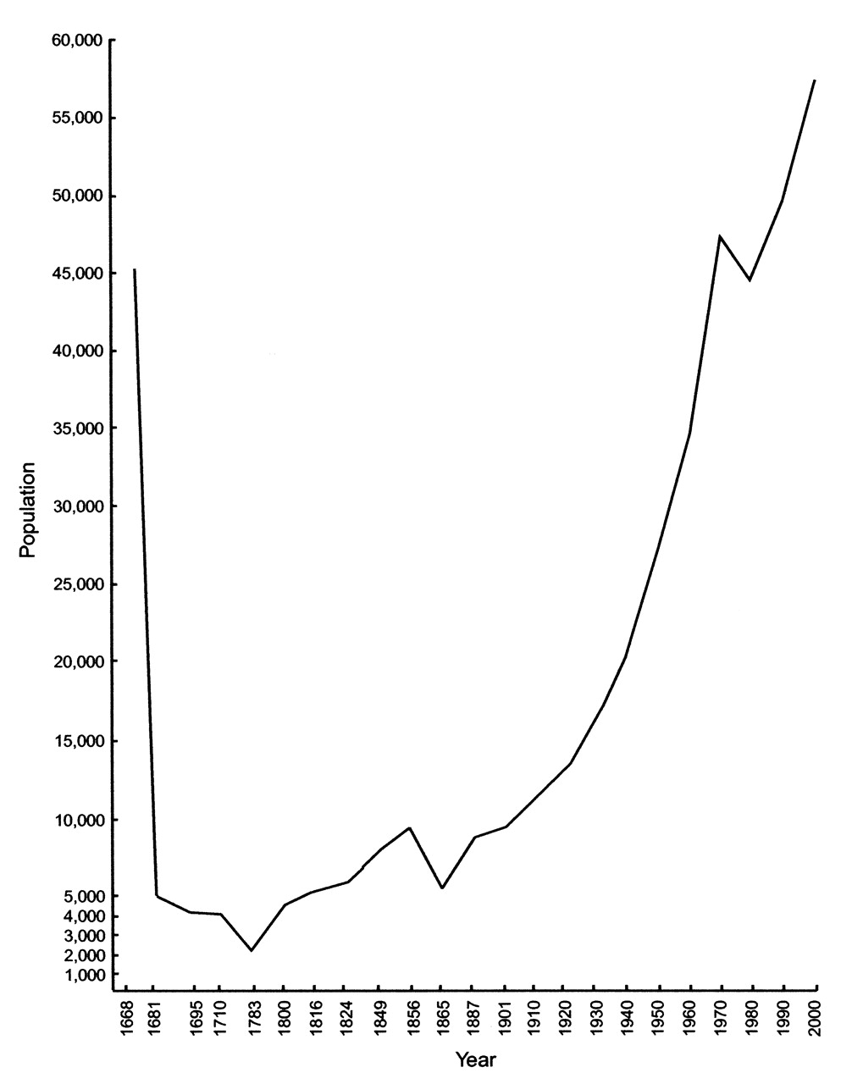
FIGURE 2. Fluctuations in the population of Guam from 1668 to 2000. Data were compiled from various ...
Notes:
FIGURE 2. Fluctuations in the population of Guam from 1668 to 2000. Data were compiled from various historical reports and official census records.
Unless provided in the caption above, the following copyright applies to the content of this slide:

Slide 3
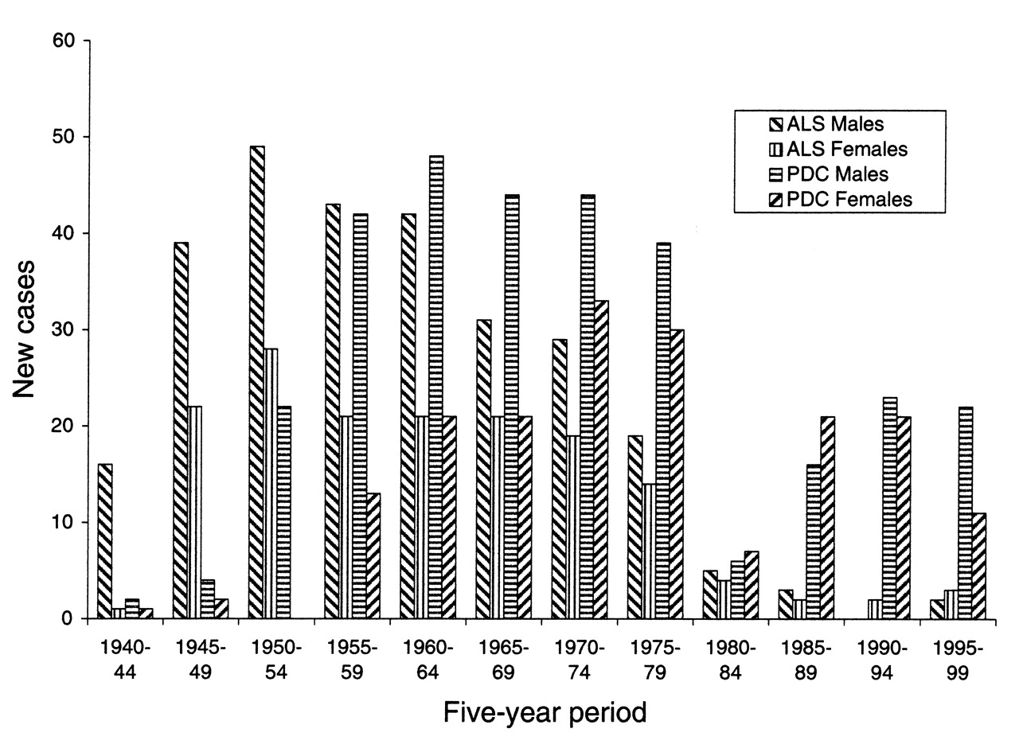
FIGURE 3. Number of new cases of amyotrophic lateral sclerosis (ALS) and parkinsonism-dementia complex (PDC), ...
Notes:
FIGURE 3. Number of new cases of amyotrophic lateral sclerosis (ALS) and parkinsonism-dementia complex (PDC), during each 5-year period, among male and female Guamanian Chamorros, from 1940 to 1999.
Unless provided in the caption above, the following copyright applies to the content of this slide:

Slide 4
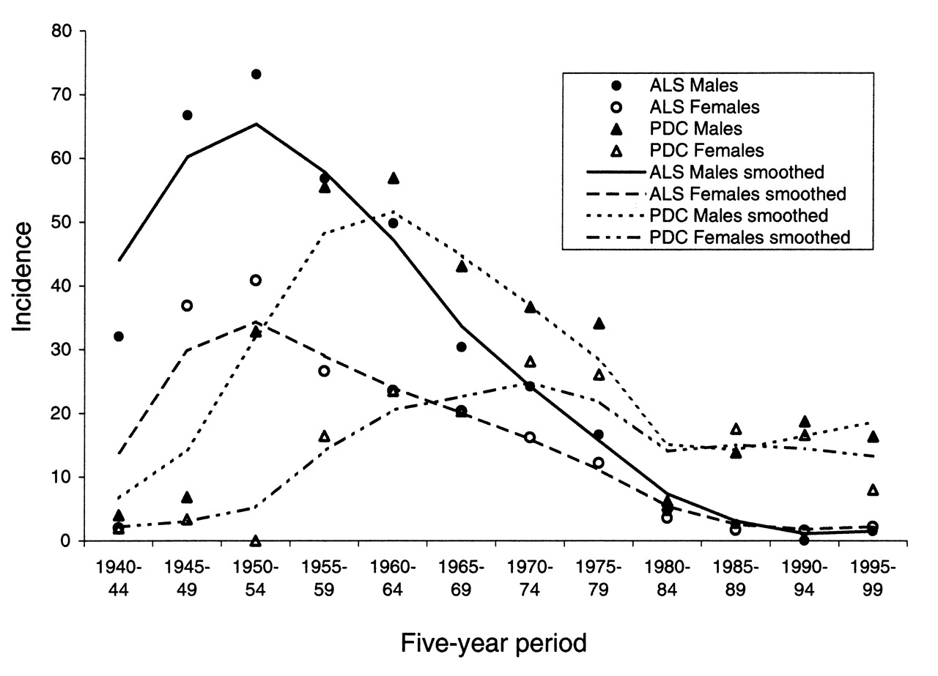
FIGURE 4. Average annual incidence of amyotrophic lateral sclerosis (ALS) and parkinsonism-dementia complex ...
Notes:
FIGURE 4. Average annual incidence of amyotrophic lateral sclerosis (ALS) and parkinsonism-dementia complex (PDC) per 100,000 male and female Guamanian Chamorros per 5-year period from 1940 to 1999. Lines smoothed.
Unless provided in the caption above, the following copyright applies to the content of this slide:

