Slide 1
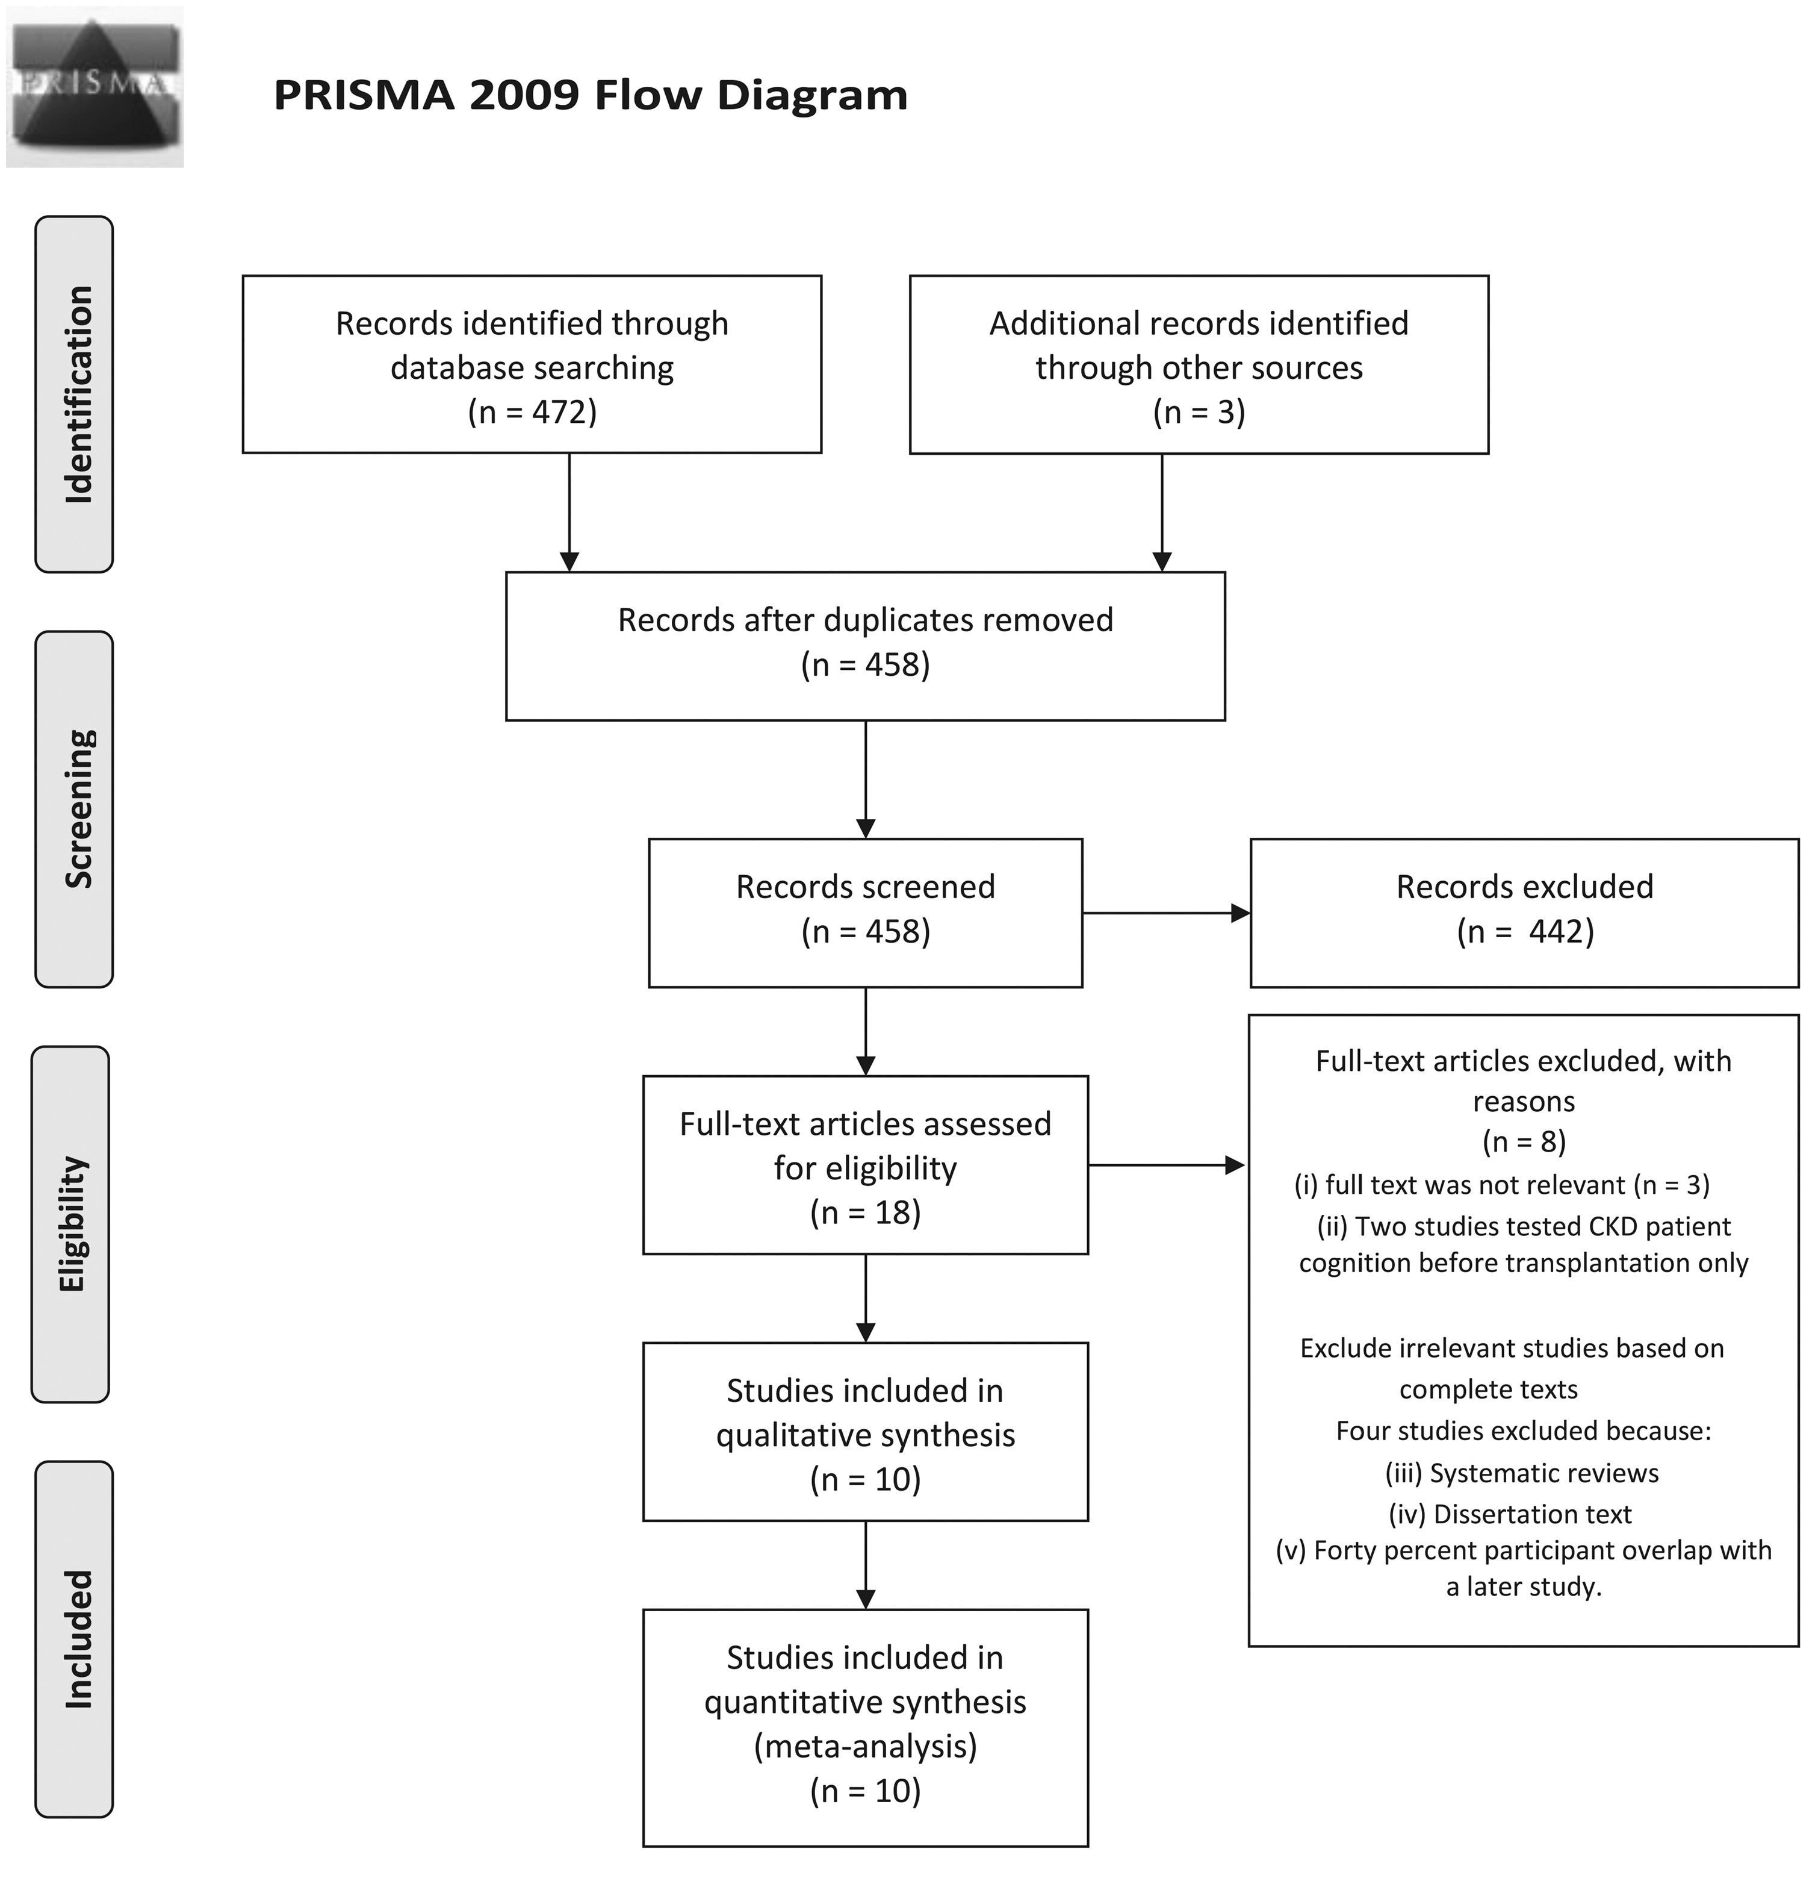
FIGURE 1 Overview of search methodology: (i) Koushik et al. [38], Olbrisch et al. [39] and Wolkowitz et al. [40]; (ii) ...
Notes:
FIGURE 1 Overview of search methodology: (i) Koushik et al. [38], Olbrisch et al. [39] and Wolkowitz et al. [40]; (ii) Hailpern et al. [41] and Kurella et al. [42]; (iii) Carrasco et al. [43] and Gutierrez-Dalmau and Campistol [44] and (v) Harciarek et al. [45].
Unless provided in the caption above, the following copyright applies to the content of this slide: © The Author 2017. Published by Oxford University Press on behalf of ERA-EDTA.This is an Open Access article distributed under the terms of the Creative Commons Attribution Non-Commercial License (http://creativecommons.org/licenses/by-nc/4.0/), which permits non-commercial re-use, distribution, and reproduction in any medium, provided the original work is properly cited. For commercial re-use, please contact journals.permissions@oup.com

Slide 2
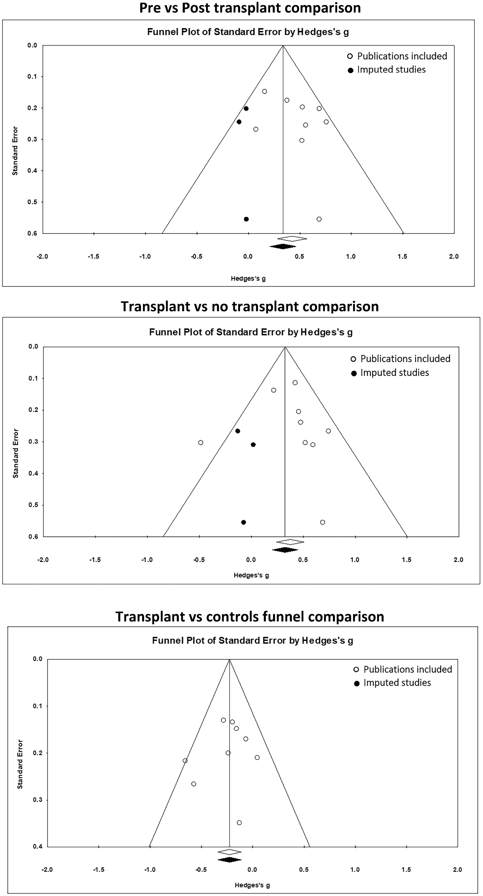
FIGURE 2 Funnel plots assessing publication bias by analyses conducted, cognitive domain effect sizes and significance ...
Notes:
FIGURE 2 Funnel plots assessing publication bias by analyses conducted, cognitive domain effect sizes and significance level. Hollow symbols represent publication bias of studies included and solid symbols represent imputed studies required to avoid publication bias.
Unless provided in the caption above, the following copyright applies to the content of this slide: © The Author 2017. Published by Oxford University Press on behalf of ERA-EDTA.This is an Open Access article distributed under the terms of the Creative Commons Attribution Non-Commercial License (http://creativecommons.org/licenses/by-nc/4.0/), which permits non-commercial re-use, distribution, and reproduction in any medium, provided the original work is properly cited. For commercial re-use, please contact journals.permissions@oup.com

Slide 3
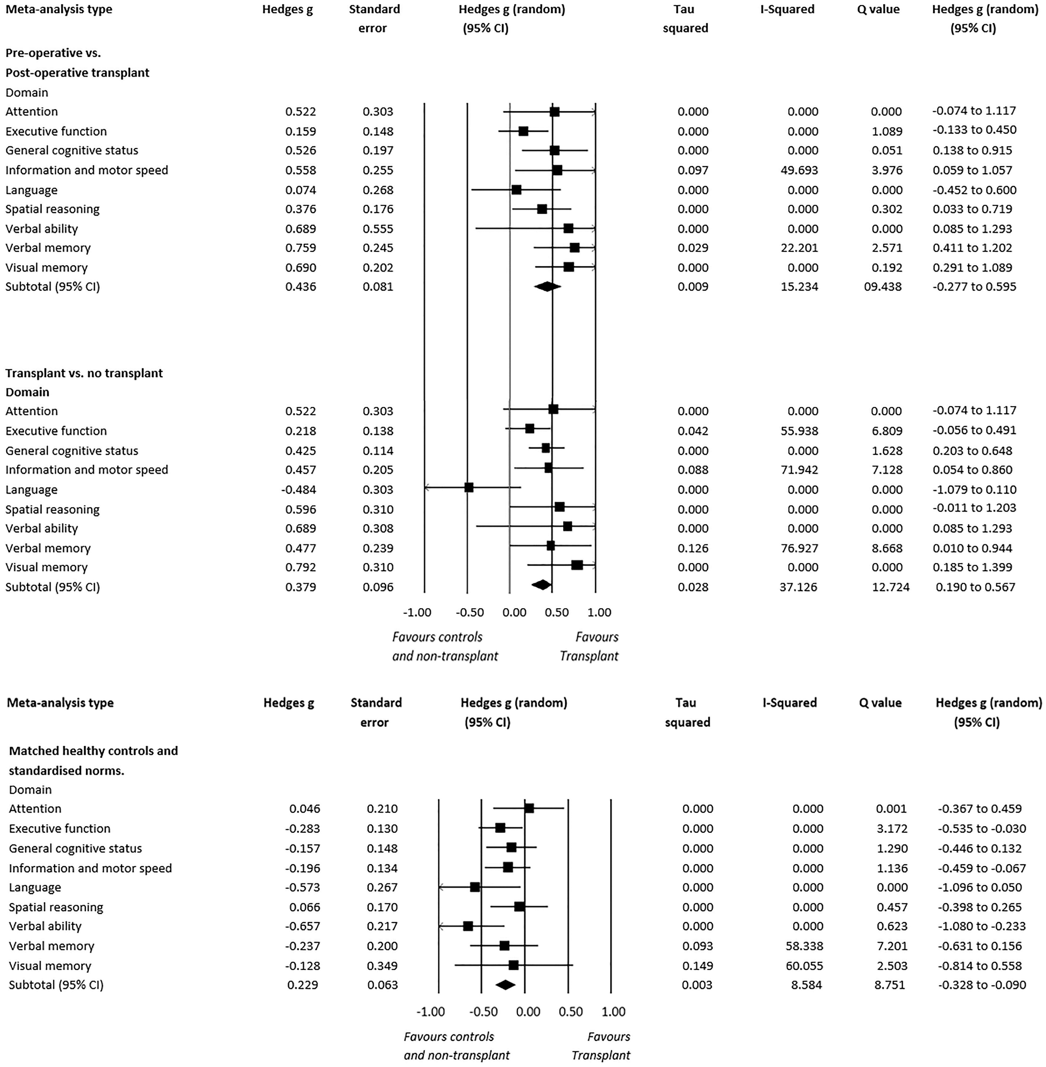
FIGURE 3 Cognitive performance by domains of transplant patients’ baseline performance compared with follow-up. ...
Notes:
FIGURE 3 Cognitive performance by domains of transplant patients’ baseline performance compared with follow-up. Transplant patients compared with non-transplanted patients and transplant patients compared with matched healthy controls and standardized norms.
Unless provided in the caption above, the following copyright applies to the content of this slide: © The Author 2017. Published by Oxford University Press on behalf of ERA-EDTA.This is an Open Access article distributed under the terms of the Creative Commons Attribution Non-Commercial License (http://creativecommons.org/licenses/by-nc/4.0/), which permits non-commercial re-use, distribution, and reproduction in any medium, provided the original work is properly cited. For commercial re-use, please contact journals.permissions@oup.com

